Slide 1
Chapter 5 – System Modeling
Lecture 1

Slide 3
Topics covered
Context models
Interaction models
Structural models
Behavioral models

Slide 4
System modeling
The process of developing abstract models of a system
Each model presents a different view or perspective of that system.
System modeling ≈ representing a system using some kind of graphical notation,
almost always based on notations in the Unified Modeling Language (UML).
Mathematical modelling is also possible; usually at detailed specs
Uses of System modelling and models
Modelling helps the analyst to understand the functionality of the system
Models are used to communicate with customers.

Slide 5
Use of graphical models
As a means of facilitating discussion about an existing or proposed system
Incomplete and incorrect models are OK as their role is to support discussion.
As a way of documenting an existing system
Models should be an accurate representation of the system but need not be complete.
As a detailed system description that can be used to generate a system implementation
Models have to be both correct and complete.
Models are the basis for generating source

Slide 6
System perspectives
An external perspective,
model the context or environment of the system.
An interaction perspective,
model the interactions between a system and its environment, or between the components of a system.
A structural perspective,
model the organization of a system or the structure of the data that is processed by the system.
A behavioral perspective,
model the dynamic behavior of the system and how it responds to events.

Slide 7
Most used UML diagrams (out of 14)
Activity diagrams:
show the activities involved in a process or in data processing
Use case diagrams:
show the interactions between a system and its environment.
Sequence diagrams:
show interactions between actors and the system and between system components.
Class diagrams:
show the object classes in the system and the associations between these classes.
State diagrams:
show how the system reacts to internal and external events.

Slide 8
Context models
Context models are used to illustrate the operational context of a system
show the system and its relationship with other systems.
they show what lies outside the system boundaries.
Once system boundaries are decided, part of the analysis activity is the definition of that context and the dependencies that a system has on its environment
Social and organisational concerns may affect the decision on where to position system boundaries.

Slide 9
System boundaries
System boundaries are established to define what is inside and what is outside the system.
They show other systems that are used or depend on the system being developed.
The position of the system boundary has a profound effect on the system requirements.
Defining a system boundary is a political judgment
There may be pressures to develop system boundaries that increase / decrease the influence or workload of different parts of an organization.

Slide 10
Example: patient information system for mental healthcare (MHC-PMS)
This system is intended to manage information about patients attending mental health clinics and the treatments that have been prescribed.
In developing the specification for this system, you have to decide whether the system should focus exclusively on collecting information about consultations (using other systems to collect personal information about patients) or whether it should also collect personal patient information.
The advantage of relying on other systems for patient information is that you avoid duplicating data.
The major disadvantage is that using other systems may make it slower to access information. If these systems are unavailable, then the MHC-PMS cannot be used.
i.e. Need to decide on the boundary

Slide 11
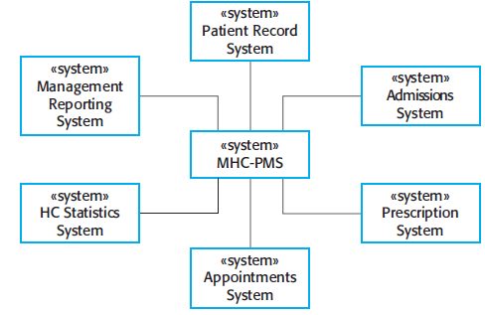
The context of the MHC-PMS (Mental Health Care-Patient Management System)

Slide 12
Context models: external entities
External systems might produce data for or consume data from the system.
They might share data with the system, or they might be connected directly, through a network or not connected at all.
They might be physically co-located or located in separate buildings.
All of these relations may affect the requirements and design of the system being defined and must be taken into account.

Slide 13
Process perspective
Context models simply show the other systems in the environment, not how the system being developed is used in that environment.
Process models reveal how the system being developed is used in broader business processes.
UML activity diagrams may be used to define business process models.
Notes:
External systems might produce data for or consume data from the system. They might share data with the system, or they might be connected directly, through a network or not connected at all. They might be physically co-located or located in separate buildings. All of these relations may affect the requirements and design of the system being defined and must be taken into account.

Slide 14
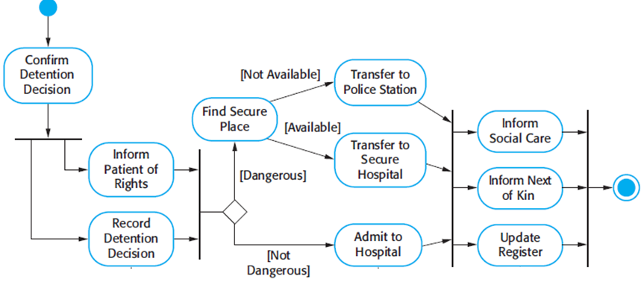
Process model of involuntary detention
Start of process
Activity
all of these activities
must be completed
to move on
End of
process
activities
executed
in parallel
Guard

Slide 15
Activity Diagram – Basic Syntax
Action 1
Action 2
Start of process
Action 3
[C]
Action 4
split
[~C]
Guard
End of
process
merge

Slide 16
SWIMLANES
Customer
Sales
Stockroom
Request service
Take Order
Pay
Fill Order
Deliver order
Collect order

Slide 17
Customer
Sales
Stockroom
Objects passed as parameters
between actions
Request service
: Order [placed]
:Order [entered]
Take Order
Pay
Fill Order
: Order [filled]
:Order [delivered]
Deliver order
Collect order

Slide 18
exercise
Commuter who needs to buy a ticket. Ticket vending machine will request trip information from Commuter. This information will include number and type of tickets, e.g. whether it is a monthly pass, one way or round ticket, route number, destination or zone number, etc.
Based on the provided trip info ticket vending machine will calculate payment due and request payment options. Those options include payment by cash, or by credit or debit card. If payment by card was selected by Commuter, a Bank will participate in the activity by authorizing the payment.
After payment is complete, ticket is dispensed to the Commuter. Cash payment might result in some change due, so the change is dispensed to the Commuter in this case. Ticket vending machine will show some "Thank You" screen at the end of the activity.
https://www.uml-diagrams.org/ticket-vending-machine-activity-diagram-example.html?context=activity-examples

Slide 19
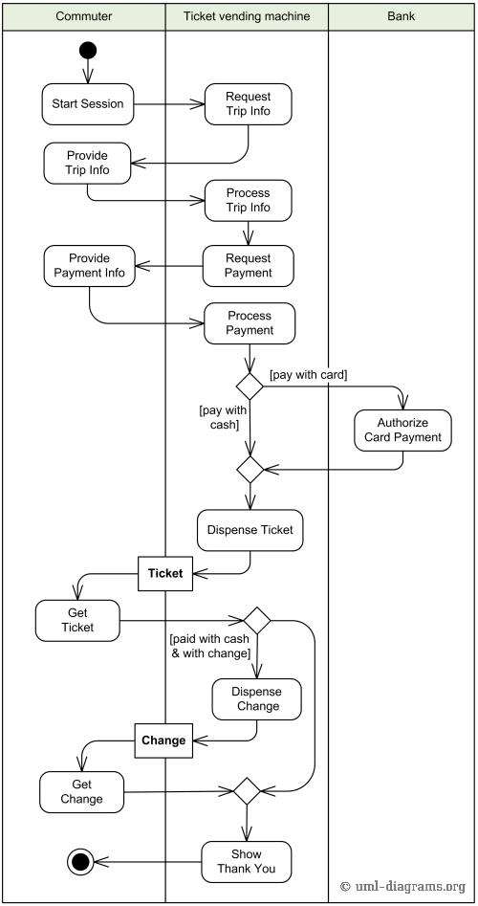

Slide 20
Interaction models
Modeling user interaction is important as it helps to identify user requirements.
Modeling system-to-system interaction highlights the communication problems that may arise.
Modeling component interaction helps us understand if a proposed system structure is likely to deliver the required system performance and dependability.
Use case diagrams and sequence diagrams may be used for interaction modeling.

Slide 21
Sequence diagrams
To model the interactions between the actors and the objects within a system.
Used both in requirement and design phase
Shows the sequence of interactions that take place during a particular use case or use case instance.
The objects and actors involved are listed along the top of the diagram, with a dotted line drawn vertically from these. (dotted line=lifeline)
Interactions between objects are indicated by annotated arrows. (messages)
Filled arrow: Synchronized message
Line arrow: Asynchronized message

Slide 22
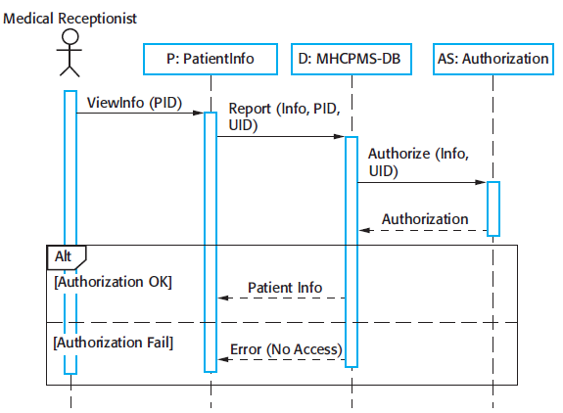
Sequence diagram for View patient information
Time
Message
response
choice

Slide 23
Reading the sequence diagram
The medical receptionist triggers the ViewInfo method in an instance P of the PatientInfo object class, supplying the patient’s identifier, PID. P is a user interface object, which is displayed as a form showing patient information.
The instance P calls the database to return the information required, supplying the receptionist’s identifier to allow security checking (at this stage, we do not care where this UID comes from).
The database checks with an authorization system that the user is authorized for this action.
If authorized, the patient information is returned and a form on the user’s screen is filled in. If authorization fails, then an error message is returned

Slide 24
Messages
: A
myb: B
doR
This.doZ
doR
creation of instances
doX
Execution
specification
bar
indicates focus
of control
«create»
: C
doY(myb)
doT
doZ
a found message
sender will not
be specified
doW
rv
two ways to show
a return result
from a message
rv = doW
doS
«destroy»
Object
destruction

Slide 25
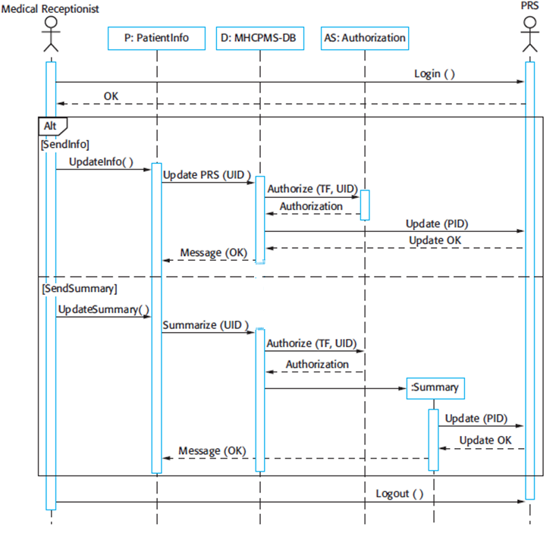
Sequence diagram for Transfer Data
New instance
is created

Slide 26
Representing Iteractions
myB : B
public class A{
private B myB = new B;
public void doOne(){
myB.doTwo();
myB.doThree();
}
…
}
:A
doOne
doTwo
doThree
sequence
diagram
partial definition
of class A

Slide 27
Lifeline Boxes
: Sale
unnamed instance of class Sale
Lifeline boxes represent the participants in the interaction
s1 : Sale
a named instance of class Sale
«metaclass»
Font
represents the class Font.
Used in representing static method
invocations
sales:
ArrayList<Sale>
represents an instance of ArrayList class,
parameterized to hold Sale objects
sales[i] : Sale
represents one instance of class Sale,
selected from the sales
1
: Store
1 implies this is a singleton

Slide 28
class A{
x(){ y(); } y(){..}
}
: A
x
y

Slide 29
Class A{ x(){ b1.z(); c1=new C()} y ()}
Class B(){
z(){ a1.y()}
a1: A
b1: B
x
z
y
c1: C

Slide 30
Class A{ x(){ y=b1.z(); c1=new C()}
}
Class B(){
z(){ return y}
a1: A
b1: B
x
z
y
c1: C

Slide 31
Class A{ x(){ y=b1.z(); c1.y()}
}
Class B(){
z(){ return y()}
a1: A
b1: B
c1: C
x
z
y
y

Slide 32
Class A{ x(){ y=b1.z(); c1.y()}
}
Class B(){
z(){ return y()}
a1: A
b1: B
c1: C
x
y=z()
y

Slide 33
Class A{ x(){ y=b1.z(); r=c1.w(b1)}
}
Class B(){
z(){ return y()}
Class C{
w(B b1) { return r;}
a1: A
b1: B
c1: C
x
y=z()
r=w(b1)

Slide 34
Class A{ x(){ y=b1.z(); r=c1.w(b1)}
}
Class B(){
z(){ return y()}
Class C{
w(B b1) { return r;}
a1: A
b1: B
c1: C
x
z()
r=w(b1)

Slide 35
Loop box
Alt box (alternation)
Ref box

Slide 36
The receptionist logs on to the PRS.
There are two options available. These allow the direct transfer of updated patient information to the PRS and the transfer of summary health data from the MHC-PMS to the PRS.
In each case, the receptionist’s permissions are checked using the authorization system.
Personal information may be transferred directly from the user interface object to the PRS. Alternatively, a summary record may be created from the database and that record is then transferred.
On completion of the transfer, the PRS issues a status message and the user logs off.

Slide 37
Structural models
Display the organization of a system in terms of the components that make up that system and their relationships.
2 types of structural models (we do both):
Static models: show the structure of the system design,
Class, component, package, deployment diagrams
Dynamic models: show the organization of the system when it is executing.
Create structural models of a system when you are discussing and designing the system architecture.

Slide 38
Class diagrams
Class diagrams are used when developing an object-oriented system model to show the classes in a system and the associations between these classes.
An object class can be thought of as a general definition of one kind of system object.
An association is a link between classes that indicates that there is some relationship between these classes.
When you are developing models during the early stages of the software engineering process, objects represent something in the real world, such as a patient, a prescription, doctor, etc.

Slide 39

UML classes and association
There are 2 classes: Patient and Patient Record
No detail yet, early in the analysis
Patient is associated with patient record
i.e. for each patient there is a patient record
i.e. every patient record is associated with a patient

Slide 40
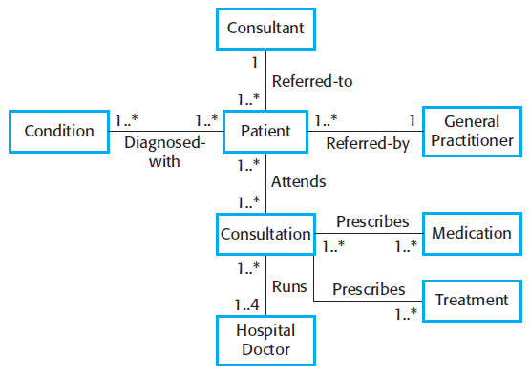
Classes and associations in the MHC-PMS
multiplicity
Name of the association
For better reading

Slide 41
Association Relationships
Inbox
Inbox has a number of messages
0..*
From the message you can access to the body
Message
MessageBody
Each body has 0
or more attachments.
Attachments cannot
exist without a body
You can navigate from a message to its header
or from a header to the message
0..*
Header
Attachment
Notes:
No attachment will exists without a messagebody

Slide 42
Inbox
aggregation
directed association
Message
MessageBody
association
composition
0..*
Header
multiplicity
Attachment

Slide 43
Relationship Summary
Association
When two classes are connected to each other in any way
You can define the flow of the association by using a directed association. The arrowhead identifies the container-contained relationship
Aggregation
When a class is formed as a collection of other classes,
It is also called a "has a" relationship.
Composition
When there is a strong life cycle is associated between the classes.
part and whole live and die together
Multiplicity
one to many, many to many, many to one, one to one, etc.

Slide 44
Composition - Aggregation
Aggregation: A kind of association that loosely suggests whole-part relationships
Composition: A strong kind of whole-part aggregation
e.g., GameBoard-Square
A composition relationship implies
An instance of the part belongs to only one composite instance at a time
The part must always belong to a composite
The composite is responsible for the creation and deletion of parts
either by itself or by collaborating with other objects
If the composite is destroyed, its parts must either be destroyed, or attached to another composite
Sale
*
SalesLineItem
1
1..

Slide 45
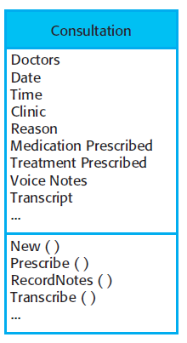
The Consultation class
Detailing a class
Class NAME
Attributes
(characteristics of an object)
Services (or operations)
(things that you can request
from an object)

Slide 46
Class diagram Exercise: rent video
Use case: rent video
The customer browses through the catalog and selects a title. If the title is available, the system adds the media for the title to the cart and the media is pending rental. Otherwise, the customer must make another choice.
When the customer is finished selecting media, he places the order. To place the order, the customer is authenticated and the account is validated. If the account is invalid due to an invalid credit card, the system prompts the customer for a valid credit card
The cost of media is debited from the account. The media in the cart associated with the order is changed to Rented. The system acknowledges the order.

Slide 47
Account
Customer
Catalog
-------
+browse()
+selectTitle(title)
1..*
cart
title
0..*
order
1..*
media

Slide 48
Generalization
In modeling systems, it is often useful to examine the classes in a system to see if there is scope for generalization.
If changes are proposed, then you do not have to look at all classes in the system to see if they are affected by the change.
In object-oriented languages (Java, C++), generalization is the class inheritance mechanisms built into the language.
Attributes and operations associated with higher-level classes are also associated with the lower-level classes.
The lower-level classes are subclasses inherit the attributes and operations from their superclasses.
These lower-level classes then add more specific attributes and operations.

Slide 49
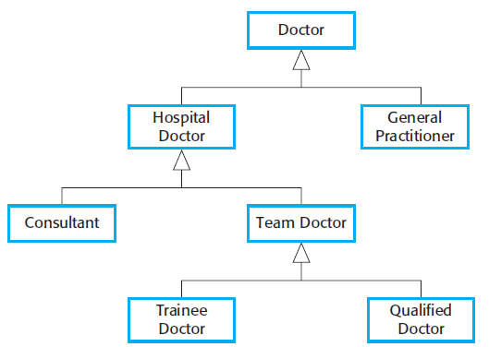
A generalization hierarchy
generalization

Slide 50
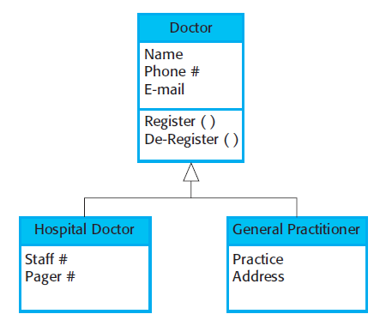
A generalization hierarchy with added detail
All doctors have a name,phone number, and email
All hospital doctors have a staff
number and a department but general practitioners don’t have these attributes as they
work independently. They do however, have a practice name and address

Slide 51
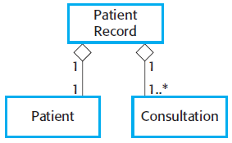
The aggregation association
An aggregation model shows how classes that are collections are composed of other classes.
A class is composed of other classes
Part-whole relationship
E.g. a patient record is composed of many consultation and a patient

Slide 52
Behavioral models
dynamic behavior of a system as it is executing.
They show what happens or what is supposed to happen when a system responds to a stimulus from its environment.
You can think of these stimuli as being of two types:
Data Some data arrives that has to be processed by the system.
Events Some event happens that triggers system processing. Events may have associated data, although this is not always the case.

Slide 53
Data-driven modeling
Many business systems are data-processing systems that are primarily driven by data.
They are controlled by the data input to the system, with relatively little external event processing.
Data-driven models show the sequence of actions involved in processing input data and generating an associated output.
They are particularly useful during the analysis of requirements as they can be used to show end-to-end processing in a system.
DFD –not a part of UML

Slide 54
Data driven modelling in UML
DFDs are not part of UML since DFDs focus on system functions and do not recognize system objects.
However, because data-driven systems are so common in business, UML 2.0 introduced activity diagrams, which are similar to data-flow diagrams.
Sequence diagram are also used to show the sequence of processing.
draw them so that messages are only sent from left to right, then they show the sequential data processing in the system
Activity diagram could also be used instead

Slide 55
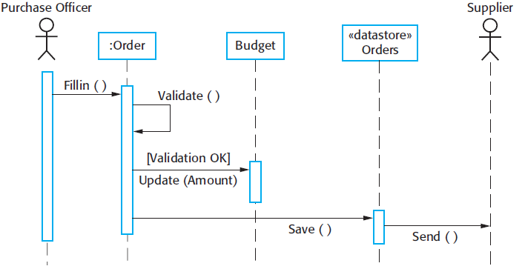
Example: Order processing
Sequence models highlight objects in a system, whereas data-flow diagrams highlight the functions

Slide 56
Event-driven modeling
Real-time systems are often event-driven, with minimal data processing.
For example, a landline phone switching system responds to events such as ‘receiver off hook’ by generating a dial tone.
Event-driven modeling shows how a system responds to external and internal events.
Based on the assumption that a system has a finite number of states and that events (stimuli) may cause a transition from one state to another.
e,.g. a system controlling a valve may move from a state ‘Valve open’ to a state ‘Valve closed’ when an operator command (the stimulus) is received.

Slide 57
State machine models
UML has state diagrams for event-driven modelling
Based on Statecharts (Harell87), similar to state machines
Model the behaviour of the system in response to external and internal events.
often used for modelling real-time systems.
Notation:
System states as nodes and events as arcs between these nodes.
When an event occurs, the system moves from one state to another. (state transition)
They do not show the flow of data within the system but may include additional information on the computations carried out in each state

Slide 58
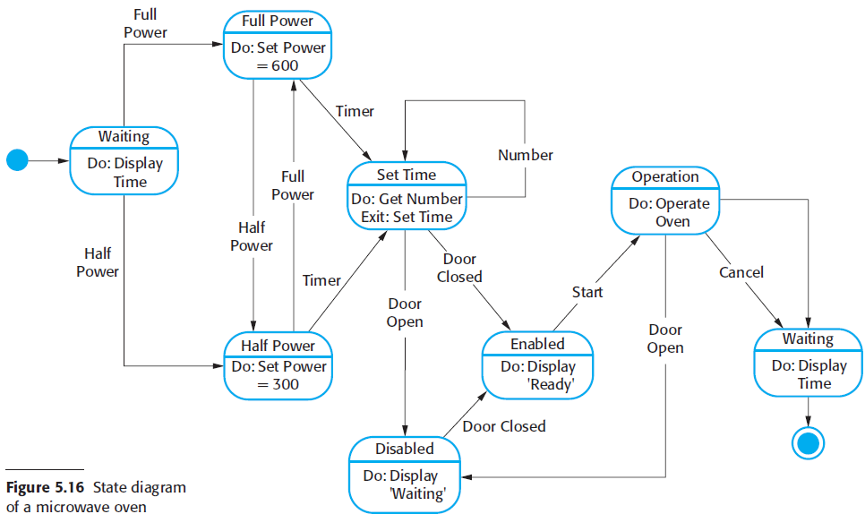
State diagram of a microwave oven
state
Do: actions taken in that state
Stimuli/event

Slide 59
States and stimuli for the microwave oven (a)
State | Description
Waiting | The oven is waiting for input. The display shows the current time.
Half power | The oven power is set to 300 watts. The display shows ‘Half power’.
Full power | The oven power is set to 600 watts. The display shows ‘Full power’.
Set time | The cooking time is set to the user’s input value. The display shows the cooking time selected and is updated as the time is set.
Disabled | Oven operation is disabled for safety. Interior oven light is on. Display shows ‘Not ready’.
Enabled | Oven operation is enabled. Interior oven light is off. Display shows ‘Ready to cook’.
Operation | Oven in operation. Interior oven light is on. Display shows the timer countdown. On completion of cooking, the buzzer is sounded for five seconds. Oven light is on. Display shows ‘Cooking complete’ while buzzer is sounding.

Slide 60
States and stimuli for the microwave oven (b)
Stimulus | Description
Half power | The user has pressed the half-power button.
Full power | The user has pressed the full-power button.
Timer | The user has pressed one of the timer buttons.
Number | The user has pressed a numeric key.
Door open | The oven door switch is not closed.
Door closed | The oven door switch is closed.
Start | The user has pressed the Start button.
Cancel | The user has pressed the Cancel button.

Slide 61
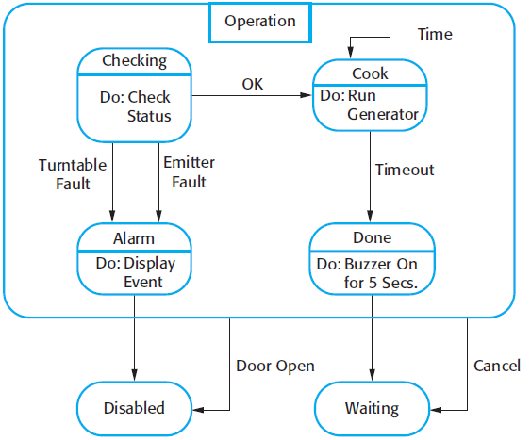
Microwave oven operation
the number of possible states increases rapidly.
Superstate

