Slide 1
Software Requirements
Partially based on the slides of Ian Sommerville

Slide 2
Software Requirements
Brooks in “No Silver Bullet” paper says:
The hardest single part of building a software system is deciding precisely what to build. No other part of the conceptual work is as difficult as establishing the detailed technical requirements ... No other part of the work so cripples the resulting system if done wrong. No other part is as difficult to rectify later.
Developers of the early Ballistic Missile Defense System observed [Alford, IEEE TSE, 1977]
In nearly every software project that fails to meet performance and cost goals, requirements inadequacies play a major and expensive role in project failure
A study on problems in mission-critical defense systems identifies requirements as a major problem source in two thirds of the systems examined [US General Accounting Office, 1992]
Other studies on projects in aerospace industry and NASA found requirements to be a critical software development problem

Slide 3
“[We] have grown to care about requirements because we have seen more projects stumble or fail as a result of poor requirements than for any other reason”
Kulak and Guiney, in “Use Cases: Requirements in Context”
Studies show that many of the key contributors to project failures originate or relate to requirements
The Standish Group CHAOS reports
31% of projects cancelled before they are even completed
Billions wasted per year on cancelled, unused or unusable projects
52.7% of projects were more than 189% over budget when delivered

Slide 4
What is a requirement?
Webster Dictionary:
“something required, something wanted or needed”.
IEEE standard 729 (1983) :
(1) a condition or capability needed by a user to solve a problem or achieve an objective;
(2) a condition or capability that must be met or possessed by a system ... to satisfy a contract, standard, specification, or other formally imposed document.
The requirements for a system are
descriptions of the services provided by the system and
its operational constraints.
Notes:
recognize if something is a "requirement"
but does not state what must be included in requirements, and what should be excluded!
a requirement may be
a high-level abstract statement of a service or of a system constraint
a detailed mathematical functional specification.

Slide 5
What is a requirement?
A requirement may range from
a high-level abstract statement of a service or of a system constraint, to
a detailed mathematical functional specification.
This is inevitable as requirements may serve a dual function
May be the basis for a bid for a contract - therefore must be open to interpretation;
May be the basis for the contract itself - therefore must be defined in detail;
Both these statements may be called requirements.

Slide 6
Requirements engineering
Requirements of a software defines
the services that the customer requires from a system
the constraints under which it operates and is developed.
Requirements engineering , process of gathering these
Requirements analysis
Activity of discovering/observing/gathering customer’s needs
Requirements specification
Activity of describing/documenting customer’s needs

Slide 7
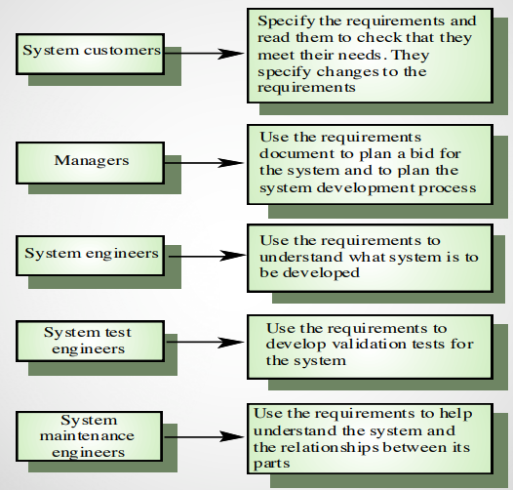
Who uses requirements?

Slide 8
Who uses requirements?
What are the uses of software requirement specification?
For customers it is a specification of the product that will be delivered,
For managers it can be used as a basis for scheduling and measuring progress
For the software designers it provides a specification of what to design
For coders it defines the range of acceptable implementations and the outputs that must be produced
For quality assurance personnel it is used for validation, test planning, and verification

Slide 9
Requirements and design
In principle, requirements should state what the system should do under which constraints and the design should describe how it does this.
In practice, requirements and design are inseparable
A system architecture may be designed to structure the requirements;
The system may inter-operate with other systems that generate design requirements;
The use of a specific architecture to satisfy non-functional requirements may be a domain requirement.
This may be the consequence of a regulatory requirement.

Slide 10
Types of requirement
User requirements
Written for customers.
understandable by client and contractor management, system procurers and users.
Statements in natural language plus diagrams of the services the system provides and its operational constraints.
Includes user needs
System requirements
A structured document setting out detailed descriptions of the system’s functions, services and operational constraints.
Defines what should be implemented, so may be part of a contract between client and contractor.
Includes Product behavior,
understandable by procurer and software designer.

Slide 11
User and system requirements
User requirement definition
The software must provide a means of representing and accessing external files created by other tools.
System Requirements specification
The user should be provided with facilities to define the type of external files.
Each external file type may have an associated tool which may be applied to the file.
Each external file type may be represented as a specification on the user’s display.
Facilities should be provided for the icon representing an external file type to be defined by the user.
When a user selects an icon representing an external file, the effect of that selection is to apply the tool associated with type of the external file to the file represented by the selected icon.

Slide 12
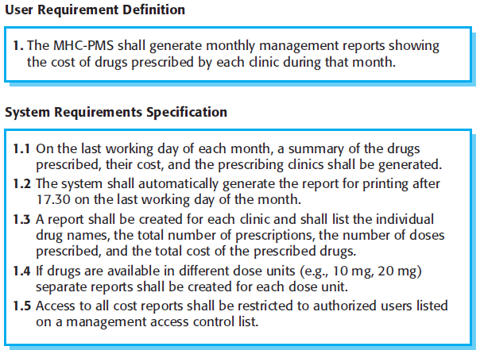
User and system requirements

Slide 13
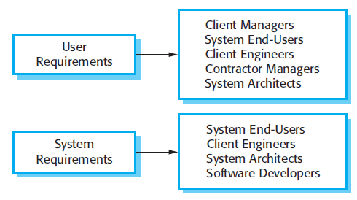
Readers of different types of requirements specification

Slide 14
Requirements abstraction (Davis)
“If a company wishes to let a contract for a large software development project, it must define its needs in a sufficiently abstract way that a solution is not pre-defined. The requirements must be written so that several contractors can bid for the contract, offering, perhaps, different ways of meeting the client organization’s needs. Once a contract has been awarded, the contractor must write a system definition for the client in more detail so that the client understands and can validate what the software will do. Both of these documents may be called the requirements document for the system.”

Slide 15
Classification of Requirements
Functional requirements
Statements of services the system should provide,
how the system should react to particular inputs
how the system should behave in particular situations.
May state what the system should not do.
Non-functional requirements
Constraints on the services or functions offered by the system such as timing constraints, constraints on the development process, standards, etc.
Often apply to the system as a whole rather than individual features or services.
Domain requirements
Constraints on the system from the domain of operation
reflect characteristics of the domain
can be functional or nonfunctional

Slide 16
Example: Library system
Library system:
A library system that provides a single interface to a number of databases of articles in different libraries. Users can search for, download and print these articles for personal study.
Functional Requirements:
The user shall be able to search either all of the initial set of databases or select a subset from it.
The system shall provide appropriate viewers for the user to read documents in the document store.
Every order shall be allocated a unique identifier (ORDER_ID) which the user shall be able to copy to the account’s permanent storage area.

Slide 17
Example 2:
Functional requirements for the Medical Health Center-Patient Monitoring System
A user shall be able to search the appointments lists for all clinics.
The system shall generate each day, for each clinic, a list of patients who are expected to attend appointments that day.
Each staff member using the system shall be uniquely identified by his or her 8-digit employee number.

Slide 18
Requirements imprecision
Problems arise when requirements are not precisely stated.
Ambiguous requirements may be interpreted in different ways by developers and users.
Consider the term ‘search’ in requirement in previous slide
“A user shall be able to search the appointments lists for all clinics.”
User intention – search for a patient name across all appointments in all clinics;
Developer interpretation – search for a patient name in an individual clinic. User chooses clinic then search.
Example 2: “The system shall provide appropriate viewers for the user to read documents in the document store.”
User intention - special purpose viewer for each different document type;
Developer interpretation - Provide a text viewer that shows the contents of the document.

Slide 19
Requirements completeness and consistency
In principle, requirements should be both complete and consistent.
Complete
They should include descriptions of all facilities required.
Consistent
There should be no conflicts or contradictions in the descriptions of the system facilities.
In practice, it is impossible to produce a complete and consistent requirements document.

Slide 20
Non-functional requirements
These define system properties and constraints
e.g. reliability, response time and storage requirements.
Constraints are I/O device capability, system representations, etc.
Process requirements may also be specified mandating a particular IDE, programming language or development method.
Non-functional requirements may be more critical than functional requirements. If these are not met, the system is useless.
“Not fast enough as specified” does not work
“Not reliable as needed” does not work

Slide 21
Example: Library System
The user interface for LIBSYS shall be implemented as simple HTML without frames or Java applets.
The system development process and deliverable documents shall conform to the process and deliverables defined in XYZCo-SPSTAN-95.
The system shall not disclose any personal information about customers apart from their name and reference number to the operators of the system.
Notes:
1: product req. Nfr’de goreceklerimiz
2:organizational:

Slide 22
Non-functional requirements implementation
Non-functional requirements may affect the overall architecture of a system rather than the individual components.
For example, to ensure that performance requirements are met, you may have to organize the system to minimize communications between components.
A single non-functional requirement, such as a security requirement, may generate a number of related functional requirements that define system services that are required.
It may also generate requirements that restrict existing requirements.

Slide 23
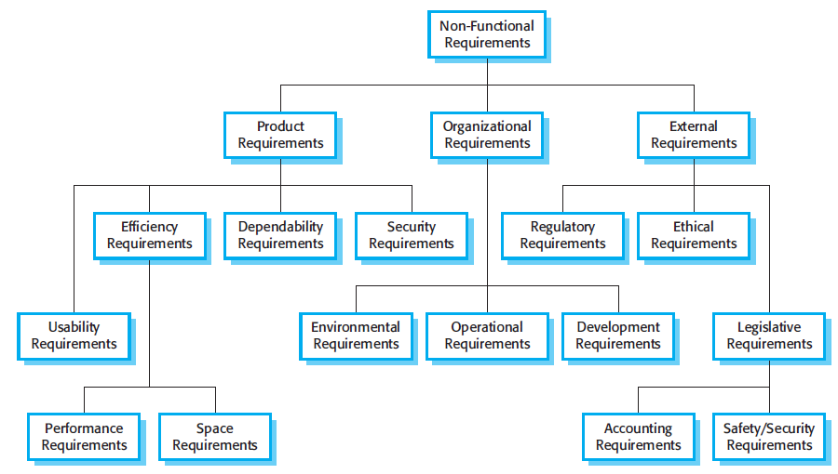
Types of nonfunctional requirement

Slide 24
Non-functional classifications
Product requirements
Requirements which specify that the delivered product must behave in a particular way
e.g. execution speed, reliability, etc.
Organisational requirements
Requirements which are a consequence of organisational policies and procedures
e.g. process standards used, implementation requirements, etc.
External requirements
Requirements which arise from factors which are external to the system and its development process
e.g. interoperability requirements, legislative requirements, etc.

Slide 25
Examples of nonfunctional requirements in the MHC-PMS
Product requirement The MHC-PMS shall be available to all clinics during normal working hours (Mon–Fri, 0830–17.30). Downtime within normal working hours shall not exceed five seconds in any one day. Organizational requirement Users of the MHC-PMS system shall authenticate themselves using their health authority identity card. External requirement The system shall implement patient privacy provisions as set out in HStan-03-2006-priv.

Slide 26
Usability requirements example
The system should be easy to use by medical staff and should be organized in such a way that user errors are minimized.
States a Goal:A general intention of the user such as ease of use.
Medical staff shall be able to use all the system functions after four hours of training. After this training, the average number of errors made by experienced users shall not exceed two per hour of system use.
Testable non-functional requirement: using some measure the requirement can be objectively tested.

Slide 27
Non-Functional Requirements – Bad examples
The system should be easy to use by experienced controllers and should be organized in such a way that user errors are minimized.
Not precise enough, not verifiable
Experienced controllers shall be able to use all the system functions after a total of two hours training. After this training, the average number of errors made by experienced users shall not exceed two per day.
A verifiable way to state the requirement
Notes:
● A verifiable non-functional requirement

Slide 28
Metrics for specifying nonfunctional requirements
Property | Measure
Speed | Processed transactions/second User/event response time Screen refresh time
Size | Mbytes Number of ROM chips
Ease of use | Training time Number of help frames
Reliability | Mean time to failure Probability of unavailability Rate of failure occurrence Availability
Robustness | Time to restart after failure Percentage of events causing failure Probability of data corruption on failure
Portability | Percentage of target dependent statements Number of target systems

Slide 29
Domain requirements
The system’s operational domain imposes requirements on the system.
For example, a train control system has to take into account the braking characteristics in different weather conditions.
Derived from the application domain and describe system characteristics and features that reflect the domain.
Rather than specific needs of the users
Domain requirements be new functional requirements, constraints on existing requirements or define specific computations.
If domain requirements are not satisfied, the system may be unworkable.

Slide 30
Examples: Library System
There shall be a standard user interface to all databases which shall be based on the Z39.50 standard.
Because of copyright restrictions, some documents must be deleted immediately on arrival. Depending on the user’s requirements, these documents will either be printed locally on the system server for manually forwarding to the user or routed to a network printer.
Notes:
1: design constraint. Find the standard before doing the interface design
2: copyright law.

Slide 31
Example:Train protection system
This is a domain requirement for a train protection system:
The deceleration of the train shall be computed as:
Dtrain = Dcontrol + Dgradient
where Dgradient is 9.81ms2 * compensated gradient/alpha and where the values of 9.81ms2 /alpha are known for different types of train.
It is difficult for a non-specialist to understand the implications of this and how it interacts with other requirements.

Slide 32
Domain requirements problems
Understandability
Requirements are expressed in the language of the application domain;
This is often not understood by software engineers developing the system.
Implicitness
Domain specialists understand the area so well that they do not think of making the domain requirements explicit.

Slide 33
Key points
Requirements for a software system set out what the system should do and define constraints on its operation and implementation.
Functional requirements are statements of the services that the system must provide or are descriptions of how some computations must be carried out.
Non-functional requirements often constrain the system being developed and the development process being used.
They often relate to the emergent properties of the system and therefore apply to the system as a whole.

Slide 34
Nonfunctional requirements-revisit
Lets focus on nonfunctional Product Requirements

Slide 35
Portability
The degree of ease to port a software running on one system environment to another one.
The maximum time to convert a PC-Based product to the one running on Macintosh will be 10 days.
Not testable requirement!
Quantifiable (testable) statements can be more useful but cannot guarantee actual requirements.
Percentage of components with host-dependent code
Percentage of code that is host dependent
A better approach is to specify design contsraints:
Source language, host operating system, particular compiler, particular libraries and frameworks.
Trade-off: premature design decisions.
Specify also the likelihood that the SW will be ported in the future
Notes:
The goals of portability requirements usually will not create a testable requirement. For example stating that:
We raraley know the next generation host. Maximum time is relatively meaningless.
Would you design your sofrware any differently if it had to be ported in two weeks rather than one day?
Quantifiable statements such as;
- Percentage of components with host-dependent code or
- Percentage of code that is host dependent
can be more useful but can not guarantee actual requirements.
Another approach to define portability requirements is to specify design constraints:
Use of a proven language, language subset or operating system.
However, this brings the risk of taking premature design decisions

Slide 36
Reliability
Ability of software to behave consistently in an acceptable manner.
“the system shall be 99.999 % reliable “
means different things to different people!
In telephony it means that the telephone system may loose a phone call, but not go down completely more than 5 min every year.
Patient-monitoring system: Does it mean that it may be okay occasionally to loose a patient provided that the system does not go down completely?
It may go down completely provided that it alerts the medical staff so that patients can be monitored manually. The 99.999 percent implies that when it is operating, it may not incorrectly monitor more than 1 patient out of every hundred thousand.
Notes:
In telephony it means that the telsphone system may loose a phone call, but not go down completely more than 5 min every year.
Patient-monitoring system: Does it mean that it may be okay occasionally to loose a patient provided that the system does not go down completely?
It may go down completely provided that it alerts the medical staff so that patients can be monitored manually. The 99.999 percent implies that when it is operating, it may not incorrectly monitor more than 1 patient out of every hundred thousand.

Slide 37
Reliability
Ability of software to behave consistently in an acceptable manner.
Cannot use the traditional techniques from hardware
Hardware wares down as used, but software does not
Their metrics are based on wearing down
After 10 years this latch will start to fail, because …
In SW if the system fails after 10 years it is because
SW is used in a way that has never used before and there was a bug since the delivery
Maintenance introduced a bug
The rate of failures for HW
# of failures
time
Notes:
MTTF and MTTR assumes time as factor to cause reliability problems. This is valid for HW as parts wear out in time.
For example, one circuit might have a MTTF of 100,000 hours, meaning that on the average, it can be expected to fail after about 11.5 years of relatively constant operation.
Let us say we have a piece fo SW and it runs for 11.5 years without failure, then the SW suddenly stops working. Two possible explanations:
A SW maintenance person has made an error and introduced a new bug or (no relation with the initial level of reliability)
The software user eployed the SW in a way which it had never been used and thus uncovered a bug that has been there. (reliability of the user)
The two programs solved the same problem and have the same number og bugs would demonstrate different MTTF.

Slide 38
Reliability
We need other techniques
Since 1969 we believe that
Reliability must be build in rather than tested afterwards
The system must “work”
If there are no bugs, then it works (one interpretation)
Bug: some defect in the software
Counting bugs
The software shall have no more than two bugs/KLOC.
How many bugs are in the software when it is delivered?
Monte Carlo technique ... (one possibility)
Notes:
Statement concerning lenght of the testing interval or number of bugs found during testing would not be appropriate for an SRS. These are the attributes of the software development process rather than the SW product itself.
But how can we know how many bugs are in the software when it is delivered? Monte Carlo technique involves determining some aspect of the real world through statistical analysis of random events.

Slide 39
Monte Carlo Technique
Before system level testing insert a known number of bugs (called seeded bugs).
An independent test team tries to uncover bugs.
Some are seeded bugs
Some are previously unknown bugs
Calculate the number of bugs:
Number of seeded bugs x Number of detected
Number of detected seeded bugs
Number of bugs in the system =
Monte Carlo(in general)is a technique to estimate sth using random sampling

Slide 40
Example
Before the system test, we have seeded 10 bugs in the SW without notifying the testers. The test team detects 120 bugs of which 6 had proviously been seeded.
The number of bugs in the system = 10 * 120/ 6 = 200 bugs.
We must remove the 120 detected bugs as well as the 4 previously seeded. NUmber of bugs = 200-120-4 = 76

Slide 41
Monte Carlo Technique Fallacies
Not all bugs are created equal
Better to have 100 bugs which causes a minor inconvenience than one bug that kills a person
Existence of one bug may hide the presence of another
Not all bugs can be found equally easily
If 10 easy-to-find bugs seeded, results will be biased toward few bugs remaining
If 10 hard-to-find bugs seeded, results will be biased toward a large quantity of bugs remaining
Fixing bugs often creates other bugs
Cannot assume we have 200-120 bugs remaining

Slide 42
Monte Carlo Technique (cont)
When is it good?
Assume 100 bugs are seeded 100 bugs are found and none of them are among seeded bugs.
Software is ?
100 bugs seeded and 100 bugs detected during the first 2 months and no other bugs are detected
Software is ?
Worst case: we can use this technique to measure the effectiveness of the tests
It is a good test set if it finds all the seeded bugs
Notes:
Poor software
Good sw

Slide 43
Reliability in Perspective
How important is reliability?
Developer: low customer satisfaction which means reduced revenues and major financial loss if a non-reliable product is delivered
Users: There are hierarchies in defining the level of detail appropriate when specifying reliability:
Destroy all human kind (nuclear weapon control system)
Destroy large numbers of human beings (nuclear reactor control system)
Kill a few people (intensive-care patient monitoring system)
İnjure people
Cause major financial loss
Cause major embarrassment
Cause minor finacial loss
Cause mild inconvenience

Slide 44
Stating the Reliability Requirements
Reliability specification example
No more than 5 bugs per 10K lines of executable code may be detected during integration and system testing. No more than 10 bugs per 10K lines of executable may remain in the system after delivery as calculated by Monte Carlo seeding technique defined in Appendix X. The system must be 100% operational 99.9% of the calendar time during its first year of operation.

Slide 45
Efficiency
The level at which software uses system resources.
Capacity: Number of users, terminals, ships, rooms in hotel … (for every possible input)
Maximum at any one time, per hour, … (Rate at which things arrive)
The system shall handle up to and including 20 simultaneous terminals and users performing any activities without degradation of service below that defined in Section X.
Other systems may make short requests of this system at a maximum rate of 50 per hour and long requests at a maximum rate of 1 per hour without degradation.

Slide 46
Efficiency (cont.)
Degradation of service: define what shall the system do if the capacity is exceeded
The system shall trace the movements of up to fifty aircrafts
New positions of all aircraft shall be displayed no less often than once per 5 seconds
What will happen if a 51st aircraft arrives?
Define what performance level is acceptable within the specified capacity AND what should the system do (how should it behave?) if the capacity exceeded
Notes:
Enter a fatal state (this will happen when developers ignore the case that the capacity exceeded)
Track the first 50 planes and ignore the 51st
Print an error message that the requirement (or assumption) is violated
Notify the pilot to exit the sector immediately
Track all 51 planes but update the positions in every 7 seconds instead of 5 seconds

Slide 47
Example
New positions of all aircraft shall be displayed no less often than once per 5 seconds
What will happen if a 51st aircraft arrives?
Enter a fatal state (this will happen when developers ignore the case that the capacity exceeded)
Track the first 50 planes and ignore the 51st
Print an error message that the requirement (or assumption) is violated
Notify the pilot to exit the sector immediately
Track all 51 planes but update the positions in every 7 seconds instead of 5 seconds

Slide 48
Efficiency (cont.)
Timing
The system shall generate close command within 5 seconds
The system shall generate a dial tone within 15 seconds of a user taking the phone of the hook.
Action of the system as a response to its environment
The system shall generate a launch missile command no sooner than 5 seconds after generating a ‘start battery warm-up command’
Action of the system after another action of the system
Memory
Total amount of memory utilization

Slide 49
Usability
User interface
The system shall have an easy to use human interface
The system shall be menu driven
The system shall be menu driven: Appendix X shows sample menus
The system shall be menu driven: Appendix X shows all menus to be used
Error messages
Tendency not to specify
Define in an Appendix in SRS the exact text of all error messages.
Other system ouptputs (report formats)
Define what output looks like
Levels of detail
Notes:
The first level is clearly ambigusous and inadequate.
The second leaves mush interpretation to the designer.
The third and fourth are just right. They leave no doubt in designers.

Slide 50
Maintainability
Very difficult to quantify the required levels in SRS but very important contributors of the life-cycle cost.
These are closely related
Testability
Understandability
Modifiability

Slide 51
Maintainability (cont.)
To guarantee maintainability:
Specify required levels of coupling and cohesion properties of the design
Language considerations: Certain languages are inherently more understandable and thus more maintainable
Specify conformity to a previously written set of programming standards:
Naming conventions (components, data)
Invocation (message) conventions (calling, etc)
Component header (format, content)
Use of global variables, constants, control structures
....

Slide 52
Non-behavioral Requirements
An SRS (software requirement specification document) need not specify every non-functional requirement
Spend your effort on the ones that are critical for the software, do not waste effort on others
Emphasize the important ones to your system
A life-critical application: reliability
An application to be long-lived: portability, modifiability
An application to long-lived, but not expected to be upgraded (e.g. An elevator control system) ?
A real-time application: reliability, efficiency, usability

Slide 53
Why are Requirements Important?
High cost of repair
Requirements errors are detected too late
There are many requirements errors
Errors are typically incorrect facts, omissions and inconsistencies.
Requirements errors can be detected.

Slide 54
High Cost of Repair
The later in the software process that a software error is detected, the more expensive it will be to repair
Stage | Relative Repair Cost
Requirements | 1-2
Design | 5
Coding | 10
Unit Test | 20
System Test | 50
Maintenance | 200
Relative cost to repair a requirements error in different stages of
software development process

Slide 55
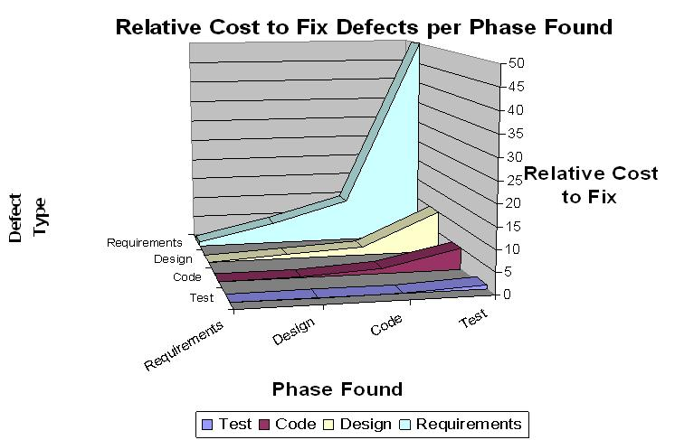

Slide 56
Proliferation of Errors
Cost of errors that are not detected until well after they have been made grows exponentially.
Requirements spec.
Preliminary Design
Design
Coding

Slide 57
Errors Are Detected Too Late
Many errors remain latent and are not detected until well after the stage at which they have been made.
A TRW study:
54% of all errors detected after coding and unit testing
45% were attributable to the requirements and design phases
9% were attributable to coding

Slide 58
Requirements Errors Are Abundant
There are many requirements errors being made.
DeMarco:
56% of all the bugs detected can be traced to errors made during requirements phase.
Analysis of a U.S. army management information system:
Uncovered over 500 requirements errors in the document.

Slide 59
Requirements Error Types
Errors in requirements specifications are typically incorrect facts, omissions, inconsistencies and ambiguities.
A7-E operational flight program:

Slide 60
Requirements Error Detection
Requirements errors can be detected.
A7-E operational flight program
%33 of requirements errors in the specification were detected by manual review.
Another study:
%65 can be detected by inspection.
%15 by unit and integration testing.
Notes:
The quantitative results demonstrates that we do not pay enough attention to the requirements process
These studies also emphasize that the cost to correct software errors multiplies during the software development process

Slide 61
Requirements validation
Concerned with demonstrating that the requirements define the system that the customer really wants.
Requirements error costs are high so validation is very important
Fixing a requirements error after delivery may cost up to 100 times the cost of fixing an implementation error.
Redesign, reimplement, system retest

Slide 62
Requirements checking
Validity. Does the system provide the functions which best support the customer’s needs?
Consistency. Are there any requirements conflicts?
No contradictory constraints.
No different description of the same system function
Completeness. Are all functions required by the customer included?
Realism. Can the requirements be implemented given available budget and technology
Verifiability. Can the requirements be checked?
To reduce the potential for dispute between customer and contractor,system requirements should always be written so that they are verifiable.
Notes:
To reduce the potential for dispute between customer and contractor,
system requirements should always be written so that they are verifiable.

Slide 63
Requirements validation techniques
Requirements reviews
Systematic manual analysis of the requirements.
Prototyping
Using an executable model of the system to check requirements.
Test-case generation
Developing tests for requirements to check testability.
If a test is difficult or impossible to design, this usually means that the requirements will be difficult to implement

Slide 64
Requirements reviews
Regular reviews should be held while the requirements definition is being formulated.
Both client and contractor staff should be involved in reviews.
Reviews may be formal (with completed documents) or informal. Good communications between developers, customers and users can resolve problems at an early stage.
Review Checks….
Verifiability
Is the requirement realistically testable?
Comprehensibility
Is the requirement properly understood?
Traceability
Is the origin of the requirement clearly stated?
Adaptability
Can the requirement be changed without a large impact on other requirements?

