Slide 1
Design
Chapter 6 &7 Sommerville
Chapter 8 & 9 Pressman

Slide 2
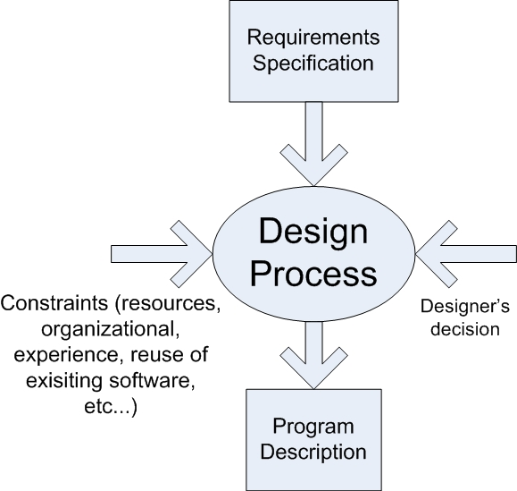
A general Model of the design process
Notes:
design focuses on four major areas of concern: data, architecture, interfaces and components.

Slide 3
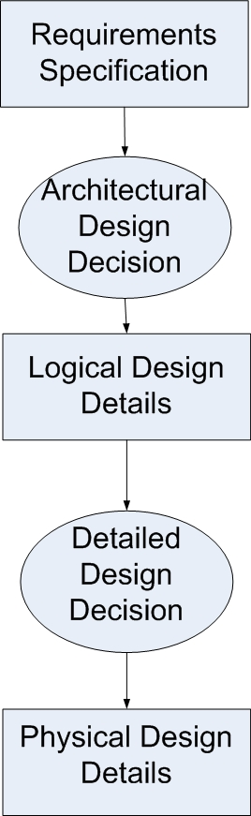
Major Phases of the design process
Highly abstract model of a solution in which only external properties of the model elements.
Called Architectural or Logical Design
Black-box partitioning of the problem
Decompose the reqs into sw subsystems
Abstract chunks are mapped on technological-based units
Specify each subsystem
Called Detailed or Physical Design
Blackbox to whitebox
Notes:
1. Preliminary Design
– External design describes the real-world model
– Architectural design decomposes the requirement specification
into software subsystems
2. Detailed Design
– Specify each subsystem
– Further decomposed subsystems, if necessary

Slide 4
design focuses on four major areas of concern:
data,
architecture,
interfaces
components.

Slide 5
Design Model Elements
Data design
transforming the analysis information model (data dictionary and ERD) into data structures
Part of this design may occur with the architectural design
More detailed data design occurs as each software component is designed.
Architectural design
defines the relationships among the major structural elements of the software
derived from the system specification, the analysis model, and the subsystem interactions defined in the analysis model (DFD).

Slide 6
Design Model Elements
Interface design
describes how the software elements communicate
with each other,
with other systems, and
with human users;
the data flow and control flow diagrams provide much of the necessary information required.
Component-level design
Transforming the structural elements in the architecture into procedural descriptions
Notes:
software components using information obtained from the process specification (PSPEC), control specification (CSPEC), and state transition diagram (STD).

Slide 7
Design Quality Guidelines
A design should be modular; that is, the software should be logically partitioned into elements or subsystems
A design should contain distinct representations of data, architecture, interfaces, and components.
A design should lead to components that exhibit independent functional characteristics.
A design should lead to interfaces that reduce the complexity of connections between components and with the external environment.
A design should be represented using a notation that effectively communicates its meaning.

Slide 8
Design Views
Constructional: is concerned with essentially static aspects of system
Behavioral: seek to describe casual links between events and system responses during execution
Functional: seek to describe what system does in terms of its tasks.
Data-modeling: concerned with the data objects used within the system and relationships between them.

Slide 9
Design Representations
Representation | Viewpoint | Comment
Data Flow Diagram | Functional | Information flow, operation dependency, relation with data stores
Entity-Relation Diagram | Data Modeling | Static relationships between design entities
UML diagrams | Functionality, Decomposition Behavior Communication | Based on object-orientation. Several diagrams for different purposes
Structure Chart | Functional, constructional | Invocation hierarchy btw subprograms, decomposition into subprogram units
State Transition Diagram | Behavioral | State machine model for an entity
Petri nets | Behavioral | Interaction btw parallel processes

Slide 10
Fundamental Concepts
Abstraction—data, procedure, control
allows designers to focus on solving a problem without being concerned about irrelevant lower level details
Architecture—the overall structure of the software
Separation of concerns—any complex problem can be more easily handled if it is subdivided into pieces
Modularity—compartmentalization of data and function
Information Hiding—controlled interfaces
Refinement—elaboration of detail for all abstractions
Refactoring—a reorganization technique that simplifies the design
Patterns—”conveys the essence” of a proven design solution
Notes:
Functional independence—single-minded function and low coupling

Slide 11
Design Concepts: Abstraction
Abstraction allows designers to focus on solving a problem without being concerned about irrelevant lower level details
At the highest level of abstraction: Solution is stated broadly using the language of problem environment.
At the lowest level of abstraction: Solution is stated in a manner that can be directly implemented.

Slide 12
Abstraction types
Three types:
Procedural abstraction
High level: Purchase with card
Low level: Swipe the card, enter PIN, press Enter, take out receipt
Data abstraction
High level: Credit card
Low level: Card number, name, valid from and expiry dates, security code, etc.
Control abstraction
High level: Monitor sensors
Low level: Sensor input controller, alarm conditions controller, alarm output controller

Slide 13
Design Concepts: Refinement
Refinement is the process of elaboration where the designer provides successively more detail for each design component as going from the top to the bottom of the hierarchy.
Abstraction and refinement are complementary concepts.

Slide 14
Stepwise Refinement
open
walk to door;
reach for knob;
open door;
repeat until door opens
turn knob clockwise;
walk through;
if knob doesn't turn, then
close door.
take key out;
find correct key;
insert in lock;
endif
pull/push door
move out of way;
end repeat

Slide 15
Separation of Concerns
breaking down into distinct features that overlap in functionality as little as possible
Any complex problem can be more easily handled if it is subdivided into pieces that can each be solved and/or optimized independently
By separating concerns into smaller, and therefore more manageable pieces, a problem takes less effort and time to solve.

Slide 16
Modularity
dividing a complex system into simpler pieces --modules
"modularity is the single attribute of software that allows a program to be intellectually manageable" [Mye78].
Monolithic software (i.e., a large program composed of a single module) cannot be easily grasped by a software engineer.
The number of control paths, span of reference, number of variables, and overall complexity would make understanding close to impossible.
In almost all instances, you should break the design into many modules, hoping to make understanding easier and as a consequence, reduce the cost required to build the software.
use the principle of separation of concerns and work on each module separately
helps to create an abstraction of a module’s environment using interfaces of other modules
Notes:
You modularize a design (and the resulting program) so that development can be
more easily planned; software increments can be defined and delivered; changes can
be more easily accommodated; testing and debugging can be conducted more efficiently,
and long-term maintenance can be conducted without serious side effects.

Slide 17
Modularity: Trade-offs
What is the "right" number of modules
for a specific software design?
module development cost
cost of
software
module
integration
cost
optimal number
number of modules
of modules
Notes:
the effort (cost) to develop an individual software module does decrease as the total number of modules increases.
more modules means smaller individual size. However, as the number of modules grows, the effort (cost) associated with integrating the modules
also grows.

Slide 18
Modularization
In dividing a system into modules we need some guiding principles.
There are two notions
Cohesion: strength of relationship between elements of a module
why the components are grouped together in a module
A cohesive module performs a single task, requiring little interaction with other components in other parts of a program. Stated simply, a cohesive module should (ideally) do just one thing.
We want highly cohesive modules
Coupling: degree of interconnection between modules
Coupling depends on the interface complexity between modules, the point at which entry or reference is made to a module, and what data pass across the interface.
We want low coupling between modules
Notes:
Independent modules are easier to maintain (and test) because secondary effects caused by design
or code modification are limited, error propagation is reduced, and reusable modules are possible
..is easier to develop because function can be compartmentalized and interfaces are simplified
A cohesive module performs a single task, requiring little interaction with other components in other parts of a program.
Coupling depends on the interface complexity between modules, the point at which entry or reference is made to a module, and what data pass across the interface. …less prone to a “ripple effect”

Slide 19
Cohesion and Coupling
A
A
1
2
1
3
3
4
5
C
C
8
10
8
7
9
2
B
B
4
5
10
6
7
6
9
Bad modularization:
low cohesion, high coupling
Good modularization:
high cohesion, low coupling

Slide 20
Information Hiding
module
• algorithm
controlled
interface
• data structure
• details of external interface
• resource allocation policy
clients
"secret"
a specific design decision
Notes:
modules should be specified and designed so that information (algorithms and data) contained within a module is inaccessible to other modules that have no need for such information
Hiding implies that effective modularity can be achieved by defining a set of independent modules that communicate with one another only that information necessary to achieve software function.
Abstraction helps to define the entities that make up the software. Hiding defines and enforces Access constraints to both procedural detail within a module and any local data structure used by the modüle
greatest benefits when modifications are required during testing and later during software maintenance.
Because most data and procedural detail are hidden from other parts of the software, inadvertent errors introduced during modification are less likely to propagate to other locations within the software.

Slide 21
Why Information Hiding?
reduces the likelihood of “side effects”
limits the global impact of local design decisions
emphasizes communication through controlled interfaces
discourages the use of global data
leads to encapsulation—an attribute of high quality design
results in higher quality software

Slide 22
Effective modularity
Modular decomposability: The design method should provide a systematic mechanism for decomposing the problem into subproblems.
Modular composability: Design method should enable existing (reusable) design components to be assembled into a new system
Modular understandability: A module should be understandable as a stand alone unit (without reference to other modules)
Modular continuity: Small changes to the system requirements should result in changes to individual modules, rather than system wide changes, to reduce the impact of the change.
Modular protection: Problems should be constrained to individual modules and should not effect other modules.

Slide 23
Architecture
The software architecture of a program or computing system is the structure or structures of the system, which comprise software components, the externally visible properties of those components, and the relationships among them.
Notes:
architecture is the structure or organization of modules, the manner in which these components interact,
and the structure of data that are used by the components.
In a broader sense, components can be generalized to represent major system elements and their interactions.

Slide 24
Example: architecture of a packing robot control system
Conceptual system view
Notes:
Conceptual system view

Slide 25
Software architecture
The design process for identifying the sub-systems making up a system and the framework for sub-system control and communication is architectural design.
Identify main structural components and their relationships
The output: software architecture.
An architectural model that describes how the system is organized as a set of communicating components.

Slide 26
Architectural design
An early stage of the system design process.
the critical link between specification and design processes.
Often carried out in parallel with some specification activities.
Identifying major system components and their communications.
individual components implement the functional system requirements.
Nonfunctional requirements depend on the way these components are organized and communicate.
Software architecture is important because it affects the performance, robustness, distributability, and maintainability of a system

Slide 27
Why is Architecture Important?
Representations of software architecture are an enabler for communication between all parties (stakeholders) interested in the development of a computer-based system.
The architecture highlights early design decisions that will have a profound impact on all software engineering work that follows and, as important, on the ultimate success of the system as an operational entity.
Architecture “constitutes a relatively small, intellectually graspable mode of how the system is structured and how its components work together” [BAS03].

Slide 28
Advantages of explicit architecture
Stakeholder communication
Architecture may be used as a focus of discussion by system stakeholders.
System analysis
Means that analysis of whether the system can meet its non-functional requirements is possible. (performance, reliability etc)
Large-scale reuse
The architecture may be reusable across a range of systems
Product-line architectures may be developed.

Slide 29
Architectural design decisions
Architectural design is a creative process so the process differs depending on the type of system being developed.
However, a number of common decisions span all design processes and these decisions affect the non-functional characteristics of the system.

Slide 30
Architectural design decisions

Slide 31
Architectural design decisions
Is there a generic application architecture that can be used?
How will the system be distributed?
What architectural styles/patterns are appropriate?
What approach will be used to structure the system?
Client/server, layered, etc
How will the system be decomposed into modules?
What control strategy should be used?
How will the architectural design be evaluated?
How should the architecture be documented?

Slide 32
Architecture and system characteristics
Performance
Localise critical operations and minimise communications. Use large rather than fine-grain components.
Security
Use a layered architecture with critical assets in the inner layers.
Safety
Localise safety-critical features in a small number of sub-systems.
Availability
Include redundant components and mechanisms for fault tolerance.
Maintainability
Use fine-grain, replaceable components.
Notes:
Performance If performance is a critical requirement, the architecture should be designed to localize critical operations within a small number of components,
with these components deployed on the same computer rather than distributed across the network. Using large components reduces the number of component communications, as most of the interactions between related system features take place within a component.
Security If security is a critical requirement, a layered structure for the architecture should be used, with the most critical assets protected in the innermost layers
and a high level of security validation applied to these layers
Safety If safety is a critical requirement, the architecture should be designed so that safety-related operations are co-located in a single component or in a small
number of components. This reduces the costs and problems of safety validation and may make it possible to provide related protection systems that can safely
shut down the system in the event of failure.
Availability If availability is a critical requirement, the architecture should be designed to include redundant components so that it is possible to replace and
update components without stopping the system
Maintainability If maintainability is a critical requirement, the system architecture should be designed using fine-grain, self-contained components that may
readily be changed. Producers of data should be separated from consumers, and shared data structures should be avoided.

Slide 33
Architectural views
What views or perspectives are useful when designing and documenting a system’s architecture?
For both design and documentation, we usually need to present multiple views of the software architecture.
Impossible to show everything in 1 model
What notations should be used for describing architectural models?
Box and arrow, UML, ADL (architecture description language)
Each architectural model only shows one view or perspective of the system.
It might show how a system is decomposed into modules,
how the run-time processes interact or
the different ways in which system components are distributed across a network.
Therefore, we need multiple views of the software architecture
Notes:
It is impossible to represent all relevant information about a system’s architecture in a single diagram, as a graphical model can only show one view or perspective of the system.

Slide 34
4+1 View Model of Architecture
End user
Logical view
Development view
Programmers
& software managers
Scenarios
Process View
Physical View
Performance
Scalability
troughput
System Engineer
Notes:
The architecture in fact partially evolved from these scenarios as well as
The model is rather generic, and other notations and tools can be used, other design methods can be used especially for the logical and process decompositions
For each view, the architects can pick a certain architectural style
Similar views in UML
Use case view> - Encompass the use cases that describe the behavior of the system as seen by its end users, analysts, and testers
Design view - Encompass the classes, interfaces, and collaborations that form the vocabulary of the problem and its solution
Process view - Encompass the threads and processes that form the system's concurrency and synchronization mechanisms
Implementation view - Encompass the components and files that are used to assemble and release the physical system
Deployment view - Encompass the nodes that form the system's hardware topology on which the system executes

Slide 35
4 + 1 view model of software architecture
logical view: shows the key abstractions in the system as objects or object classes.
It should be possible to relate the system requirements to entities in this logical view
It is concerned with the functionality that the system provides to end-users.
E.g. class and sequence diagrams may be used
process view: shows how, at run-time, the system is composed of interacting processes.
It addresses concurrency, distribution, integrators, performance, and scalability, etc
This view is useful for making judgments about non-functional system characteristics such as performance and availability.
Activity diagram may be used
development view
Physical view
+1

Slide 36
4 + 1 view model of software architecture
logical view
process view
development view: shows how the software is decomposed for development.
It illustrates a system from a programmer's perspective and is concerned with software management.
it shows the breakdown of the software into components that are implemented by a single developer or development team.
This view is useful for software managers and programmers.
Component or package diagrams may be used
physical view,
Related use cases or scenarios (+1)

Slide 37
4 + 1 view model of software architecture
logical view
process view
development view
physical view: shows the system hardware and how software components are distributed across the processors in the system.
This view is useful for systems engineers planning a system deployment.
It depicts the system from a system engineer's point of view.
It is concerned with the topology of software components on the physical layer, as well as the physical connections between these components.
Deployment diagram may be used
Related use cases or scenarios (+1)

Slide 38
In addition to 4+1 : conceptual view.
Conceptual view is an abstract view of the system that can be the basis for decomposing high-level requirements into more detailed specifications, help engineers make decisions about components that can be reused.
Usually with box and arrow
Notes:
In practice, conceptual views of a system’s architecture are almost always developed during the design process.
They are used to explain the system architecture to stakeholders and to inform architectural decision making.

Slide 39
Example: architecture of a packing robot control system
Conceptual system view
Notes:
Conceptual system view

