Slide 1
Introduction to Software Engineering
Project Management

Slide 2
Software project management
Project is a planned activity
  Planned means to a large extent we can determine how we are going to carry out a task before we start.
Good management cannot guarantee project success. However, bad management usually results in failures of the projects.
Project management is needed because software development is always subject to budget and schedule constraints

Slide 3
Project management
Manage Risks
Understand
the Need
Define
the Approach
Generate
Detailed Plans
Monitor Execution
Detailed planning
Initial planning
Tracking and oversight
Notes:
PM into 4 tasks:..
During the execution of these tasks risks are identified. For these risks contingency (possibility to occur) and avoidance plans are created and tracked
Today we’ll discuss planning

Slide 4
Project Planning: A 12 Step Program
Set goal and scope
Select lifecycle
Set org./team form
Start team selection
Determine risks
Create WBS
Identify tasks
Estimate size
Estimate effort
Identify task dependencies
Assign resources
Schedule work

Slide 5
The planning cycle
Decompose
work
WBS
Decompose
work
Estimate
product size
Size
Estimate
product size
Estimate
effort
Effort
Estimate
cost
Cost
Develop
schedule
No: rethink assumptions or renegotiate
Meet the need?
Schedule
The elements of a software plan:
  Goals and objectives
  WBS
  Product size estimates
  Resource estimates
  Project schedule
Plans are living documents!
planning is an iterative process

Slide 6
How To Schedule
1. Identify “what” needs to be done
  Work Breakdown Structure (WBS)
2. Identify “how much” (the size)
  Size estimation techniques
3. Identify the dependency between tasks
  Dependency graph, network diagram
4. Estimate total duration of the work to be done
  The actual schedule

Slide 7
Work Breakdown Structure (WBS)
Hierarchical list of the work activities required to complete a project.
  Work activities includes tasks for:
    Software development and its management
    Support of software development
    Any other activities required to meet customer requirements, such as creating documents, training programs, tool development or acquisition, travel, etc.
Role of WBS
Cost/schedule estimate
(project/proposal start)
Source
documents
WBS
Cost tracking (execution)
Historical records
(after/at end of project)

Slide 8
WBS example
Software for
“C” Compiler
Build “C”
Compiler
Build
Test Suite
Write
Documentation
Installation
Software
Manage
Development
User
Interface
File
System
Parser
Code
Generator
Run Time
System
1.0 Software for “C” Compiler
1.1 Build a “C” compiler
1.1.1 Build user interface
1.1.2 Build file system
1.1.3 Build parser
1.1.4 Build code generator
1.1.5 Build run time system
1.2 Build the test suite for the compiler
1.2.1 ...
1.3 Write documentation
1.4 Build installation software
1.5 Manage software development
Notes:
This is a three level WBS -- most real ones have more levels of detail
It lists all tasks that need to be done to supply the complete product
Note that level 2 consists of the main tasks and level 3 provides more detail
Every task in the WBS should reflect something in a statement of work, requirements specification or such
Every task in the WBS needs to be reflected in cost estimates

Slide 9
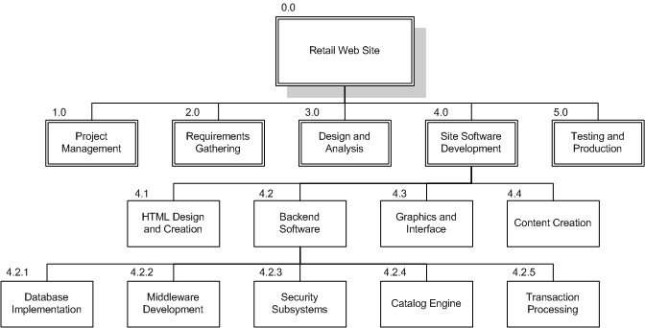
WBS Chart Example

Slide 10
WBS Outline Example
0.0 Retail Web Site
1.0 Project Management
2.0 Requirements Gathering
3.0 Analysis & Design
4.0 Site Software Development
4.1 HTML Design and Creation
4.2 Backend Software
4.2.1 Database Implementation
4.2.2 Middleware Development
4.2.3 Security Subsystems
4.2.4 Catalog Engine
4.2.5 Transaction Processing
4.3 Graphics and Interface
4.4 Content Creation
5.0 Testing and Production

Slide 11
Concepts: activity, work package
An activity is a specific task to be performed at any level of the WBS.
  Generally, each activity corresponds to some documented work requirement, such as a SOW (statement of work) paragraph
  Some activities are merely implied
    Management
    Details of development process
A work package is a bottom-level or “atomic” activity in the WBS
  This represents a task or group of tasks whose costs will be tracked and estimated together
  Small enough to manage and large enough to be worth tracking separately
Work package
Notes:
e.g. Design of a software component

Slide 12
Concepts: Cost content summary
A description of a work package and a rationale for its cost estimate.
Item: Travel for customer interchange meetings
WBS #: 1.5.2.3 Cost: $16,800
Description: Four trips to customer for interchange meetings. Each trip will involve 3 engineers and be 2 days long
Cost Calculation: 4 * 3 * 2 * $700/day = $16,800
Notes:
The cost content summary is normally not done until cost estimation.
The point of showing it here is that a work package should be something that is sufficiently specific and detailed that you can estimate cost for it

Slide 13
Concepts: WBS Dictionary
A supplement to the WBS that provides additional detail for each WBS activity
  Typical contents for a given activity:
  Inputs, Outputs
  Performance goals (if any)
  Reviews
  Exit or completion criteria,
  Detailed description (if a work package),
  Sub-activities that make up this activity

Slide 14
A WBS dictionary entry
Name: Design the file system (for compiler)
WBS #: 1.1.3.2
Performance Goal: 3 months
Inputs: requirements specification for file system
Output: file system design description
Reviews: preliminary design review, detailed design review, plus intermediate peer reviews
Exit Criteria: file system design addresses all requirements and meets design standards
Detailed Description: use object oriented design technique to establish a design for the file system. .............

Slide 15
Observations on the WBS
Different parts of the WBS could have different levels of detail
Later updates of the WBS provide more detail than what is developed initially
Avoid making too many very small work packages
  if several of them have nearly identical descriptions, see if you can combine them.
  Each level in the WBS multiplies by 5-10 the amount of detail that must be estimated, tracked, etc.
Trace the WBS to the requirements

Slide 16
Risks in preparing a WBS
Too much detail
  The more detail, the higher the overhead costs
  Some customers might insist on tracking all detail that you put in the WBS -- do you really want them tracking how many weeks you spent during design reviews?
Work packages are vague
  Look for concrete starting & ending events with specific evaluation criteria
  A work package must be discrete, trackable, and measurable
Excluding certain tasks
  Exclusion implies 0 cost -- rarely true
Duplication
  It is easy to have the same work show up in more than one place, especially on a large project

Slide 17


Slide 18
Estimations
Very difficult to do, but needed often
Created, used or refined during
  Strategic planning
  Feasibility study and/or SOW
  Proposals
  Vendor and sub-contractor evaluation
  Project planning (iteratively)
Basic process
  Estimate the size of the product
  Estimate the effort (man-months)
  Estimate the schedule
  NOTE: Not all of these steps are always explicitly performed

Slide 19
Estimating the size of Software
Assumptions:
  The effort required to perform software development tasks are hard to estimate directly
  Size is an accurate predictor of the resources required to develop a product.
Size estimation picture:
Size
estimate
for each
software
product
Size
estimate
for the
software
product
Source
documents
WBS
Σ

Slide 20
Algorithmic Measures
Lines of Code (LOC)
Function points
Feature points or object points
Other possible
  Number of bubbles on a DFD
  Number of of ERD entities
  Number of processes on a structure chart
LOC and function points most common
  (of the algorithmic approaches)
Majority of projects use none of the above

Slide 21
Software size metrics...
What are the best units?
    Lines of code
    Functions performed
    Number of requirements
    Number of objects
    Document pages
    Number of screens
Useful for planning
  Development effort should reasonably correlate with the size measured
Precision
  Measure should be precisely defined
Automated counting
  Ensure it is accurate and economical

Slide 22
Software size metrics
Length metrics
  used to collect direct measures of software engineering output
  size software products from the developer’s point of view (e.g. LOC, Executable Statements, etc.).
Functionality metrics
  provide indirect measures of software which focus on functionality and utility.
  size software products from the user’s point of view (e.g. Function Points, Object Points)
Other metrics
  Use Case Points, etc.

Slide 23
LOC :Lines of Code
Physical LOC: counts text lines
Logical LOC: counts language elements
If A>B
then A - B
else A + B;
Physical LOC:
First example: 3 LOC
Second example: 9 LOC
Logical LOC:
Each logic construct as a single line:
Both examples: 1 LOC
Count selected keywords (if, then, else, begin, end, …) :
First example: 3 LOC
Second example: 7 LOC
If A>B
then
begin
A - B
end
else
begin
A + B
end;

Slide 24
LOC Conversion Ratios
From\To Basic Ada Pascal Cobol Fortran Jovial C Assemb
Basic 1.0 1.11 1.44 1.67 1.67 1.67 2.0 5.0
Ada 0.9 1.0 1.3 1.5 1.5 1.5 1.8 4.5
Pascal 0.69 0.77 1.0 1.15 1.15 1.15 1.38 3.5
Cobol 0.6 0.67 0.87 1.0 1.0 1.0 1.2 3.0
Fortran 0.6 0.67 0.87 1.0 1.0 1.0 1.2 3.0
Jovial 0.6 0.67 0.87 1.0 1.0 1.0 1.2 3.0
C 0.5 0.55 0.72 0.83 0.83 0.83 1.0 2.5
Assemb 0.2 0.22 0.29 0.33 0.33 0.33 0.4 1.0

Slide 25
Function Point Process
1. Count # of biz functions per category
  Categories: outputs, inputs, db inquiries, internal logical files, and external interfaces

Slide 26
Function-point example
A simple information system is required for a bank.
It will enable new customers to be added and deleted from a customer file.
The system shall support paying in and withdrawal transactions and display a warning message if the borrower has an excessive overdraft
Customers should be able to query their account balance via a terminal.
A report of overdrawn customers can be requested.

Slide 27
Function-point example...
External inputs:
add new customers
delete customer
paying in transaction
withdrawal transaction
External outputs:
displaying warning message of an excessive overdraft
request a report of overdrawn customers
External enquiry:
Query account balance
External interface file:
none
Internal logical file:
customer file

Slide 28
Function Point Process
1. Count # of biz functions per category
  Categories: outputs, inputs, db inquiries, internal logical files, and interfaces
2. Establish Complexity Factor for each and apply
  Simple, Average, Complex
  Set a weighting multiplier for each (0->15)
  This results in the “unadjusted function-point total”

Slide 29
Deciding Complexity levels (Albrecht)
Count references to file accesses, record type accesses, data elements
Complexity scores 2 – 3: simple 4: average >5: complex
Function | Determinants
 | # files |  |  | # record types |  |  | # data elements
Complexity Scores | 1 | 2 | 3 | 1 | 2 | 3 | 1 | 2 | 3
External Input | 0-1 | 2 | 3+ |  |  |  | 1-4 | 5-15 | 16+
External Output | 0-1 | 2-3 | 4+ |  |  |  | 1-5 | 6-19 | 20+
Internal File |  |  |  | 1 | 2-5 | 6+ | 1-19 | 20-50 | 51+
External Interface |  |  |  | 1 | 2-5 | 6+ | 1-19 | 20-50 | 51+
External Enquiry | Use the greater of the input and output components
For example:
External input that reference four files and nine data types:
3 + 2 … ‘complex’

Slide 30
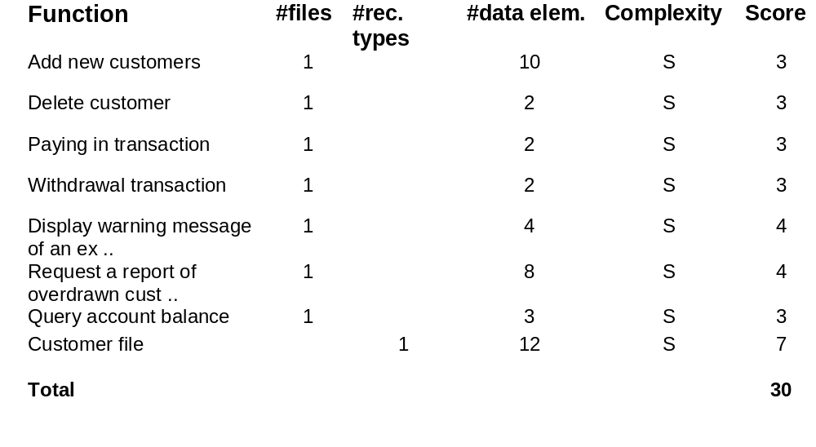
Function-point example: complexities

Slide 31
Function-point example: complexities

Slide 32
Function Points (Albrecht)
Count the number of each item and multiply by its weight factor
    Simple Average Complex
    External input 3 4 6
    External output 4 5 7
    External enquiry 3 4 6
    Internal file 7 10 15
    External interface 5 7 10
For example:
Function Type Complexity Score
Add new Customers External Input S 3
Customer file Internal file S 7

Slide 33
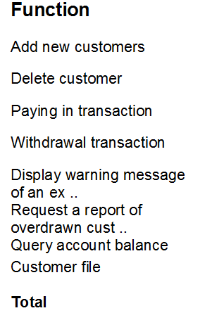
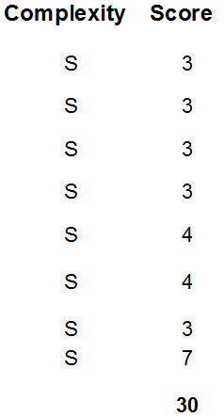
Function-point example: complexities

Slide 34
Function Point Process
1. Count # of biz functions per category
  Categories: outputs, inputs, db inquiries, internal logical files, and interfaces
2. Establish Complexity Factor for each and apply
  Simple, Average, Complex
  Set a weighting multiplier for each (0->15)
  This results in the “unadjusted function-point total”
3. Compute an “influence multiplier” and apply
  It ranges from 0.65 to 1.35; is based on 14 factors
4. Results in “function point total”
  This can be used in comparative estimates

Slide 35
Influence factors
FP could be adjusted by the influence factors:
  Influence factors range from 0 to 5 (simple …complex or low …high)
  Total Degree of Influence(TDI)
  = Sum of the influence factors
  Value Adjustment Factor (VAF)
  = 0.65 + (0.01 * TDI)
  Function Points
  = VAF * unadjusted FP
Influence factors (example)
  Data communications 2
  Distributed functions 0
  Performance objectives 3
  Heavily used configuration 3
  Transaction rate 4
  On-line data entry 4
  End-user efficiency 3
  On line update 2
  Complex processing 3
  Reusability 2
  Installation ease 3
  Operational ease 4
  Multiple sites 5
  Facilitate change 3
TDI 41
VAF 1.06
Function points ...

Slide 36
Function-point example : Influence
Influence factors (example) DI Comment
  Data communications 3 On line data collection for batch process
  Distributed functions 3 Data transfer on-line in one direction
  Performance objectives 3 Online response time is critical
  Heavily used configuration 2 Will run on existing system, security cons.
  Transaction rate 4 Demanded by the specification
  On-line data entry 5 Half of the transactions are online
  End-user efficiency 4 Minimize key strokes
  On line update 4 Customer file with recovery mechanism
  Complex processing 1 Only security issues
  Reusability 0 No special requirements
  Installation ease 0 No special requirements
  Operational ease 1 Effective startup, backup and recovery
  Multiple sites 0 Only installation
  Facilitate change 0 No req. for flexible queries ...
TDI 30
VAF = 0.65 * (0.01 * 30) 0.95
FP = VAF * UFC 31.35

Slide 37
LOC vs Function points
LOC
  Simple and can be precisely defined
  Measurement can be easily automated
  Directly relates to the product built: can be measured after the product is developed.
  Large variations during early phases
  Language/tool dependent
Function points
  Early size estimates more meaningful, easier and direct.
  Language independent
  Should be converted to a unit that can measure the content of program

Slide 38
LOC Misleading Conclusions
Activity Case assembly Case fortran
(30 FP; 10,000 LOC) (30 FP; 3000 LOC)
Requir. 2 Mon. 2 Mon.
Design 3 Mon. 3 Mon.
Coding 10 Mon. 3 Mon.
Int./Test 5 Mon. 3 Mon.
Doc/Man/Sup 5 Mon. 4 Mon
Total Cost $125,000 $75,000
Cost per FP $4,166.67 $2,500.00
Cost per LOC $12.50 $25.00

Slide 39
Using function points
After all of the calculations above, you must convert function points to lines of code
Formula:
  LOC = FP * ADJ * CONVERSION FACTOR
ADJ is an adjustment for the general characteristics of the application
The conversion factor is established based on historical experience for your application
  It represents the average number of lines of code to implement a simple function

Slide 40
FP Conversion Factors
Language | SLOC per FP
Assembler | 320
Cobol, Fortran | 106
Pascal | 91
RPG, PLI | 80
Ada | 71
Lisp, Basic | 64
4th Generation Database | 40
Java | 30
Smalltalk | 21

Slide 41
Which method if there are no data
What if you have absolutely no data on the code to be written?
  no prior experience
  no expertise available
You may be able to try something like function points if you know the functional requirements
Or even just count requirements
In a worst case, you may need to plan on several updated estimates as you learn more

Slide 42
Size estimating methods
Consult with experts
Example: Wideband-Delphi
  Good for new, unique, different situations
  Biased, knowledge may be insufficient
Using past history
Example: Standard-component
  History is a good guide if you have enough data
  Truly similar products are difficult to find
Estimate each component
  Good for tracking costs afterwards
  Time consuming, often lack info
  Use if data and time are available

Slide 43
Wideband-Delphi Method
Consensus-based technique for estimating effort
Several experts individually produce estimates then those estimates converge on a consensus estimate.
  1- A group of experts given source documents and estimation form
  2- Meeting 1: discuss project goals, assumptions, estimation issues
  3- Each anonymously list tasks and estimated sizes
  4- Estimates are tabulated by a moderator and given back to experts.
  Personal estimate is identified others anonymous.
  0 20 40 60 80 100
  X X* X! X X
Your estimate
Median estimate

Slide 44
Wideband-Delphi Method
  5- Meeting 2: discuss results
  Bring insight to the problem
  specifically focusing on having the experts discuss points where their estimates vary widely
  6- If possible, reach a consensus estimate
  If no consensus, break until you can gather additional data, then go to step 3

Slide 45
Wideband Delphi
Group consensus approach
RAND corp. used original Delphi approach to predict future technologies
Present experts with a problem and response form
Conduct group discussion, collect anonymous opinions, then feedback
Conduct another discussion & iterate until consensus
Advantages
  Easy, inexpensive, utilizes expertise of several people
  Does not require historical data
Disadvantages
  Difficult to repeat
  May fail to reach consensus, reach wrong one, or all may have same bias

Slide 46
Advantages and disadvantages
Advantages
  Takes advantage of the expertise of several people
  Participants understand each other`s view and better respond to later problems
  Does not require historical data (although it can be useful input if it is available)
Disadvantages
  May fail to reach consensus, reach wrong one, or all may have same bias
  Consensus on an incorrect estimate can be reached
    Difficult to get feedback: You may not be skeptical enough when actual data shows it is wrong
  Difficult to repeat

Slide 48
Planning and Monitoring
Charts for planning and monitoring a project
  PERT (Program Evaluation and Review Technique)
    An Activity network
  Gantt charts (developed by Henry L. Gantt)
    A Milestone chart
Common tasks
  Break the project into tasks
    List tasks to be done (from WBS)
    Estimate the amount of time required for completing each task (from WBS)
  Identify the dependencies among the tasks
Notes:
Tasks should not be too large (it is harder to estimate larger tasks)
There is a dependency between two tasks if one has to be completed before the other one starts
AFTER the size / cost /effort estimation

Slide 49
PERT Charts
Task 4:
2 days
Task 9: 5 days
E
Task 1:
6 days
B
H
Task 5: 4 days
Task 12:
3 days
Task 10:
5 days
A
Task 2: 6 days
F
C
Task 6: 4 days
J
Task 3: 2 days
Task 7: 7 days
G
Task 11: 5 days
D
Task 8: 4 days
Circles are events. Events are numbered or labeled
Consecutive events in a PERT chart are linked by activities
  Arcs are activities, duration is shown in arcs
The events are presented in a logical sequence and no activity can commence until its immediately preceding event is completed.
Notes:
Circles are events. Events are numbered or labeled
Two consecutive events in a PERT chart are linked by activities, which are conventionally represented as arrows in the diagram above.
The events are presented in a logical sequence and no activity can commence until its immediately preceding event is completed.

Slide 50
Identify critical path
Critical path
  The path that must be shortened in order to shorten the whole schedule
  The path that drives schedule slips
    if a critical path task slips, the whole schedule slips
  The riskiest part of the schedule
    to be monitored the closest
If a task has two or more predecessors, use whichever is larger. The smaller one is declared “not on the critical path”
Task 4:
2 days
Task 1:
7 days
E
B
A
Task 5: 4 days
F
Notes:
In this case, it is 11 weeks to do the job and two of the three tasks are on the critical path
In a larger project, the critical path is generally a smaller proportion of the total
The algorithm for computing a critical path is actually a bit more complicated than what I have shown here
There are a number of papers on this
But the basic idea is shown here

Slide 51
Critical path
Total duration of last task is the minimum possible time to carry out the steps
The critical path is the path that involves no “non critical path” tasks
Using the critical path
  If the minimum schedule is too long:
    Must begin with tasks that are on the critical path
      assign more resources so you can do them faster
      Find a way to do them in parallel (for example, through incremental deliveries)
  When you do this you usually create a different critical path

Slide 52
PERT Charts
Task 4:
2 days
Task 9: 5 days
E
Task 1:
6 days
B
H
Task 5: 4 days
Task 12:
3 days
Task 10:
5 days
A
Task 2: 6 days
F
C
Task 6: 4 days
J
Task 3: 2 days
Task 7: 7 days
G
Task 11: 5 days
D
Task 8: 4 days
Arcs represent the activities, nodes represent end or beginning of activities.
Dashed arcs show the critical path (longest path from the Start node to Finish node)
Notes:
Circles are events. Events are numbered or labeled
Two consecutive events in a PERT chart are linked by activities, which are conventionally represented as arrows in the diagram above.
The events are presented in a logical sequence and no activity can commence until its immediately preceding event is completed.

Slide 53
Gantt Chart
used for project planning and scheduling
Show the relative time phasing of the tasks instead of the dependencies (in activity network).
Each “activity” box is sized to be proportional to the length of time it takes
The boxes are lined up, usually in the order of execution, to show what is happening at what time
Tasks are scheduled based on the dependencies

Slide 54
Time units (e.g. days) of the project are shown with vertical dashed lines.
Tasks are shown with horizontal rectangles
Each “activity” box is sized to be proportional to the length of time it takes
Task1
Task6
Task9
Task2
Task8
Task10
Task3
Task4
Task11
Task5
Task7
Task12

Slide 55
Gantt chart
Task1
Task4
Task9
Task12
Task5
Task10
Task6
Task2
Task7
Task11
Task3
Task8
Tasks are scheduled based on the dependencies

Slide 56
GANTT Charts
Day 1
Day 18
Task 1
Task 4
Task 9
Task 12
Task 5
Task 10
Task 6
Task 2
Task 7
Task 11
Task 3
Task 8
Time units (e.g. days) of the project are shown with vertical dashed lines.
Tasks are shown with horizontal rectangles
Each “activity” box is sized to be proportional to the length of time it takes
Tasks are scheduled based on the dependencies
Notes:
Gantt Charts can also be used for project planning and scheduling
Show the relative time phasing of the tasks instead of the dependencies (in activity network).
Each “activity” box is sized to be proportional to the length of time it takes
The boxes are lined up, usually in the order of execution, to show what is happening at what time

Slide 57
GANTT Chart
Sometimes, height of box indicates number of people working on the activity
Task 1
Task 2
Task 3
GANTT chart does not identify
  Significance of the slips
  Task dependencies
  Whether it is realistic to expect you to meet the schedule
  Critical path
Notes:
Task 2 involves more people for a shorter time than task 1
Task 3 varies in staffing during the program
Note that if you have a big project, this form of Gantt chart takes more space

Slide 58
Exercise
A simple compiler project is divided in to following tasks with the associated cost estimates:
  Design (6 days)
  Implement Scanner (4 days)
  Implement Parser (5 days)
  Implement Code Generator (7 days)
  Integration and Testing (7 days)
  Write Manual (4 days)
The dependencies among these tasks are as follows:
  Implementation of Scanner, Parser and Code Generator and Writing of the Manual can start after the Design is finished
  Integration and Testing can start after Implementation of Scanner, Parser and Code Generator are all finished

Slide 59
  Implementation of Scanner, Parser and Code Generator and Writing of the Manual can start after the Design is finished
  Integration and Testing can start after Implementation of Scanner, Parser and Code Generator are all finished
Code Gen:7
Write manual:4
Integration&Test:7
Desing:6
Scanner:4
Parser:5

Slide 60
An Example: PERT Chart
Implement Scanner:
4 days
Implement.
Finished
Implement Parser:
5 days
Integration and Testing:
7 days
Design:
6 days
Project
Start
Design
Finished
Implement Code
Generator: 7 days
Project
Finished
Write Manual:
4 days
Dashed arcs show the critical path

Slide 61
An Example: Gantt Chart
Day 1
Day 20
Imp. Parser
Design
Integration and Test
Imp. Code Generator
Imp. Scanner
Write Manual

Slide 62
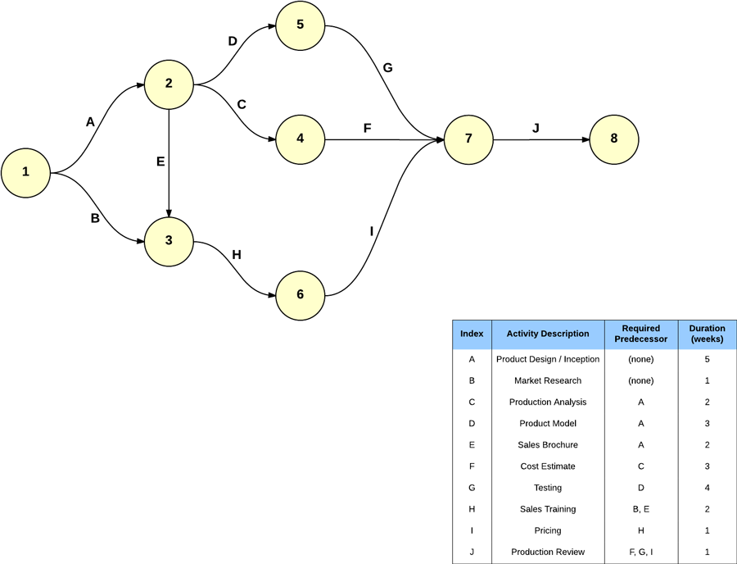
https://www.lucidchart.com/pages/pert-chart-critical-path-method

Slide 63
Principles of planning*
1. The precedence principle:
  Planning logically takes precedence over all other managerial functions
2. The effective planning principle:
  Plans will be effective if they are consistent with the organization’s policy and strategy framework
3. The living document principle:
  Plans must be maintained as living documents or they quickly lose their value
* Reifer, Donald, “The Nature of Software Management: A Primer,” Tutorial on Software Management, IEEE Computer Society Press, 1986, p. 43.
Notes:
1) If you don’t plan, you act without knowledge
2) If you work against your own organization, you will destroy your project or your organization or both
3) Plans are the foundation for control. If they are not updated, control is impeded.

Slide 64
Estimation:
Dealing with reuse
Many software programs are derived from previous programs
  This MAY result in savings of cost and/or time
  It MAY also result in increased quality
Reuse can also cost more and take longer and yield lower quality
What can be reused?
    Code
    Test Code
    Test Cases and Procedures
    Documentation
    Design Specifications
    Designs
    Requirements Specification
    …
The earlier in the development process, the greater the leverage from reuse

Slide 65
Documenting Reuse Estimates
Item
New LOC
Modified LOC
Reused LOC
Total LOC
Component #1
1233
0
0
1233
Component #2
0
988
0
988
Component #3
0
0
781
781
Component #4
560
245
0
805
Component #5
345
549
420
1314
Total
2138
1782
1201
5121
The total LOC column is total delivered lines of code
This could be applied equally to function points or other measures
Notes:
This is beginning to look like part of the spreadsheet from assignment 4
In fact, spreadsheets are an excellent way to document reuse and then to calculate the effect of reuse

Slide 66
Calculating the benefit of reuse
After estimating size, and before estimating effort, you must convert reused code to “equivalent” new code
Total
delivered size
Conversion
Equivalent size
Reuse info.
The conversion factor is based on how much less effort you will expend for reused code than for new code This can be estimated directly, e.g. :
  Reused code takes 30% as much effort as new code
  Modified code takes 30-90% as much effort as new code
Assuming you have historical justification of the conversion factors, you can do a simple calculation

Slide 67
Applying to previous example
Item
New LOC
Modified LOC
Reused LOC
Total LOC
Total
2138
1782
1201
5121
Factor
100%
60%
30%
-------
Net
2138
1069
360
3567
This says that the total effort to develop these 5121 lines of code will be comparable to that of producing 3567 lines of new code.
The same approach can be used for function points or other measures of software size.
Notes:
If you did the previous example with a spreadsheet, you can just add a few rows at the bottom to calculate it this way
Note that the factors may be different for different parts of the software
Assignment 4 allows for this
If you have some code where 60% is right for modified and other code where perhaps 75% is right, just go to two columns, as was illustrated before

Slide 68
Getting more accurate
If we are willing to look more closely at the Process and the Reuse characteristics, then we can gain a deeper understanding of the reuse impact
1- Examine the process
  List the phases of the process
  Then determine the % of the total effort expended in each step, when developing new code
  Note that this is effort, not time
  Example:
Requirements
Design
Code & Test
Integrate
18%
25%
25%
32%

Slide 69
Getting more accurate
2- Examine the reused software for each process step
  Let RM be the % of the requirements effort that will be required for this reused software
    Must analyze requirements to see if reused code can be used
  Let DM be the % of the design effort that will be required for this reused software
    We may have to plan to test the software and maybe design the rest of the software in a special way
  Let CM be the % of the coding and unit testing effort required for this reused software
    Normally 0 for “pure reused” code, but not for modified code
  Let IM be the % of the integration effort required for this code
    Often 50-100% even for pure reused
Notes:
Note that different parts of the software may have different reuse characteristics and thus different values of these factors

Slide 70
Example ...
Process Step
Rqmts
Design
Code
Integrate
Percent
0.18
0.25
0.25
0.32
Delivered
% Effort
RM
DM
CM
IM
Equivalent
2138
New
1
1
1
1
2138
1782
Modified
0.2
0.4
0.7
1
1124
1201
Reused
0.1
0
0
1
406
5121
TOTAL
3668
The method can be used for any measure of size, such as function points ...
For truly reused code, CM is 0
although one can make a reasonable argument that RM and DM might well be > 0
Even for reused code, IM is generally not 0 because you must rerun at least some of the integration steps and all integration tests
Notes:
Sum of percentages on process row should be 100%
Remember that you might have several different types of “modified” or “reused” code - each would have a different row and a different set of RM, DM, CM, and IM factors.

Slide 71
Why is it “Modified”
Totally reused code has:
  Identical documentation
  Identical test procedures, Code, ...
  One master copy to maintain in the configuration management library
  One part number for record keeping, inventory, etc.
Even if you change 1 comment line
  You need to maintain two copies in the configuration management library (of the code, test code, documents, etc.)
And if you change 1 line of executable code
  You need to change tests and documentation

