Slide 1
Chapter 3
Data Modeling Using the Entity-Relationship (ER) Model

Slide 2
Chapter Outline
Overview of Database Design Process
ER Model Concepts
Entities and Attributes
Entity Types, Value Sets, and Key Attributes
Relationships and Relationship Types
Weak Entity Types
Roles and Attributes in Relationship Types
ER Diagrams - Notation
ER Diagram for COMPANY Schema
EER Models

Slide 3
Overview of Database Design Process
Two main activities:
Database design
Applications design
Focus in this chapter on database design
To design the conceptual schema for a database application
Application design focuses on the programs and interfaces that access the database
Generally considered part of software engineering

Slide 4
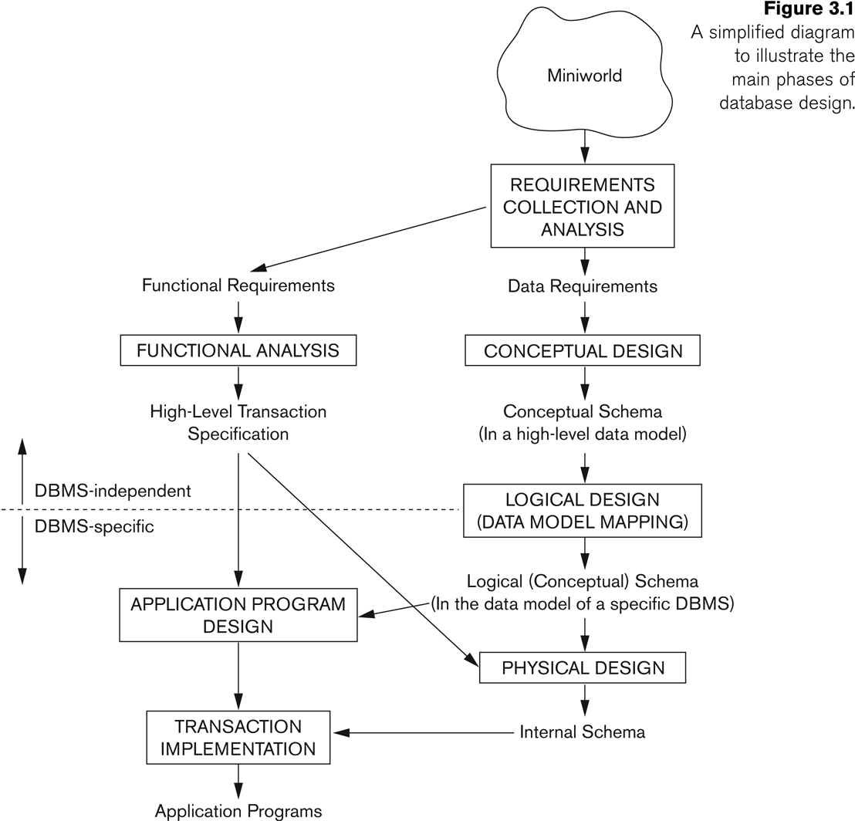
Overview of Database Design Process
Notes:
Conceptual, logical and physical model or ERD are three different ways of modeling data in a domain. While they all contain entities and relationships, they differ in the purposes they are created for and audiences they are meant to target. A general understanding to the three models is that, business analyst uses conceptual and logical model for modeling the data required and produced by system from a business angle, while database designer refines the early design to produce the physical model for presenting physical database structure ready for database construction.
Once all the requirements have been collected and analyzed, the next step is to create a conceptual schema for the database, using a high-level conceptual data model. This step is called conceptual design. The conceptual schema is a concise description of the data requirements of the users and includes detailed descriptions of the entity types, relationships and constraints; these are expressed using the concepts provided by the high-level data model.
The next step in database design is the actual implementation of the database, using a commercial DBMS. Most current commercial DBMSs use an implementation data model-such as the relational or the object relational database model- so the conceptual schema is transformed from the high-level data model into the implementation data model. This step is called logical design or data model mapping. The last step is the physical design phase, during which the internal storage structures, indexes, access paths, and file organizations for the database files are specified. Application programs are designed and implemented as database transactions corresponding to the high-level transaction specifications.

Slide 5
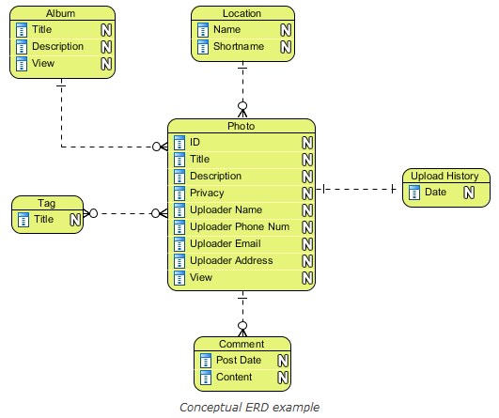
Overview of Database Design Process
Conceptual ERD models information gathered from business requirements. Entities and relationships modeled in such ERD are defined around the business' need.
Notes:
Ref. https://www.visual-paradigm.com/support/documents/vpuserguide/3563/3564/85378_conceptual,l.html

Slide 6
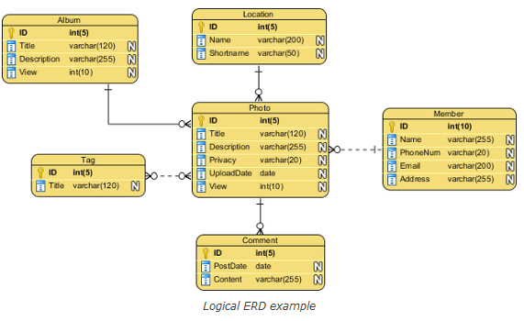
Overview of Database Design Process
Logical ERD also models information gathered from business requirements. It is more complex than conceptual model in that column types are set. Note that the setting of column types is optional and if you do that, you should be doing that to aid business analysis. It has nothing to do with database creation yet.
Notes:
Ref. https://www.visual-paradigm.com/support/documents/vpuserguide/3563/3564/85378_conceptual,l.html

Slide 7
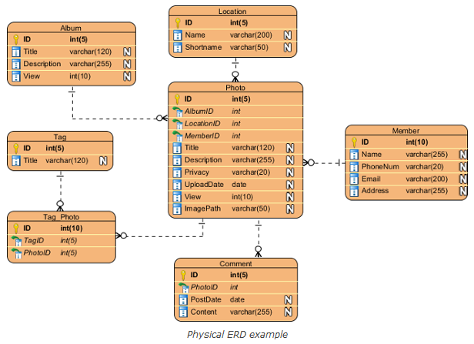
Overview of Database Design Process
Physical ERD represents the actual design blueprint of a relational database. It represents how data should be structured and related in a specific DBMS so it is important to consider the convention and restriction of the DBMS you use when you are designing a physical ERD.
Notes:
Ref. https://www.visual-paradigm.com/support/documents/vpuserguide/3563/3564/85378_conceptual,l.html
Physical ERD represents the actual design blueprint of a relational database. It represents how data should be structured and related in a specific DBMS so it is important to consider the convention and restriction of the DBMS you use when you are designing a physical ERD. This means that an accurate use of data type is needed for entity columns and the use of reserved words has to be avoided in naming entities and columns. Besides, database designers may also add primary keys, foreign keys and constraints to the design.

Slide 8
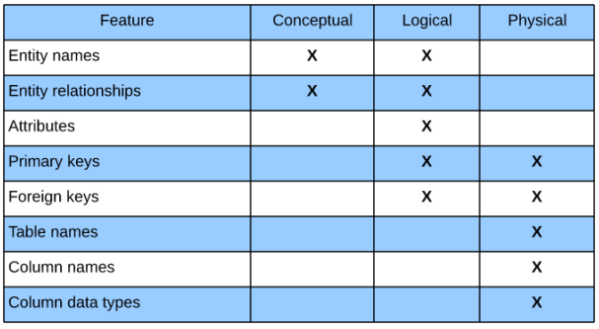
Overview of Database Design Process Data Models
Notes:
Ref: https://www.lucidchart.com/pages/ER-diagram-symbols-and-meaning

Slide 9
Notatıons for data modelıng
OMT
IDEF
Bachman
Chen (examples on this presentation)
Martin
UML
Crow’s Foot

Slide 10
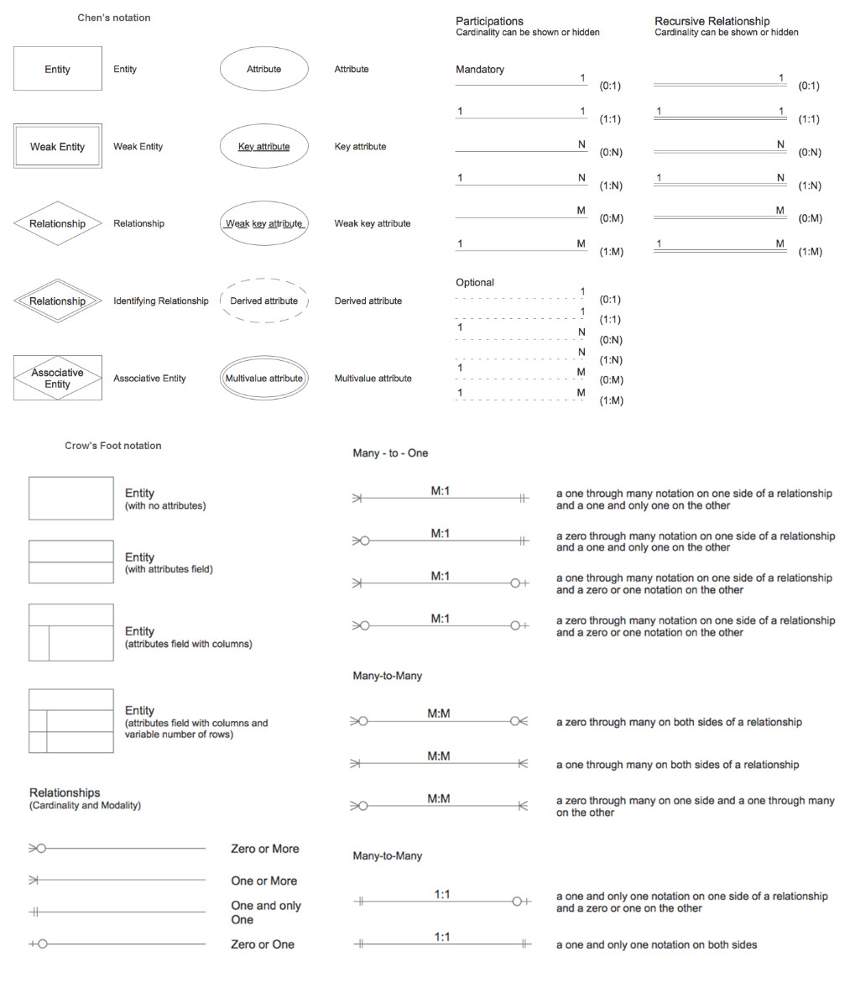

Slide 11
ER Model Concepts: entity - attribute
Entities are specific objects or things in the mini-world that are represented in the database.
For example the EMPLOYEE John Smith, the Research DEPARTMENT, the PROJECT P1
Attributes are properties used to describe an entity.
For example an EMPLOYEE entity may have the attributes Name, SSN, Address, BirthDate
A specific entity will have a value for each of its attributes.
For example a specific employee entity may have Name='John Smith', SSN='123456789', Address ='731, Fondren, Houston, TX, BirthDate='09-JAN-55‘
Each attribute has a value set (or data type) associated with it – e.g. integer, string, subrange, enumerated type, …

Slide 12
Types of Attributes (1)
Simple
Each entity has a single atomic value for the attribute. For example, SSN or Gender.
Composite
The attribute may be composed of several components. For example:
Address(Apt#, House#, Street, City, State, ZipCode, Country),
Name(FirstName, MiddleName, LastName).
Composition may form a hierarchy where some components are themselves composite.
Multi-valued
An entity may have multiple values for that attribute. For example, PreviousDegrees of a STUDENT.
Denoted as {PreviousDegrees}.

Slide 13
Types of Attributes (2)
In general, composite and multi-valued attributes may be nested arbitrarily to any number of levels, although this is rare.
For example, PreviousDegrees of a STUDENT is a composite multi-valued attribute denoted by {PreviousDegrees (College, Year, Degree, Field)}
Multiple PreviousDegrees values can exist
Each has four subcomponent attributes:
College, Year, Degree, Field

Slide 14
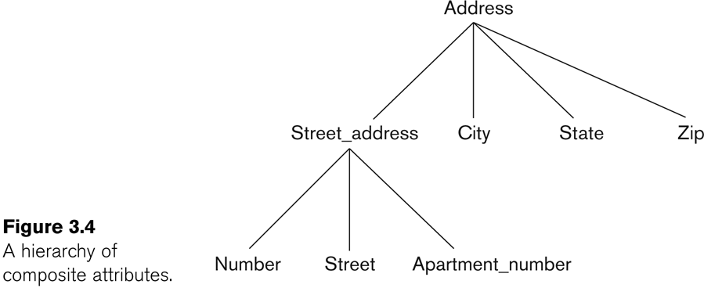
Example of a composite attribute

Slide 15
Types of Attributes (3)
Simple
Composite
Multi-valued
Derived attribute: an attribute whose value is calculated (derived) from other attributes.
The derived attribute need not be physically stored within the database; instead, it can be derived by using an algorithm.
For example, an employee’s age, EMP_AGE, may be found by computing the integer value of the difference between the current date and the birth date of the employee

Slide 16
Entity Types
Entities with the same basic attributes are grouped or typed into an entity type.
For example, the entity type EMPLOYEE and PROJECT.
A database usually contains groups of entities that are similar.
For example, a company employing hundreds of employees may want to store similar information concerning each of the employees.
These employee entities share the same attributes, but each entity has its own value(s) for each attribute.
An entity type defines a collection (or set) of entities that have the same attribute.
Each entity type in the database is described by its name and attributes.
Notes:
A database usually contains groups of entities that are similar. For example, a company employing hundreds of employees may want to store similar information concerning each of the employees. These employee entities share the same attributes, but each entity has its own value(s) for each attribute. An entity type defines a collection (or set) of entities that have the same attribute. Each entity type in the database is described by its name and attributes.

Slide 17
Entity Types and Key Attributes (1)
Entities with the same basic attributes are grouped or typed into an entity type.
An attribute of an entity type for which each entity must have a unique value is called a key attribute of the entity type.
For example, TCKimlikNO of EMPLOYEE.

Slide 18
Entity Types and Key Attributes (2)
A key attribute may be composite.
VehicleTagNumber is a key of the CAR entity type with components (City, Number).
An entity type may have more than one key.
The CAR entity type may have two keys:
VehicleIdentificationNumber (popularly called VIN)
VehicleTagNumber (City, Number), aka license plate number.
Each key is underlined

Slide 19
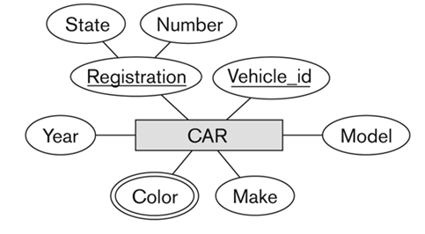
Displaying an Entity type in ER diagrams
An entity type is displayed in a rectangular box
Attributes are displayed in ovals
Each attribute is connected to its entity type
Components of a composite attribute are connected to the oval representing the composite attribute
Each key attribute is underlined
Multivalued attributes displayed in double ovals

Slide 20
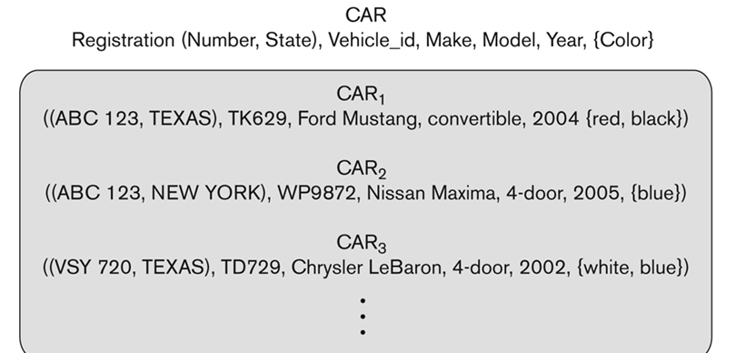
Entity Set
Each entity type will have a collection of entities stored in the database: Called the entity set
Example: set of all employees, departments, ….
Entity set is the current state of the entities of that type that are stored in the database
e.g. 3 CAR entity instances in the entity set for CAR

Slide 21
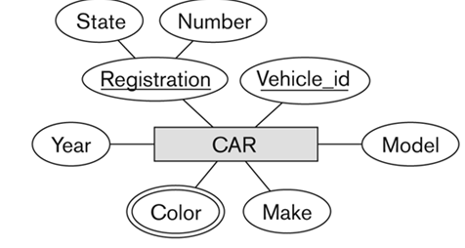
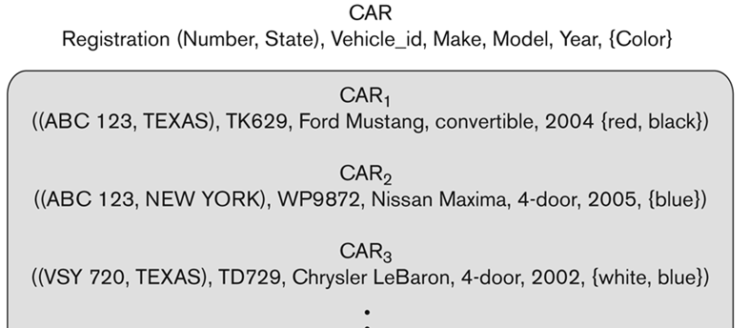
Entity Set and Entity Type
Same name (CAR) used to refer to both the entity type and the entity set

Slide 22
Example COMPANY Database
We need to create a database schema design based on the following (simplified) requirements of the COMPANY Database:
The company is organized into DEPARTMENTs. Each department has a name, number and an employee who manages the department. We keep track of the start date of the department manager. A department may have several locations.
Each department controls a number of PROJECTs. Each project has a unique name, unique number and is located at a single location.

Slide 23
Example COMPANY Database (Contd.)
We store each EMPLOYEE’s social security number, address, salary, gender, and birthdate.
Each employee works for one department but may work on several projects.
We keep track of the number of hours per week that an employee currently works on each project.
We also keep track of the direct supervisor of each employee.
Each employee may have a number of DEPENDENTs.
For each dependent, we keep track of their name, gender, birthdate, and relationship to the employee.

Slide 24
Initial Design of Entity Types for the COMPANY Database Schema
Based on the requirements, we can identify four initial entity types in the COMPANY database:
DEPARTMENT
PROJECT
EMPLOYEE
DEPENDENT
Their initial design is shown on the following slide
The initial attributes shown are derived from the requirements description

Slide 25
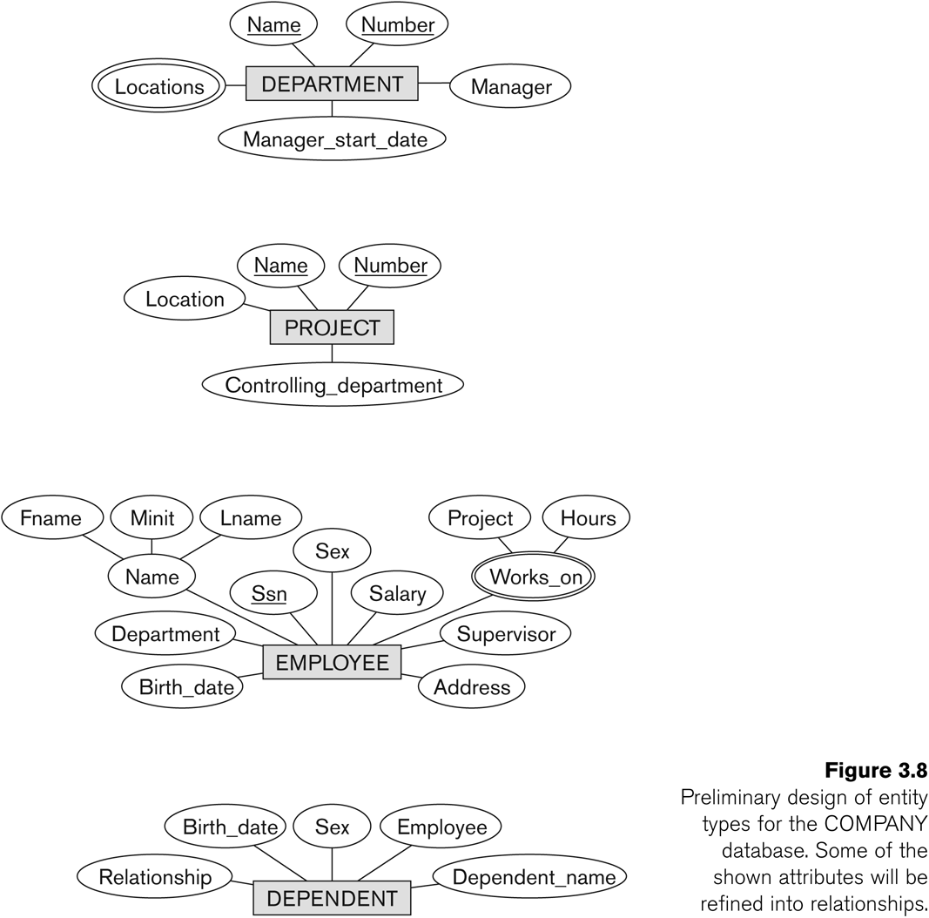
Initial Design of Entity Types

Slide 26
Refining the initial design by introducing relationships
The initial design is typically not complete
Some aspects in the requirements will be represented as relationships
ER model has three main concepts:
Entities (and their entity types and entity sets)
Attributes (simple, composite, multivalued)
Relationships (and their relationship types and relationship sets)
We introduce relationship concepts next

Slide 27
Relationships and Relationship Types (1)
A relationship relates two or more distinct entities with a specific meaning.
EMPLOYEE John Smith works on the NZT48 PROJECT,
EMPLOYEE Franklin Wong manages the Research DEPARTMENT.
Relationships of the same type are grouped or typed into a relationship type.
the WORKS_ON relationship type in which EMPLOYEEs and PROJECTs participate,
the MANAGES relationship type in which EMPLOYEEs and DEPARTMENTs participate.
The degree of a relationship type is the number of participating entity types.
Both MANAGES and WORKS_ON are binary relationships.

Slide 28
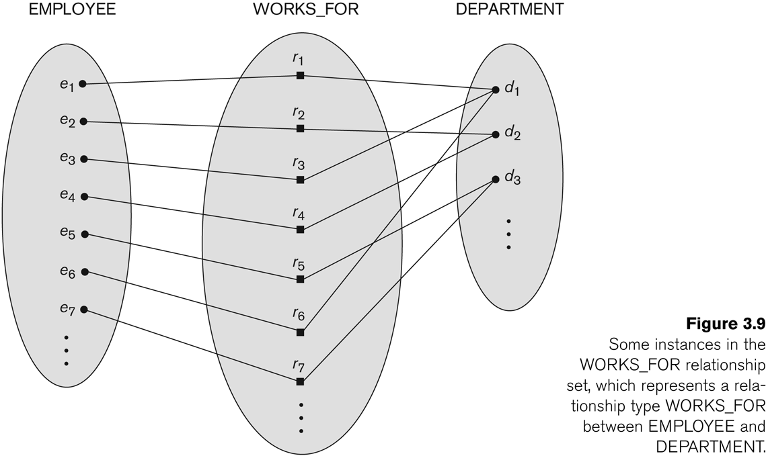
Relationship instances of the WORKS_FOR N:1 relationship between EMPLOYEE and DEPARTMENT

Slide 29
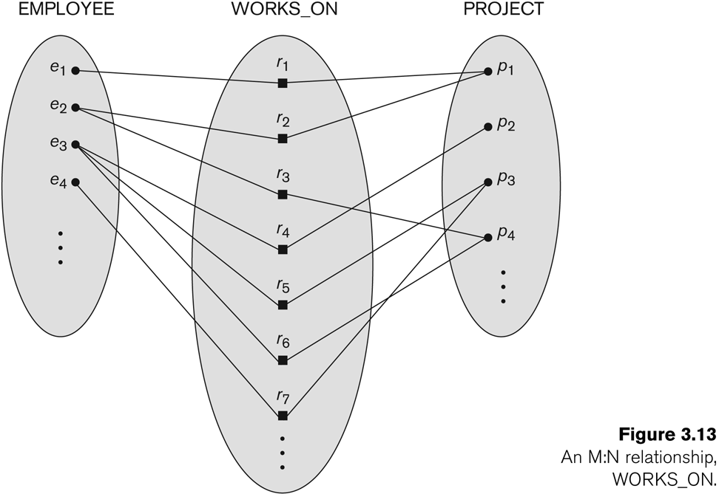
Relationship instances of the M:N WORKS_ON relationship between EMPLOYEE and PROJECT

Slide 30
Relationship type vs. relationship set (1)
Relationship Type:
It is the schema description of a relationship
Identifies the relationship name and the participating entity types
Also identifies certain relationship constraints
Relationship Set:
The current set of relationship instances represented in the database
The current state of a relationship type

Slide 31
Relationship type vs. relationship set (2)
Previous figures displayed the relationship sets
Each instance in the set relates individual participating entities – one from each participating entity type
In ER diagrams, we represent the relationship type as follows:
Diamond-shaped box is used to display a relationship type
Connected to the participating entity types via straight lines
EMPLOYEE
WORKS_FOR
DEPARTMENT

Slide 32
Example COMPANY Database
The company is organized into DEPARTMENTs.
Each department has a name, number and an employee who manages the department.
We keep track of the start date of the department manager.
A department may have several locations.
Each department controls a number of PROJECTs.
Each PROJECT has a unique name, unique number and is located at a single location.
We store each EMPLOYEE’s social security number, address, salary, gender, and birthdate.
Each employee works for one department but may work on several projects.
We keep track of the number of hours per week that an employee currently works on each project.
We also keep track of the direct supervisor of each employee.
Each employee may have a number of DEPENDENTs.
For each dependent, we keep track of their name, gender, birthdate, and relationship to the employee.

Slide 33
Refining the COMPANY database schema by introducing relationships
By examining the requirements, six relationship types are identified
All are binary relationships( degree 2)
Listed below with their participating entity types:
WORKS_FOR (between EMPLOYEE, DEPARTMENT)
MANAGES (also between EMPLOYEE, DEPARTMENT)
CONTROLS (between DEPARTMENT, PROJECT)
WORKS_ON (between EMPLOYEE, PROJECT)
SUPERVISION (between EMPLOYEE (as subordinate), EMPLOYEE (as supervisor))
DEPENDENTS_OF (between EMPLOYEE, DEPENDENT)

Slide 34
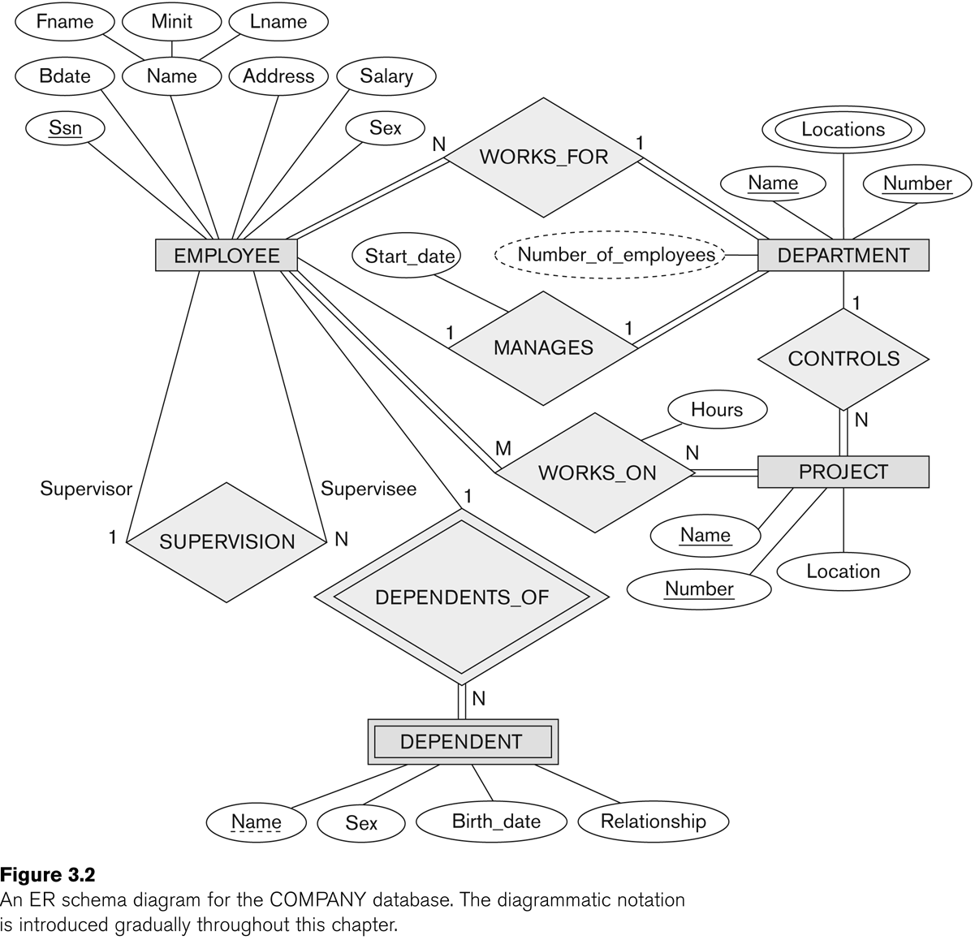
ER DIAGRAM – Relationship Types are: WORKS_FOR, MANAGES, WORKS_ON, CONTROLS, SUPERVISION, DEPENDENTS_OF

Slide 35
Discussion on Relationship Types
In the refined design, some attributes from the initial entity types are refined into relationships:
Manager of DEPARTMENT -> MANAGES
Works_on of EMPLOYEE -> WORKS_ON
Department of EMPLOYEE -> WORKS_FOR
etc
In general, more than one relationship type can exist between the same participating entity types
MANAGES and WORKS_FOR are distinct relationship types between EMPLOYEE and DEPARTMENT
Different meanings and different relationship instances.

Slide 36
Recursive Relationship Type
Each entity type participating in a relationship type plays a particular role.
Role name is written on the line connecting entity and relationship.
Role names are necessary when the same entity type participates in a relationship type more than once with different roles
These relationship types are called recursive relationships.
EMPLOYEE
WORKS_FOR
DEPARTMENT
employee
department

Slide 37
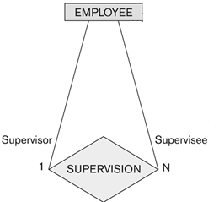
Recursive Relationship Type
Example recursive relationship: SUPERVISION
EMPLOYEE participates twice in two distinct roles:
supervisor (or boss) role
supervisee (or subordinate) role
Each relationship instance relates two distinct EMPLOYEE entities:
One employee in supervisor role
One employee in supervisee role

Slide 38
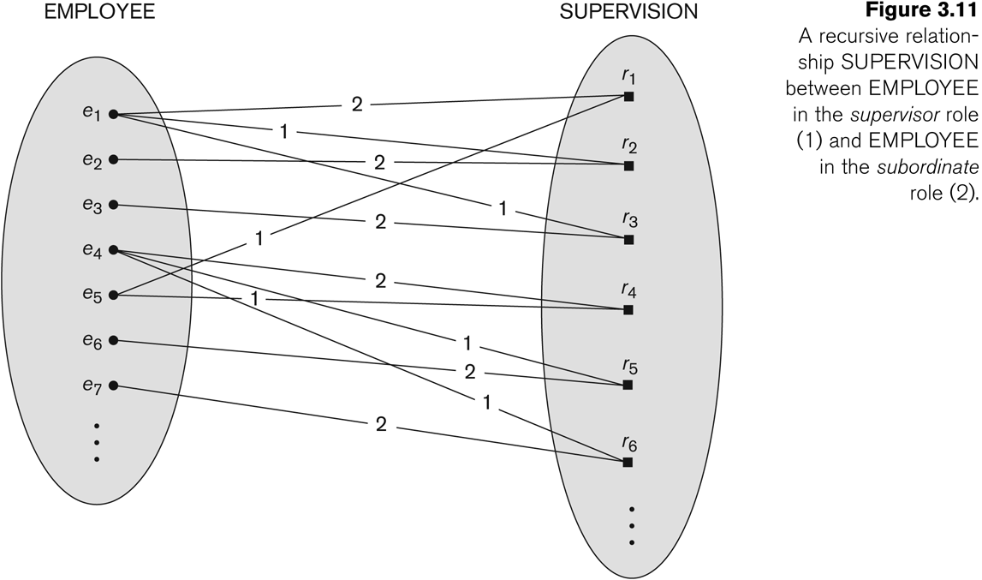
A Recursive Relationship Supervision`
Notes:
The supervision relationship type relates an employee to a supervisor, where both employee and supervisor entities are members of the same EMPLOYEE entity type. Hence, the EMPLOYEE entity type participates twice in SUPERVISION: once in the role of supervisor (or boss), and once in the role of supervisee (or subordinate). Each relationship instance r1 in SUPERVISION associates two employee entities ej and ek, one of which plays the role of supervisor and the other role of supervisee.

Slide 39
Weak Entity Types
An entity that does not have a key attribute of their own.
Reminder: An attribute of an entity type for which each entity must have a unique value is called a key attribute of the entity type.
i.e. An entity in a set is identified by the key.
A weak entity must participate in an identifying relationship type with an owner or identifying entity type
E.g. the son (a DEPENDENT) of the Employee ‘John X’ is identified with the entity ‘John X’.
A weak entity cannot be identified without an owner
E.g. I need to know John X to identify his son.
Notes:
In contrast, regular entity types that do have a key attribute-are called strong entity types. Entities belonging to a weak entity type are identified by being related to specific entities from another entity type in combination with one of their attribute values. We call this other entity type the identifying or owner entity type, and we call the relationship type that relates a weak entity type to its owner the identifying relationship of the weak entity type. A weak entity type always has a total participation constraint (existence dependency) with respect to its identifying relationship, because a weak entity cannot be identified without an owner entity. However, not every existence dependency results in a weak entity type. For example, a DRIVER_LICENSE entity cannot exist unless it is related to a PERSON entity, even though it has its own key (LicenseNumber) and hence is not a weak entity.

Slide 40
Weak Entity Types
Example:
A DEPENDENT entity is identified by the dependent’s first name, and the specific EMPLOYEE with whom the dependent is related
Name of DEPENDENT is the partial key
DEPENDENT is a weak entity type
EMPLOYEE is its identifying entity type via the identifying relationship type DEPENDENT_OF
Employee_ID | Employee_Name
Employee
Primary key
First Name | Employee ID | Gender
Dependent
Composite primary key
Notes:
In our example, if we assume that no two dependents of the same employee ever have the same first name, the attribute Name of DEPENDENT is the partial key. In the worst case, a composite attribute of all the weak entity’s attributes will be the partial key.

Slide 41
Weak Entity Types
Weak Entities are identified by the combination of:
The particular entity they are related to in the identifying entity type
A partial key (if exists) of the weak entity type
E.g. the employee ‘John X’ has two sons, each one is identified with son’s name and the Employee entity of John X.
Notes:
In contrast, regular entity types that do have a key attribute-are called strong entity types. Entities belonging to a weak entity type are identified by being related to specific entities from another entity type in combination with one of their attribute values. We call this other entity type the identifying or owner entity type, and we call the relationship type that relates a weak entity type to its owner the identifying relationship of the weak entity type. A weak entity type always has a total participation constraint (existence dependency) with respect to its identifying relationship, because a weak entity cannot be identified without an owner entity. However, not every existence dependency results in a weak entity type. For example, a DRIVER_LICENSE entity cannot exist unless it is related to a PERSON entity, even though it has its own key (LicenseNumber) and hence is not a weak entity.

Slide 42
ER DIAGRAM – Relationship Types are: WORKS_FOR, MANAGES, WORKS_ON, CONTROLS, SUPERVISION, DEPENDENTS_OF
Owner entity
Identifying relationship
Weak entity
Partial key

Slide 43
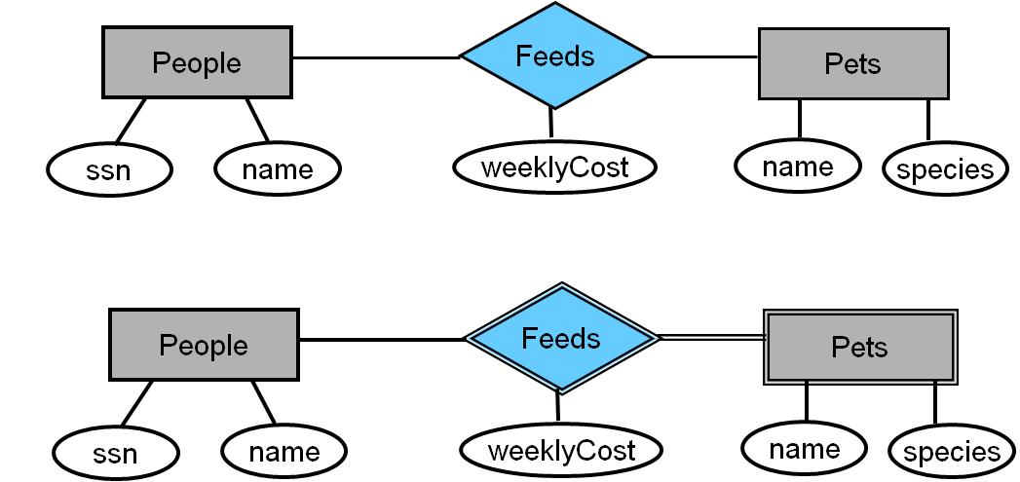
Question:
Examine the ER diagram of a database scenario which implements the following constraints:
Pets are fed by people.
There is a weekly cost of feeding pets.
Decide which of the following representations (a, or b) you would prefer to use and give your reasons. Explain what is implied by each design.
(a)
(b)
Notes:
B should be preferred. Because each pet’s survival (existence) is dependent on an owner who should feed it.
In the first one, a pet may not have an owner. Also pet name should be defined as a primary key. However, many pets could share same names.
In the second one, the pet can be defined by both the name and the owner. We assume that the owner may not have two pets with the same name.

Slide 44
Attributes of Relationship types
A relationship type can have attributes:
For example, HoursPerWeek of WORKS_ON
Its value for each relationship instance describes the number of hours per week that an EMPLOYEE works on a PROJECT.
A value of HoursPerWeek depends on a particular (employee, project) combination

Slide 45
Example Attribute of a Relationship Type: Hours of WORKS_ON

Slide 46
Constraints on Relationships
Constraints on Relationship Types
(Also known as ratio constraints)
Cardinality Ratio (specifies maximum participation)
One-to-one (1:1)
One-to-many (1:N) or Many-to-one (N:1)
Many-to-many (M:N)
Existence Dependency Constraint (specifies minimum participation) (also called participation constraint)
zero (optional participation, not existence-dependent)
one or more (mandatory participation, existence-dependent)

Slide 47
Notation for Constraints on Relationships
Cardinality ratio (of a binary relationship): 1:1, 1:N, N:1, or M:N
Shown by placing appropriate numbers on the relationship edges.
Participation constraint (on each participating entity type)
total (aka existence dependency) or partial.
Total shown by double line, partial by single line.
NOTE: These are easy to specify for Binary Relationship Types.

Slide 48
Alternative (min, max) notation for relationship structural constraints:
Specified on each participation of an entity type E in a relationship type R
Specifies that each entity e in E participates in at least min and at most max relationship instances in R
Default(no constraint): min=0, max=n (signifying no limit)
Must have min≤max, min≥0, max ≥1
Derived from the knowledge of mini-world constraints
Examples:
A department has exactly one manager and an employee can manage at most one department.
Specify (0,1) for participation of EMPLOYEE in MANAGES
Specify (1,1) for participation of DEPARTMENT in MANAGES
An employee can work for exactly one department but a department can have any number of employees.
Specify (1,1) for participation of EMPLOYEE in WORKS_FOR
Specify (1,n) for participation of DEPARTMENT in WORKS_FOR

Slide 49
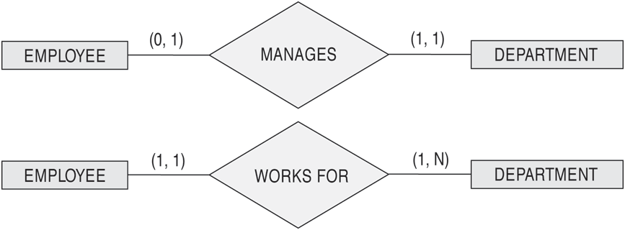
The (min,max) notation for relationship constraints
Read the min,max numbers next to the entity type and looking away from the entity type

Slide 50
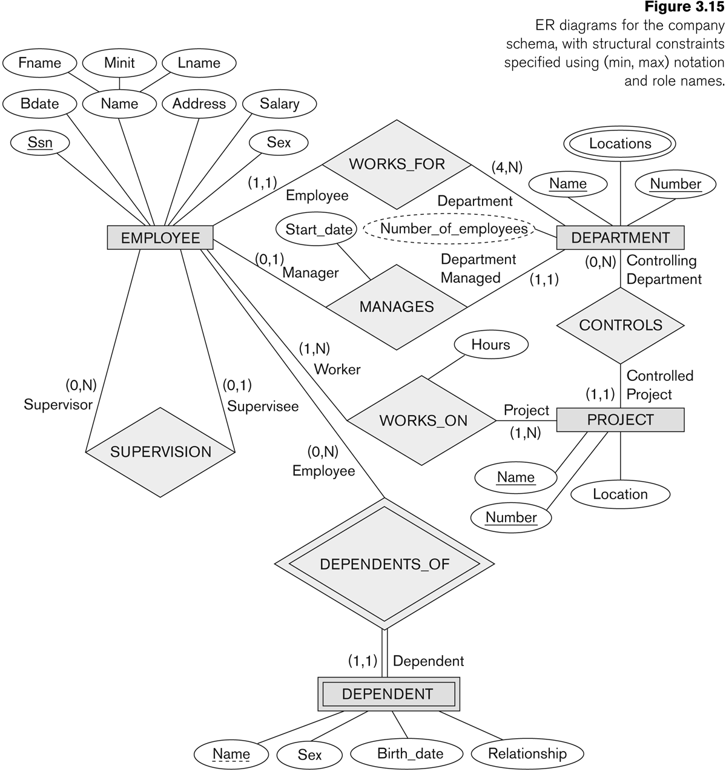
COMPANY ER Schema Diagram using (min, max) notation

Slide 51
Alternative diagrammatic notation
ER diagram is one popular example for displaying database schemas.
Many other notations exist in the literature and in various database design and modeling tools such as UML class diagrams.

Slide 52
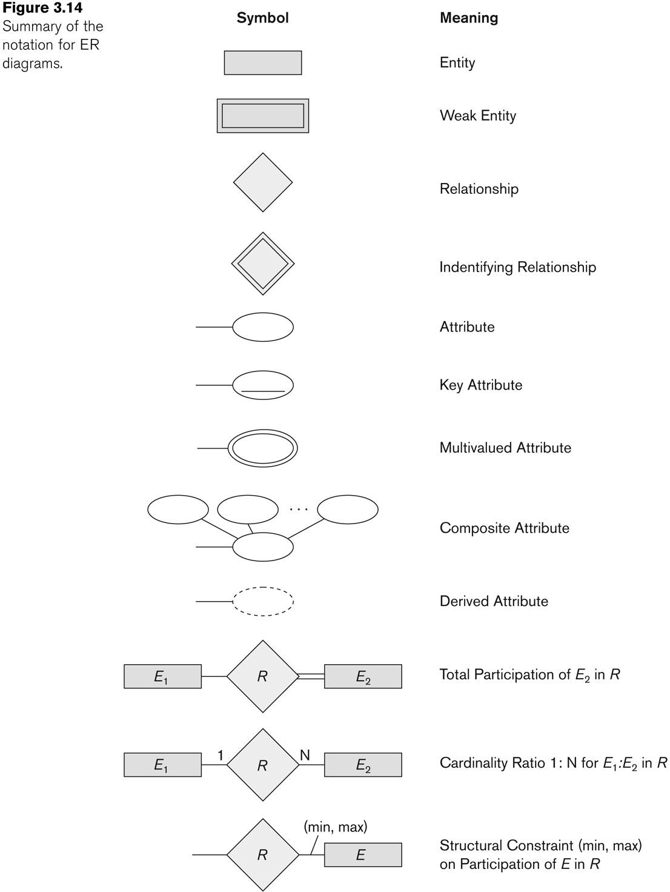
Summary of notation for ER diagrams

Slide 53
Line Types
Plain lines mean many to many and partial participation
Arrows mean the arrow side has a cardinality of one
(one to many)
Thick line requires total participation and can be added to any line, arrow or not
(one to many)

Slide 54
Relationships of Higher Degree
Relationship types of degree 2 are called binary
Relationship types of degree 3 are called ternary and of degree n are called n-ary
In general, an n-ary relationship is not equivalent to n binary relationships
Constraints are harder to specify for higher-degree relationships (n > 2) than for binary relationships

Slide 55
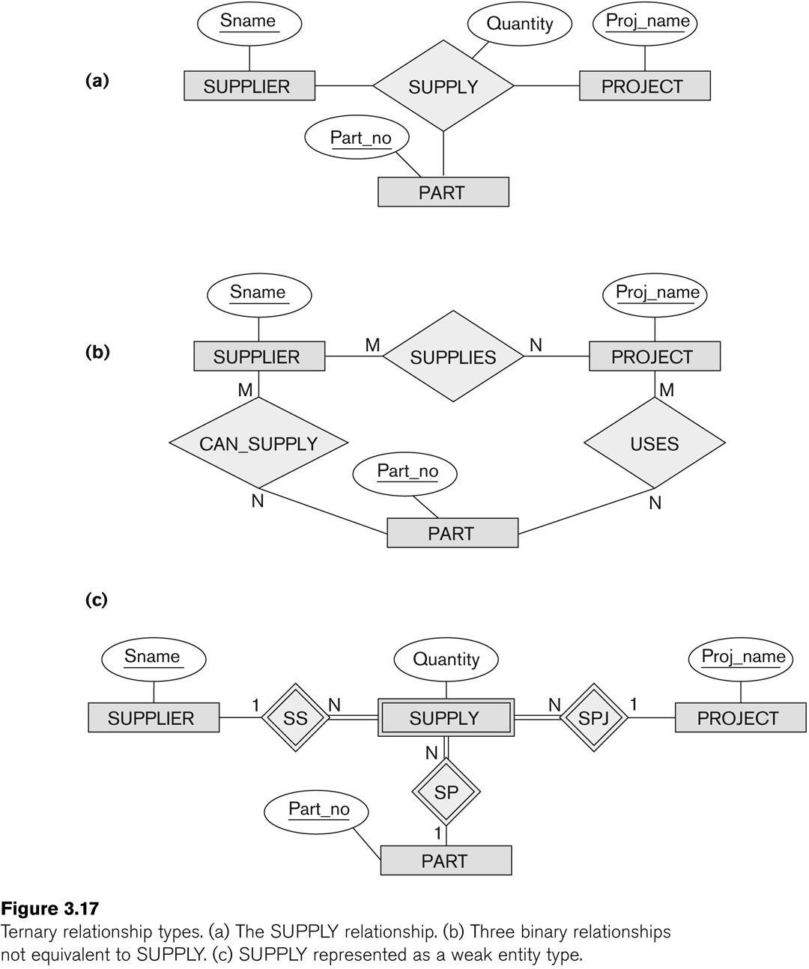
Example of a ternary relationship

Slide 56
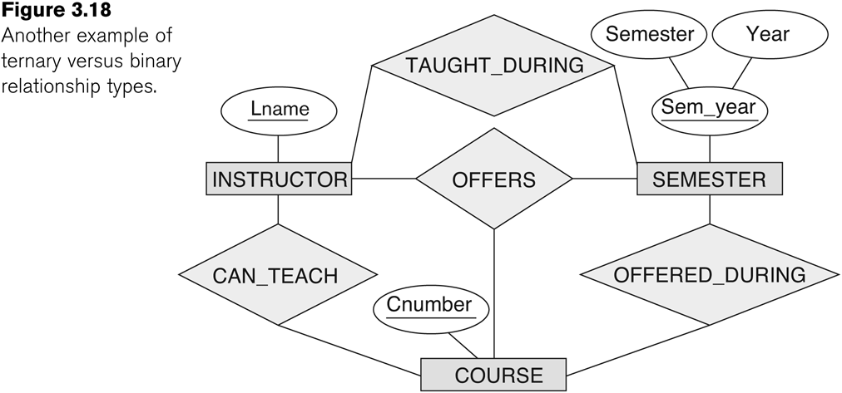
Discussion of n-ary relationships (n > 2)
If a particular binary relationship can be derived from a higher-degree relationship at all times, then it is redundant
E.g. the TAUGHT_DURING binary relationship can be derived from the ternary relationship OFFERS (based on the meaning of the relationships)

Slide 57
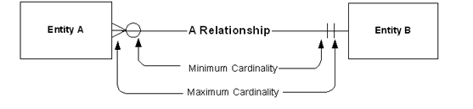
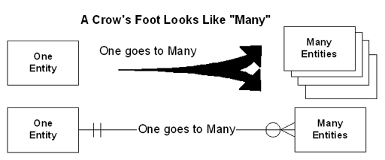
Crow’s foot notatıon
Ref: http://tdan.com/crows-feet-are-best/7474

Slide 58
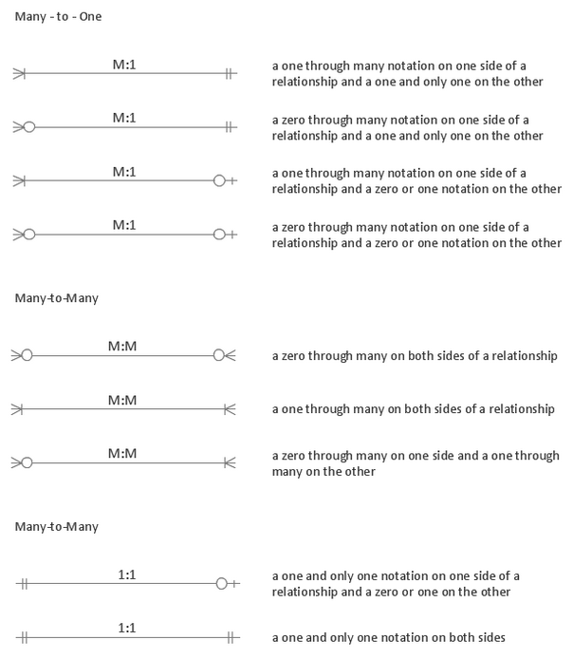
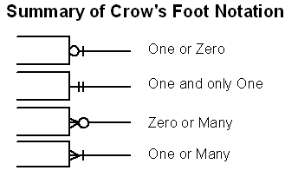
Crow’s foot notatıon
One-to-One
Ref: http://tdan.com/crows-feet-are-best/7474
Notes:
Ref: http://www.conceptdraw.com/examples/crowfoot-notation

Slide 59
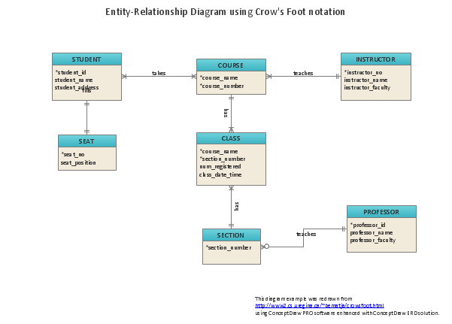
Crow’s foot notatıon

Slide 60
Design Issue 1
Entity sets vs. Attributes
depends on enterprise being modeled and the semantics of the data
Example : An auto for a person could be attribute whereas in a manufacturing plant it is an entity set.
Presentation slides of B.Ramamurthy

Slide 61
Design Issue 2
Entity vs Relationship
Relationship is to describe an action that occurs among entities.
Example 1: Author for a book company could be an entity whereas it is relationship between entity Person and Books
One of the ways to distinguish between entity and relationships is to use connectives such “for” , “of” :
Example : “Author of” instead “Author” explicitly puts that as a relationship than an entity.
Example 2 : “Works for” instead of “worker”
Presentation slides of B.Ramamurthy

Slide 62
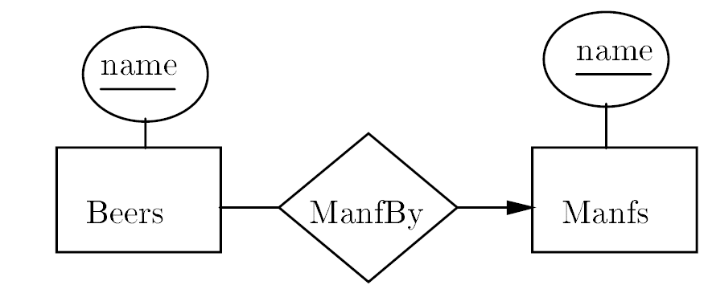
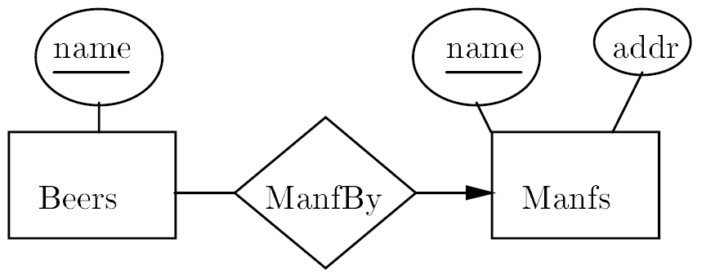
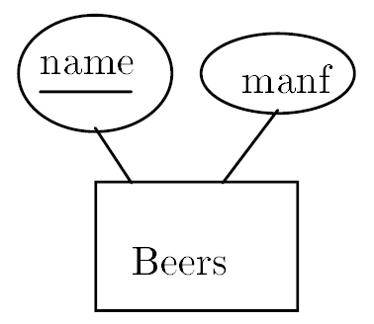
Design Issue 2
Which one of the representation would you prefer and why?
(a)
(c)
(b)
Notes:
http://infolab.stanford.edu/~ullman/fcdb/slides/slides2.pdf
a results in redundancy. Makes the database larger in a needless way
b is optimal.
c is also reasonable.
Manfs deserves to be an E.S. because we record addr, a nonkey attribute.
Beers deserves to be an E.S. because it is at the “many" end.
If not, we would have to make “set of beers" an attribute of Manfs | something we avoid doing, although some may tell you it is OK in E/R model

Slide 63
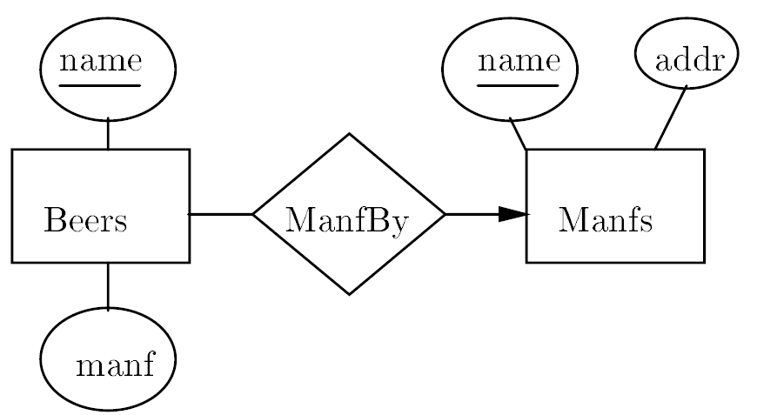
Design Issue 3
Avoid redundancy.
Consider the following ER.
Bad design since the manufacturer’s name said twice.
Notes:
Reference: http://infolab.stanford.edu/~ullman/fcdb/slides/slides2.pdf

Slide 64
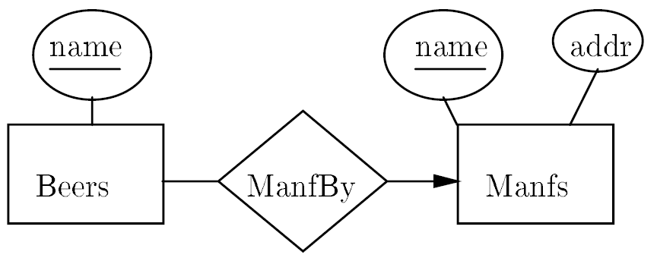
Design Issue 3
Avoid redundancy.
A good design:
Notes:
Reference: http://infolab.stanford.edu/~ullman/fcdb/slides/slides2.pdf

Slide 65
Classroom Exercise 1 Bioinformatics Application
Construct the ER model for the following scenario:
A Bioinformatics Application
Patient: has a unique MSP number, a Patient name, a Date of Birth, a Tissue Type and an indicator denoting whether the tissue is cancerous or normal.
A patient library associates a patient with multiple tags
Each tag has a unique tag number and a unique nucleotide sequence.
For each tag in the patient library, a count is given to record the number of times the tag occurs in the library. In general, the same tag can be associated with any number of patients.
A tag may be mapped to a gene. Each gene has a unique gene name and a type.
In general, multiple tags may be mapped to the same gene. However, two different genes cannot be mapped to the same tag.
Finally, an article is identified by a unique article number and a journal name. An article may analyze multiple genes and a gene may be analyzed by multiple articles.
MSP:medical service plan
Notes:
Reference: http://www.cs.albany.edu/~ganesh/cpsc304/ER-example.pdf
MSP: Medical services plan

Slide 66
Classroom Exercise 1 Bioinformatics Application
Entity Sets:
Patients - Attibutes are MSP Number, Name, DOB, Tissue Type and Indicator
Tags - Attributes are Tag Number and Nucleotide Sequence
Genes - Attributes are Gene Name and Type
Articles - Attributes are Article Number and Journal Name
Relationship Sets:
Patient Library - Many to Many, Has an attribute Count
Map - Many to 1 from Tags to Genes
Analyzes - Many to Many
Notes:
Reference: http://www.cs.albany.edu/~ganesh/cpsc304/ER-example.pdf

Slide 67
Classroom Exercise 1 Bioinformatics Application: ER Diagram
T-Type
MSPNo
NucSeq
Name
Count
DOB
Indic
TagNo
Patient
[1,M]
PatLib
[0,N]
Tags
[0,1]
Maps
[0,N]
Articles
[0,M]
Analyzes
[0,N]
Genes
ArtNo.
JName
Type
GName
Notes:
Reference: http://www.cs.albany.edu/~ganesh/cpsc304/ER-example.pdf

Slide 68

Classroom Exercise 2
Assume that an employee may work in up to two departments or may not be assigned to any department. Assume that each department must have one and may have up to three phone numbers. Supply (min, max) constraints on this diagram. State clearly any additional assumptions you make. Under what conditions would the relationship HAS_PHONE be redundant in this example?
Works_in
Employee
Department
Has_phone
Contains
Phone

Slide 69
Classroom Exercise 2
Assume that an employee may work in up to two departments or may not be assigned to any department. Assume that each department must have one and may have up to three phone numbers. Supply (min, max) constraints on this diagram. State clearly any additional assumptions you make. Under what conditions would the relationship HAS_PHONE be redundant in this example?
Works_in
Employee
Department
(0,2)
(1,n)
(0,6)
(1,3)
Has_phone
Contains
(1,n)
(1,1)
Phone
Notes:
My assumptions: A phone can belong to only one department.
A department may have any number of employees but should have at least one employee.
Each employee should have only one phone assigned.
An employee can have at least one at most six phone numbers.
Has_phone: It will be redundant if - Each employee is assigned all of the phones of each department that he/she works in.
- An employee cannot have any other phones outside the departments he/she works is.

Slide 70
Classroom Exercise 3
Assume that a course may or may not use a textbook, but that a text by definition is a book that is used in some course. A course may not use more than five books. Instructors teach from two to four courses. Supply (min, max) constraints on this diagram. State clearly any additional assumptions you make.
Teaches
Instructor
Course
Uses
Text

Slide 71
Classroom Exercise 3
Assume that a course may or may not use a textbook, but that a text by definition is a book that is used in some course. A course may not use more than five books. Instructors teach from two to four courses. Supply (min, max) constraints on this diagram. State clearly any additional assumptions you make.
Teaches
Instructor
Course
(2,4)
(1,1)
(0,5)
Uses
(1,n)
Text
Notes:
My assumptions: A course can only be taught by an instructor.
A textbook can be used in more than one courses or may not be adopted in any course at all.
If your assumption is that each textbook is used by one and only one course, then it will be (1,1).

Slide 72
Classroom Exercise 4
Consider the database design for the following problem:
The Leevmiya Loan company of Merchantville wants to design a database to track student loans. Each student attending school is eligible for a loan. A student may have more than one loan. A student may be registered, possibly at different times, in more than one school. Each loan should belong to only one bank. Each bank can approve as many loans as it desires. For each loan, the Leevmiya Loan Company will track: the student’s SSN, name, address, amount of loan, date of loan, interest rate (which may be different for each loan as determined by the bank), duration of loan, monthly payment, remaining balance, school ID, school name and address, number of years the student has been at the school, bank name, bank branch and bank ID.
Draw an ERD that includes entities, attributes, keys, and mapping constraints.
State any assumptions you make in the diagram.

Slide 73
amount
duration
name
date
address
İd
----
SSN
monthly payment
interest rate
Student
[0,M]
borrows
[1,1]
Loan
[1,M]
Remaining balance
[1,1]
Start_date
register
approves
[1,1]
end_date
[1,N]
[1,1]
[0,M]
Branch
has
[1,M]
Bank
School
School id
address
bank_id
name
Branch_id
---------
name
Notes:
Reference: http://www.pages.drexel.edu/~dcp23/E1Solution.htm
Assumption: Each loan to a student (for different schools) is given a unique loan_ID number.

