Slide 1
Chapter 11
Introduction to Transaction Processing Concepts and Theory

Slide 2
Chapter Outline
1 Introduction to Transaction Processing
2 Transaction and System Concepts
3 Desirable Properties of Transactions
4 Characterizing Schedules based on Recoverability
5 Characterizing Schedules based on Serializability
6 Transaction Support in SQL

Slide 3
1 Introduction to Transaction Processing (1)
Single-User System:
At most one user at a time can use the system.
Multiuser System:
Many users can access the system concurrently.
Concurrency
Interleaved processing:
Concurrent execution of processes is interleaved in a single CPU
Parallel processing:
Processes are concurrently executed in multiple CPUs.

Slide 4
1 Introduction to Transaction Processing (1)
Concurrency in databases
Transactions should occur in an ordered fashion.
Transactions should be executed without effecting the other transactions.
Concurrency allows multiple users to execute multiple transactions simultaneously.
Disallowing concurrent access can degrade performance

Slide 5
In a good DBMS
Concurrency should not cause anomalies
E.g. one travel agent looks up for flight 825 on April 2nd and finds an empty seat. Another agent simultaneously makes a reservation for that seat. The information seen by the first agent is obsolete.
At system crash, all data should be restored
At system crash during execution, intermediate steps and partial changes should be undone.

Slide 6
Introduction to Transaction Processing (2)
A Transaction:
Logical unit of database processing that includes one or more access operations (read -retrieval, write - insert or update, delete).
A transaction (set of operations) may be stand-alone specified in a high level language like SQL submitted interactively, or may be embedded within a program.
Transaction boundaries:Begin and End transaction.
An application program may contain several transactions separated by the Begin and End transaction boundaries.

Slide 7
Introduction to Transaction Processing (3)
SIMPLE MODEL OF A DATABASE (for purposes of discussing transactions):
A database is a collection of named data items (e.g. table, view)
Granularity of data - a field, a record , or a whole disk block (Concepts are independent of granularity)
SQL provides querying, inserting, deleting and updating operations. These utilize basic read and write operations.
read_item(X): Reads a database item named X into a program variable. To simplify our notation, we assume that the program variable is also named X.
write_item(X): Writes the value of program variable X into the database item named X.

Slide 8
Introduction to Transaction Processing (4)
READ AND WRITE OPERATIONS:
Basic unit of data transfer from the disk to the computer main memory is one block. In general, a data item (what is read or written) will be the field of some record in the database, although it may be a larger unit such as a record or even a whole block.
read_item(X) command includes the following steps:
Find the address of the disk block that contains item X.
Copy that disk block into a buffer in main memory (if that disk block is not already in some main memory buffer).
Copy item X from the buffer to the program variable named X.

Slide 9
Introduction to Transaction Processing (5)
READ AND WRITE OPERATIONS (contd.):
write_item(X) command includes the following steps:
Find the address of the disk block that contains item X.
Copy that disk block into a buffer in main memory (if that disk block is not already in some main memory buffer).
Copy item X from the program variable named X into its correct location in the buffer.
Store the updated block from the buffer back to disk (either immediately or at some later point in time).

Slide 10
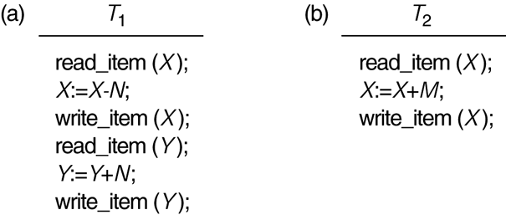
Two sample transactions
FIGURE 17.2 Two sample transactions:
(a) Transaction T1
(b) Transaction T2

Slide 11
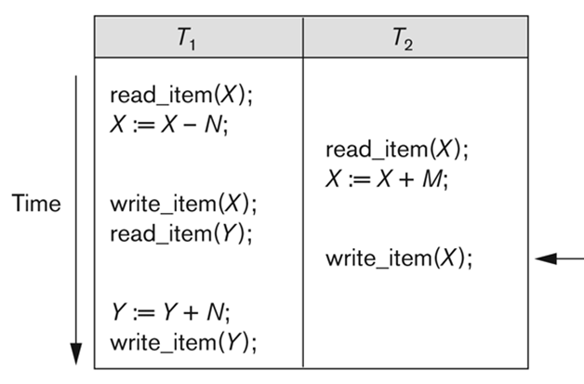
Why Concurrency Control is needed: WW
The Lost Update Problem - Write-Write conflict (WW)
when two transactions that access the same database items have their operations interleaved in a way that makes the value of some database item incorrect.
T1 modifies A , then T2 overrides A while T1 is in progress. Update of T1 is lost
Item X has an incorrect value because its update by T1 is lost (overridden)

Slide 12
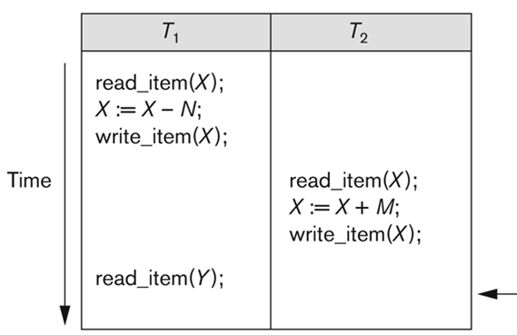
Why Concurrency Control is needed: WR
Temporary Update ( Dirty Read) Problem – WR conflict
when one transaction updates a database item and then the transaction fails for some reason.
The updated item is accessed by another transaction before it is changed back to its original value.
T1 fails and must change the value of X back to its old value; meanwhile T2 has read the temporary incorrect value of X

Slide 13
WR conflict : Reading uncommitted data
T1 changes A, T2 reads A, T1 is still in progress
Example: T1 transfers money from A to B. T2 adds %6 interest rate to all accounts.
T1 deducts 100 TL from A
T2 reads account balance of A and B.
T2 adds %6 to A and B
T1 adds 100 TL to B
→ 100TL transferred did not get any interest rate.

Slide 14
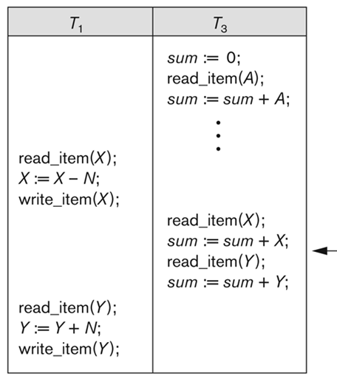
Why Concurrency Control is needed: RW
Unrepeatable Read Problem – RW conflict
T3 reads A, T1 changes A while T3 is in progress
One transaction is calculating an aggregate summary on a number of records while other transactions are updating some of these records, the aggregate function may calculate some values before they are updated and others after they are updated.
T3 reads X after N is subtracted and reads Y before N is added: a wrong summary is the result (off by N)

Slide 15
RW conflict : unrepeatable read
T1 reads A, T2 changes A while T1 is in progress
Example:
T1 reads the number of books, check if it is >0
T2 reads the number of books and decreases to 0
T1 decrements the number of books! ERROR

Slide 16
Why recovery is needed: What causes a Transaction to fail
1. A computer failure (system crash):
A hardware or software error occurs in the computer system during transaction execution. If the hardware crashes, the contents of the computer’s internal memory may be lost.
2. A transaction or system error:
Some operation in the transaction may cause it to fail, such as integer overflow or division by zero. Transaction failure may also occur because of erroneous parameter values or because of a logical programming error. In addition, the user may interrupt the transaction during its execution.

Slide 17
Why recovery is needed: What causes a Transaction to fail
3. Local errors or exception conditions detected by the transaction:
Certain conditions necessitate cancellation of the transaction. For example, data for the transaction may not be found. A condition, such as insufficient account balance in a banking database, may cause a transaction, such as a fund withdrawal from that account, to be canceled.
A programmed abort in the transaction causes it to fail.
4. Concurrency control enforcement:
The concurrency control method may decide to abort the transaction, to be restarted later, because it violates serializability or because several transactions are in a state of deadlock .

Slide 18
Why recovery is needed: What causes a Transaction to fail
5. Disk failure:
Some disk blocks may lose their data because of a read or write malfunction or because of a disk read/write head crash. This may happen during a read or a write operation of the transaction.
6. Physical problems and catastrophes:
This refers to an endless list of problems that includes power or air-conditioning failure, fire, theft, sabotage, overwriting disks or tapes by mistake, and mounting of a wrong tape by the operator.

Slide 19
2 Transaction and System Concepts (1)
A transaction is an atomic unit of work that is either completed in its entirety or not done at all.
For recovery purposes, the system needs to keep track of when the transaction starts, terminates, and commits or aborts.

Slide 20
Transaction and System Concepts (2)
Recovery manager keeps track of the following operations:
begin_transaction: This marks the beginning of transaction execution.
read or write: These specify read or write operations on the database items that are executed as part of a transaction.
end_transaction: This specifies that read and write transaction operations have ended and marks the end limit of transaction execution.
At this point it may be necessary to check whether the changes introduced by the transaction can be permanently applied to the database (commit) or whether the transaction has to be aborted because it violates concurrency control or for some other reason.

Slide 21
Transaction and System Concepts (3)
Recovery manager keeps track of the following operations (cont):
commit_transaction: This signals a successful end of the transaction so that any changes (updates) executed by the transaction can be safely committed to the database and will not be undone.
rollback (or abort): This signals that the transaction has ended unsuccessfully, so that any changes or effects that the transaction may have applied to the database must be undone.

Slide 22
Transaction and System Concepts (4)
Recovery techniques use the following operators:
undo: Similar to rollback except that it applies to a single operation rather than to a whole transaction.
redo: This specifies that certain transaction operations must be redone to ensure that all the operations of a committed transaction have been applied successfully to the database.

Slide 23
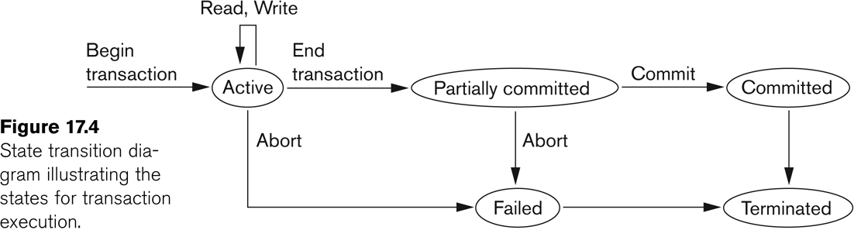
State transition diagram illustrating the states for transaction execution
Transaction states:
Active state, Partially committed state
Committed state, Failed state, Terminated State
Notes:
A transaction goes into an active state immediately after it starts execution, where it can issue READ and WRITE operations. When the transaction ends, it moves to the partially committed state. At this point, some recovery protocols need to ensure that a system failure will not result in an inability to record the changes of the transaction permanently. Once this check is successful, the transaction is said to have reached its commit point and enters the committed state. Once a transaction is committed, it has concluded its execution successfully and all its changes must be recorded permanently in the database.

Slide 24

Transaction and System Concepts
Memory
area
T1
T2
T3
T4
committed
Permanent disk
Transactions work within their memory space until they reach a commit point. When they are committed, the changes made by the transactions are permanently stored on the disk. Then other transactions read the updated values.

Slide 25
Transaction and System Concepts : The System Log
Log or Journal: The log keeps track of all transaction operations that affect the values of database items.
This information may be needed to permit recovery from transaction failures.
The log is kept on disk, so it is not affected by any type of failure except for disk or catastrophic failure.
In addition, the log is periodically backed up to archival storage to guard against such catastrophic failures.

Slide 26
Transaction and System Concepts : The System Log (cont)
T in the following discussion refers to a unique transaction-id that is generated automatically by the system and is used to identify each transaction:
Types of log record:
[start_transaction,T]: Records that transaction T has started execution.
[write_item,T,X,old_value,new_value]: Records that transaction T has changed the value of database item X from old_value to new_value.
[read_item,T,X]: Records that transaction T has read the value of database item X.
[commit,T]: Records that transaction T has completed successfully, and affirms that its effect can be committed (recorded permanently) to the database.
[abort,T]: Records that transaction T has been aborted.
Protocols for recovery that avoid cascading rollbacks do not require that Read operations be written to the system log, whereas other protocols require these entries for recovery.
Notes:
Protocols for recovery that avoid cascading rollbacks –which include nearly all practical protocols – do not require that READ operations be written to the system log. However, if the log is also used for other purposes – such as auditing (keeping track of all database operations) – then such entries can be included.

Slide 27
Transaction and System Concepts (9)
Recovery using log records:
If the system crashes, we can recover to a consistent database state by examining the log and using one of the concurrency control techniques.
Because the log contains a record of every write operation that changes the value of some database item, it is possible to undo the effect of these write operations of a transaction T by tracing backward through the log and resetting all items changed by a write operation of T to their old_values.
We can also redo the effect of the write operations of a transaction T by tracing forward through the log and setting all items changed by a write operation of T (that did not get done permanently) to their new_values.

Slide 28
Transaction and System Concepts (10)
Commit Point of a Transaction:
Definition a Commit Point:
A transaction T reaches its commit point when all its operations that access the database have been executed successfully and the effect of all the transaction operations on the database has been recorded in the log.
Beyond the commit point, the transaction is said to be committed, and its effect is assumed to be permanently recorded in the database.
The transaction then writes an entry [commit,T] into the log.

Slide 29
Transaction and System Concepts (10)
In case of a system problem, transactions are either
Committed or
Not committed
For transactions that are not committed yet:
Roll Back of transactions:
Needed for transactions that have a [start_transaction,T] entry into the log but no commit entry [commit,T] into the log.
For transactions that are committed
Redoing transactions:
Transactions that have written their commit entry in the log must also have recorded all their write operations in the log; otherwise they would not be committed, so their effect on the database can be redone from the log entries. (Notice that the log file must be kept on disk.)
At the time of a system crash, only the log entries that have been written back to disk are considered in the recovery process because the contents of main memory may be lost.

Slide 30
Transaction and System Concepts (10)
Memory
area
T1
T2
T3
T4
committed
Permanent disk
Transactions work within their memory space until they reach a commit point. When they are committed, the changes made by the transactions are permanently stored on the disk. Then other transactions read the updated values.

Slide 31
Transaction and System Concepts (11)
Force writing a log:
Before a transaction reaches its commit point, any portion of the log that has not been written to the disk yet must now be written to the disk.
This process is called force-writing the log file before committing a transaction.

Slide 32
3 Desirable Properties of Transactions: ACID properties
ACID properties:
Atomicity: A transaction is an atomic unit of processing; it is either performed in its entirety or not performed at all.
Consistency preservation: A correct execution of the transaction must take the database from one consistent state to another.
Isolation: A transaction should not make its updates visible to other transactions until it is committed; this property, when enforced strictly, solves the temporary update problem and makes cascading rollbacks of transactions unnecessary.
Durability or permanency: Once a transaction changes the database and the changes are committed, these changes must never be lost because of subsequent failure.

Slide 33
4 Characterizing Schedules based on Recoverability (1)
Transaction schedule or history:
When transactions are executing concurrently in an interleaved fashion, the order of execution of operations from the various transactions forms what is known as a transaction schedule (or history).
A schedule (or history) S of n transactions T1, T2, …, Tn:
It is an ordering of the operations of the transactions subject to the constraint that, for each transaction Ti that participates in S, the operations of Ti in S must appear in the same order in which they occur in Ti.
Note, however, that operations from other transactions Tj can be interleaved with the operations of Ti in S.

Slide 34
Characterizing Schedules based on Recoverability (2)
Schedules classified on recoverability:
Recoverable schedule:
A schedule S is recoverable if no transaction T in S commits until all transactions T’ that have written an item that T reads have committed.
E.g. in a recoverable schedule if T2 reads item X from T1 then T2 may not commit before T1 commit.
No committed transactions read data written by aborted transactions
Effects of the aborted transactions do not exist in the resulting database states
Notes:
Recoverability means that committed transactions have not read data written by aborted transactions (whose effects do not exist in the resulting database states).

Slide 35
Characterizing Schedules based on Recoverability (2)
Recoverable schedule:
Consider the following schedule.
T1
Begin transaction
R(X)
X=X+10, W(X)
R(Y)
End transaction
Commit
T2
Begin transaction
R(Y)
Y=Y+5, W(Y)
End transaction
Commit
T3
Begin transaction
W(X)
R(Y)
End transaction
Commit
Time
T3 aborted

Slide 36
Characterizing Schedules based on Recoverability (2)
Memory
(initial values: X=6, Y=13)
T3 writes X as 10
T1 reads X as 10
T2 reads Y as 13
T1 writes X as 20
T2 writes Y as 18
T1 reads Y as 18
T1 commits and writes X permanently on the disk
T3 is aborted because of a failure
T1 calculated the values using incorrect values.
NOT RECOVERABLE SCHEDULE.
T1
Begin transaction
R(X)
X=X+10, W(X)
R(Y)
End transaction
Commit
T2
Begin transaction
R(Y)
Y=Y+5, W(Y)
End transaction
Commit
T3
Begin transaction
W(X)
R(Y)
End transaction
Commit
Time
T3 aborted

Slide 37
Characterizing Schedules based on Recoverability (2)
Recoverable schedule:
Consider the following schedule.
T1
Begin transaction
R(X)
W(X)
R(Y)
End transaction
Commit
T2
Begin transaction
R(Y)
W(Y)
End transaction
Commit
T3
Begin transaction
W(X)
R(Y)
End transaction
Commit
RECOVERABLE SCHEDULE
Time
T1 aborted

Slide 38
Characterizing Schedules based on Recoverability (2)
Recoverable schedule:
S_{a}: r₁(X);
r₂(X);
w₁(X);
r₁(Y);
w₂(X);
c₂;
w₁(Y);
c₁;
This schedule is recoverable, even though it suffers from the lost update problem.
“S is recoverable if no transaction T in S commits until all transactions T’ that have written an item that T reads have committed.”
T1 does not read from T2.
T2 does not read from T1.
Since no transaction has read a value written by a committed transaction, there is no problem
ABORT
Notes:
Sa:
W1(x) is done prior to T2’s operation but the value is overwritten to T2’s operation.
A transaction T reads from transaction T’ in a schedule S if some item X is first written by T’ and later read by T. In addition, T’ should not have been aborted before T reads item X, and there should be no transactions that write X after T’ writes it and before T reads it.
If c2 is aborted, c1 does not need to recover anything since there is no commit.

Slide 39
Characterizing Schedules based on Recoverability (2)
Recoverable schedule:
S_{c}: r₁(X); w₁(X); r₂(X); r₁(Y); w₂(X);c₂; a₁;
Is this schedule recoverable? Why or why not?
Recoverable:
S_{d}: r₁(X); w₁(X); r₂(X); r₁(Y); w₂(X); w₁(Y); c₁; c₂;
In a recoverable schedule, no committed transaction ever needs to be rolled back.
Notes:
Sc:
No, because T2 reads item X from T1 and then T2 commits before T1 commits. If T1 aborts after the c2 operation in Sc, then the value of X that T2 read is no longer valid and T2 must be aborted after it had been committed, leading to a schedule that is not recoverable. For the schedule to be recoverable, the c2 operation in Sc must be postponed until after T1 commits.
In a recoverable schedule, no committed transaction ever needs to be rolled back.

Slide 40
Characterizing Schedules based on Recoverability (3)
Schedules classified on recoverability (contd.):
Schedules requiring cascaded rollback:
A schedule in which uncommitted transactions that read an item from a failed transaction must be rolled back.

Slide 41
Characterizing Schedules based on Recoverability (3)
Schedules requiring cascaded rollback:
A schedule in which uncommitted transactions that read an item from a failed transaction must be rolled back.
S_{e}: r₁(X); w₁(X); r₂(X); r₁(Y); w₂(X); w₁(Y); a₁; a₂;
If T1 aborts instead of committing, then T2 should also abort as shown in Se, because the value of X it reads is no longer valid.

Slide 42
Characterizing Schedules based on Recoverability (2)
Schedules classified on recoverability:
Cascadeless schedule:
every transaction reads only the items that are written by committed transactions.
To satisfy this criterion, the r₂(X) command in schedules S_{d} and S_{e} must be postponed until after T₁ has committed (or aborted), thus delaying T₂ but ensuring no cascading rollback if T₁ aborts.
S_{d}: r₁(X); w₁(X); r₂(X); r₁(Y); w₂(X); w₁(Y); c₁; c₂;
S_{e}: r₁(X); w₁(X); r₂(X); r₁(Y); w₂(X); w₁(Y); a₁; a₂;
CASCADELESS SCHEDULE:
S_{e}: r₁(X); w₁(X); r₁(Y); w₂(X); w₁(Y); a₁; r₂(X); a₂;

Slide 43
Characterizing Schedules based on Recoverability (2)
Cascadeless schedule:
The modified version. The result is a cascadeless schedule:
T1
Begin transaction
R(X)
W(X)
R(Y)
End transaction
Commit
T2
Begin transaction
R(Y)
W(Y)
End transaction
Commit
T3
Begin transaction
W(X)
R(Y)
End transaction
Commit
Time

Slide 44
Characterizing Schedules based on Recoverability (3)
Schedules classified on recoverability (contd.):
Strict Schedules:
A schedule in which a transaction can neither read or write an item X until the last transaction that wrote X has committed.

Slide 45
Characterizing Schedules based on Recoverability (3)
Strict Schedules:
Ex: S_{f}: w₁(X,5); w₂(X,8);c₁;c2;
Initialize X=9, set X=5, then X=8, commit all.
Ex: S_{f}: w₁(X,5); w₂(X,8);a₁ ;c2;
Initialize X=9, set X=5, then X=8. When X=8, T1 is aborted but T2 is committed.
Rollback T1. Do nothing with T2.
X will be converted to 9, its initial value.
Leading to potential incorrect results.
T2 will not be able to change it to 8 any more.

Slide 46
Characterizing Schedules based on Recoverability (2)
Strict schedule:
The modified version:
T1
Begin transaction
R(X)
W(X)
R(Y)
End transaction
Commit
T2
Begin transaction
R(Y)
W(Y)
End transaction
Commit
T3
Begin transaction
W(X)
R(Y)
End transaction
Commit
Time

Slide 47
Example:
Consider the schedules S1 and S2. Determine whether each schedule is strict, cascadeless, recoverable or nonrecoverable.
S1: R1(Y); R1(Z); R2(X); W1(Y); W2(X); R3(Z); W1(Z); C1; R3(X); W3(X); R2(Y); R3(Y); W2(Y); C2; W3(Y); C3;
S2: R1(Y); R1(Z); R2(X); W2(X); W1(Y); W1(Z); C1; R3(Z); R3(X); W3(X); R3(Y); W2(Y); R2(Y); C2; W3(Y); C3;
Notes:
For S2:
The schedule is recoverable.
The Schedule is not strict.
The Schedule is not cascadeless.

Slide 48
Example:
S1: R1(Y); R1(Z); R2(X); W1(Y); W2(X); R3(Z); W1(Z); C1; R3(X); W3(X); R2(Y); R3(Y); W2(Y); C2; W3(Y); C3;
The schedule S1 is recoverable.
A schedule S is recoverable if no transaction T in S commits until all transactions T’ that have written an item that T reads have committed.
Since all transactions reading the committed write operations, no transaction is required to be rolled back.
The schedule S1 is not strict
Recall that a strict schedule is a schedule in which a transaction can neither read or write an item X until the last transaction that wrote X has committed.
The schedule S1 is not cascadeless.
Recall that a cascadeless schedule is the one where every transaction reads only the items that are written by committed transactions.

Slide 49
Example:
S2: R1(Y); R1(Z); R2(X); W2(X); W1(Y); W1(Z); C1; R3(Z); R3(X); W3(X); R3(Y); W2(Y); R2(Y); C2; W3(Y); C3;
The schedule is recoverable.
The Schedule is not strict.
The Schedule is not cascadeless.

Slide 50
5 Characterizing Schedules based on Serializability (1)
Serial schedule:
A schedule S is serial if, for every transaction T participating in the schedule, all the operations of T are executed consecutively in the schedule.
Otherwise, the schedule is called nonserial schedule.
Serializable schedule:
A schedule S is serializable if it is equivalent to some serial schedule of the same n transactions.

Slide 51
Characterizing Schedules based on Serializability (2)
A Serial schedule:
T1
Begin transaction
R(X)
W(X)
R(Y)
End transaction
Commit
T2
Begin transaction
R(Y)
W(Y)
End transaction
Commit
T3
Begin transaction
W(X)
R(Y)
End transaction
Commit
Time

Slide 52
Characterizing Schedules based on Serializability (2)
Being serializable is not the same as being serial
Being serializable implies that the schedule is a correct schedule.
It will leave the database in a consistent state.
The interleaving is appropriate and will result in a state as if the transactions were serially executed, yet will achieve efficiency due to concurrent execution.

Slide 53
Characterizing Schedules based on Serializability (3)
Serializability is hard to check.
Interleaving of operations occurs in an operating system through some scheduler
Difficult to determine beforehand how the operations in a schedule will be interleaved.

Slide 54
Characterizing Schedules based on Serializability (4)
Practical approach:
Come up with methods (protocols) to ensure serializability.
It’s not possible to determine when a schedule begins and when it ends.
Hence, we reduce the problem of checking the whole schedule to checking only a committed project of the schedule (i.e. operations from only the committed transactions.)
Current approach used in most DBMSs:
Use of locks with two phase locking

Slide 55
Characterizing Schedules based on Serializability (5)
Serializability options:
Result equivalent:
Two schedules are called result equivalent if they produce the same final state of the database.
View serializable
Conflict serializable
Least stringent

Slide 56
Characterizing Schedules based on Serializability (7)
Result equivalent schedules: Assume that initial values of X=6 and Y=13
Schedule 1:
Schedule 2:
T1
Begin transaction
R(X)
X=X-10, W(X)
R(Y)
End transaction
Commit
T2
Begin transaction
R(Y)
Y=Y+5, W(Y)
End transaction
Commit
T1
Begin transaction
R(X)
X=X-10, W(X)
R(Y)
End transaction
Commit
T2
Begin transaction
R(Y)
Y=Y+5, W(Y)
End transaction
Commit
Last state: X=-4 and Y=18
Last state: X=-4 and Y=18

Slide 57
Characterizing Schedules based on Serializability (7)
Not result equivalent schedules: Assume that initial value of X=100 and Y=13, seems OK with the current values but see next slide....
Schedule 1:
Schedule 2:
T1
Begin transaction
R(X)
X=X*1.1, W(X)
R(Y)
End transaction
Commit
T2
Begin transaction
R(Y)
Y=Y+5, W(Y)
End transaction
Commit
T1
Begin transaction
R(X)
X=X+10, W(X)
R(Y)
End transaction
Commit
T2
Begin transaction
R(Y)
Y=Y+5, W(Y)
End transaction
Commit
Last state: X=110 and Y=18
Last state: X=110 and Y=18

Slide 58
Characterizing Schedules based on Serializability (7)
Not result equivalent schedules: Assume that initial value of X=110 and Y=13
Schedule 1:
Schedule 2:
T1
Begin transaction
R(X)
X=X*1.1, W(X)
R(Y)
End transaction
Commit
T2
Begin transaction
R(Y)
Y=Y+5, W(Y)
End transaction
Commit
T1
Begin transaction
R(X)
X=X+10, W(X)
R(Y)
End transaction
Commit
T2
Begin transaction
R(Y)
Y=Y+5, W(Y)
End transaction
Commit
Last state: X=121 and Y=18
Last state: X=120 and Y=18

Slide 59
Characterizing Schedules based on Serializability
Serializability options:
Result equivalent:
Two schedules are called result equivalent if they produce the same final state of the database.
View serializability:
Definition of serializability based on view equivalence.
A schedule is view serializable if it is view equivalent to a serial schedule.
Least stringent
Moderate stringent

Slide 60
Characterizing Schedules based on Serializability (7)
Two schedules are said to be view equivalent if the following three conditions hold:
The same set of transactions participates in S and S’, and S and S’ include the same operations of those transactions.
For any operation Ri(X) of Ti in S, if the value of X read by the operation has been written by an operation Wj(X) of Tj (or if it is the original value of X before the schedule started), the same condition must hold for the value of X read by operation Ri(X) of Ti in S’.
If the operation Wk(Y) of Tk is the last operation to write item Y in S, then Wk(Y) of Tk must also be the last operation to write item Y in S’.

Slide 61
Characterizing Schedules based on Serializability (7)
View equivalent schedules: Assume that initial values of X=6 and Y=13.
View equivalent serialized schedule of Schedule 1: T2->T1
Schedule 1:
Schedule 2:
T1
Begin transaction
R(X)
X=X-10, W(X)
R(Y)
End transaction
Commit
T2
Begin transaction
R(Y)
Y=Y+5, W(Y)
End transaction
Commit
T1
Begin transaction
R(X)
X=X-10, W(X)
R(Y)
End transaction
Commit
T2
Begin transaction
R(Y)
Y=Y+5, W(Y)
End transaction
Commit
Last state: X=-4 and Y=18
Last state: X=-4 and Y=18

Slide 62
Characterizing Schedules based on Serializability (7)
View equivalent schedules: Assume that initial values of X=6 and Y=13.
View equivalent serialized schedule of Schedule 1: T2->T1
Schedule 1:
Schedule 2: T2->T1
T1
Begin transaction
R(X)
X=X-10, W(X)
R(Y)
X=X*Y, W(X)
End transaction
Commit
T2
Begin transaction
R(Y)
R(X)
Y=Y*X, W(Y)
End transaction
Commit
Begin transaction(2)
R2(Y)
R2(X)
Y=Y*X, W2(Y)
End transaction(2)
Commit(2)
Begin transaction(1)
R1(X)
X=X-10, W1(X)
R1(Y)
X=X*Y, W1(X)
End transaction(1)
Commit(1)
Last state: X=-312 and Y=78
Last state: X=-312 and Y=78
Notes:
x=-4 y=78
X=-312

Slide 63
Characterizing Schedules based on Serializability (7)
Assume that initial values of X=6 and Y=13.
There is no view equivalent serialized schedule of Schedule 1.
Schedule 1:
Schedule 2: T2->T1
T1
Begin transaction
R(X)
X=X-10, W(X)
R(Y)
X=X*Y, W(X)
End transaction
Commit
T2
Begin transaction
R(Y)
R(X)
Y=Y*X, W(Y)
End transaction
Commit
Begin transaction(2)
R2(Y)
R2(X)
Y=Y*X, W2(Y)
End transaction(2)
Commit(2)
Begin transaction(1)
R1(X)
X=X-10, W1(X)
R1(Y)
X=X*Y, W1(X)
End transaction(1)
Commit(1)
Last state: X=288 and Y=-72
Last state: X=-312 and Y=78
Notes:
x=-4 y=78
X=-312

Slide 64
Characterizing Schedules based on Serializability (7)
Assume that initial values of X=6 and Y=13.
There is no view equivalent serialized schedule of Schedule 1.
Schedule 1:
Schedule 2: T1->T2
T1
Begin transaction
R(X)
X=X-10, W(X)
R(Y)
X=X*Y, W(X)
End transaction
Commit
T2
Begin transaction
R(Y)
R(X)
Y=Y*X, W(Y)
End transaction
Commit
Begin transaction(1)
R1(X)
X=X-10, W1(X)
R1(Y)
X=X*Y, W1(X)
End transaction(1)
Commit(1)
Begin transaction(2)
R2(Y)
R2(X)
Y=Y*X, W2(Y)
End transaction(2)
Commit(2)
Last state: X=288 and Y=-72
Last state: X=-72 and Y=936
Notes:
x=-4 y=78
X=-312

Slide 65
Characterizing Schedules based on Serializability (8)
The premise behind view equivalence:
As long as each read operation of a transaction reads the result of the same write operation in both schedules, the write operations of each transaction must produce the same results.
“The view”: the read operations are said to see the same view in both schedules.

Slide 66
Characterizing Schedules based on Serializability
Serializability options:
Conflict equivalent:
Two schedules are said to be conflict equivalent if the order of any two conflicting operations (write operations) is the same in both schedules.
Conflict serializable:
A schedule S is said to be conflict serializable if it is conflict equivalent to some serial schedule S’.
Most stringent
Conflicts: w1(x)w2(x), r1(x)w2(x), w1(x)r2(x)

Slide 67
Characterizing Schedules based on Serializability (5)
Serializability options:
If a schedule is less strict, you will get higher concurrency.
Less strict schedule -> higher concurrency

Slide 68
Characterizing Schedules based on Serializability (9)
Relationship between view and conflict equivalence:
Conflict serializability is stricter than view serializability.
Any conflict serializable schedule is also view serializable, but not vice versa.
With unconstrained write (or blind write), a schedule that is view serializable is not necessarily conflict serializable.
The two are same under constrained write assumption which assumes that if T writes X, it is constrained by the value of X it reads;
i.e., new X = f(old X)

Slide 69
Characterizing Schedules based on Serializability (10)
Relationship between view and conflict equivalence (cont):
Consider the following schedule of three transactions
T1: r1(X), w1(X); T2: w2(X); and T3: w3(X):
Schedule Sa: r1(X); w2(X); w1(X); w3(X); c1; c2; c3;
In Sa, the operations w2(X) and w3(X) are blind writes, since T2 and T3 do not read the value of X.
Sa is view serializable, since it is view equivalent to the serial schedule T1, T2, T3.
However, Sa is not conflict serializable, since it is not conflict equivalent to any serial schedule.
Notes:
R1(x)=10
W1(x)=20
W2(x)=30
W3(x)=40

Slide 70
Characterizing Schedules based on Serializability (7)
Conflict equivalent schedules: Assume that initial values of X=6 and Y=13.
Conflict equivalent serialized schedule of Schedule 1: T2->T1
Schedule 1:
Schedule 2:
T1
Begin transaction
R(X)
X=X-10, W(X)
R(Y)
Y=Y+14, W(Y)
End transaction
Commit
T2
Begin transaction
R(Y)
Y=Y+5, W(Y)
End transaction
Commit
T1
Begin transaction
R(X)
X=X-10, W(X)
R(Y)
Y=Y+14, W(Y)
End transaction
Commit
T2
Begin transaction
R(Y)
Y=Y+5, W(Y)
End transaction
Commit
Last state: X=-4 and Y=32
Last state: X=-4 and Y=32

Slide 71
Characterizing Schedules based on Serializability (7)
Assume that initial values of X=6 and Y=13.
There is no equivalent serial schedule.
Schedule 2: T2->T1
Schedule 1:
T1
Begin transaction
R(X)
X=X-10, W(X)
R(Y)
R(X)
Y=Y*X, W(Y)
End transaction
Commit
T2
Begin transaction
R(Y)
Y=Y+5, W(Y)
R(X)
X=X*Y, W(X)
End transaction
Commit
Begin transaction(2)
R2(Y)
Y=Y+5, W2(Y)
R2(X)
X=X*Y, W2(X)
End transaction(2)
Commit(2)
Begin transaction(1)
R1(X)
X=X-10, W1(X)
R1(Y)
R1(X)
Y= X*Y, W1(Y)
End transaction(1)
Commit(1)
Last state: X=-72and Y=-1296
Last state: X=98 and Y=1764
Notes:
x=98
y=18

Slide 72
Characterizing Schedules based on Serializability (7)
Assume that initial values of X=6 and Y=13.
There is no equivalent serial schedule.
Schedule 3: T1->T2
Schedule 1:
T1
Begin transaction
R(X)
X=X-10, W(X)
R(Y)
Y=Y*X, W(Y)
End transaction
Commit
T2
Begin transaction
R(Y)
Y=Y+5, W(Y)
R(X)
X=X*Y, W(X)
End transaction
Commit
Begin transaction(1)
R1(X)
X=X-10, W1(X)
R1(Y)
Y= X*Y, W1(Y)
End transaction(1)
Commit(1)
Begin transaction(2)
R2(Y)
Y=Y+5, W2(Y)
R2(X)
X=X*Y, W2(X)
End transaction(2)
Commit(2)
Last state: X=-72and Y=-1296
Last state: X=268and Y=1072
Notes:
X:-4
Y:-67

Slide 73
Characterizing Schedules based on Serializability (11)
Testing for conflict serializability: Algorithm 17.1:
Looks at only read(X) and write (X) operations
Constructs a precedence graph (serialization graph) - a graph with directed edges
An edge is created from Ti to Tj if one of the operations in Ti appears before a conflicting operation in Tj
Before, not necessarily consecutive
The schedule is serializable if and only if the precedence graph has no cycles.

Slide 74
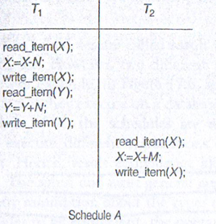
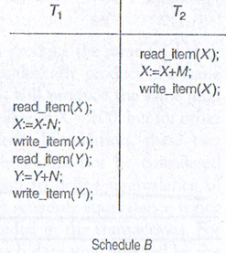
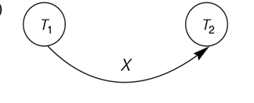
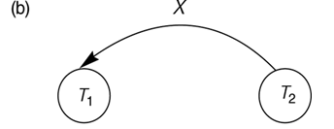
Constructing the Precedence Graphs
w1(x), r2(x)
w2(x)w1(X)

Slide 75
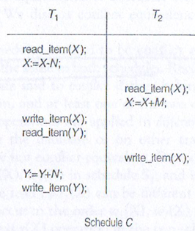
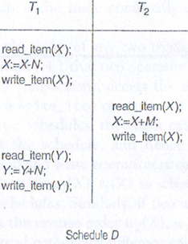
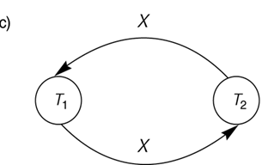
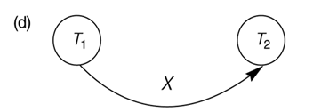
Constructing the Precedence Graphs

Slide 76
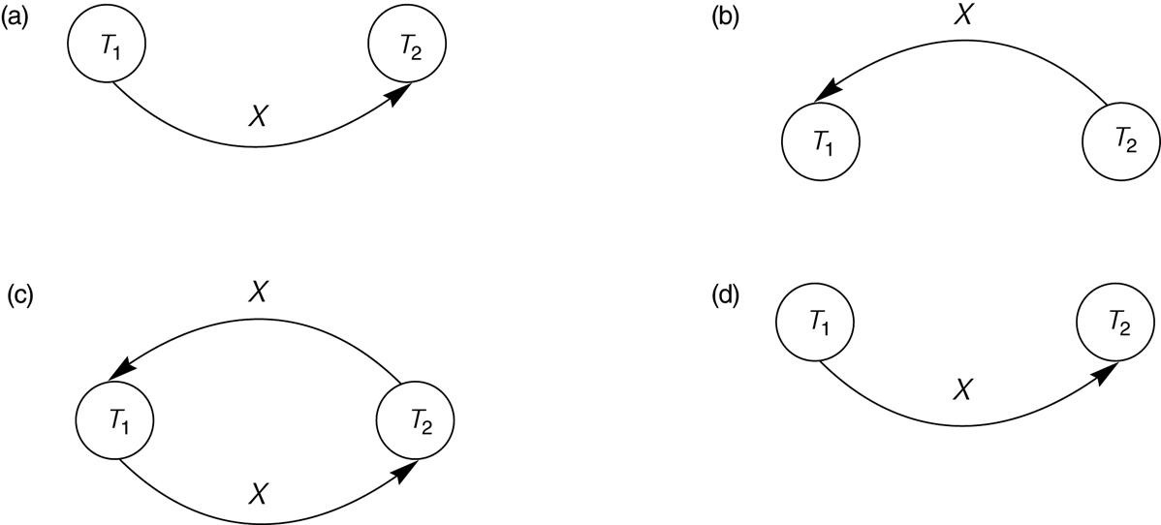
Constructing the Precedence Graphs
FIGURE 17.7 Constructing the precedence graphs for schedules A and D from Figure 17.5 to test for conflict serializability.
(a) Precedence graph for serial schedule A.
(b) Precedence graph for serial schedule B.
(c) Precedence graph for schedule C (not serializable).
(d) Precedence graph for schedule D (serializable, equivalent to schedule A).

Slide 77
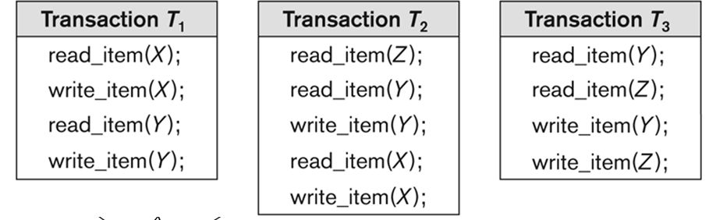
Another example of serializability Testing
Consider the 2 following schedules

Slide 78
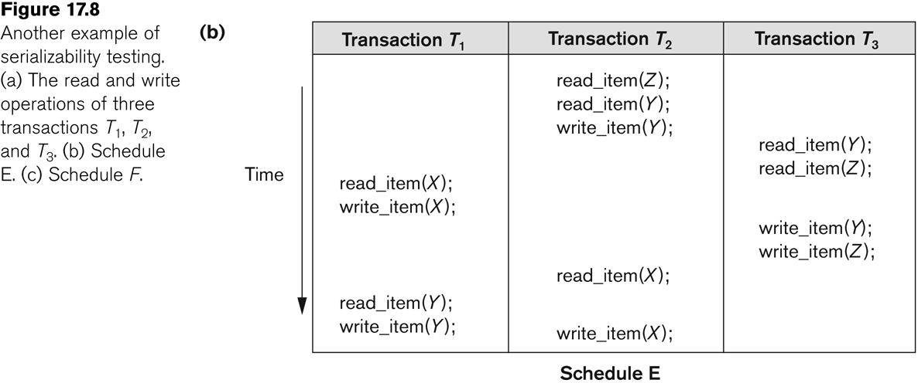
Another Example of Serializability Testing

Slide 79
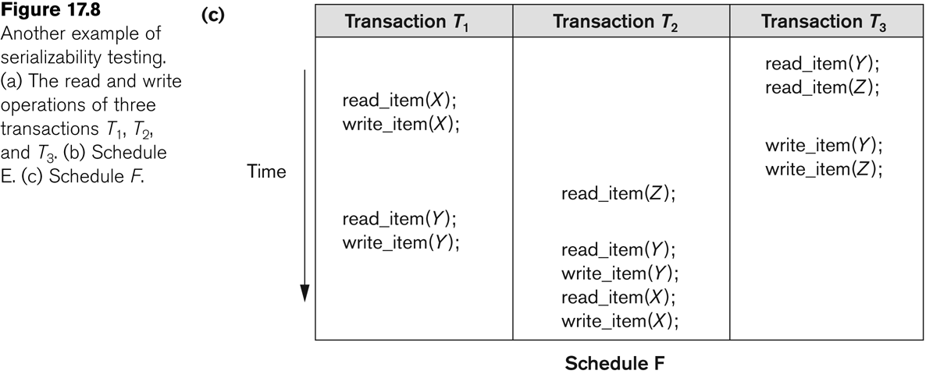
Another Example of Serializability Testing

Slide 80
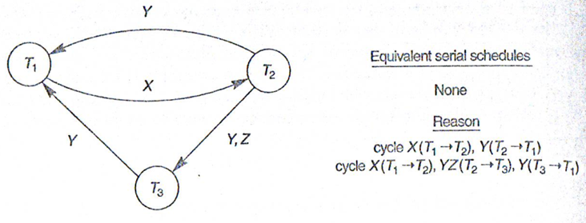
Another Example of Serializability Testing
Precedence graph of E

Slide 81
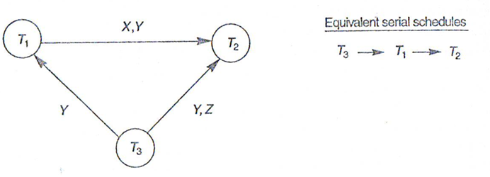
Precedence graph of F

Slide 82
Example 1:
Which of the following schedules is (conflict) serializable? For each serializable schedule, determine the equivalent serial schedules.
(a) r1 (X); r3 (X); w1(X); r2(X); w3(X)
(b) r1 (X); r3 (X); w3(X); w1(X); r2(X)
(c) r3 (X); r2 (X); w3(X); r1(X); w1(X)
(d) r3 (X); r2 (X); r1(X); w3(X); w1(X)
Notes:
(a) This schedule is not serializable because T1 reads X (r1(X)) before T3 but T3 reads X
(r3(X)) before T1 writes X (w1(X)), where X is a common data item. The operation
r2(X) of T2 does not affect the schedule at all so its position in the schedule is
irrelevant. In a serial schedule T1, T2, and T3, the operation w1(X) comes after r3(X),
which does not happen in the question.
(b) This schedule is not serializable because T1 reads X ( r1(X)) before T3 but T3 writes X
(w3(X)) before T1 writes X (w1(X)). The operation r2(X) of T2 does not affect the
schedule at all so its position in the schedule is irrelevant. In a serial schedule T1, T3,
and T2, r3(X) and w3(X) must come after w1(X), which does not happen in the question.
(c) This schedule is serializable because all conflicting operations of T3 happens before
all conflicting operation of T1. T2 has only one operation, which is a read on X (r2(X)),
which does not conflict with any other operation. Thus this serializable schedule is
equivalent to r2(X); r3(X); w3(X); r1(X); w1(X) (e.g., T2  T3  T1) serial schedule.
(d) This is not a serializable schedule because T3 reads X (r3(X)) before T1 reads X (r1(X))
but r1(X) happens before T3 writes X (w3(X)). In a serial schedule T3, T2, and T1, r1(X)
will happen after w3(X), which does not happen in the question.

Slide 83
Example 2
Consider the three transactions T1, T2, and T3, and the schedules S1 and S2 given below. Draw the serializability (precedence) graphs for S1 and S2 and state whether each schedule is serializable or not. If a schedule is serializable, write down the equivalent serial schedule(s).
T1: r1(x); r1(z); w1(x)
T2: r2(z); r2(y); w2(z); w2(y)
T3: r3(x); r3(y); w3(y)
S1: r1(x); r2(z); r1(z); r3(x); r3(y); w1(x); w3(y); r2(y); w2(z); w2(y)
S2: r1(x); r2(z); r3(x); r1(z); r2(y); r3(y); w1(x); w2(z); w3(y); w2(y)

Slide 85
6 Transaction Support in SQL2 (1)
A single SQL statement is always considered to be atomic.
Either the statement completes execution without error or it fails and leaves the database unchanged.
With SQL, there is no explicit Begin Transaction statement.
Transaction initiation is done implicitly when particular SQL statements are encountered.
Every transaction must have an explicit end statement, which is either a COMMIT or ROLLBACK.

Slide 86
Transaction Support in SQL2 (2)
Characteristics specified by a SET TRANSACTION statement in SQL2:
To control the locking overhead and performance
Access mode:
READ ONLY or READ WRITE.
The default is READ WRITE unless the isolation level of READ UNCOMMITTED is specified, in which case READ ONLY is assumed.
Diagnostic size n, specifies an integer value n, indicating the number of conditions that can be held simultaneously in the diagnostic area.
Notes:
These conditions supply feedback information (errors or exceptions) to the user or program on the most recently executed SQL statement.

Slide 87
Transaction Support in SQL2 (3)
Characteristics specified by a SET TRANSACTION statement in SQL2 (contd.):
Isolation level <isolation>, where <isolation> can be READ UNCOMMITTED, READ COMMITTED, REPEATABLE READ or SERIALIZABLE. The default is SERIALIZABLE.
With SERIALIZABLE: the interleaved execution of transactions will adhere to our notion of serializability.
However, if any transaction executes at a lower level, then serializability may be violated.
Notes:
If every transaction does not make its updates visible to other transactions until it is committed, one form of isolation is enforced that solves the temporary update problem and eliminates cascading rollbacks. A transaction is said to have level 0 isolation if it does not overwrite the dirty reads of higher-level transactions. Level 1 isolation has no lost updates; and level 2 isolation has no lost updates and no dirty reads. Finally level 3 isolation (also called true isolation) has, in addition to degree 2 properties, repeatable reads.
The use of serializable here is based on not allowing violations that cause dirty read, unrepeatable read and phantoms, and it is thus not identical to the way serializability was defined earlier.

Slide 88
Transaction Support in SQL2 (6)
Sample SQL transaction:
EXEC SQL whenever sqlerror go to UNDO;
EXEC SQL SET TRANSACTION
READ WRITE
DIAGNOSTICS SIZE 5
ISOLATION LEVEL SERIALIZABLE;
EXEC SQL INSERT
INTO EMPLOYEE (FNAME, LNAME, SSN, DNO, SALARY)
VALUES ('Robert','Smith','991004321',2,35000);
EXEC SQL UPDATE EMPLOYEE
SET SALARY = SALARY * 1.1
WHERE DNO = 2;
EXEC SQL COMMIT;
GOTO THE_END;
UNDO: EXEC SQL ROLLBACK;
THE_END: ...

Slide 89
Transaction Support in SQL2 (4)
Potential problem with lower isolation levels:
Dirty Read: (WR conflict)
Reading a value that was written by a transaction which failed.
A session can read rows changed by transactions in other sessions that have not been committed. If the other session then rolls back its transaction, subsequent reads of the same rows will find column values returned to previous values, deleted rows reappearing and rows inserted by the other transaction missing.
Notes:
Non-repeatable Read -- a session can read a row in a transaction. Another session then changes the row (UPDATE or DELETE) and commits its transaction. If the first session subsequently re-reads the row in the same transaction, it will see the change.
Phantoms -- a session can read a set of rows in a transaction that satisfies a search condition (which might be all rows). Another session then generates a row (INSERT) that satisfies the search condition and commits its transaction. If the first session subsequently repeats the search in the same transaction, it will see the new row.

Slide 90
Transaction Support in SQL2 (4)
Potential problem with lower isolation levels:
Nonrepeatable Read: (RW conflict)
Allowing another transaction to write (update or delete) a new value between multiple reads of one transaction.
A session can read a row in a transaction. Another session then changes the row (UPDATE or DELETE) and commits its transaction. If the first session subsequently re-reads the row in the same transaction, it will see the change.
Consider that T1 reads the employee salary for Smith. Next, T2 updates the salary for Smith. If T1 reads Smith's salary again, then it will see a different value for Smith's salary.
Notes:
Phantoms

Slide 91
Transaction Support in SQL2 (5)
Potential problem with lower isolation levels (contd.):
Phantoms:
a session can read a set of rows in a transaction that satisfies a search condition (which might be all rows). Another session then generates a row (INSERT) that satisfies the search condition and commits its transaction. If the first session subsequently repeats the search in the same transaction, it will see the new row.

Slide 92
Transaction Support in SQL2 (5)
Potential problem with lower isolation levels (contd.):
Phantoms:
New rows being read using the same read with a condition.
A transaction T1 may read a set of rows from a table, perhaps based on some condition specified in the SQL WHERE clause.
Now suppose that a transaction T2 inserts a new row that also satisfies the WHERE clause condition of T1, into the table used by T1.
If T1 is repeated, then T1 will see a row that previously did not exist, called a phantom.

Slide 93
Transaction Support in SQL2 (7)
Possible violation of serializabilty:
Type of Violation
Isolation Dirty nonrepeatable
level read read phantom
_______________________________________________________
READ UNCOMMITTED yes yes yes
READ COMMITTED no yes yes
REPEATABLE READ no no yes
SERIALIZABLE no no no

Slide 94
Summary
Transaction and System Concepts
Desirable Properties of Transactions
Characterizing Schedules based on Recoverability
Characterizing Schedules based on Serializability
Transaction Support in SQL

