Slide 1
Chapter 7
Relational Database Design by EER-to-Relational Mapping

Slide 2
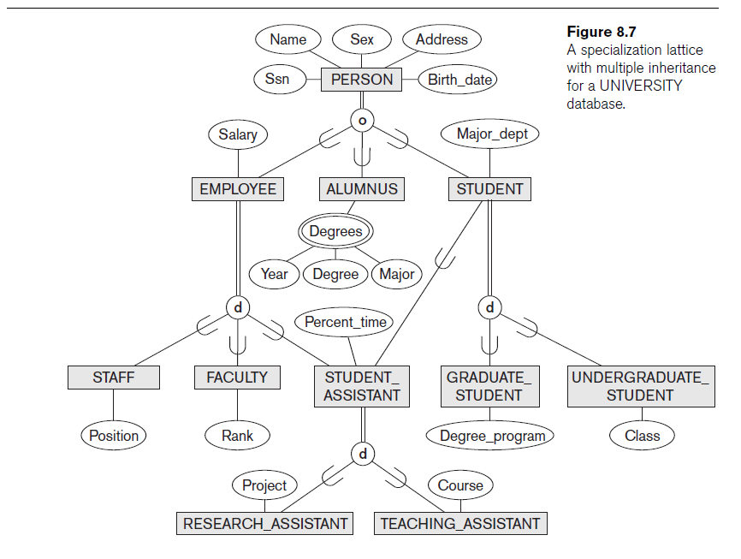
Mapping of Specialization or Generalization
Notes:
PK is the primary key.

Slide 3
Mapping of Specialization or Generalization
STEP 8. Convert each specialization with m subclasses {S₁, S₂, …, S_{m}} and superclass C with attributes {k, a₁,…, a_{n}} where k is the (primary) key, into relation schemas using one of the following options:
RULE 1: Multiple relations—superclass and subclasses
Apply when: For any specialization (total or partial, disjoint or overlapping)
Create a relation L for the superclass C with attributes Attrs(L) = {k, a₁, …, a_{n}} and PK(L)=k.
Create a relation L_{i} for each subclass S_{i}, 1≤i ≤m, with the attributes Attrs(L_{i})={k}U{attributes of S_{i}} and PK(L_{i})=k.
PK(L): primary key of L
Notes:
There are several options for mapping a number of subclasses that together form a specialization (or alternatively, that are generalized into a superclass).
PK is the primary key.

Slide 4
Mapping of Specialization: Rule1
Person
SSN | Name | Sex | Address | Birth_date
Superclass C={k, a₁, a₂, … , a_{n}}
S1
S2
S3
We have m=3 subclasses.
Employee
SSN | Salary
Alumnus
SSN
Alumnus_degrees
SSN | Year | Degree | Major
Student
SSN | Major_dept
Notes:
PK is the primary key.

Slide 5
Mapping of Specialization
RULE 2: Multiple relations—subclass relations only
Apply when
Subclasses are total (every entity in the superclass must belong to (at least) one of the subclasses)
Specialization has disjointedness constraint
If the specialization is overlapping, the same entity may be duplicated in several relations.
Create a relation L for each subclass S_{i} , 1≤i ≤m, with the attributes
Attrs(Li) = {attributes of S_{i}}U {k, a₁, …, a_{n}}
and PK(L_{i})=k.
Notes:
It is only recommended if the specialization has the disjointedness constraint. If the specialization is overlapping, the same entity may be duplicated in several relations.

Slide 6
Mapping of Specialization: RULE 2
Assume we have only this EER diagram.
We have m=3 subclasses.
Instead of creating Employee table, we could have three relations but not Employee table:
Salary
SSN
Employee
Superclass C->{k, a₁, a₂, … , a_{n}}
d
Staff
S1
Staff
S3
Student Assistant
S3
SSN | Salary | Position
Faculty
S2
Faculty
Rank
SSN | Salary | Rank
Position
Student_assistant
Percent time
SSN | Salary | Percent_time
Attributes of the superclass
Notes:
PK is the primary key.

Slide 7
Mapping of Generalization : Rule 3
RULE 3: Single relation with one type attribute
Apply when
Type or discriminating attribute indicates subclass of tuple
Subclasses are disjoint
Create a single relation L with attributes
Attrs(L) = {k, a₁, …, a_{n}}U
{attributes of S₁}U…U
{attributes of S_{m}}U {t}
and PK(L)=k.
The attribute t is called a type (or discriminating) attribute whose value indicates the subclass to which each tuple belongs.
Caution: Potential for generating many NULL values if many specific attributes exist in the subclasses
Notes:
This option works only for a specialization whose subclasses are disjoint, and has the potential for generating many NULL values if many specific attributes exist in the subclasses.

Slide 8
Mapping of Specialization: rule 3
Salary
SSN
Employee
THIS RULE HAS THE POTENTIAL TO GENERATE MANY NULL VALUES.
d
S1
Staff
S3
Student Assistant
S3
Faculty
S2
Rank
Position
Percent time
EMPLOYEE
SSN | Salary | Employee_type | Position | Rank | Percent_type
Distinguishes Staff, Faculty and Student_Assistant
Notes:
PK is the primary key.

Slide 9
Mapping of Generalization: Rule 4
RULE 4: Single relation with multiple type attributes
Apply when
Subclasses are overlapping or disjoint
Create a single relation schema L with attributes Attrs(L) = {k, a₁, …, a_{n}}U
{attributes of S₁}U…U
{attributes of S_{m}}U {t₁, t₂, …, t_{m}} and PK(L)=k.
Each t_{i}, 1≤i ≤m, is a boolean type attribute indicating whether a tuple belongs to subclass S_{i}.

Slide 10
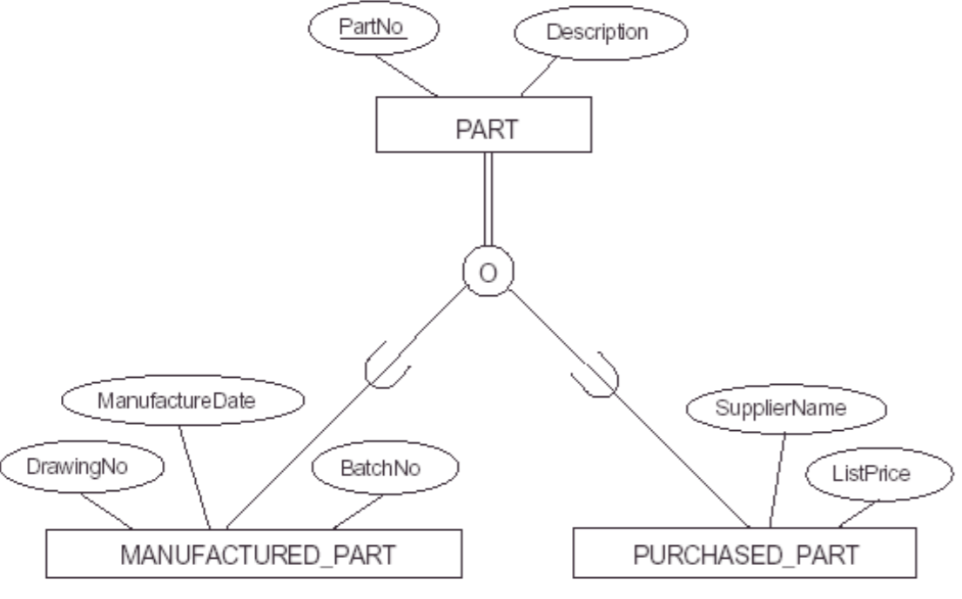
Mapping of Specialization: rule 4

Slide 12
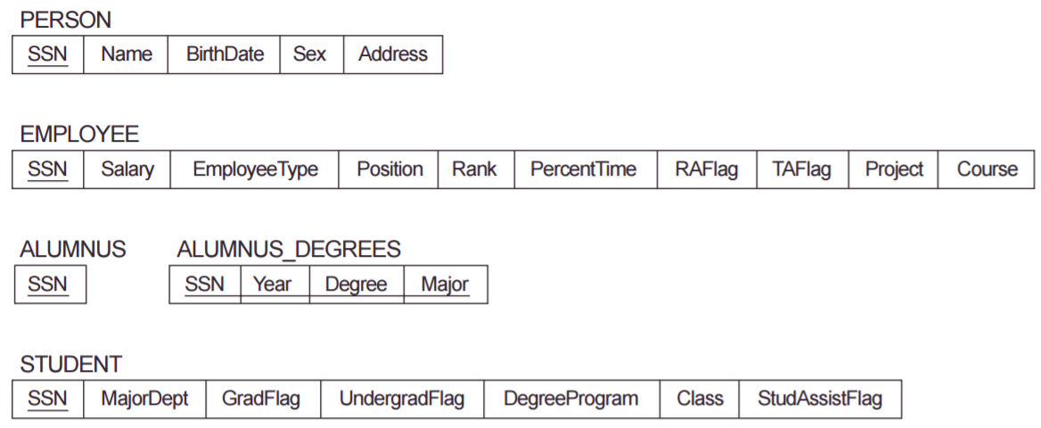
Mapping of the EER specialization lattice for University database using multiple options/rules

Slide 13
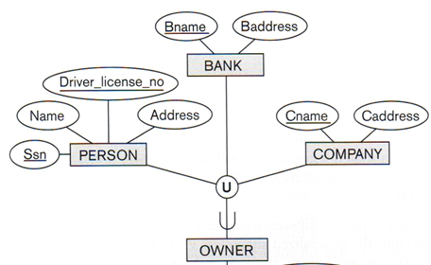
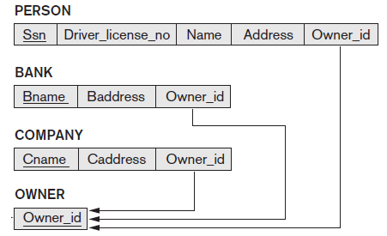
Mapping of Categories (Union Types)
Step 9: Mapping of Union Types (Categories)
Defining superclasses have different keys
Specify a new key attribute: Surrogate key
Owner_id is a surrogate key

Slide 14
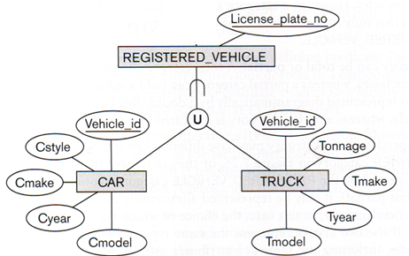
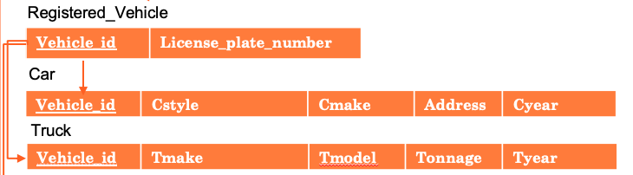
example2
Vehicle_id is the key.
No need for
Surragate key

Slide 15
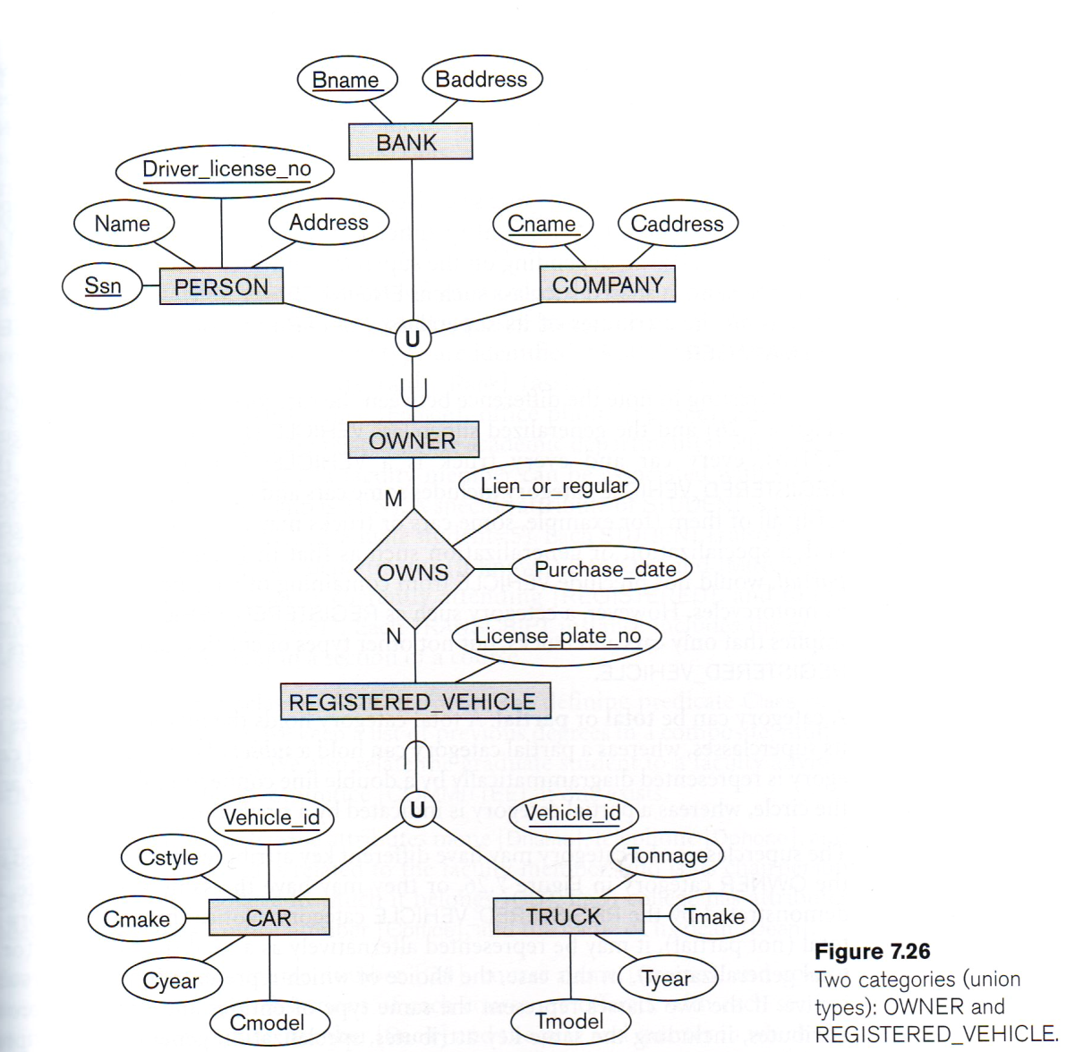
EER Diagram of database for motor vehicle registration

Slide 16
Person
SSN | Driver_license_no | Name | Address | Owner_id
Bank
Bname | Baddress | Owner_id
Company
Cname | Caddress | Owner_id
Owner
Owner_id
Registered_Vehicle
Vehicle_id | License_plate_number
Car
Vehicle_id | Cstyle | Cmake | Address | Cyear
Truck
Vehicle_id | Tmake | Tmodel | Tonnage | Tyear
Owns
Owner_id | Vehicle_id | Purchase_date | Address | Lien_or_regular
Vehicle_id is the key when the auto gallery obtained vehicles and assigned a key for each but have not sold yet. When it is sold, a new tuple will be entered into the registered_vehicle table.
Note that in this design, only one vehicle can be owned by a person, bank or company. They cannot own more than one.

Slide 17
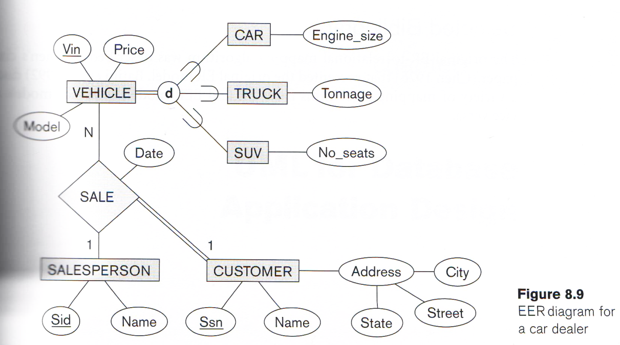
Exercise
Consider the EER diagram for a car dealer.
Map the schema into a set of relations. For the VEHICLE to CAR/TRUCK/SUV generalization, consider the aforementioned four options.

Slide 18
Exercise: Option 1
Customer
SSN | Name | State | Street | City
Salesperson
SID | Name
Sale
VIN | SID | SSN | Date
Vehicle
VIN | Price | Model
Car
VIN | Engine_size
Truck
VIN | Tonnage
SUV
VIN | No_seats
Notes:
I assume that the same address can be assigned to more than one customer. If not, we can use SSN instead of AddressID. We can even discard Address table and put the composite attributes in Customer table.

Slide 19
Exercise: Option 2 Find single relations with one type
Customer
SSN | Name | State | Street | City
Salesperson
SID | Name
Sale
VIN | SID | SSN | Date
Vehicle
VIN | Price | Model
Discard Car, Truck and SUV tables and revise Vehicle
Car
VIN | Engine_size
VIN | Price | Model | Vehicle_type | Engine_size | Tonnage | No_seats
Truck
VIN | Tonnage
SUV
VIN | No_seats

Slide 20
Draw the ER/EER diagram and then write down the relations.
The IntelligentSplit application facilitates to split expenses between friends. Users first create an account by entering their full name, email, phone and password. Then, they can enter the details of their friends including their email addresses, full names, and phone numbers. Users can create groups where they can share expenses with other group members. A group can be for roommates, trips and restaurants. A user can invite her friends to a group. Each group is saved with a unique group name, date of foundation, description and type (apartment, house, trip, other) information in the database. When a user pays for the bill, an ID is automatically generated for the bill. Users can enter the description, its amount, date, associated group name, the person who paid the bill and split type (“split equally” or ”split unequally”). The split information, more specifically whom is required to pay the bill and the amount a user is going to pay is also provided in the application. Each user can see her balance in each group: How much she paid and the remaining amount. In addition, the application shows who is owed to whom in each group and its amount. A bill should always be assigned to a group and a group may include at least more than one bill. Each user can also see her balance: how much she owes in overall and the remaining amount.

Slide 21
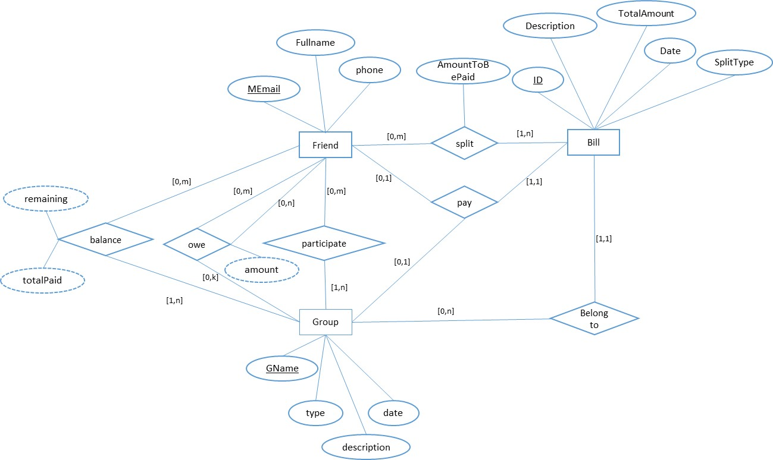
[1,1]
Notes:
My assumption is that I do not need to keep who invited whom to a group in a database.
I assume passwords are stored separately from the relational db. But you can prefer to store it.

Slide 22
