Slide 1
CHAPTER 6
Relational Database Design by ER- to-Relational Mapping

Slide 2
CHAPTER OUTLINE
ER-to-Relational Mapping Algorithm
  Step 1: Mapping of Regular Entity Types
  Step 2: Mapping of Weak Entity Types
  Step 3: Mapping of Binary 1:1 Relation Types
  Step 4: Mapping of Binary 1:N Relationship Types.
  Step 5: Mapping of Binary M:N Relationship Types.
  Step 6: Mapping of Multivalued attributes.
  Step 7: Mapping of N-ary Relationship Types.
Slide 7- <number>

Slide 3
ER-TO-RELATIONAL MAPPING ALGORITHM
STEP 1: MAPPING OF REGULAR ENTITY TYPES.
For each entity type E create a relation R
R includes all the simple attributes of E.
R includes all parts of composite attributes of E
The primary key of R is one of the key attributes
  You choose one of the key attributes
  If the chosen key of E is composite, the set of simple attributes that form it will together form the primary key of R.
Slide 7- <number>
Notes:
Example: We create the relations EMPLOYEE, DEPARTMENT, and PROJECT in the relational schema corresponding to the regular entities in the ER diagram.
SSN, DNUMBER, and PNUMBER are the primary keys for the relations EMPLOYEE, DEPARTMENT, and PROJECT as shown.

Slide 4

Slide 7- <number>

Slide 5
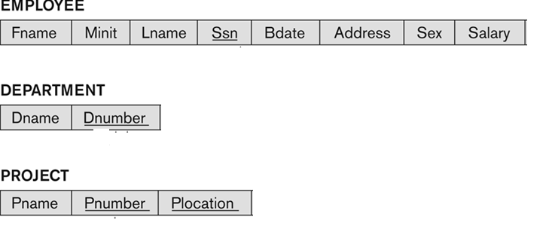
MAPPING STRONG ENTITIES INTO A RELATIONAL SCHEMA
Slide 7- <number>
Notes:
Example: We create the relations EMPLOYEE, DEPARTMENT, and PROJECT in the relational schema corresponding to the regular entities in the ER diagram.
SSN, DNUMBER, and PNUMBER are the primary keys for the relations EMPLOYEE, DEPARTMENT, and PROJECT as shown.

Slide 6
ER-TO-RELATIONAL MAPPING ALGORITHM
STEP 2: MAPPING OF WEAK ENTITY TYPES
For each weak entity type W with owner E, create a relation R
  include all simple attributes (or simple components of composite attributes) of W as attributes of R.
  include as foreign key attributes of R the primary key attribute(s) of the relation(s) that correspond to the owner entity type(s).
The primary key of R is the combination of the primary key(s) of the owner(s) and the partial key attribute of the weak entity type W, if any.
Slide 7- <number>

Slide 7
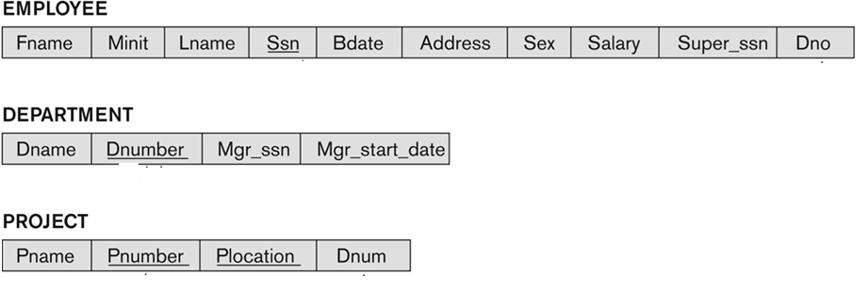
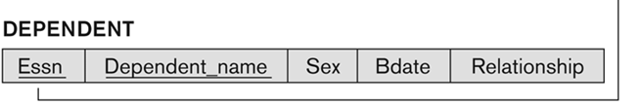
MAPPING STRONG AND WEAK ENTITIES INTO A RELATIONAL SCHEMA
Slide 7- <number>
Notes:
Example: Create the relation DEPENDENT in this step to correspond to the weak entity type DEPENDENT.
Include the primary key SSN of the EMPLOYEE relation as a foreign key attribute of DEPENDENT (renamed to ESSN).
The primary key of the DEPENDENT relation is the combination {ESSN, DEPENDENT_NAME} because DEPENDENT_NAME is the partial key of DEPENDENT.

Slide 8

ER-TO-RELATIONAL MAPPING ALGORITHM
STEP 3: MAPPING OF BINARY 1:1 RELATION TYPES
For each binary 1:1 relationship type R in the ER schema, identify the relations S and T that correspond to the entity types participating in R.
Approach 1.Foreign Key approach:
  Choose one of the relations-say S.
    It is better to choose an entity type with total participation in R in the role of S.
  Include the primary key of T as foreign key in S
  Include the Attributes of the Relationtype into S
Slide 7- <number>
Notes:
Example: 1:1 relation MANAGES is mapped by choosing the participating entity type DEPARTMENT to serve in the role of S, because its participation in the MANAGES relationship type is total
Primary key of EMPLOYEE is a foreign key of DEPARTMENT
Include the STARTDATE attribute also in the DEPARTMENT.

Slide 9
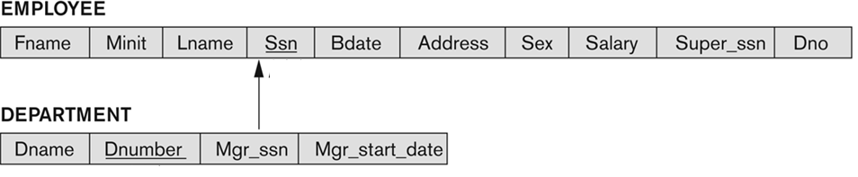
ER-TO-RELATIONAL MAPPING ALGORITHM
STEP 3: MAPPING OF BINARY 1:1 RELATION TYPES
1.Foreign Key approach: Choose one of the relations-say S-and include a foreign key in S the primary key of T. It is better to choose an entity type with total participation in R in the role of S.
T: Employee and S: Department, R: Manages
Alternative:
primary key of DEPARTMENT as a foreign key in EMPLOYEE.
However then EMPLOYEE will have null values for employee tuples who do not manage a department.
Slide 7- <number>
Notes:
Primary key of EMPLOYEE is a foreign key of DEPARTMENT
Include the STARTDATE attribute also in the DEPARTMENT.

Slide 10

ER-TO-RELATIONAL MAPPING ALGORITHM
STEP 3: MAPPING OF BINARY 1:1 RELATION TYPES
Example:
Approach 2.Merged relation option:
Merge S,T and R into a single relation.
Primary key is the combination of primary keys of S and T
  This may be appropriate when both participations are total.
Person
1
has
1
IdentityCard
Education
Passport
ID
ID#
MotherName
Slide 7- <number>
PassportID | Education | ID | MotherName

Slide 11
ER-TO-RELATIONAL MAPPING ALGORITHM
STEP 3: MAPPING OF BINARY 1:1 RELATION TYPES
For each binary 1:1 relationship type R in the ER schema, identify the relations S and T that correspond to the entity types participating in R.
Approach 3. Cross-reference or relationship relation option:
set up a new relation R
cross-reference the primary keys of the S and T
  Include as foreign key attributes in R the primary keys of S and T; their combination will form the primary key of R.
Person
1
has
1
BankAccount
Name
ID#
No
BranchName
Slide 7- <number>

Slide 12
Person
1
has
1
BankAccount
Name
ID#
No
BranchName
Person
ID# | Name
BankAccount
No | BranchName
PersonBankAccount
Slide 7- <number>
ID# | No

Slide 13
ER-TO-RELATIONAL MAPPING ALGORITHM
STEP 4: MAPPING OF BINARY 1:N RELATIONSHIP TYPES.
For each regular binary 1:N relationship type R,
identify the relation S that represents the participating entity type at the N-side of the relationship type.
Include as foreign key in S the primary key of the relation T
Include any simple attributes of the 1:N relation type as attributes of S.
Slide 7- <number>

Slide 14

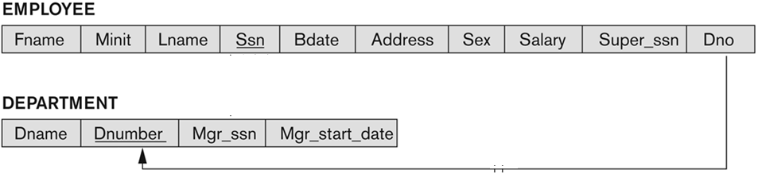
ER-TO-RELATIONAL MAPPING ALGORITHM
STEP 4: MAPPING OF BINARY 1:N RELATIONSHIP TYPES.
R
T
S
Example: WORKS_FOR, CONTROLS, SUPERVISION
WORKS_FOR includes the primary key DNUMBER of the DEPARTMENT relation as foreign key in the EMPLOYEE relation and call it DNO.
Slide 7- <number>
Notes:
Include as foreign key in S the primary key of the relation T
Include any simple attributes of the 1:N relation type as attributes of S.

Slide 15
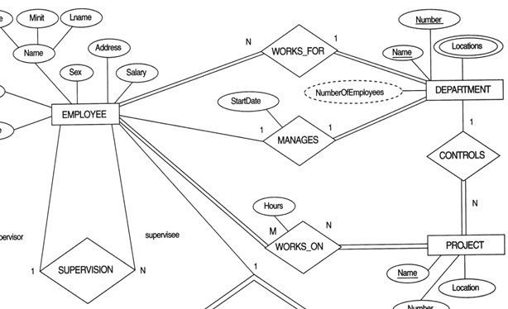
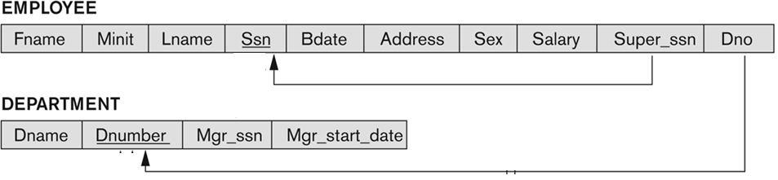
Slide 7- <number>

Slide 16
ER-TO-RELATIONAL MAPPING ALGORITHM
STEP 5: MAPPING OF BINARY M:N RELATIONSHIP TYPES.
For each regular binary M:N relationship type Q, create a new relation R to represent Q.
Include as foreign key attributes in R the primary keys of the relations that represent the participating entity types; their combination will form the primary key of R.
Also include any simple attributes of the M:N relationship type (or simple components of composite attributes) as attributes of R.
  This is the Approach3 for 1:1 relationship.
Slide 7- <number>

Slide 17

ER-TO-RELATIONAL MAPPING ALGORITHM
STEP 5: MAPPING OF BINARY M:N RELATIONSHIP TYPES.
Example: Create a schema for WORKS_ON in the relational database schema.
  The primary keys of the PROJECT and EMPLOYEE relations are included as foreign keys in WORKS_ON and renamed PNO and ESSN, respectively.
  Attribute HOURS in WORKS_ON represents the HOURS attribute of the relation type.
  The primary key of the WORKS_ON relation is the combination of the foreign key attributes {ESSN, PNO}.
Slide 7- <number>

Slide 18
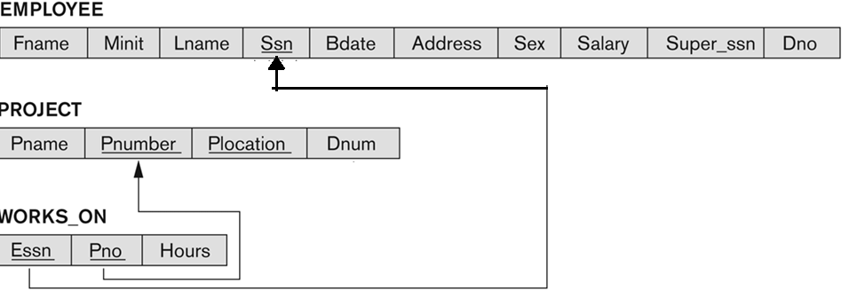
Slide 7- <number>

Slide 19
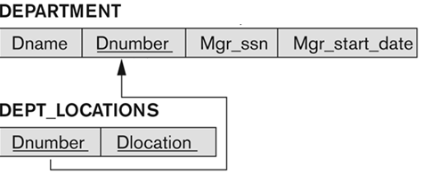
ER-TO-RELATIONAL MAPPING ALGORITHM
STEP 6: MAPPING OF MULTIVALUED ATTRIBUTES.
For each multivalued attribute A in E, create a new relation R.
R includes an attribute corresponding to A, plus the primary key attribute K-as a foreign key in R-of the relation that represents E
The primary key of R is the combination of A and K.
If the multivalued attribute is composite, we include its simple components.
Example: The relation DEPT_LOCATIONS is created.
  The attribute DLOCATION represents the multivalued attribute LOCATIONS of DEPARTMENT, while DNUMBER-as foreign key-represents the primary key of the DEPARTMENT relation.
  The primary key of R is the combination of {DNUMBER, DLOCATION}.
K
Slide 7- <number>

Slide 20
ER-TO-RELATIONAL MAPPING ALGORITHM
STEP 6: MAPPING OF MULTIVALUED ATTRIBUTES.
Example2
EMPLOYEE
Employee_ID
Employee_Name
Employee_Address
{Skill}
Employee
Employee_ID | Employee_Name | Employee_Address
Employee_Skill
Employee_ID | Skill
Slide 7- <number>

Slide 21
ER-TO-RELATIONAL MAPPING ALGORITHM
STEP 7: MAPPING OF N-ARY RELATIONSHIP TYPES
For each n-ary relationship type Q, where n>2, create a new relationship R to represent Q.
Include as foreign key attributes in R the primary keys of the relations that represent the participating entity types.
Also include any simple attributes of the n-ary relationship type (or simple components of composite attributes) as attributes of R.
Similar to M:N binary relationship type matching. The difference is here R has n foreign keys.
Slide 7- <number>

Slide 22

FIGURE 4.11
TERNARY RELATIONSHIP TYPES. (A) THE SUPPLY RELATIONSHIP.
Example: The relationship type SUPPY is 3-ary
  This can be mapped to the relation SUPPLY whose primary key is the combination of the three foreign keys {SNAME, PARTNO, PROJNAME}
Slide 7- <number>

Slide 23

FIGURE 7.3
MAPPING THE N-ARY RELATIONSHIP TYPE SUPPLY FROM FIGURE 4.11A.
Slide 7- <number>

Slide 24
SUMMARY OF MAPPING CONSTRUCTS AND CONSTRAINTS
Table 7.1 Correspondence between ER and Relational Models
ER Model Relational Model
Entity type “Entity” relation
1:1 relationship type Foreign key, or “relationship” relation, or merge
1:N relationship type Foreign key, or “relationship” relation
M:N relationship type “Relationship” relation and two foreign keys
n-ary relationship type “Relationship” relation and n foreign keys
Simple attribute Attribute
Composite attribute Set of simple component attributes
Multivalued attribute Relation and foreign key
Value set Domain
Key attribute Primary (or secondary) key
Slide 7- <number>

Slide 25
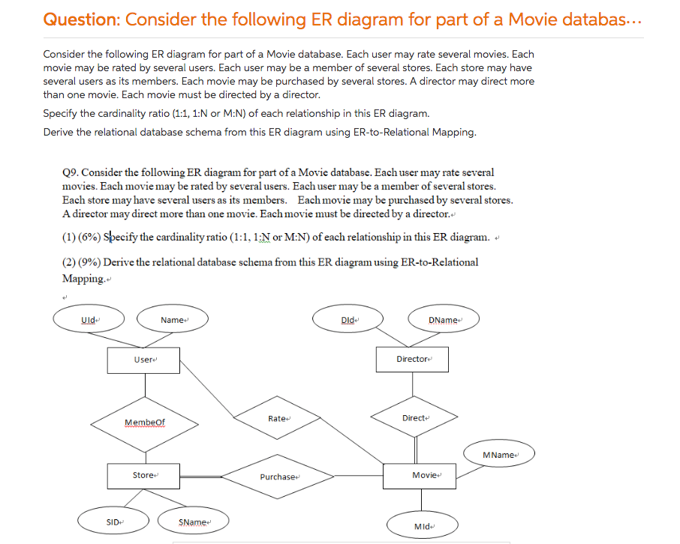
Consider the following ER diagram for part of a movie database
Slide 7- <number>

Slide 26
[0,N]
[1,N]
[0,N]
[0,M]
[0,M]
[1,1]
[1,M]
[0,N]
Slide 7- <number>

Slide 27
[0,N]
[1,N]
[0,N]
[0,M]
[0,M]
[1,1]
[1,M]
[0,N]
User
UID | Name
Movie
Purchase
MID | MName | DID
SID | MID
Director
MemberOf
DID | DName
UID | SID
Store
SID | SName
Rate
UID | MID
Slide 7- <number>

Slide 28
CHAPTER SUMMARY
ER-to-Relational Mapping Algorithm
  Step 1: Mapping of Regular Entity Types
  Step 2: Mapping of Weak Entity Types
  Step 3: Mapping of Binary 1:1 Relation Types
  Step 4: Mapping of Binary 1:N Relationship Types.
  Step 5: Mapping of Binary M:N Relationship Types.
  Step 6: Mapping of Multivalued attributes.
  Step 7: Mapping of N-ary Relationship Types.
Slide 7- <number>

