Slide 1


EISTATECH
PRESENT’S
WOMEN SAFETY ANALYTICS – LEO: EMPOWERING PROTECTION THROUGH SMART TECHNOLOGY

Slide 2

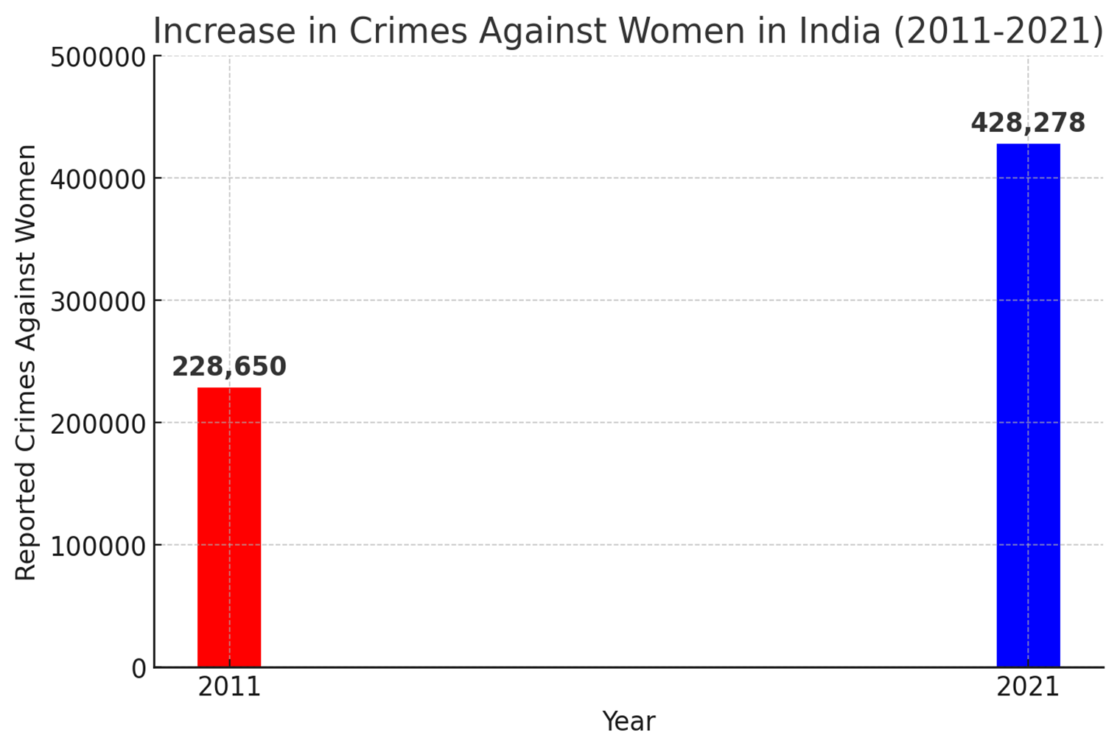
Introduction – Why This Project?
•Every 16 minutes, a woman is assaulted in India (NCRB 2022).
•In 2021, there were 428,278 reported incidents of crime on women, an 87% increase compared to 228,650 in 2011.
•92% of women feel unsafe in public places (UN Women Report 2023)
•Traditional safety apps require manual activation, making them ineffective in emergencies where victims may not have quick access to their phones.

Slide 3
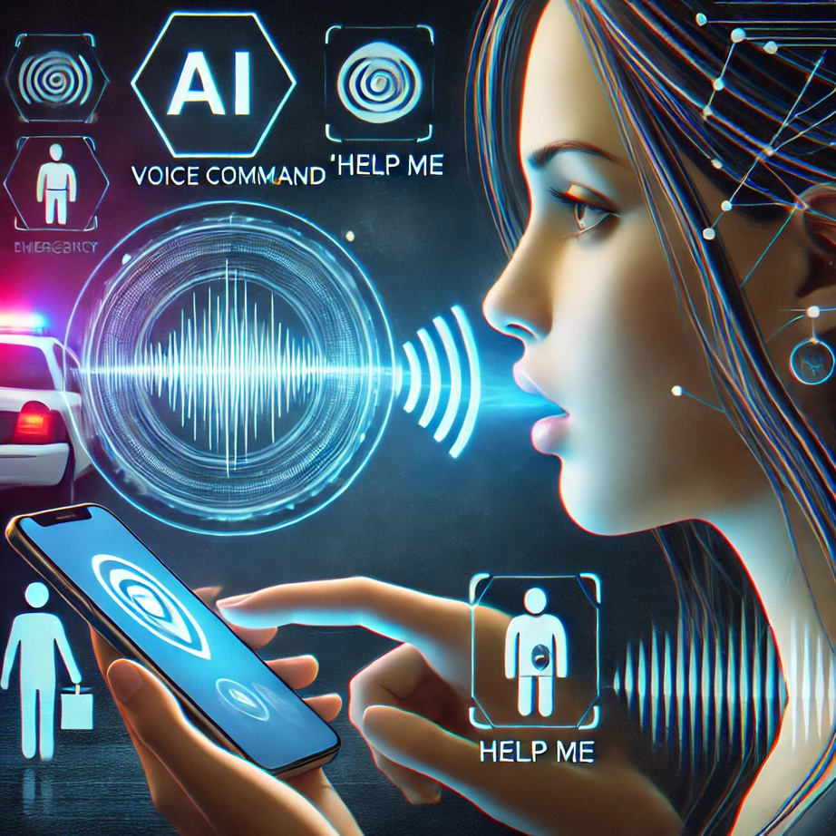
Solution’s
•AI-driven smart safety software that enables instant emergency response through gestures, voice commands, and ensuring hands-free activation in critical situations.
Impact: A faster, more accessible, and evidence-based security system that enhances women's safety and strengthens legal protection

Slide 4

How it works:
Instant Activation:
Gestures of Phone and voice activation
Immediate Alerts:
Sends live location to police & emergency contact
AI Evidence Collection:
Captures attacker’s photos & records audio
Secure & Private:
End-to-end encryption ensures data safety

Slide 5

Key Features & Innovation:
Multi-Trigger: Shake, button press, or voice command.
AI Voice Recognition: Detects distress words in noise.
Live GPS Tracking: Sends location to law enforcement.
Evidence Collection: Captures attacker’s image & voice.
Low Battery Mode: Works via SMS alerts.
Secure & Private: End-to-end encrypted data.
Unique? Hands-free activation with real-time, verifiable evidence

Slide 6

Feature | Dial-112 | bSafe | Sheroes | LEO – AI-Powered Safety
Activation | Manual (Call/SOS) | Manual (App-based) | Manual (Community Support) | Hands-Free (Shake, Button, Voice)
Emergency Calling | User must dial | Yes (Limited) | No | AI Auto-Calls Police
Location Sharing | Yes (After Call) | Yes (To Contacts) | No | Instant Live GPS Tracking
Evidence Collection | No | No | No | Auto Captures Images, Audio, Video
Threat Deterrence | No | No | No | AI Fake Police Call & Warning Voice
Offline Mode | No | No | No | Works via USSD/SMS
Data Privacy | Limited | Basic Encryption | No Encryption | End-to-End Encryption
Scalability | Standalone Service | Standalone App | Standalone App | Integrates with Govt. & NGOs

Slide 7
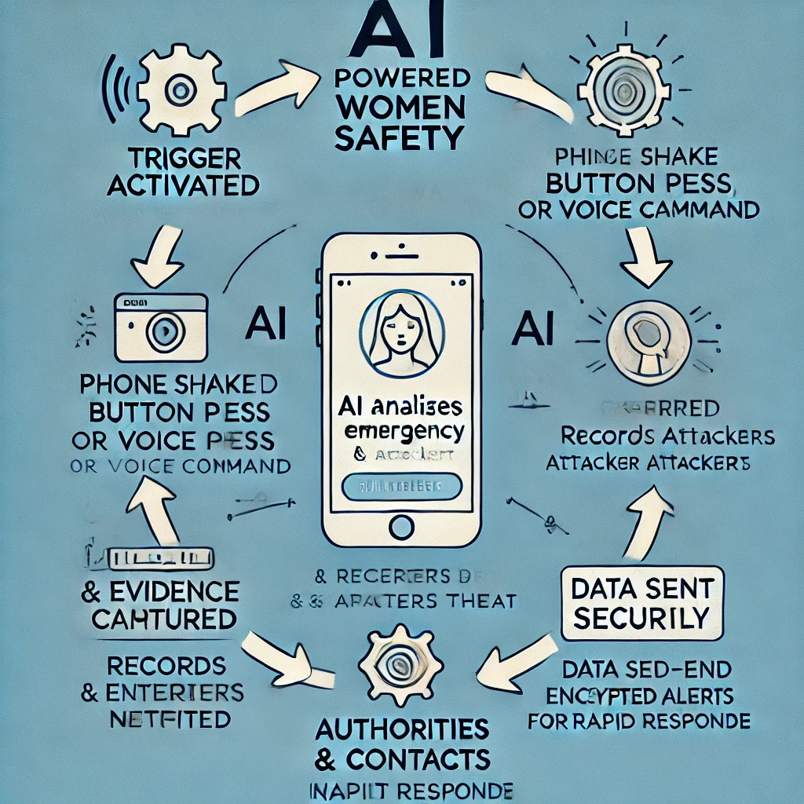
Technical Implementation – How It Works?
Trigger Activated – Shake, button press, or voice command.
AI Analyzes Emergency – Detects distress & verifies threat.
Location & Evidence Captured – Records attacker’s image & voice.
Data Sent Securely – End-to-end encrypted transmission.
Authorities & Contacts Notified – Instant alerts for rapid response.

Slide 8

Scalability Plan:
Govt. & NGO Collaboration: Real-world implementation.
Public Safety Integration: Syncs with police networks.
Global Expansion: Extends to corporate safety & international markets.

Slide 9

Conclusion – Why Choose This?
AI-Driven & Hands-Free Activation – Works even when the user can't access their phone.
Live Location & Real-Time Alerts – Ensures faster emergency response.
Legal Proof Collection – Captures voice & images to aid in convictions.
Multi-Device Compatibility – Supports smartphones & future IoT expansion.
Future-Ready & Scalable – Integrates with police networks & NGOs.
More than an app – it's a movement towards a safer society.

