Slide 1
Lecture # 6

Slide 2
Stack: Array or List
Since both implementations support stack operations in constant time, any reason to choose one over the other?
Allocating and deallocating memory for list nodes does take more time than preallocated array.
List uses only as much memory as required by the nodes; array requires allocation ahead of time.
List pointers (head, next) require extra memory.
Array has an upper limit; List is limited by dynamic memory allocation.

Slide 3
Implmentation Issues/Discussion in C/C++
Stack – push() operation
Stack – pop() operation
Stack – Is_Full() operation
Stack – Is_Empty() operation

Slide 4
Uses of Stack

Slide 5
Use of Stack
Example of use: prefix, infix, postfix expressions.
Consider the expression A+B: we think of applying the operator “+” to the operands A and B.
“+” is termed a binary operator: it takes two operands.
Writing the sum as A+B is called the infix form of the expression.

Slide 6
Prefix, Infix, Postfix
Two other ways of writing the expression are + A B prefix A B + postfix
The prefixes “pre” and “post” refer to the position of the operator with respect to the two operands.

Slide 7
Prefix, Infix, Postfix
Consider the infix expression A + B * C
We “know” that multiplication is done before addition.
The expression is interpreted as A + ( B * C )
Multiplication has precedence over addition.

Slide 8
Prefix, Infix, Postfix
Conversion to postfix
A + ( B * C ) infix form
A + ( B C * ) convert multiplication
A ( B C * ) + convert addition
A B C * + postfix form

Slide 9
Prefix, Infix, Postfix
Conversion to postfix
(A + B ) * C infix form
( A B + ) * C convert addition
( A B + ) C * convert multiplication
A B + C * postfix form

Slide 10
Precedence of Operators
The five binary operators are: addition, subtraction, multiplication, division and exponentiation. The order of precedence is (highest to lowest)
Exponentiation ↑
Multiplication/division *, /
Addition/subtraction +, -

Slide 11
Precedence of Operators
For operators of same precedence, the left-to-right rule applies: A+B+C means (A+B)+C.
For exponentiation, the right-to-left rule applies A ↑ B ↑ C means A ↑ ( B ↑ C )

Slide 12
Infix to Postfix
Infix Postfix
A + B A B +
12 + 60 – 23 12 60 + 23 –
(A + B)*(C – D ) A B + C D – *
A ↑ B * C – D + E/F A B ↑ C*D – E F/+

Slide 13
Infix to Postfix
Note that the postfix form an expression does not require parenthesis.
Consider ‘4+3*5’ and ‘(4+3)*5’. The parenthesis are not needed in the first but they are necessary in the second. The postfix forms are: 4+3*5 435*+ (4+3)*5 43+5*

Slide 14
Evaluating Postfix
Each operator in a postfix expression refers to the previous two operands.
Each time we read an operand, we push it on a stack.
When we reach an operator, we pop the two operands from the top of the stack, apply the operator and push the result back on the stack.

Slide 15
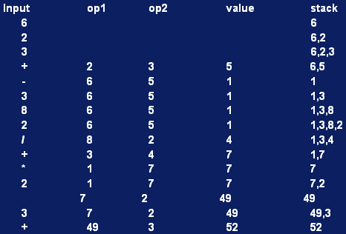
Evaluating Postfix
Evaluate: 6 2 3 + - 3 8 2 / + * 2 ↑ 3 +

