Slide 1
Lecture # 2

Slide 2
LIST Data Structure
The List is among the most generic of data structures.
In Real life:
shopping list,
groceries list,
list of people to invite to dinner
List of presents to get

Slide 3
Lists
A list is collection of items that are all of the same type (grocery items, integers, names)
The items, or elements of the list, are stored in some particular order
It is possible to insert new elements into various positions in the list and remove any element of the list

Slide 4
Lists
List is a set of elements in a linear order. For example, data values a1, a2, a3, a4 can be arranged in a list: (a3, a1, a2, a4) In this list, a3, is the first element, a1 is the second element, and so on
The order is important here; this is not just a random collection of elements, it is an ordered collection

Slide 5
List Operations
Useful operations
createList(): create a new list (presumably empty)
copy(): set one list to be a copy of another
clear(); clear a list (remove all elements)
insert(X, ?): Insert element X at a particular position in the list
remove(?): Remove element at some position in the list
get(?): Get element at a given position
update(X, ?): replace the element at a given position with X
find(X): determine if the element X is in the list
length(): return the length of the list.

Slide 6
List Operations
We need to decide what is meant by “particular position”; we have used “?” for this.
There are two possibilities:
Use the actual index of element: insert after element 3, get element number 6. This approach is taken by arrays
Use a “current” marker or pointer to refer to a particular position in the list.

Slide 7
List Operations
If we use the “current” marker, the following four methods would be useful:
start(): moves to “current” pointer to the very first element.
tail(): moves to “current” pointer to the very last element.
next(): move the current position forward one element
back(): move the current position backward one element

Slide 8

Implementing Lists
We have designed the interface for the List; we now must consider how to implement that interface.
Implementing Lists using an array: for example, the list of integers (2, 6, 8, 7, 1) could be represented as:

Slide 9
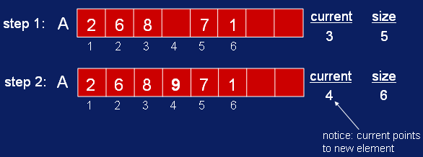
List Implementation
add(9); current position is 3. The new list would thus be: (2, 6, 8, 9, 7, 1)
We will need to shift everything to the right of 8 one place to the right to make place for the new element ‘9’.

Slide 10

Implementing Lists
next():

Slide 11
Implementing Lists
There are special cases for positioning the current pointer:
past the last array cell
before the first cell
We will have to worry about these when we write the actual code.

Slide 12
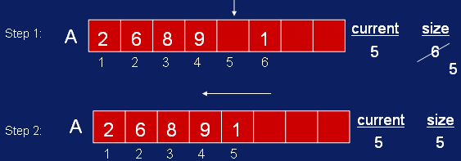
Implementing Lists
remove(): removes the element at the current index
We fill the blank spot left by the removal of 7 by shifting the values to the right of position 5 over to the left one space

Slide 13
Implementing Lists
find(X): traverse the array until X is located. int find(int X) { int j; for(j=1; j < size+1; j++ ) if( A[j] == X ) break; if( j < size+1 )
{ // found X current = j; // current points to where X found return 1; // 1 for true } return 0; // 0 (false) indicates not found
}

Slide 14
Implementing Lists
Other operations: get() → return A[current]; update(X) → A[current] = X; length() → return size; back() → current--; start() → current = 1; end() → current = size;

Slide 15
Assignment # 1
Implement a List Data Structure discussed above including following operations using Array ADT.
get()
update()
length()
back()
Next()
start()
end()
Remove()
Add()
NOTE: Implement above operations only using Pointers without using any indexes of arrays.
Assignment will be graded on the basis of relevant quiz of this assignment.

Slide 16
List Using Linked Memory
Various cells of memory are not allocated consecutively in memory.
Array is Not enough to store the future elements of the list after full exhaust of array locations.
With arrays, the second element was right next to the first element.
Now in Linked Memory approach, the first element must explicitly tell us where to look for the second element.
Do this by holding the memory address of the second element

