Slide 1
Lecture # 18

Slide 2
BuildHeap
Suppose we are given as input N keys (or items) and we want to build a heap of the keys.
Obviously, this can be done with N successive inserts.

Slide 3

BuildHeap
Initial data (N=15)

Slide 4
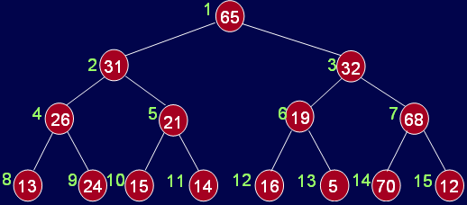
BuildHeap
Initial data (N=15)

Slide 5
BuildHeap
The general algorithm is to place the N keys in an array and consider it to be an unordered binary tree.
The following algorithm will build a heap out of N keys.
for( i = N/2; i > 0; i-- ) percolateDown(i);

Slide 6
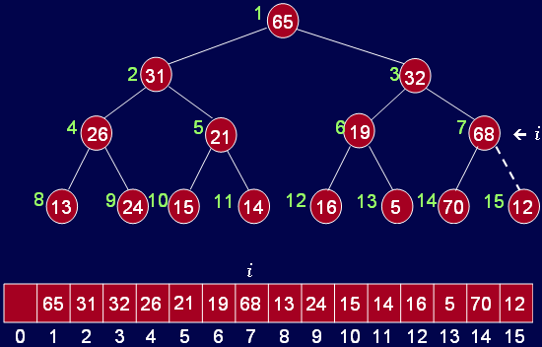
BuildHeap
i = 15/2 = 7 Why i=n/2?

Slide 7
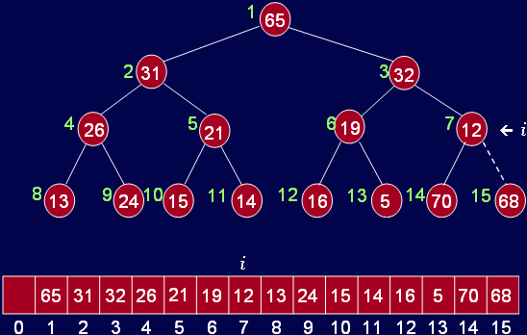
BuildHeap
i = 15/2 = 7

Slide 8
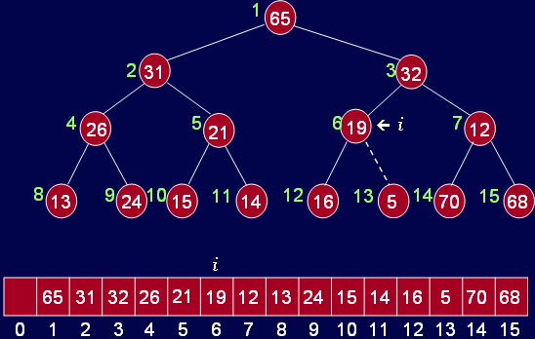
BuildHeap
i = 6

Slide 9
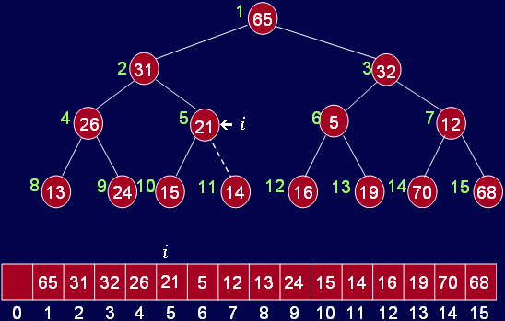
BuildHeap
i = 5

Slide 10
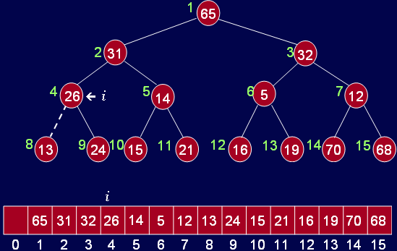
BuildHeap
i = 4

Slide 11
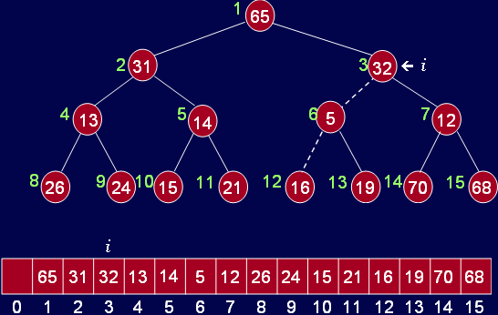
BuildHeap
i = 3

Slide 12
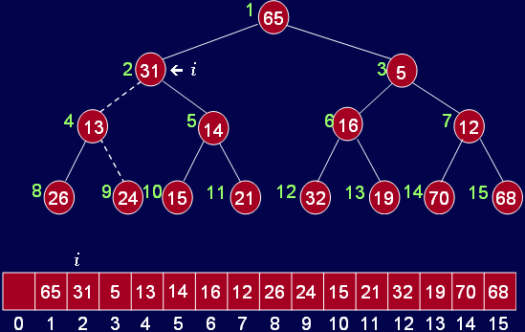
BuildHeap
i = 2

Slide 13
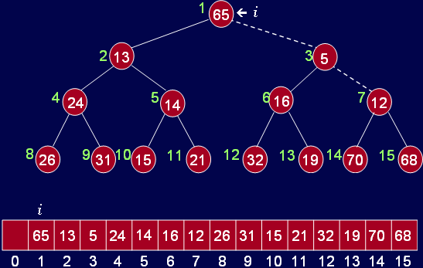
BuildHeap
i = 1

Slide 14
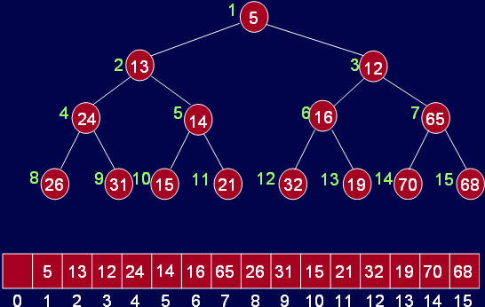
BuildHeap
Min heap

Slide 15
Other Heap Operations
decreaseKey(p, delta):
lowers the value of the key at position ‘p’ by the amount ‘delta’. Since this might violate the heap order, the heap must be reorganized with percolate up (in min heap) or down (in max heap).
increaseKey(p, delta):
opposite of decreaseKey.
remove(p):
removes the node at position p from the heap. This is done by first decreaseKey(p, ∞) and then performing deleteMin().

Slide 16
Thank You …

