Slide 1
Lecture # 17

Slide 2
Complete Binary Tree
A
B
C
D
E
F
G
H

Slide 3
Complete Binary Tree
Recall that such a tree of height h has between 2^{h} to 2^{h+1} –1 nodes.
Because the tree is so regular, it can be stored in an array; no pointers are necessary.

Slide 4
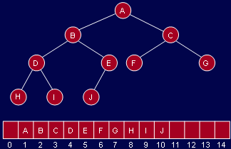
Complete Binary Tree

Slide 5

Complete Binary Tree
For any array element at position i, the left child is at 2i, the right child is at (2i +1) and the parent is at ⎣i/2⎦.

Slide 6


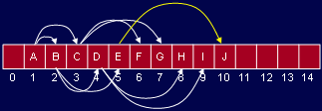
Complete Binary Tree

Slide 7
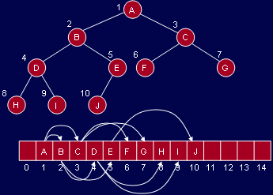
Complete Binary Tree

Slide 8
Complete Binary Tree
Question:
why don’t we store all binary trees in arrays? Why use pointers?

Slide 9
The Heap ADT
The major usage of heap is in Priority Queues.

Slide 10
Heap
A heap is a complete binary tree that conforms to the heap order.
The heap order property: in a (min) heap, for every node X, the key in the parent is smaller than (or equal to) the key in X.
Or, the parent node has key smaller than or equal to both of its children nodes.

Slide 11
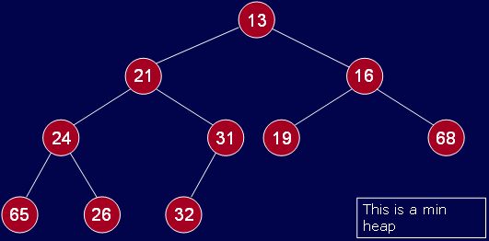
Heap

Slide 12
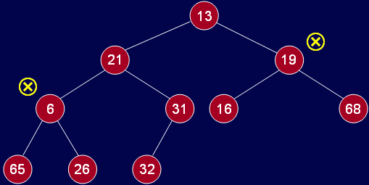
Heap
Not a heap: heap property violated

Slide 13
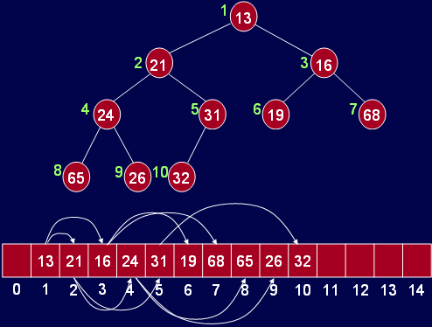
Inserting into a Heap
Assume this existing heap

Slide 14
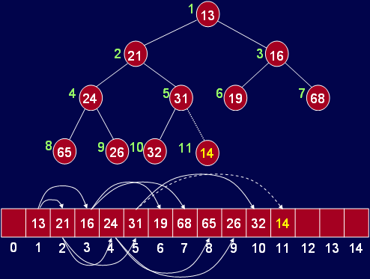
Inserting into a Heap
insert(14)

Slide 15

Inserting into a Heap
insert(14) with exchange

Slide 16
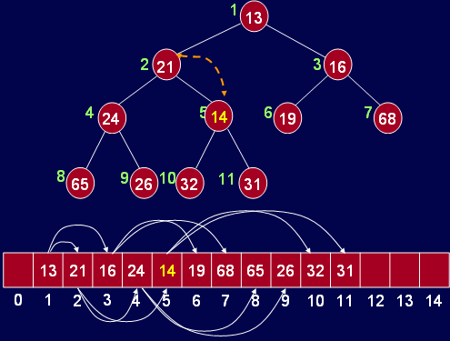
Inserting into a Heap

Slide 17
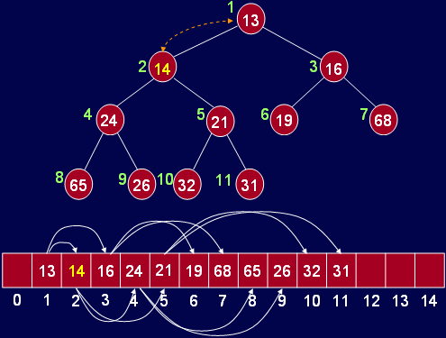
Inserting into a Heap

Slide 18
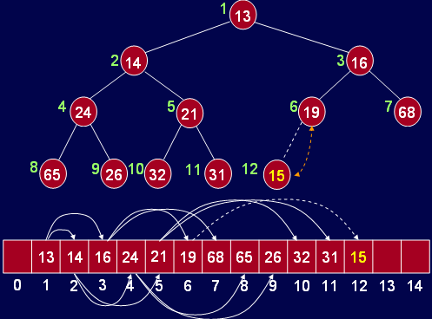
Inserting into a Heap
insert(15) with exchange

Slide 19
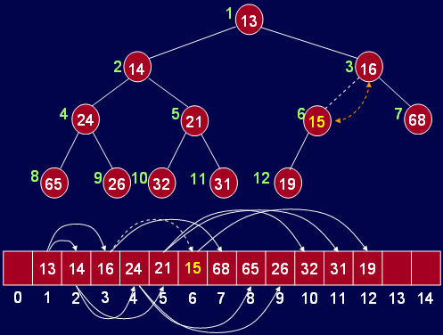
Inserting into a Heap

Slide 20
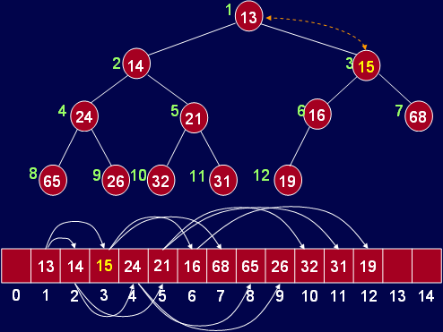
Inserting into a Heap

Slide 21

Inserting into a Heap

Slide 22
DeleteMin from Heap
Finding the minimum is easy; it is at the top of the heap.
Deleting it (or removing it) causes a hole which needs to be filled.

Slide 23
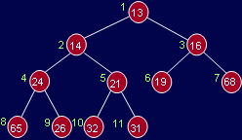
DeleteMin from Heap

Slide 24
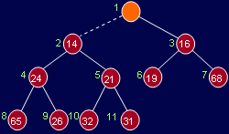
DeleteMin from Heap
deleteMin()

Slide 25
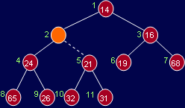
DeleteMin from Heap
deleteMin()

Slide 26
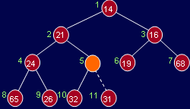
DeleteMin from Heap
deleteMin()

Slide 27
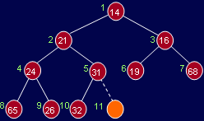
DeleteMin from Heap
deleteMin()

Slide 28
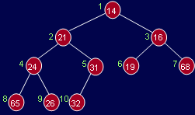
DeleteMin from Heap
deleteMin(): heap size is reduced by 1.

Slide 29
Thank You …

