Slide 1
Lecture # 15

Slide 2
Uses of Binary Trees
Expression Trees

Slide 3
Expression Trees
Expression trees, and the more general parse trees and abstract syntax trees are significant components of compilers.
Compilers usually transforms high level language code into assembly language and then assembler transforms it into machine language which is understandable to low level machine.
Let us consider the expression tree.

Slide 4
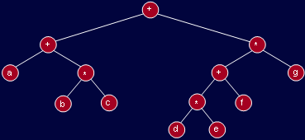
Expression Tree
(a+b*c)+((d*e+f)*g)

Slide 5
Expression Tree
Expression trees are generated inside compilers as in previous example.
Another usage is in spreadsheet software where we write formula for a cell and at the back end the expression tree for that formula is generated.

Slide 6
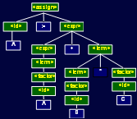
Parse Tree in Compiler
A := A + B * C
Expression grammar
<assign>→ <id> := <expr>
<id>→ A | B | C
<expr>→ <expr> + <term> | <term>
<term>→ <term> * <factor> | <factor>
<factor>→ ( <expr> ) | <id>

Slide 7
Parse Tree in Compiler
Compilers basically generates the above kind of trees based on grammar.
Parsing a program means reading a program and identifying some kind of structures in that based on grammar.

Slide 8
Parse Tree for an SQL query
Consider querying a movie database
Find the titles for movies with stars born in 1960
The database has tables:
StarsIn(title, year, starName) MovieStar(name, address, gender, birthdate)
SELECT title
FROM StarsIn, MovieStar
WHERE starName = name AND birthdate LIKE ‘%1960’ ;

Slide 9
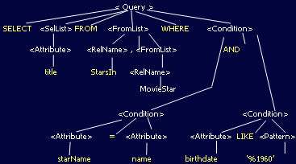
SQL Parse Tree

Slide 10
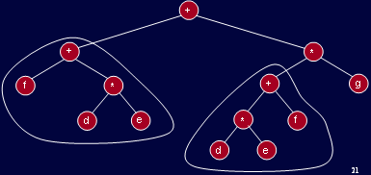
Compiler Optimization
Common subexpression: (f+d*e)+((d*e+f)*g)

Slide 11
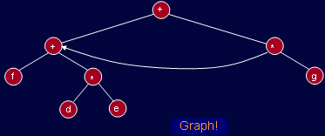
Compiler Optimization
Common subexpression: (f+d*e)+((d*e+f)*g)

Slide 12
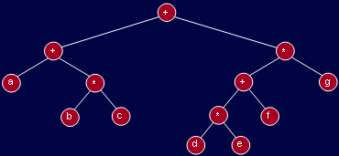
Expression Tree
The inner nodes contain operators while leaf nodes contain operands.

Slide 13
Expression Tree
The tree is binary because the operators are binary.

Slide 14
Expression Tree
This is not necessary. A unary operator (!, e.g.) will have only one subtree.

Slide 15
Expression Tree
In-order traversal yields: a+b*c+d*e+f*g

Slide 16
Expression Tree
Postorder traversal: a b c * + d e * f + g * + which is the postfix form.

Slide 17
Constructing Expression Tree
Algorithm to convert postfix expression into an expression tree.
We already have an expression to convert an infix expression to postfix.
Read a symbol from the postfix expression.
If symbol is an operand, put it in a one node tree and push it on a stack.
If symbol is an operator, pop two trees from the stack, form a new tree with operator as the root and T1 and T2 as left and right subtrees and push this tree on the stack.

Slide 18

Constructing Expression Tree
a b + c d e + * *
Stack is growing left to right

Slide 19

Constructing Expression Tree
a b + c d e + * *
if symbol is an operand, put it in a one node tree and push it on a stack
Stack is growing left to right

Slide 20
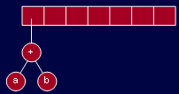
Constructing Expression Tree
a b + c d e + * *
If symbol is an operator, pop two trees from the stack, form a new tree with operator as the root and T1 and T2 as left and right subtrees and push this tree on the stack.
Stack is growing left to right

Slide 21
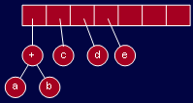
Constructing Expression Tree
a b + c d e + * *
Stack is growing left to right

Slide 22
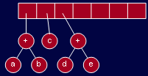
Constructing Expression Tree
a b + c d e + * *
Stack is growing left to right

Slide 23
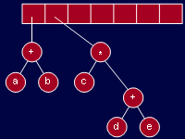
Constructing Expression Tree
a b + c d e + * *
Stack is growing left to right

Slide 24
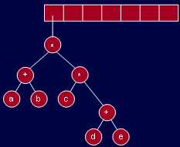
Constructing Expression Tree
a b + c d e + * *
Stack is growing left to right

Slide 25
Other Uses of Binary Trees
Huffman Encoding

Slide 26
Huffman Encoding
Data compression plays a significant role in computer networks.
To transmit data to its destination faster, it is necessary to either increase the data rate of the transmission media or to simply send less data.
Improvements with regard to the transmission media has led to increase in the rate.
The other options is to send less data by means of data compression.
Compression methods are used for text, images, voice and other types of data.

Slide 27
Huffman Encoding
Huffman code is method for the compression for standard text documents.
It makes use of a binary tree to develop codes of varying lengths for the letters used in the original message.
Huffman code is also part of the JPEG image compression scheme.
The algorithm was introduced by David Huffman in 1952 as part of a course assignment at MIT.

Slide 28
Huffman Encoding
To understand Huffman encoding, it is best to use a simple example.
Encoding the 32-character phrase:
"traversing threaded binary trees",
If we send the phrase as a message in a network using standard 8-bit ASCII codes, we would have to send 8*32= 256 bits.
Using the Huffman algorithm, we can send the message with only 116 bits.

Slide 29
Huffman Encoding
List all the letters used, including the "space" character, along with the frequency with which they occur in the message.
Consider each of these (character,frequency) pairs to be nodes; they are actually leaf nodes, as we will see.
Pick the two nodes with the lowest frequency, and if there is a tie, pick randomly amongst those with equal frequencies.

Slide 30
Huffman Encoding
Make a new node out of these two, and make the two nodes its children.
This new node is assigned the sum of the frequencies of its children.
Continue the process of combining the two nodes of lowest frequency until only one node, the root, remains.

Slide 31
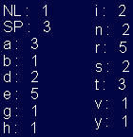
Huffman Encoding
Original text: traversing threaded binary trees
size: 33 characters (space and newline)

Slide 32
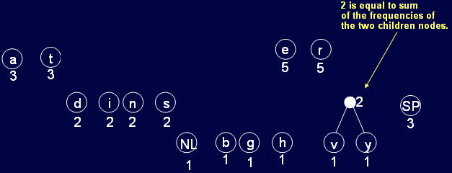
Huffman Encoding

Slide 33
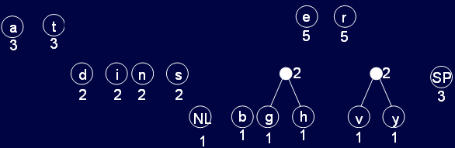
Huffman Encoding
There a number of ways to combine nodes. We have chosen just one such way.

Slide 34
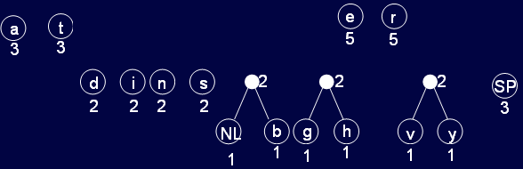
Huffman Encoding

Slide 35
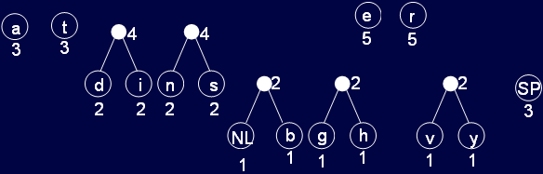
Huffman Encoding

Slide 36
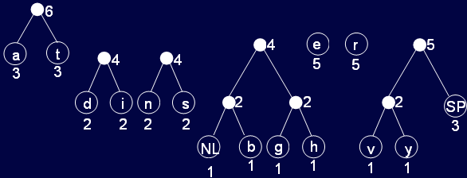
Huffman Encoding

Slide 37
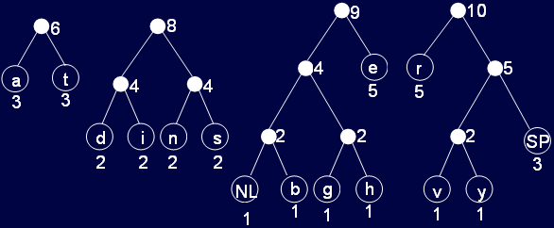
Huffman Encoding

Slide 38
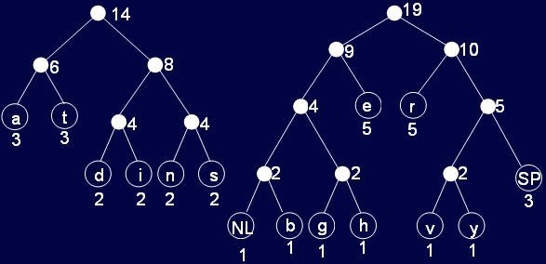
Huffman Encoding

Slide 39
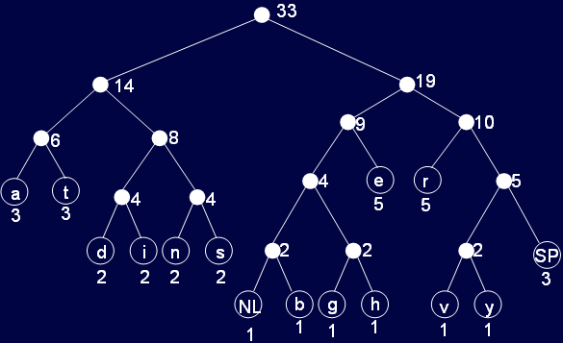
Huffman Encoding

Slide 40
Huffman Encoding
Start at the root. Assign 0 to left branch and 1 to the right branch.
Repeat the process down the left and right subtrees.
To get the code for a character, traverse the tree from the root to the character leaf node and read off the 0 and 1 along the path

Slide 41
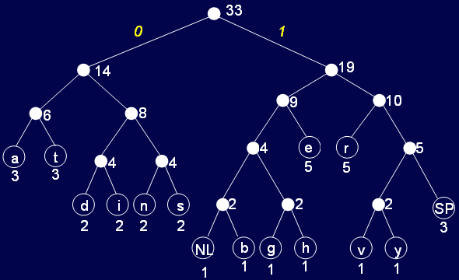
Huffman Encoding

Slide 42
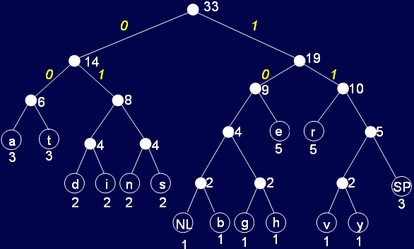
Huffman Encoding

Slide 43
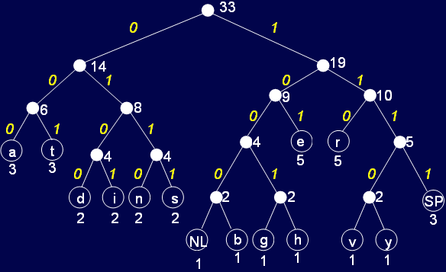
Huffman Encoding

Slide 44
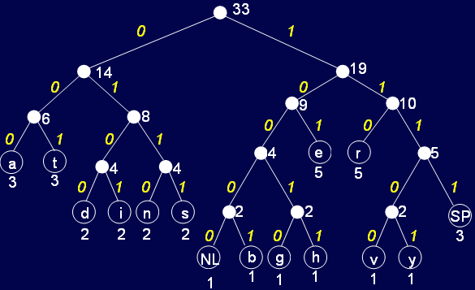
Huffman Encoding

Slide 45
Huffman Encoding
NL⇨ 10000
SP ⇨ 1111
a ⇨ 000
b ⇨ 10001
d ⇨ 0100
e ⇨ 101
g ⇨ 10010
h ⇨ 10011
i ⇨ 0101
n ⇨ 0110
r ⇨ 110
s ⇨ 0111
t ⇨ 001
v ⇨ 11100
y ⇨11101
Notice that the code is variable length.
Letters with higher frequencies have shorter codes.
The tree could have been built in a number of ways; each would yielded different codes but the code would still be minimal.

Slide 46
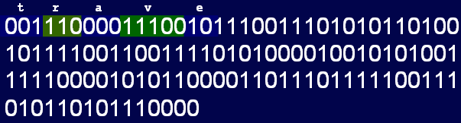
Huffman Encoding
Original: traversing threaded binary trees
Encoded:

Slide 47
Huffman Encoding
Original: traversing threaded binary trees With 8 bits per character, length is 264.
Encoded:
00111000011100101110011101010110100
10111100110011110101000010010101001
11110000101011000011011101111100111
010110101110000
Compressed into 122 bits, 54% reduction.

Slide 48
Thank You …

