Slide 1
Lecture # 3
Linked List

Slide 2
Office Hours
Tuesday: 2:30 pm – to – 4:00 pm
Friday: 2:30 pm – to – 4:00 pm
Important NOTE:
Assignments to be submitted only during office hours
Any Query regarding lecture/course to be answered only in office hours.
Please try to follow office hours strictly.

Slide 3
Link List is a Data Structure in which elements are explicitly ordered, that is each item contains within itself the address of next item.
The array implementation has the serious drawback and that is we must specify size at the construction time though it is simple and fast.
Murphy’s Law:
Construct an array with space for n = twice your estimate of largest collection
Tomorrow you will need n+1

Slide 4

Linked List
Create a structure called a Node.
The object field will hold the actual list element.
The next field in the structure will hold the starting location of the next node.
Chain the nodes together to form a linked list.

Slide 5
node
A very common source of problems in program maintenance is the need to increase the capacity of a program to handle larger collections.
In a linked list, each item is allocated space as it is added to the list. A link is kept with each item to the next item in the list.
node
node
node
Item next
Item next
Item next
Item next
NULL

Slide 6
Each node of the list has two elements:
The item being stored in the list and
A pointer to the next item in the list
The last node in the list contains a NULL pointer to indicate that it is the end or tail of the list.
As items are added to a list, memory for a node is dynamically allocated. Thus the number of items that may be added to a list is limited only by the amount of memory available.
Handle of the LL : The variable ( or handle) which represents the list, is simply a pointer to the node at the head of the list.

Slide 7

Linked List
Picture of our list (2, 6, 7, 8, 1) stored as a linked list:

Slide 8
struct node
{
char name[15];
node *next;
};

Slide 9
Linked List
Note some features of the list:
Need a head to point to the first node of the list. Otherwise we won’t know where the start of the list is.
The current here is a pointer, not an index.
The next field in the last node points to nothing. We will place the memory address NULL which is guaranteed to be inaccessible.

Slide 10
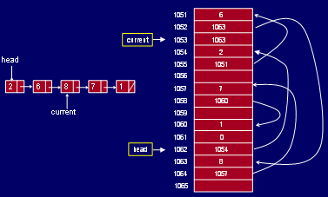
Linked List Actual picture in memory:

Slide 11
Operations of Link List
Adding (Inserting) to a Link List (LL) : The simplest strategy for adding an item to a list is to:
Allocate space for a new node.
Copy the item value into it.
Make the new node’s next pointer point to the current head of the list and
Make the head of the list point to the newly allocated node.
This strategy is fast and efficient but each item is added to the head of the list.

Slide 12
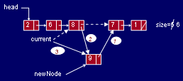
Adding element into link list

Slide 13
Searching a Link List :
To search a list of n objects or elements the search function takes n operations to search a data item in the LL in worst case, since it may have to search the entire link list.

Slide 14
Deletion from Link List :
This removes a data item’s node (block) from the start of link list. Pointer must be pointing to that node which has to be deleted and then pointer will have to be updated.
But if we wish to delete the particular node (block) with given key to match, then we have to search for that node (block) in the entire Link List.

Slide 15

removing element from link list

Slide 16
Implementation of Link List
Discussion on White Board from C++ point of view
Searching
Addition
Deletion etc ....

Slide 17
Assignment # 2
Implement a Linked List (LL) discussed above including following operations.
Insertion of node at any place in LL.
Deletion of node at any place in LL
Searching for a node at any place in LL
Printing whole Linked List (LL)
Checking emptiness of the LL
Due Date: next week same day (In Office Hours)

