Slide 1
Lecture # 16

Slide 2
Mathematical Properties of Binary Trees

Slide 3
Properties of Binary Tree
Property:
A binary tree with N internal nodes has N+1 external nodes.

Slide 4

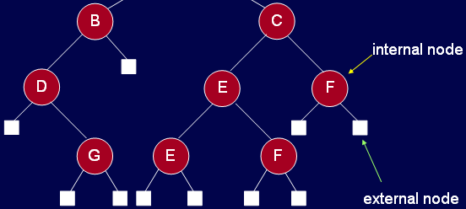
Properties of Binary Tree
A binary tree with N internal nodes has N+1 external nodes.
internal nodes: 9
external nodes: 10

Slide 5
Properties of Binary Tree
Property:
A binary tree with N internal nodes has 2N links: N-1 links to internal nodes and N+1 links to external nodes.

Slide 6
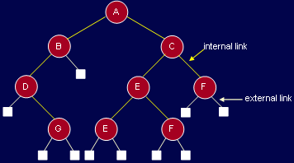
Properties of Binary Tree
Internal links: 8
External links: 10

Slide 7
Properties of Binary Tree
Property: A binary tree with N internal nodes has 2N links: N-1 links to internal nodes and N+1 links to external nodes.
In every rooted tree, each node, except the root, has a unique parent.
Every link connects a node to its parent, so there are N-1 links connecting internal nodes.
Similarly, each of the N+1 external nodes has one link to its parent.
Thus N-1+N+1=2N links.

Slide 8
Threaded Binary Tree
In many applications binary tree traversals are carried out repeatedly.
The overhead of stack operations during recursive calls can be costly.
The same would true if we use a non-recursive but stack-driven traversal procedure
It would be useful to modify the tree data structure which represents the binary tree so as to speed up, say, the inorder traversal process: make it "stack-free”.

Slide 9
Threaded Binary Tree
Oddly, most of the pointer fields in our representation of binary trees are NULL!
Since every node (except the root) is pointed to, there are only N-1 non-NULL pointers out of a possible 2N (for an N node tree), so that N+1 pointers are NULL

Slide 10
Threaded Binary Tree
Internal links: 8
External links: 10

Slide 11
Threaded Binary Tree
The threaded tree data structure will replace these NULL pointers with pointers to the inorder successor (predecessor) of a node as appropriate.
We'll need to know whenever formerly NULL pointers have been replaced by non NULL pointers to successor/predecessor nodes, since otherwise there's no way to distinguish those pointers from the customary pointers to children.

Slide 12
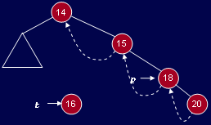
Threaded Binary Tree
t->L = p->L; // copy thread
t->LTH = thread;
t->R = p; // *p is successor of *t
t->RTH = thread;
p->L = t; // attach the new leaf
p->LTH = child;

Slide 13
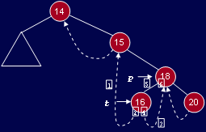
Threaded Binary Tree
1. t->L = p->L; // copy the thread 2. t->LTH = thread; 3. t->R = p; // *p is successor of *t 4. t->RTH = thread; 5. p->L = t; // attach the new leaf 6. p->LTH = child;

Slide 14
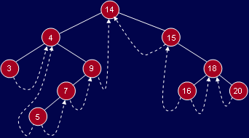
Threaded Binary Tree

Slide 15
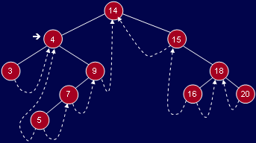
Routine: nextInorder( )
TreeNode* nextInorder(TreeNode* p)
{
if(p->RTH == thread)
return(p->R);
else
{
p = p->R;
while(p->LTH == child)
p = p->L;
return p;
}
}

Slide 16
Where is inorder successor?
Inorder successor of 4.

Slide 17
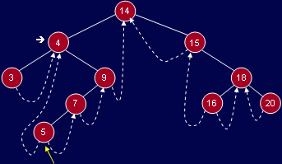
Where is inorder successor?
Inorder successor of 4.
Left-most node in right subtree of 4

Slide 18
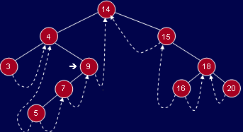
Where is inorder successor?
Inorder successor of 9.
Follow right thread to 14

Slide 19
Inorder traversal
If we can get things started correctly, we can simply call nextInorder repeatedly (in a simple loop) and move rapidly around the tree inorder printing node labels (say) - without a stack.
If we call nextInorder with the root of the binary tree, we're going to have some difficulty. The code won't work at all the way we want

Slide 20
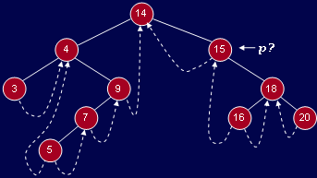
Calling nextInorder with root
TreeNode* nextInorder(TreeNode* p){
if(p->RTH == thread) return(p->R);
else {
p = p->R;
while(p->LTH == child)
p = p->L;
return p;
}
}
What is the Problem?

Slide 21
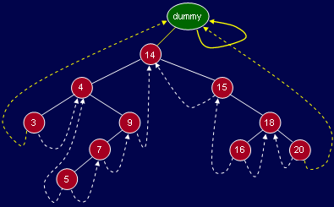
Fix with Dummy Node

Slide 22
Inorder traversal
void fastInorder(TreeNode* p)
{
while( ( p=nexInorder(p) ) != dummy )
cout << p->getInfo();
}
Start the inorder traversal by calling fastInorder(dummy)
TreeNode* nextInorder(TreeNode* p)
{
if(p->RTH == thread) return(p->R);
else {
p = p->R;
while(p->LTH == child)
p = p->L;
return p;
}
}

Slide 23
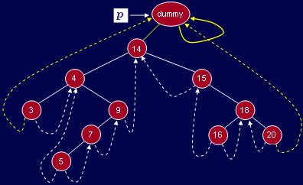
Trace or nextInorder

Slide 24
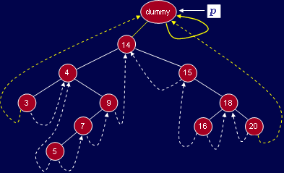
Trace or nextInorder

Slide 25
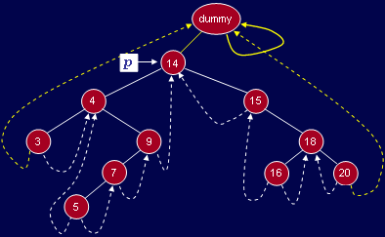
Trace or nextInorder

Slide 26
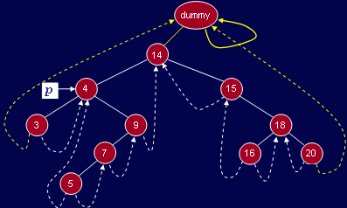
Trace or nextInorder

Slide 27
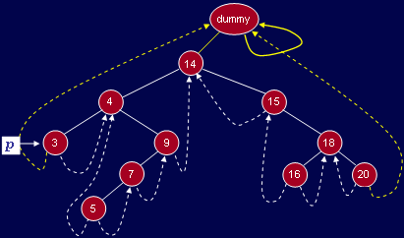
Trace or nextInorder

Slide 28
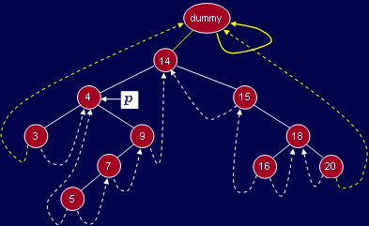
Trace or nextInorder

Slide 29
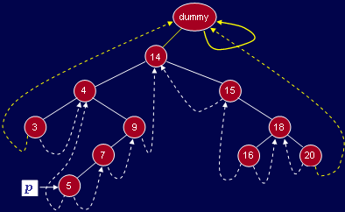
Trace or nextInorder

Slide 30
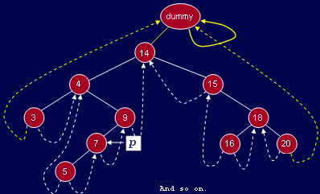
Trace or nextInorder

Slide 31
Thank You …

