Slide 1
Lecture # 8
Notes:
<number>

Slide 2
Uses of Queue
Discussing Problem:
Rearranging Railroad Cars
(Book Page No 297, Sahni)
Notes:
<number>

Slide 3
Queue using Array
If we use an array to hold queue elements, both insertions and removal at the front (start) of the array are expensive.
This is because we may have to shift up to “n” elements.
For the stack, we needed only one end; for queue we need both.
To get around this, we will not shift upon removal of an element.
Notes:
<number>

Slide 4
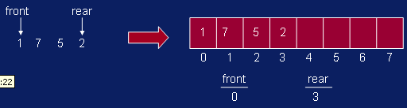
Queue using Array
Notes:
<number>

Slide 5
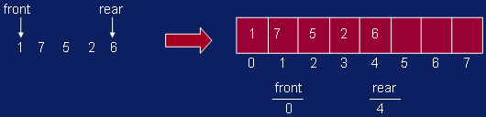
Queue using Array
Notes:
<number>

Slide 6
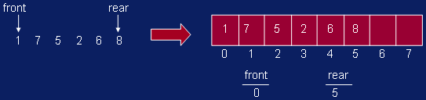
Queue using Array
Notes:
<number>

Slide 7
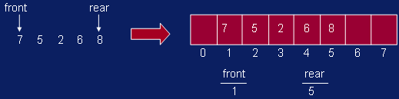
Queue using Array
Notes:
<number>

Slide 8
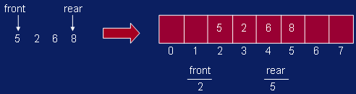
Queue using Array
Notes:
<number>

Slide 9
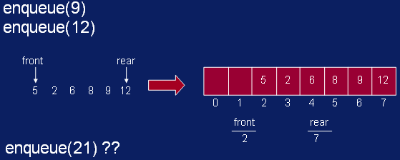
Queue using Array
Notes:
<number>

Slide 10
Queue using Array
We have inserts and removal running in constant time but we created a new problem.
Cannot insert new elements even though there are two places available at the start of the array.
Solution: allow the queue to “wrap around”.
Notes:
<number>

Slide 11
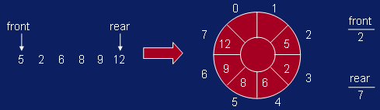
Queue using Array
Basic idea is to picture the array as a circular array.
Notes:
<number>

Slide 12
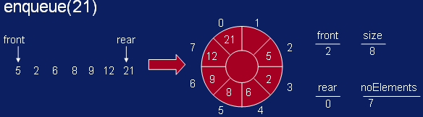
Queue using Array
Notes:
<number>

Slide 13
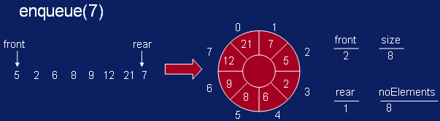
Queue using Array
Notes:
<number>

Slide 14
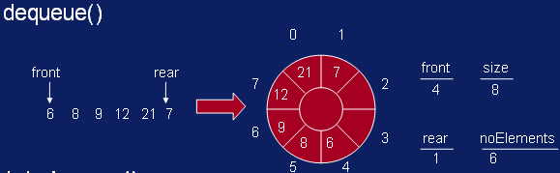
Queue using Array
Notes:
<number>

