Slide 1
Lecture # 13

Slide 2

AVL Tree Building Example

Slide 3
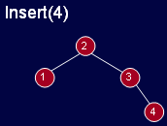
AVL Tree Building Example

Slide 4
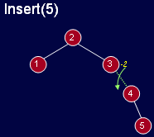
AVL Tree Building Example

Slide 5
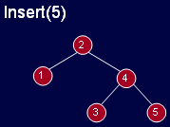
AVL Tree Building Example

Slide 6
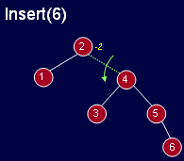
AVL Tree Building Example

Slide 7
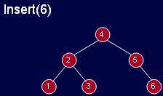
AVL Tree Building Example

Slide 8
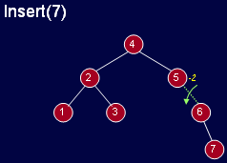
AVL Tree Building Example

Slide 9
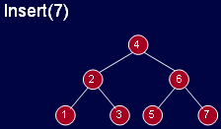
AVL Tree Building Example

Slide 10
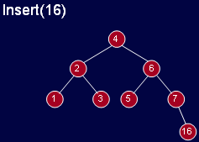
AVL Tree Building Example

Slide 11
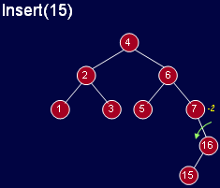
AVL Tree Building Example

Slide 12
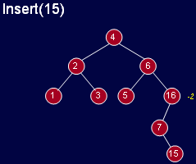
AVL Tree Building Example

Slide 13
Cases for Rotation
Single rotation does not seem to restore the balance.
The problem is the node 15 is in an inner subtree that is too deep.
Let us revisit the rotations.

Slide 14
Cases for Rotation
Let us call the node that must be rebalanced Ň.
Since any node has at most two children, and a height imbalance requires that Ň’s two subtrees differ by two (or –2), the violation will occur in four cases:

Slide 15
Cases for Rotation
An insertion into left subtree of the left child of Ň.
An insertion into right subtree of the left child of Ň.
An insertion into left subtree of the right child of Ň.
An insertion into right subtree of the right child of Ň.

Slide 16
Cases for Rotation
The insertion occurs on the “outside” (i.e., left-left or right-right) in cases 1 and 4
Single rotation can fix the balance in cases 1 and 4.
Insertion occurs on the “inside” in cases 2 and 3 which single rotation cannot fix.

Slide 17
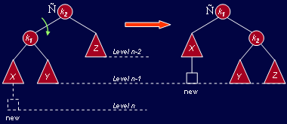
Cases for Rotation
Single right rotation to fix case 1.

Slide 18
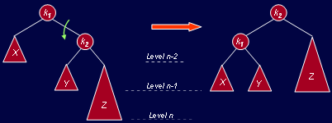
Cases for Rotation
Single left rotation to fix case 4.

Slide 19
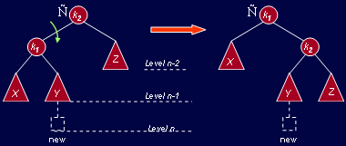
Cases for Rotation
Single right rotation fails to fix case 2.

Slide 20
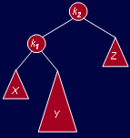
Cases for Rotation
Y is non-empty because the new node was inserted in Y.
Thus Y has a root and two subtrees.
View the entire tree with four subtrees connected with 3 nodes.

Slide 21
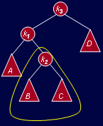
Cases for Rotation
Y is non-empty because the new node was inserted in Y.
Thus Y has a root and two subtrees.
View the entire tree with four subtrees connected with 3 nodes.

Slide 22
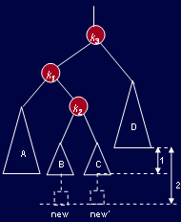
Cases for Rotation
Exactly one of tree B or C is two levels deeper than D; we are not sure which one.
Good thing: it does not matter where it is added.
To rebalance, k3 cannot be left as the root.
New node inserted at either of the two spots

Slide 23
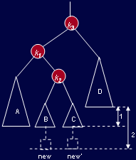
Cases for Rotation
A rotation between k3 and k1 (k3 was k2 then) was shown to not work.
The only alternative is to place k2 as the new root.
This forces k1 to be k2‘s left child and k3 to be its right child.

Slide 24
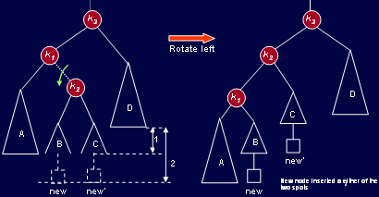
Cases for Rotation
Left-right double rotation to fix case 2.

Slide 25
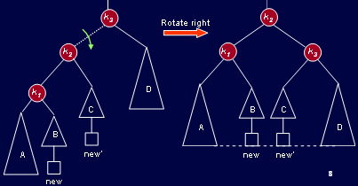
Cases for Rotation
Left-right double rotation to fix case 2.

Slide 26
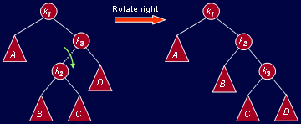
Cases for Rotation
Right-left double rotation to fix case 3 .

Slide 27
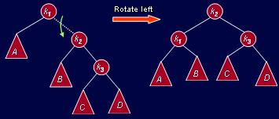
Cases for Rotation
Right-left double rotation to fix case 3 .

Slide 28
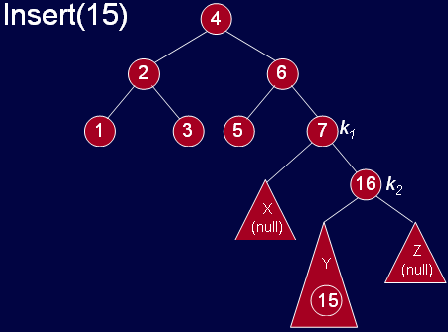
AVL Tree Building Example

Slide 29
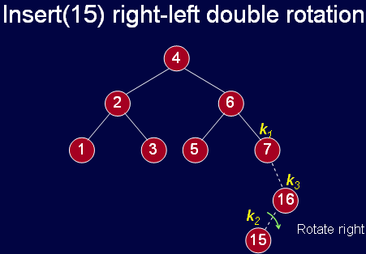
AVL Tree Building Example

Slide 30
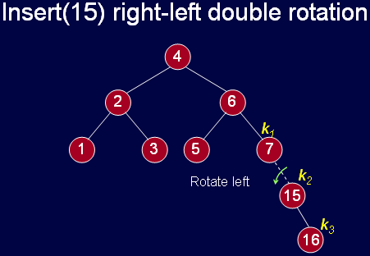
AVL Tree Building Example

Slide 31
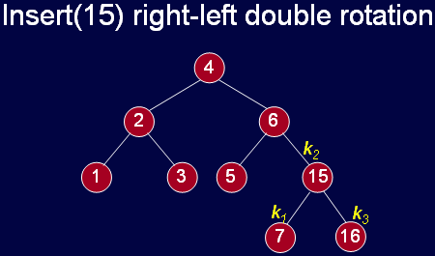
AVL Tree Building Example

Slide 32
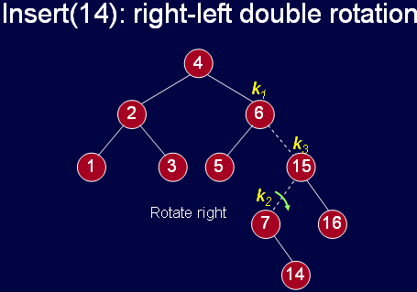
AVL Tree Building Example

Slide 33
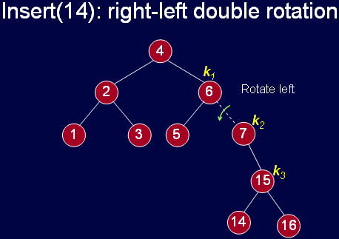
AVL Tree Building Example

Slide 34
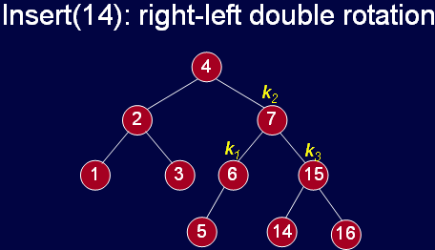
AVL Tree Building Example

Slide 35
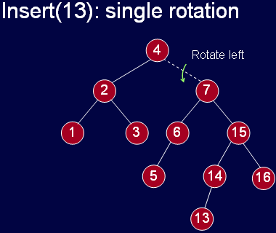
AVL Tree Building Example

Slide 36
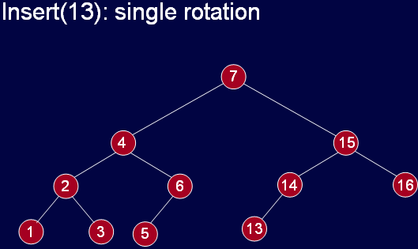
AVL Tree Building Example

Slide 37
Thanks …

