Slide 1
Lecture # 10
Notes:
<number>

Slide 2
Operations on Binary Tree
There are a number of operations that can be defined for a binary tree.
If p is pointing to a node in an existing tree then
left(p) returns pointer to the left subtree
right(p) returns pointer to right subtree
parent(p) returns the father of p
brother(p) returns brother of p.
info(p) returns content of the node.
Notes:
<number>

Slide 3
Operations on Binary Tree
In order to construct a binary tree, the following can be useful:
setLeft(p,x) creates the left child node of p. The child node contains the info ‘x’.
setRight(p,x) creates the right child node of p. The child node contains the info ‘x’.
Notes:
<number>

Slide 4
Applications of Binary Trees
A binary tree is a useful data structure when two-way decisions must be made at each point in a process.
For example, suppose we wanted to find all duplicates in a list of numbers: 14, 15, 4, 9, 7, 18, 3, 5, 16, 4, 20, 17, 9, 14, 5
Notes:
<number>

Slide 5
Applications of Binary Trees
One way of finding duplicates is to compare each number with all those that precede it.
14, 15, 4, 9, 7, 18, 3, 5, 16, 4, 20, 17, 9, 14, 5
14, 15, 4, 9, 7, 18, 3, 5, 16, 4, 20, 17, 9, 14, 5
Notes:
<number>

Slide 6
Searching for Duplicates
If the list of numbers is large and is growing, this procedure involves a large number of comparisons.
A linked list could handle the growth but the comparisons would still be large.
The number of comparisons can be drastically reduced by using a binary tree.
The tree grows dynamically like the linked list.
Notes:
<number>

Slide 7
Searching for Duplicates
The binary tree is built in a special way.
The first number in the list is placed in a node that is designated as the root of a binary tree.
Initially, both left and right subtrees of the root are empty.
We take the next number and compare it with the number placed in the root.
If it is the same then we have a duplicate.
Notes:
<number>

Slide 8
Searching for Duplicates
Otherwise, we create a new tree node and put the new number in it.
The new node is made the left child of the root node if the second number is less than the one in the root.
The new node is made the right child if the number is greater than the one in the root.
Notes:
<number>

Slide 9
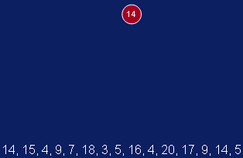
Searching for Duplicates
Notes:
<number>

Slide 10
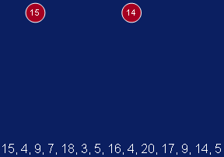
Searching for Duplicates
Notes:
<number>

Slide 11
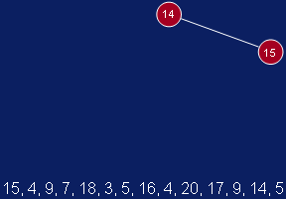
Searching for Duplicates
Notes:
<number>

Slide 12
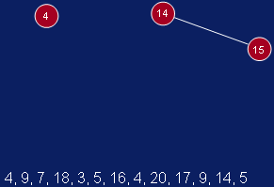
Searching for Duplicates
Notes:
<number>

Slide 13
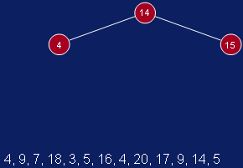
Searching for Duplicates
Notes:
<number>

Slide 14
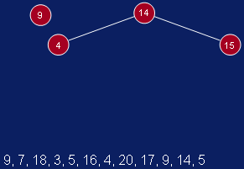
Searching for Duplicates
Notes:
<number>

Slide 15
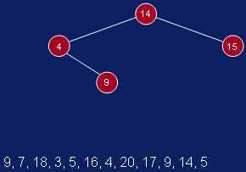
Searching for Duplicates
Notes:
<number>

Slide 16
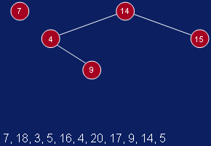
Searching for Duplicates
Notes:
<number>

Slide 17
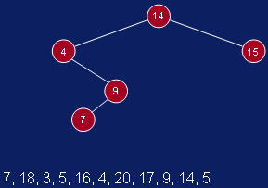
Searching for Duplicates
Notes:
<number>

Slide 18
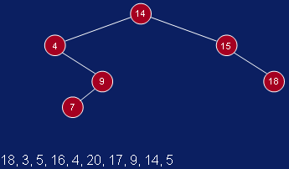
Notes:
<number>

Slide 19
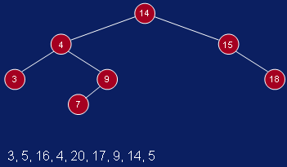
Notes:
<number>

Slide 20
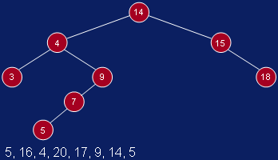
Notes:
<number>

Slide 21
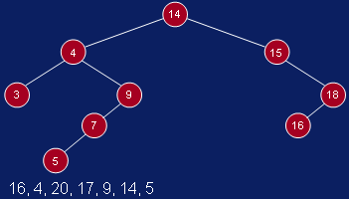
Notes:
<number>

Slide 22
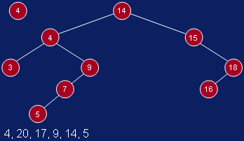
Duplicate (4) Appeared …..
Notes:
<number>

Slide 23
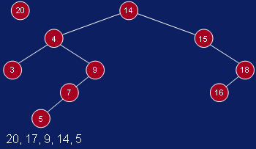
Notes:
<number>

Slide 24
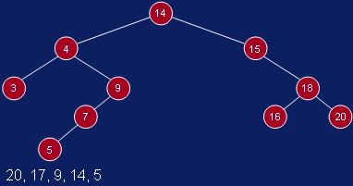
Notes:
<number>

Slide 25
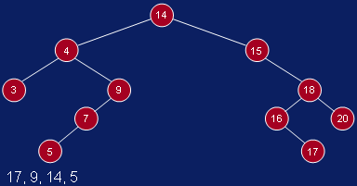
Notes:
<number>

Slide 26
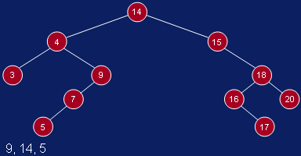
Duplicate (9), (14), (5), Appeared …..
Notes:
<number>

Slide 27
Tree Traversals
PreOrder
InOrder
PostOrder
Notes:
<number>

Slide 28
Preorder
To traverse non empty binary tree in Preorder, we perform the following operations.
Visit the Root
Traverse the left sub tree in preorder
Traverse the right sub tree in preorder
Notes:
<number>

Slide 29
Inorder
To traverse a non empty binary tree in Inorder (or Symmetric Order), we perform the following operations.
Traverse the left sub tree in Inorder
Visit the Root
Traverse the right sub tree in Inorder
Notes:
<number>

Slide 30
Postorder
To traverse non empty binary tree in Postorder, we perform the following operations.
Traverse the left sub tree in postorder
Traverse the right sub tree in postorder
Visit the Root
Notes:
<number>

Slide 31
Example of Tree Traversals
A
B
C
D
E
F
G
H
I
J
K
L
PreOrder : A B C E I F J D G H K L
InOrder : E I C F J B G D K H L A
PostOrder : I E J F C G K L H D B A
Notes:
<number>

