Slide 1
Lecture # 12

Slide 2
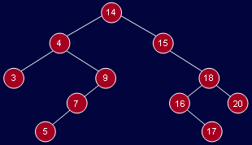
Binary Search Trees
BST for 14, 15, 4, 9, 7, 18, 3, 5, 16, 20, 17

Slide 3
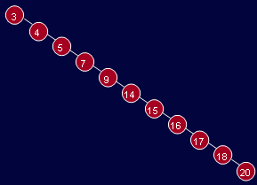
Binary Search Trees
BST for 3 4 5 7 9 14 15 16 17 18 20

Slide 4
Balanced BST
We should keep the tree balanced.
One idea would be to have the left and right subtrees have the same height

Slide 5
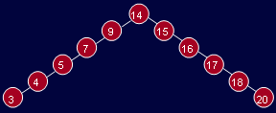
Balanced BST

Slide 6
Balanced BST
We could insist that every node must have left and right subtrees of same height.
But this requires that the tree be a complete binary tree
To do this, there must have (2^{d+1} – 1) data items, where d is the depth of the tree.
This is too rigid a condition.

Slide 7
AVL Trees

Slide 8
AVL Trees
AVL (Adelson-Velskii and Landis) tree.
An AVL tree is identical to a BST except
height of the left and right subtrees can differ by at most 1.
height of an empty tree is defined to be (–1).

Slide 9
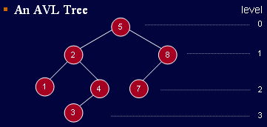
AVL Trees

Slide 10
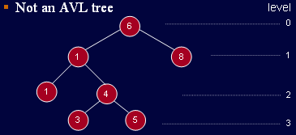
AVL Trees

Slide 11
Balanced Binary Tree
The height of a binary tree is the maximum level of its leaves (also called the depth).
The balance of a node in a binary tree is defined as the height of its left subtree minus height of its right subtree.
Here, for example, is a balanced tree. Each node has an indicated balance of 1, 0, or –1.

Slide 12
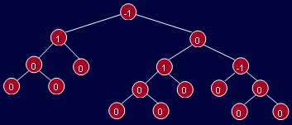
Balanced Binary Tree

Slide 13
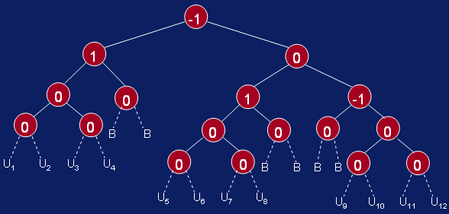
Balanced Binary Tree
Insertions and effect on balance

Slide 14
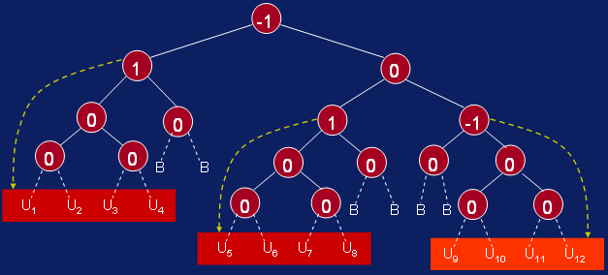
Balanced Binary Tree
Insertions and effect on balance

Slide 15
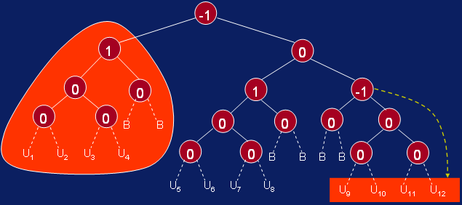

Slide 16
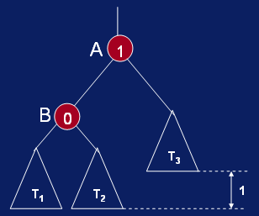
Inserting New Node in AVL Tree

Slide 17
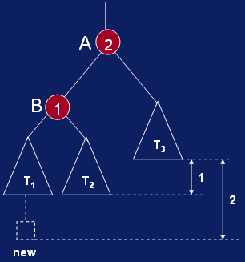
Inserting New Node in AVL Tree

Slide 18
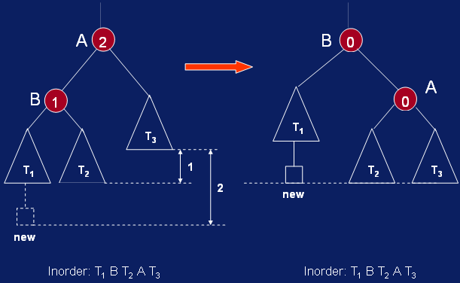
Inserting New Node in AVL Tree

Slide 19

AVL Tree Building Example

Slide 20
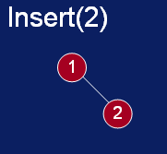
AVL Tree Building Example

Slide 21
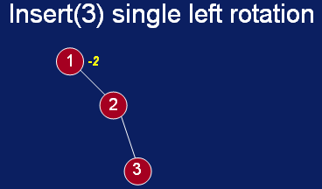
AVL Tree Building Example

Slide 22
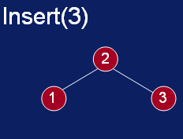
AVL Tree Building Example

Slide 23
Thanks …

