Slide 1
Lecture # 14

Slide 2
Deletion in AVL Tree
Delete is the inverse of insert: given a value X and an AVL tree T, delete the node containing X and rebalance the tree, if necessary.
Turns out that deletion of a node is considerably more complex than insert

Slide 3
Deletion in AVL Tree
Insertion in a height-balanced tree requires at most one single rotation or one double rotation.
We can use rotations to restore the balance when we do a deletion.
We may have to do a rotation at every level of the tree.

Slide 4
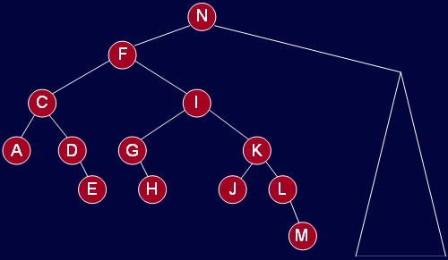
Deletion in AVL Tree
Here is a tree that causes this worse case number of rotations when we delete A. At every node in N’s left subtree, the left subtree is one shorter than the right subtree.

Slide 5
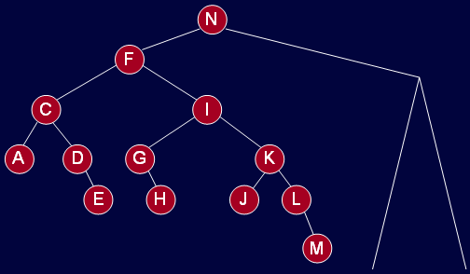
Deletion in AVL Tree
Deleting A upsets balance at C. When rotate (D up, C down) to fix this

Slide 6
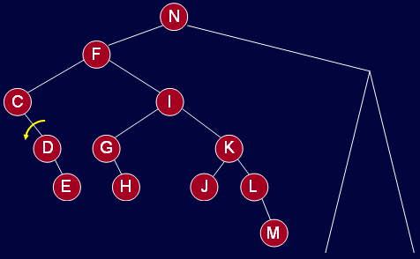
Deletion in AVL Tree
Deleting A upsets balance at C. When rotate (D up, C down) to fix this

Slide 7
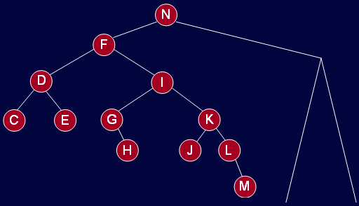
Deletion in AVL Tree
The whole of F’s left subtree gets shorter. We fix this by rotation about F-I: F down, I up.

Slide 8
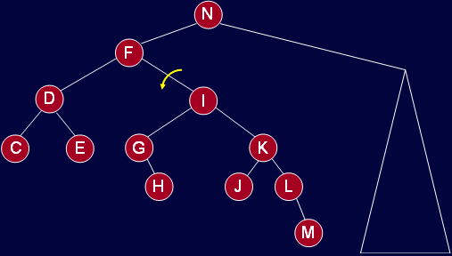
Deletion in AVL Tree
The whole of F’s left subtree gets shorter. We fix this by rotation about F-I: F down, I up.

Slide 9
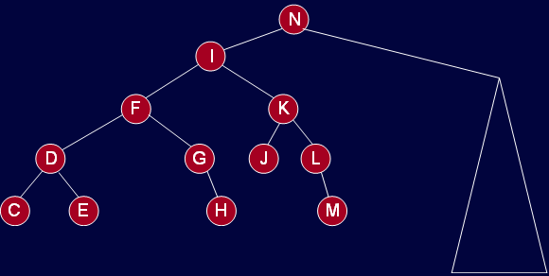
Deletion in AVL Tree
This could cause imbalance at N.
The rotations propagated to the root.

Slide 10
Deletion in AVL Tree
Procedure
Delete the node as in binary search tree (BST).
The node deleted will be either a leaf or have just one subtree.
Since this is an AVL tree, if the deleted node has one subtree, that subtree contains only one node (why?)
Traverse up the tree from the deleted node checking the balance of each node.

Slide 11
Deletion in AVL Tree
There are 5 cases to consider.
Let us go through the cases graphically and determine what action to take.
We will not develop the C++ code for deleteNode in AVL tree. This will be left as an exercise.

Slide 12
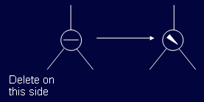
Deletion in AVL Tree
Case 1a: the parent of the deleted node had a balance of 0 and the node was deleted in the parent’s left subtree.
Action: change the balance of the parent node and stop. No further effect on balance of any higher node.

Slide 13
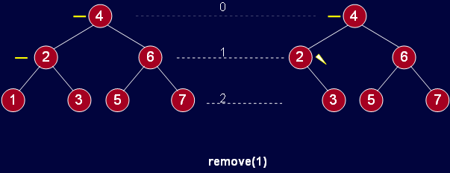
Deletion in AVL Tree
Here is why; the height of left tree does not change.

Slide 14
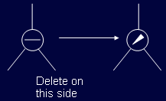
Deletion in AVL Tree
Case 1b: the parent of the deleted node had a balance of 0 and the node was deleted in the parent’s right subtree.
Action: (same as 1a) change the balance of the parent node and stop. No further effect on balance of any higher node.

Slide 15
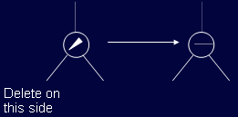
Deletion in AVL Tree
Case 2a: the parent of the deleted node had a balance of 1 and the node was deleted in the parent’s left subtree.
Action: change the balance of the parent node. May have caused imbalance in higher nodes so continue up the tree.

Slide 16
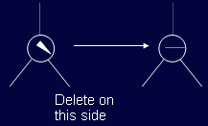
Deletion in AVL Tree
Case 2b: the parent of the deleted node had a balance of -1 and the node was deleted in the parent’s right subtree.
Action: same as 2a: change the balance of the parent node. May have caused imbalance in higher nodes so continue up the tree.

Slide 17
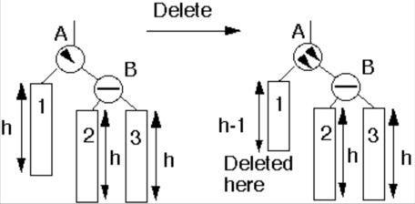
Deletion in AVL Tree
Case 3a: the parent had balance of -1 and the node was deleted in the parent’s left subtree, right subtree was balanced

Slide 18
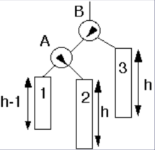
Deletion in AVL Tree
Case 3a: the parent had balance of -1 and the node was deleted in the parent’s left subtree, right subtree was balanced.
Action: perform single rotation, adjust balance. No effect on balance of higher nodes so stop here.
Single Rotate

Slide 19
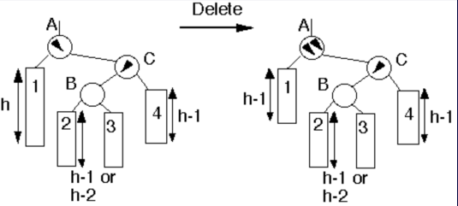
Deletion in AVL Tree
Case 4a: parent had balance of -1 and the node was deleted in the parent’s left subtree, right subtree was unbalanced.

Slide 20
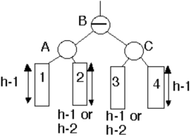
Deletion in AVL Tree
Case 4a: parent had balance of -1 and the node was deleted in the parent’s left subtree, right subtree was unbalanced.
Action: Double rotation at B. May have effected the balance of higher nodes, so continue up the tree.
Double Rotate

Slide 21
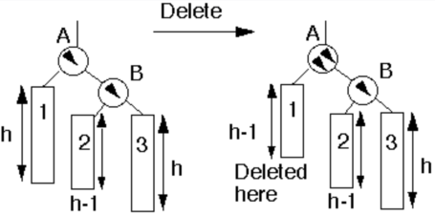
Deletion in AVL Tree
Case 5a: parent had balance of -1 and the node was deleted in the parent’s left subtree, right subtree was unbalanced.

Slide 22
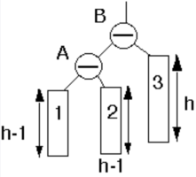
Deletion in AVL Tree
Case 5a: parent had balance of -1 and the node was deleted in the parent’s left subtree, right subtree was unbalanced.
Action: Single rotation at B. May have effected the balance of higher nodes, so continue up the tree.
Single Rotate

Slide 23
Thanks …

