Slide 1
Lecture # 4

Slide 2
Doubly Link List

Slide 3
In a Doubly linked list, each item is allocated space as it is added to the list. A link is kept with each item to the next item and previous item in the list.
Each node of the list has three elements:
The item being stored in the list
A pointer to the next item in the list
A pointer to the previous item in the list
The last node in the list contains a NULL pointer (next) to indicate that it is the end or tail of the list and first node contains NULL pointer for previous pointer to indicate that it is head of the Link List.

Slide 4
head
Figure showing Doubly Link List …..
NULL
A
B
C
D
E
NULL
Structure corresponding to above will be struct node { char info; node *next; node *previous; };

Slide 5

Adding element - Doubly-Linked List

Slide 6
Deletion - Doubly-Linked List
How ….
Think yourself
Discussion from Implementation (code) point of view.

Slide 7
Circular Link List (Ring)
Ring data structure can be regarded as circular Link List.
In Link List, instead of making last node’s next pointer to NULL, we can assign or point it to head node so that it sounds as ring data structure as follows.

Slide 8
head
Figure showing Ring…..
A
B
C
D
E
OR
B
A
head
C
E
D

Slide 9
Josephus Problem
A case where circularly linked list is handy to provide the solution of the Josephus Problem.
Consider there are 10 persons. They would like to choose a leader.
The way they decide is that all 10 sit in a circle.
They start a count with person 1 and go in clockwise direction and skip 3. Person 4 reached is eliminated.
The count starts with the fifth and the next person to go is the fourth in count.
Eventually, a single person remains.

Slide 10
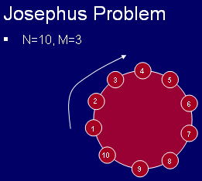

Slide 11
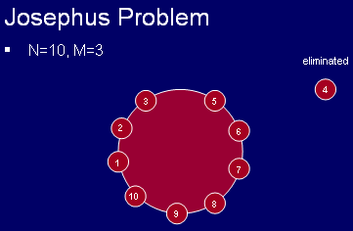

Slide 12
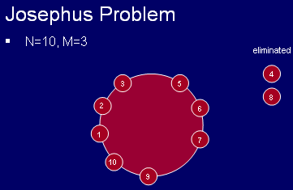

Slide 13
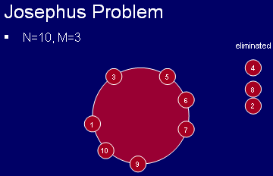

Slide 14
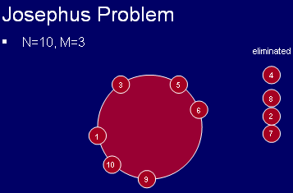

Slide 15
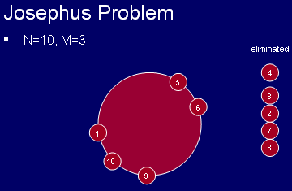

Slide 16
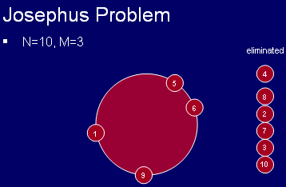

Slide 17
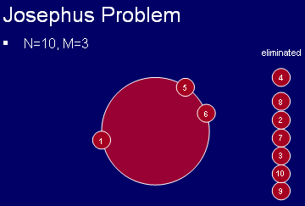

Slide 18
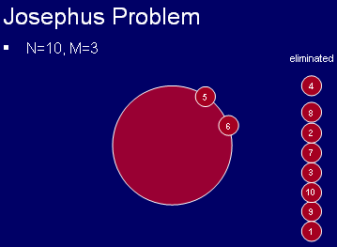

Slide 19
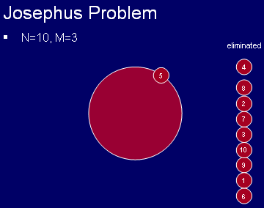

Slide 20
Doubly Ring
Doubly Ring data structure can be regarded as Circular Doubly Link List.
In Circular Doubly Link List, instead of making last node’s next pointer to NULL, We assign or point it to head node. Similarly, first (head) node’s previous pointer is pointed to last node in list . so that it sounds as Doubly Ring data structure.

Slide 21
head
Figure showing Doubly Ring…..
A
B
C
D
E
OR
B
A
head
C
E
D

Slide 22
Assignment # 3
Implement a Josephus Problem discussed above with following conditions.
Decide value of M and N at run time.
Assign numbers to every node.
Initiate the problem from node number 1.
Submission Due Date: Next week, same day
(In Office Hours)

