Slide 1

Host-Based FIREWALL
Represented by:
Saad Ahmad (20P-0051)

Slide 2
What is a Host-Based Firewall?
A host-based firewall is a software program that runs on a server or other computer and controls traffic in and out of that computer.

Slide 3
where is host based firewall used?
A host-based firewall is firewall software that is installed directly on a computer. Host-based firewalls help detect and stop viruses, malware and other malicious scripts that may not have been caught by network security and to enhance internal security

Slide 4
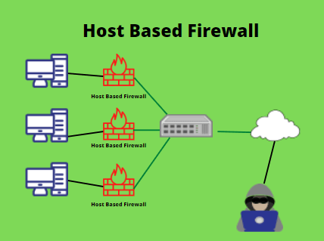

Slide 5
Practical application
Windows:
Windows Firewall (by default)
Linux:
iptables
firewalld

Slide 6
How Does Host-Based Firewall Work?
Host-based firewalls work by creating a list of rules that specify which traffic is allowed and which is not.
sudo iptables -A INPUT -i lo -j ACCEPT
sudo iptables -A OUTPUT -o lo -j ACCEPT
sudo iptables -A INPUT -o [ip-address] -j DROP
sudo iptables -A OUTPUT -o [ip-address] -j DROP

Slide 7
PROS/CONS
Pros:
You can tailor the security rules to your specific needs.
They can be more effective than network-based firewalls at blocking certain types of attacks.
Cons:
They may block legitimate traffic if they are not configured correctly.
They require each device to be configured individually.

Slide 8
Thank you

