Slide 1

Tafreeh
By:
Farhan Abbasi (20P-0044)
Usama Yazdani (20P-0598)
Saad Ahmad (20P-0044)

Slide 2
Executive Summary

Slide 3
Our business startup “TAFREEH” is a tourism service provider which deals in providing services like providing tourism packages, tickets, tourism guides for the foreigners as well as the locals who seek to explore the beautiful places.
Our aim is to provide a friendly and comfortable atmosphere where the customers can receive services at a reasonable price and give beautiful places of our country an exposure to the tourists to rank up our country in terms of tourism on national as well as on international level.
Our business will be operating on the multiple locations(tourist spot) the executive branch will operate in Islamabad being a capital of Pakistan.
The members of our executive team will be the locals having well knowledge of that specific tourist spot where our business will be operating.
Our business will be affiliated with PTDC (Pakistan Tourism Development Corporation) for the financial resources.

Slide 4
Company Profile

Slide 5
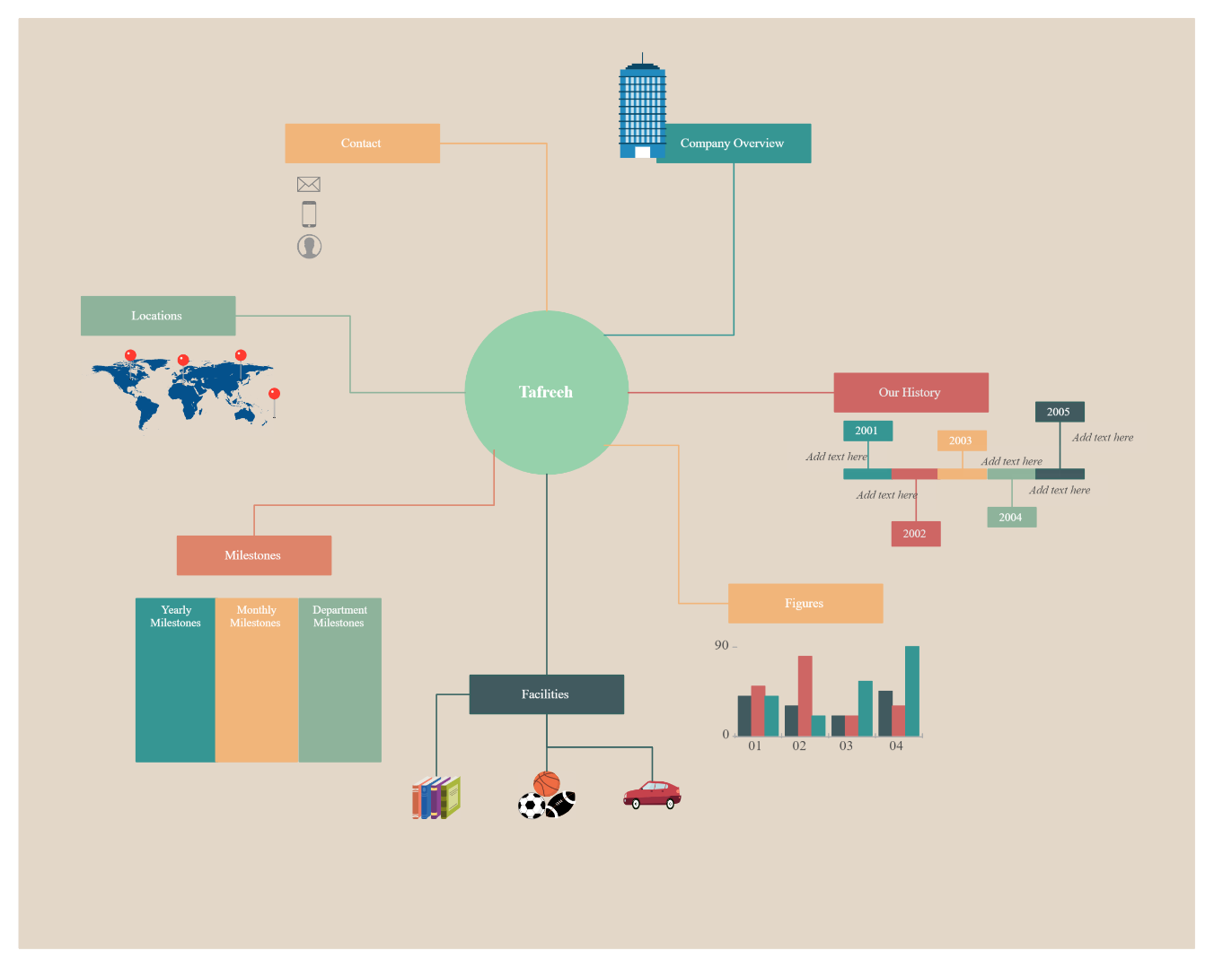
Name:
As mention earlier our company name is Tafreeh.
Aim:
The aim is to bring our country up in term of tourism by attracting local and international tourists by exposing the kind and beautiful culture, traditions, values and most importantly the charming sights of our country.
Services:
There are a plethora of services, which include:
Tourist guide.
Five star hotel.
Food service.
Transportation.

Slide 6
Market Analysis

Slide 7




Competitors

Slide 8
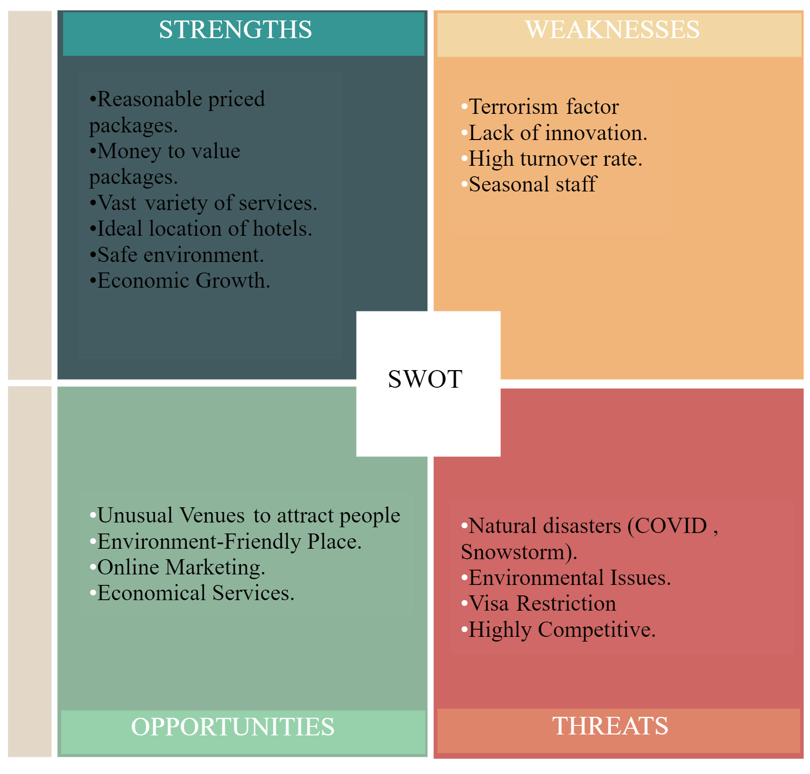

Slide 9
Organizational Structure
and Management

Slide 10
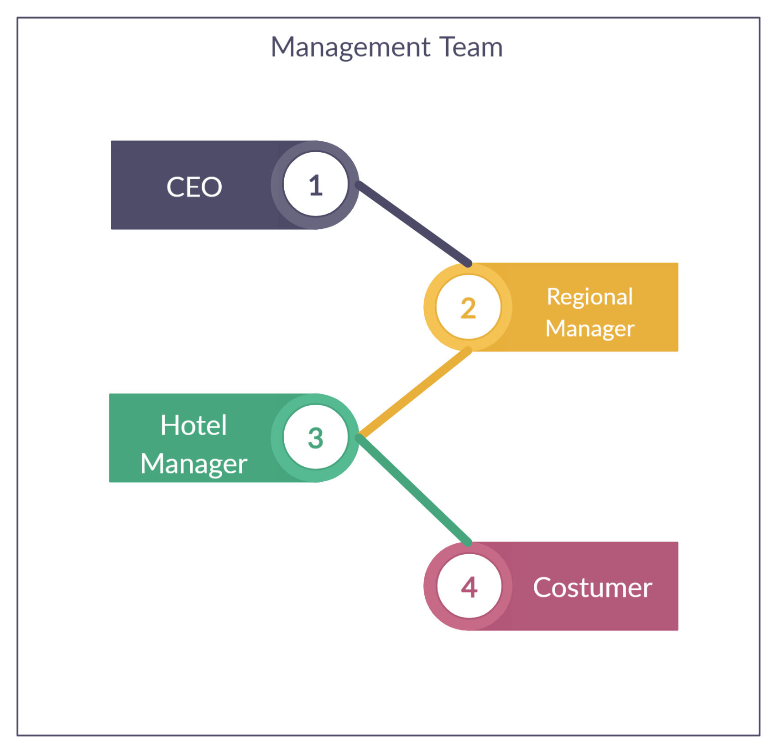

Slide 11
Financial Plan

Slide 12
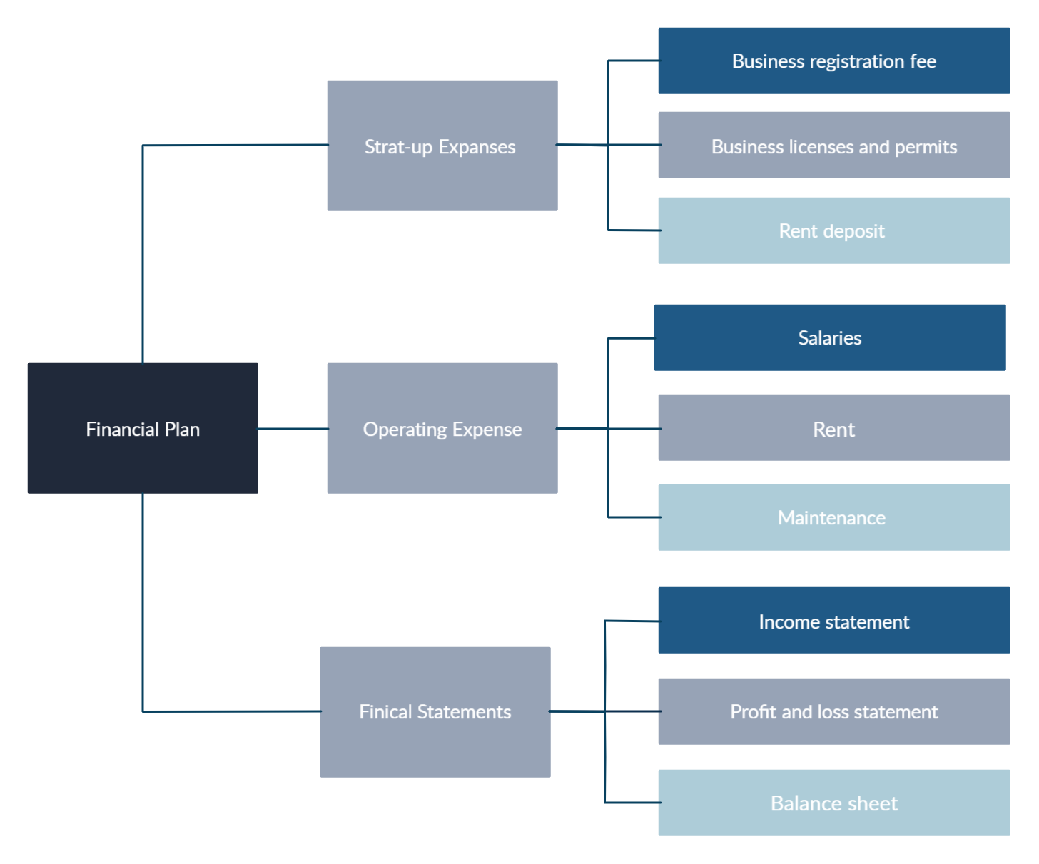

Slide 13
Thank You!

