Slide 1
Chapter 1
Facing Today’s Communication Challenges
Ch. 1–<number>

Slide 2
Communication Skills
Why do you need good communication skills?
Ch. 1–<number>

Slide 3
Communication Skills
Communication skills are essential for
  Job placement
  Job performance
  Career advancement
  Success in the new world of work
Ch. 1–<number>

Slide 4
Trends in the New Workplace
Flattened management hierarchies
More participatory management
Increased emphasis on teams
Heightened global competition
Innovative communication technologies
New work environments
Focus on information as a corporate asset
Ch. 1–<number>

Slide 5
The Process of Communication
Feedback
travels to
sender
NOISE
Sender
has
idea
Sender
encodes
message
Receiver
decodes
message
Receiver
“understands”
message
Channel carries message
Possible additional
feedback to
receiver
NOISE
Ch. 1–<number>

Slide 6
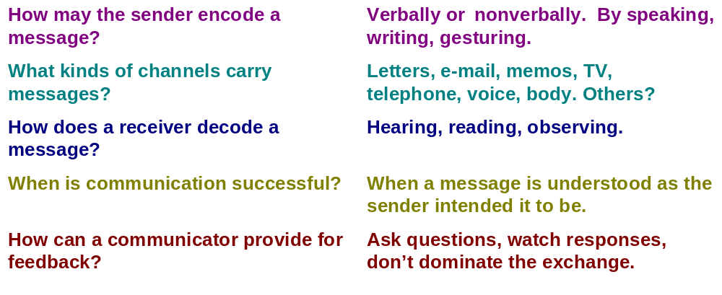
The Process of Communication
Ch. 1–<number>

Slide 7
Barriers to Effective Listening
Physical barriers—hearing disabilities, noisy surroundings
Psychological barriers—tuning out ideas that counter our values
Language problems—unfamiliar or charged words
Nonverbal distractions—clothing, mannerisms, appearance
Ch. 1–<number>

Slide 8
Barriers to Effective Listening
Thought speed—our minds process thoughts faster than speakers express them
Faking attention—pretending to listen
Grandstanding—talking all the time or listening only for the next pause
Ch. 1–<number>

Slide 9
Ten Misconceptions About Listening
Listening is a matter of intelligence.
  Fact: Careful listening is a learned behavior.
Speaking is more important than listening in the communication process.
  Fact: Speaking and listening are equally important.
Ch. 1–<number>

Slide 10
Ten Misconceptions About Listening
Listening is easy and requires little energy.
  Fact: Active listeners undergo the same physiological changes as a person jogging.
Listening and hearing are the same process.
  Fact: Listening is a conscious, selective process. Hearing is an involuntary act.
Ch. 1–<number>

Slide 11
Ten Misconceptions About Listening
Speakers are able to command listening.
  Fact: Speakers cannot make a person actually listen.
Hearing ability determines listening ability.
  Fact: Listening happens mentally—between the ears.
Ch. 1–<number>

Slide 12
Ten Misconceptions About Listening
Speakers are totally responsible for communication success.
  Fact: Communication is a two-way street.
Listening is only a matter of understanding a speaker’s words.
  Fact: Nonverbal signals also help listeners gain understanding.
Ch. 1–<number>

Slide 13
Ten Misconceptions About Listening
Daily practice eliminates the need for listening training.
  Fact: Without effective listening training, most practice merely reinforces negative behaviors.
Competence in listening develops naturally.
  Fact: Untrained people listen at only 25 percent efficiency.
Ch. 1–<number>

Slide 14
Tips for Becoming an
Active Listener
Stop talking.
Control your surroundings.
Establish a receptive mind-set.
Listen for main points.
Capitalize on lag time.
Listen between the lines.
Ch. 1–<number>

Slide 15
Tips for Becoming an
Active Listener
Judge ideas, not appearances.
Hold your fire.
Take selective notes.
Provide feedback.
Ch. 1–<number>

Slide 16
Nonverbal Communication
The eyes, face, and body send silent messages.
  Eye contact
  Facial expression
  Posture and gestures
Appearance sends silent messages.
  Appearance of business documents
  Appearance of people
Ch. 1–<number>

Slide 17
Nonverbal Communication
Time, space, and territory send silent messages.
  Time (punctuality and structure of)
  Space (arrangement of objects in)
  Territory (privacy zones)
Ch. 1–<number>

Slide 18
Tips for Improving Your Nonverbal Skills
Establish and maintain eye contact.
Use posture to show interest.
Improve your decoding skills.
Probe for more information.
Avoid assigning nonverbal meanings out of context.
Ch. 1–<number>

Slide 19
Tips for Improving Your Nonverbal Skills
Associate with people from diverse cultures.
Appreciate the power of appearance.
Observe yourself on videotape.
Enlist friends and family.
Ch. 1–<number>

Slide 20
Culture and Communication
Good communication demands special sensitivity and skills when communicators are from different cultures.
Ch. 1–<number>

Slide 21
Culture and Communication
Key North American Beliefs:
  Individualism
    Initiative, self-assertion, personal achievement
  Informality
    Little emphasis on rituals, ceremonies, rank; preference for informal dress
  Direct communication style
    Impatient, literal, suspicious of evasiveness
  Importance of time
    Precious, correlates with productivity
Ch. 1–<number>

Slide 22
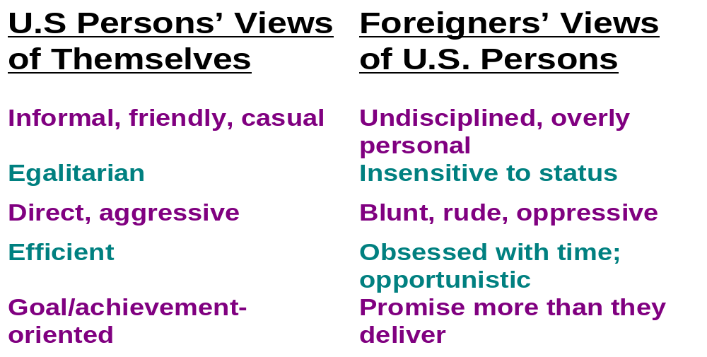
Comparing U.S. and Foreigner’s Views
Ch. 1–<number>

Slide 23
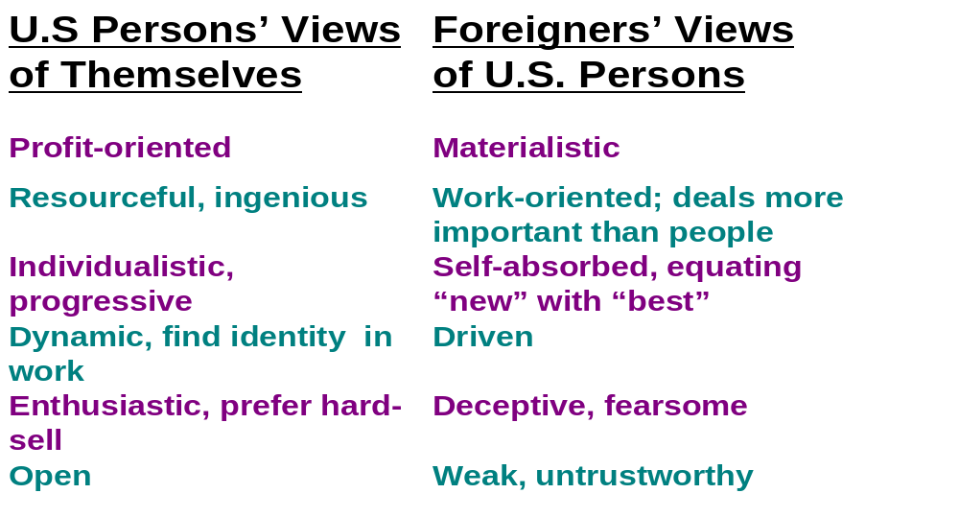
Comparing U.S. and Foreigner’s Views
Ch. 1–<number>

Slide 24
Proverbs Reflect Culture
What do these proverbs indicate about this culture and what it values?
U.S Proverbs
“The squeaking wheel gets the grease.”
“Waste not, want not.”
“He who holds the gold makes the rules.”
“If at first you don’t succeed, try, try again.”
“The early bird gets the worm.”
Ch. 1–<number>

Slide 25
Proverbs Reflect Culture
What do these proverbs indicate about this culture and what it values?
Chinese Proverbs
“A man who waits for a roast duck to fly into his mouth must wait a very, very long time.”
“A man who says it cannot be done should not interrupt a man doing it.”
“Give a man a fish, and he will live for a day; give him a net, and he will live for a lifetime.”
Ch. 1–<number>

Slide 26
Proverbs Reflect Culture
What do these proverbs indicate about these cultures and what they value?
“No one is either rich or poor who has not helped himself to be so.” (German)
“Words do not make flour.” (Italian)
“The nail that sticks up gets pounded down.” (Japanese)
Ch. 1–<number>

Slide 27
High-Context and Low-Context Cultures
High Context
  Japanese
  Arab
  Latin American
  Spanish
  English
  Italian
  French
  North American
  Scandinavian
  German
  Swiss
Low Context
Ch. 1–<number>

Slide 28
High-Context and Low-Context Cultures
High-Context Cultures
Relational
Collectivist
Intuitive
Contemplative
Low-Context Cultures
Linear
Individualistic
Logical
Action-oriented
Ch. 1–<number>

Slide 29
Improving Communication With Multicultural Audiences
Oral Messages
  Learn foreign phrases.
  Use simple English.
  Speak slowly and enunciate clearly.
  Observe eye messages.
  Encourage accurate feedback.
  Check frequently for comprehension.
Ch. 1–<number>

Slide 30
Improving Communication With Multicultural Audiences
Oral Messages (continued)
  Accept blame.
  Listen without interrupting.
  Remember to smile!
  Follow up in writing.
Ch. 1–<number>

Slide 31
Improving Communication With Multicultural Audiences
Written Messages
  Adapt to local formats.
  Use short sentences and short paragraphs.
  Avoid ambiguous expressions.
  Strive for clarity.
  Use correct grammar.
  Cite numbers carefully.
Ch. 1–<number>

Slide 32
Effective Communication With Diverse Workplace Audiences
Understand the value of differences.
Don’t expect total conformity.
Create zero tolerance for bias and stereotypes.
Practice focused, thoughtful, and open-minded listening.
Invite, use, and give feedback.
Ch. 1–<number>

Slide 33
Effective Communication With Diverse Workplace Audiences
Make fewer workplace assumptions.
Learn about your own cultural self.
Learn about other cultures and identity groups.
Seek common ground.
Ch. 1–<number>

Slide 34
End
Ch. 1–<number>

