Slide 1
Chapter 12
Making Oral Presentations

Slide 2
Preparing an Oral Presentation
Identify your purpose.
  Decide what you want your audience to believe, remember, or do when you finish.
  Aim all parts of your talk toward your purpose.

Slide 3
Preparing an Oral Presentation
Organize the introduction.
  Get the audience involved.
  Capture attention by opening with a promise, story, startling fact, question, quotation, relevant problem, or self-effacing story.
  Establish your credibility by identifying your position, expertise, knowledge, or qualifications.
  Introduce your topic.
  Preview the main points.

Slide 4
Preparing an Oral Presentation
Organize the body of your presentation.
  Develop two to four main points. Streamline your topic and summarize its principal parts.
  Arrange the points logically: chronologically, from most important to least, by comparison and contrast, or by some other strategy.
  Prepare transitions. Use "bridge" statements between major points. (I've just discussed three reasons for X; now I want to move to Y.) Use verbal signposts: however, for example, etc.

Slide 5
Preparing an Oral Presentation
Organize the body of your presentation.
  Have extra material ready. Be prepared with more information and visuals if needed.
Organize the conclusion.
  Review your main points.
  Provide a final focus. Tell how listeners can use this information, why you have spoken, or what you want them to do.

Slide 6
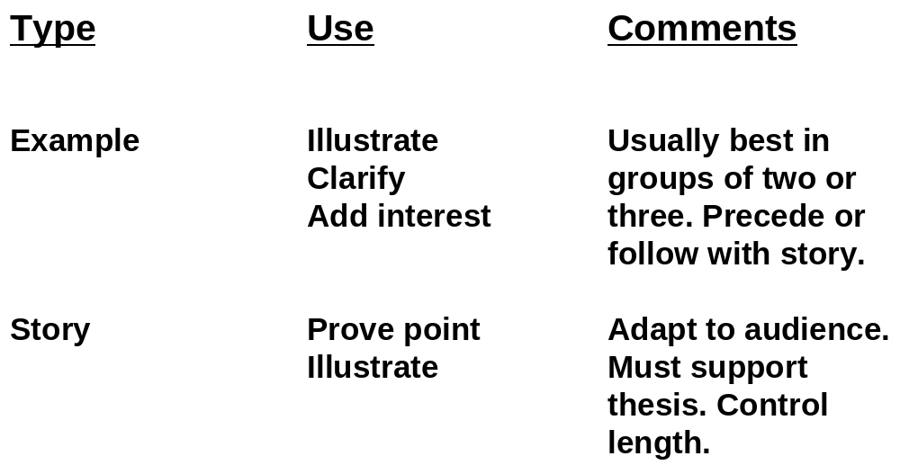
Types of Verbal Support

Slide 7
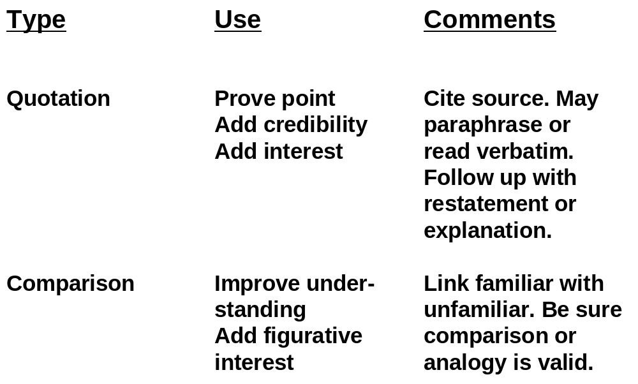
Types of Verbal Support

Slide 8
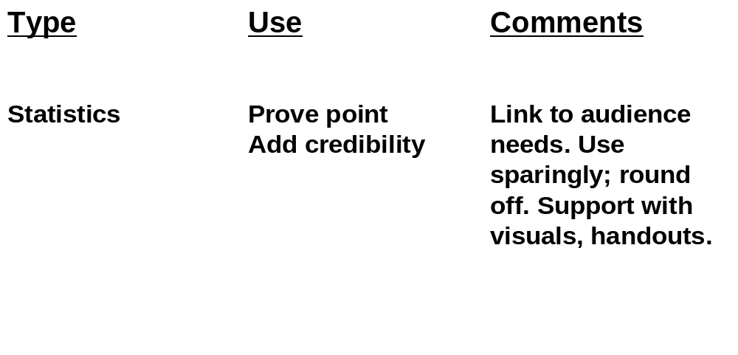
Types of Verbal Support

Slide 9
Nine Techniques for Getting Your Audience’s Attention
A Promise
  “By the end of my talk, you will . . . .”
Drama
  Tell a moving story; describe a problem.
Eye contact
  Command attention by making eye contact with as many people as possible.

Slide 10
Nine Techniques for Getting Your Audience’s Attention
Movement
  Leave the lectern area. Move toward the audience.
A question
  Ask for a show of hands. Use a rhetorical question.
A demonstration
  Include a member of the audience.

Slide 11
Nine Techniques for Getting Your Audience’s Attention
Samples, gimmicks
  Award prizes to volunteer participants; pass out samples.
Visuals
  Use graphics and other visual aids.
Appeal to the audience’s self-interest
  Audience members want to know, “What's in it for me?”

Slide 12
Maintaining Rapport
Use imagery.
  Analogy (a comparison of something familiar with something unfamiliar)
    Example: To understand how the heart is divided, imagine a house with two rooms upstairs and two downstairs.
  Metaphor (an implied, nonliteral comparison)
    Example: The old office building became a money pit.
  Simile (a comparison that includes the words like or as)
    Example: His mind works like a computer.

Slide 13
Maintaining Rapport
Use other interest-building devices.
  Personal anecdotes
  Personalized statistics
  Worst- and best-case scenarios
Send positive, nonverbal messages.
  Get out from behind the podium.
  Animate your body.
  Vary your facial expression.
  “Punctuate” your words.

Slide 14
Stage Fright Symptoms
Stomach butterflies
Pounding heart
Shortage of breath
Sweaty palms
Dry throat
Unsteady voice
Trembling hands
Wobbly knees
Tied tongue

Slide 15
How to Overcome Stage Fright
Select a familiar, relevant topic.
Prepare 150 percent.
Use positive self-talk.
Convert your fear into anticipation and enthusiasm.
Shift the focus from yourself to your visual aids.

Slide 16
How to Overcome Stage Fright
Give yourself permission to make an occasional mistake.
Ignore stumbles; keep going. Don't apologize.
Make your listeners your partners. Get them involved.
Just before you begin to talk, take some deep breaths.

Slide 17
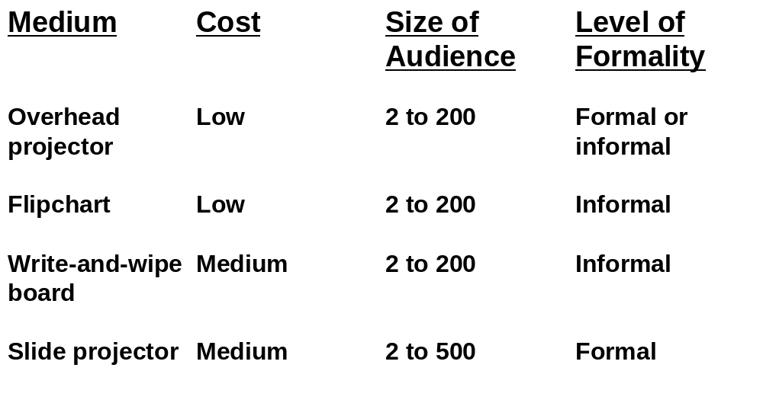
Presentation Enhancers

Slide 18
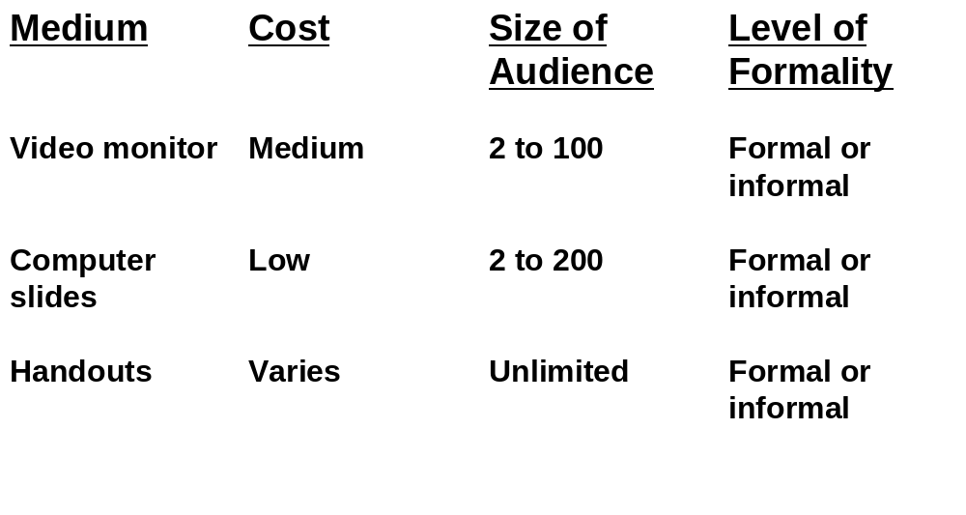
Presentation Enhancers

Slide 19
Designing and Using Graphics
Select the medium carefully.
  Consider the size of the audience and the degree of formality desired.
  Consider cost, ease of preparation, and potential effectiveness.

Slide 20
Designing and Using Graphics
Highlight main ideas.
  Focus on major concepts only.
  Avoid overkill. Showing too many graphics reduces their effectiveness.
  Keep all visuals simple.

Slide 21
Designing and Using Graphics
Ensure visibility.
  Use large type for transparencies and slides.
  Position the screen high enough to be seen.
  Be sure all audience members can see.
Enhance comprehension.
  Give the audience a moment to study a visual before discussing it.
  Paraphrase its verbal message; don't read it.

Slide 22
Designing and Using Graphics
Practice using your visual aids.
  Rehearse your talk, perfecting your handling of the visual aids.
  Talk to your audience and not to the visual aid.

Slide 23
Eight Serious Presentation Blunders
Getting distracted just before you speak.
Being dull. Relying on only one or two illustrations to make your points.
Not repeating your main point often enough.
Not answering the audience's most pressing question: “What's in it for me?”

Slide 24
Eight Serious Presentation Blunders
Failing to use signal phrases to focus on main points.
Neglecting to time your presentation and practice it “out loud.”
Forgetting to check your visual aids for readability.
Answering hypothetical questions after your presentation.

Slide 25
End

