Slide 1
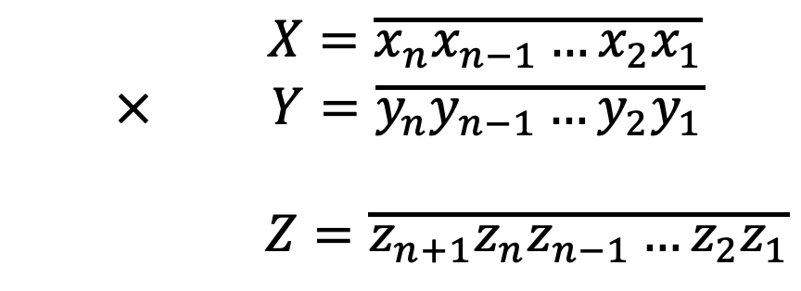
$$X=\overline{x_{n}x_{n−1}…x_{2}x_{1}}$$
$$× Y=\overline{y_{n}y_{n−1}…y_{2}y_{1}}$$
$$Z=\overline{z_{n+1}z_{n}z_{n−1}…z_{2}z_{1}}$$

Slide 2




$$\overline{x_{n}x_{n−1}…x_{n−\sqrt{n}}}$$ | … | $$\overline{x_{2\sqrt{n}}x_{2\sqrt{n}−1}…x_{\sqrt{n}+1}}$$ | $$\overline{x_{\sqrt{n}}x_{\sqrt{n}−1}…x_{1}}$$
×
$$\overline{y_{n}y_{n−1}…y_{n−\sqrt{n}}}$$ | … | $$\overline{y_{2\sqrt{n}}y_{2\sqrt{n}−1}…y_{\sqrt{n}+1}}$$ | $$\overline{y_{\sqrt{n}}y_{\sqrt{n}−1}…y_{1}}$$
$$\overline{t_{n}t_{n−1}…t_{n−\sqrt{n}}}$$ | … | $$\overline{t_{2\sqrt{n}}t_{2\sqrt{n}−1}…t_{\sqrt{n}+1}}$$ | $$\overline{t_{\sqrt{n}}t_{\sqrt{n}−1}…t_{1}}$$
$$z^{\sqrt{n}+1}=carry(t^{\sqrt{n}})$$
$$z^{\sqrt{n}}=t^{\sqrt{n}}+carry(t^{\sqrt{n}−1})$$
$$z^{3}=t^{3}+carry(t^{2})$$
$$z^{2}=t^{2}+carry(t^{1})$$
$$\overline{z_{n+1}}$$ | $$\overline{z_{n}z_{n−1}…z_{n−\sqrt{n}}}$$ | … | $$\overline{z_{2\sqrt{n}}z_{2\sqrt{n}−1}…z_{\sqrt{n}+1}}$$ | $$\overline{z_{\sqrt{n}}z_{\sqrt{n}−1}…z_{1}}$$

