Slide 2
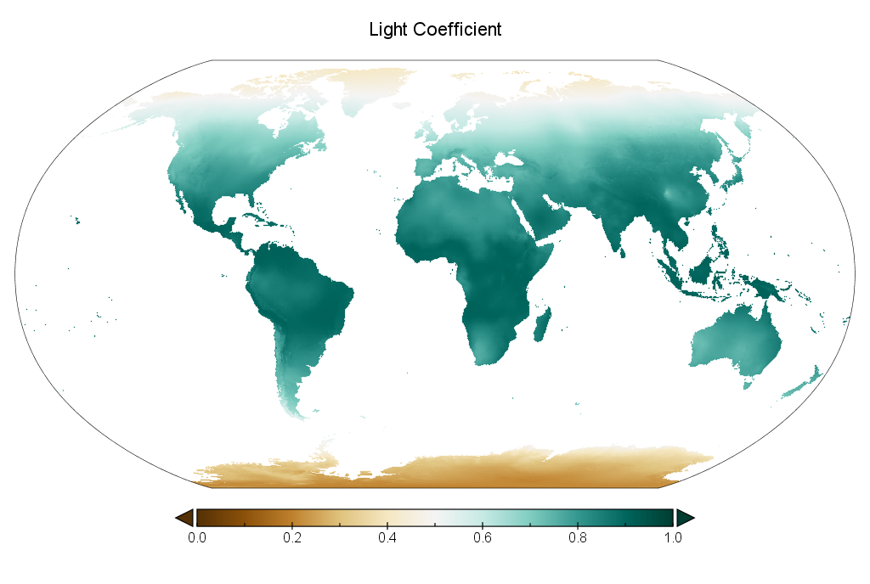
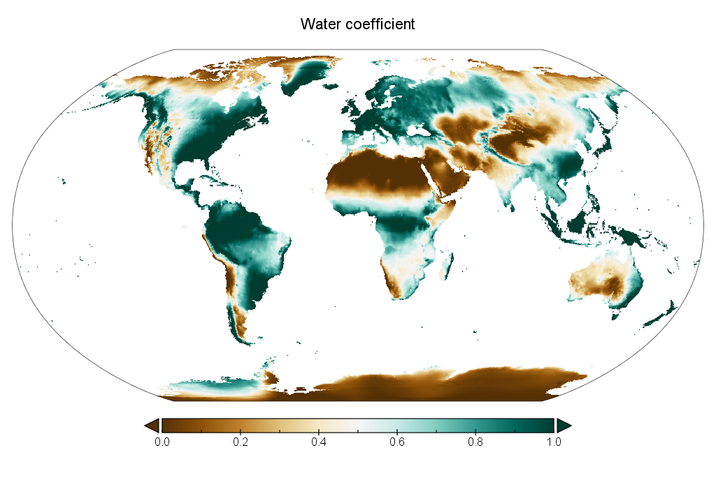
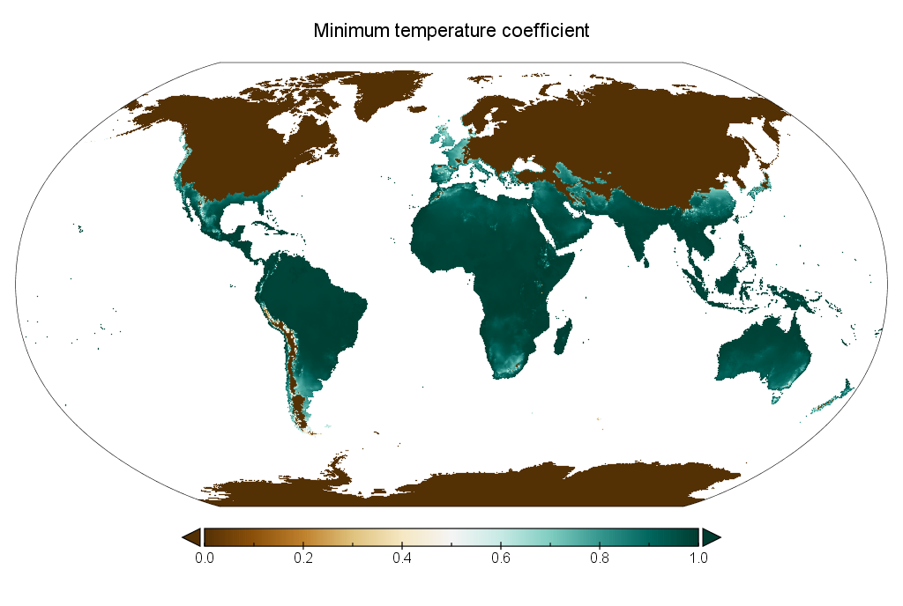
Figure 2
alpha
(light)
beta
(precip)
gamma
(temp)

Slide 3
Table

