Slide 1

Research Question –
Tutorial Presentation for Feedback
Date:
Group Name: Group B 165 Name of Student Presenting:

Slide 2
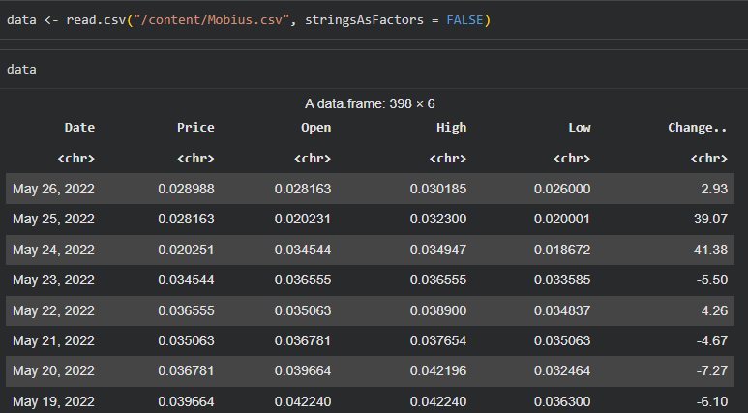
Dataset ID: Mobius.csv (extracted from IoT Coins Dataset)
Rows: 398
Variables used:
Independent Variable: Opening Price (interval)
Dependent Variable: Closing Price (interval)
Dataset Summary

Slide 3
This dataset is interesting to us because:
Mobius is a small-cap cryptocurrency with strong intraday price variation, making it ideal for studying opening–closing price relationships.
Variables used in our Research Question
Opening Price (Independent variable – interval / numeric)
Closing Price (Dependent variable – interval / numeric)
Dataset ID: DS300
Notes:
Before specifying your Research Question you must define the type of data you are analysing. Are the variables you select interval data (measurement data you can divide, multiple, etc), OR are they ordinal (there is a definite order but the intervals between each variable are not necessarily equal, or the terms might be subjective like in a likert scale); OR are they just categorical/nominal (Items such as film names, cities, etc., that you can count numbers of occurrences? You also need to understand whether the variable is either dependent or independent and this will vary according to the context. Independent variables may cause an effect, whereas the dependent variable might be effected by the independent variable. Check the lecture notes on the RQ for more information and examples.
You will get only one opportunity to present your Research Question ahead of the submission date. Have your questions ready, and be ready to take notes on feedback.

Slide 4
“Is there a significant correlation between the daily opening price (independent variable) and the daily closing price (dependent variable) for the Mobius cryptocurrency?”
This follows Template 1 (Correlation):
“Is there a correlation between dependent interval variable and independent interval variable?”
Our Research Question is

Slide 5
PRE 7COM1079-2025 Student Group No: B 165
Hypotheses
Null hypothesis (H₀):
There is no correlation between the opening price and the closing price of Mobius.
Alternative hypothesis (H₁):
There is a significant correlation between the opening price and the closing price of Mobius.

