Slide 1
The Equip Framework
Joshua Eichorn CTO Pagely
azPHP 2016-08-23

Slide 2
Why use a framework
They save time
I don’t have to write glue code
They provide out of the box documentation
They make boring decisions so I don’t have to think about them
They give a wider breadth of experience to the design of the generic stuff everything does
They help you write and maintain less code

Slide 3
Problems with PHP Frameworks
They make decisions I want to make
They use some non PSR-4 pattern for organizing code
They use library X/Y/Z that I don’t like
They decide what is convention want is configuration
They do bad things
They use a dependency Injector that is really a service locator
They encourage bad coding patterns like putting logic in controllers
They use Static methods all over the place
They can be hard to change
Choices are between implementations of the same api
If you change something major all the documentation benefits go away

Slide 4
What I look for in a framework
Its micro
Small amount of code and decisions made, not for building small apps
It encourages good coding practices
It is using constructor injected dependencies
It doesn’t pass around global undefined balls of state
It has an active community, or is small enough I wouldn’t mind forking/maintaining it

Slide 5
Equip at a high level
https://github.com/equip/framework
Micro Framework
Dependency injected (no service locator)
PSR-1, PSR-2, PSR-3, PSR-4 and PSR-7 compliant
ADR pattern
Middleware using relay
Routing using nikic/FastRoute
Dependency Injection using auryn
Developer errors with whoops
Target Php 5.6+

Slide 6
ADR?
We often talk about web frameworks as being MVC
MVC is a ui pattern, few frameworks are just MVC
ADR = Action Domain Responder

Slide 7
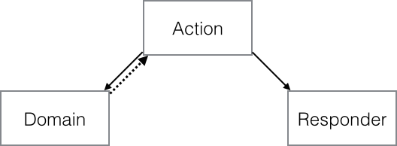
ADR Flow
Router picks an Action
Action handles input
Picks domain and sends input to it
Domain does business logic, returns output to Action
Action picks responder
Responder sends output

Slide 8
Important Parts
Actions are single purpose, 1 class or closure per action
Responder is not a template
Responder generates the entire http response
Domain is a really big bucket, and will likely contain other patterns

Slide 9
Dependency Injector vs Service Locator

Slide 10


Configuring Auryn
Auryn is based off of TypeHints
Often that is all your need
Programming to interfaces
Non class parameters

Slide 11
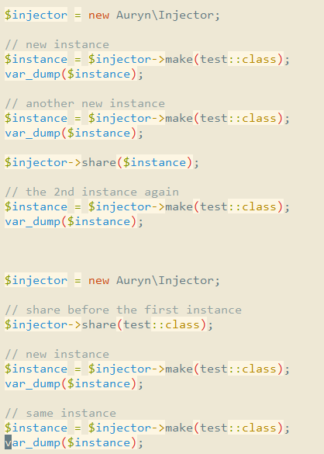
Shared Instances

Slide 12
Auryn and Factories
You can use callable factory http://shadowhand.me/using-auryn-to-write-factories/
We hide the access to the injector, so we can’t abuse it
If the factory is a concrete class, you can ask for the injector in its constructor, and share the injector your configure at bootstrap
We could do evil things with this approach, but we can still mock the factory to test
If the class needs extra configuration after being created you can use prepare callables on the injector

Slide 13
Using Equip
This is all based off the current Dev branch, what will become 3.0
Vs 2.0 less decisions are made about of the box
No default Action implementation
Stronger Model for sharing dispatching code (routing configuration)

Slide 14
Getting Started
https://github.com/equip/project
We are going to do 3.0 before its released
No create-project for us

Slide 15
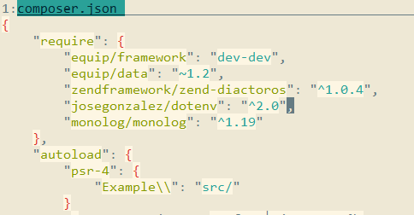
Creating a new app

Slide 16
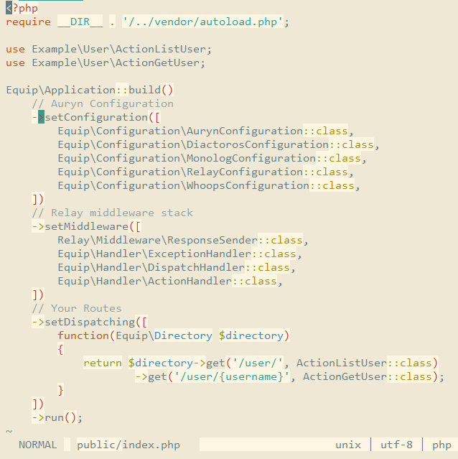
Bootstrapping your app
examples/index.php

Slide 17
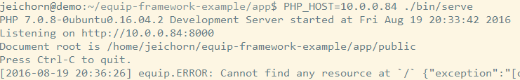
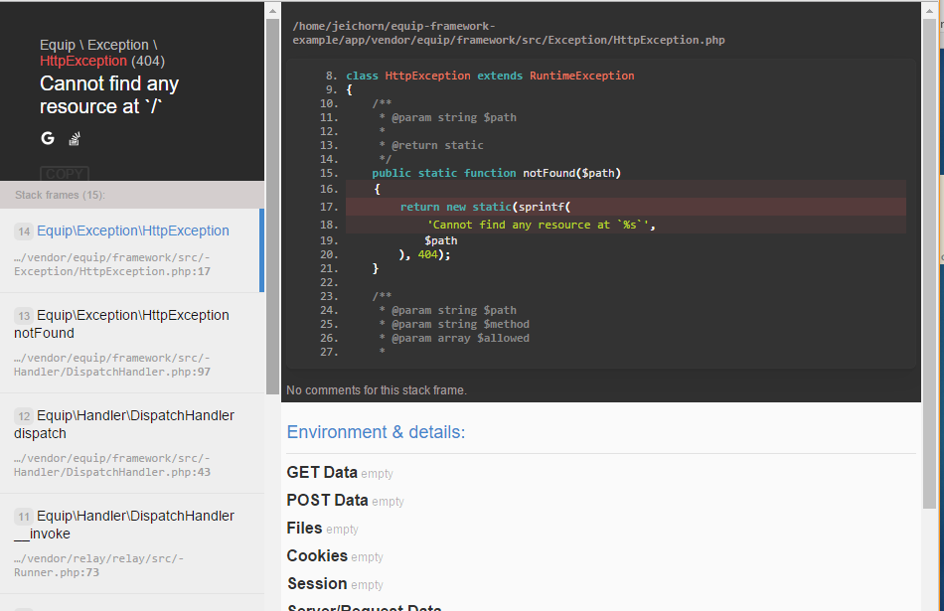
Dev mode

Slide 18
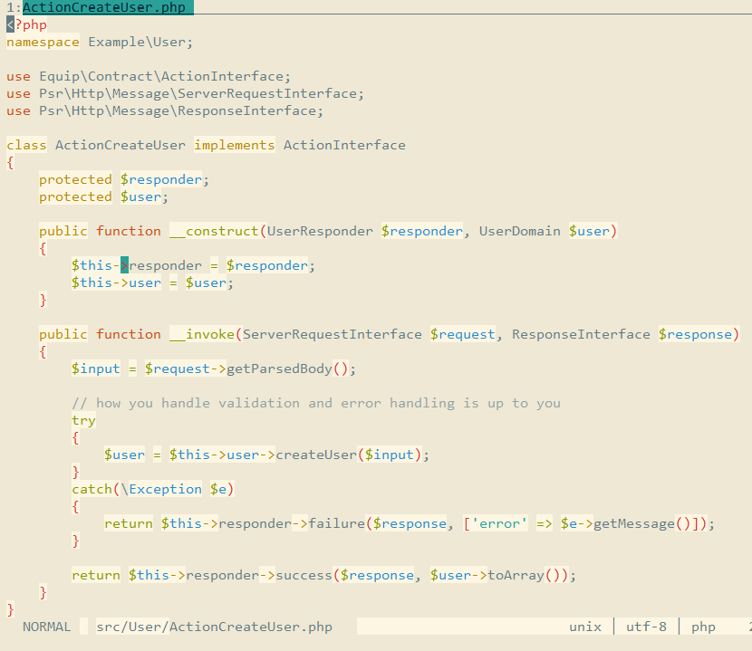
Example Action Creating a user

Slide 19
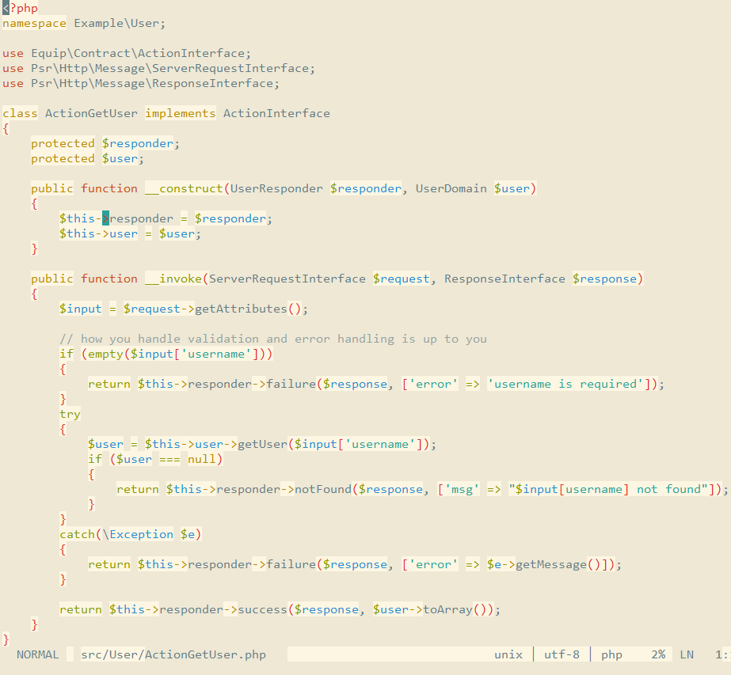
Example Action Getting a user

Slide 20
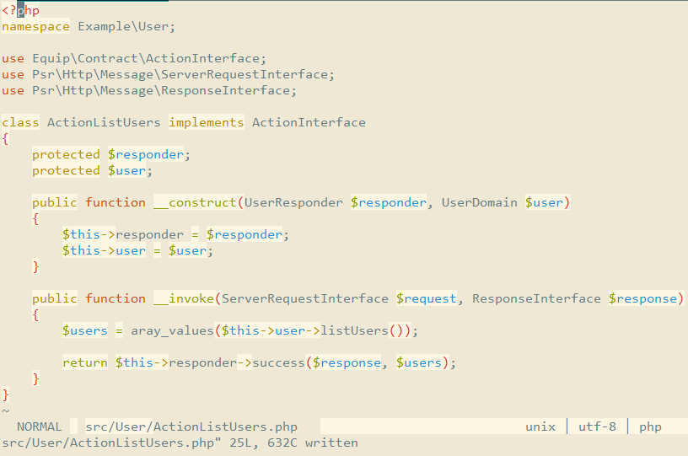
Example Action Listing users

Slide 21
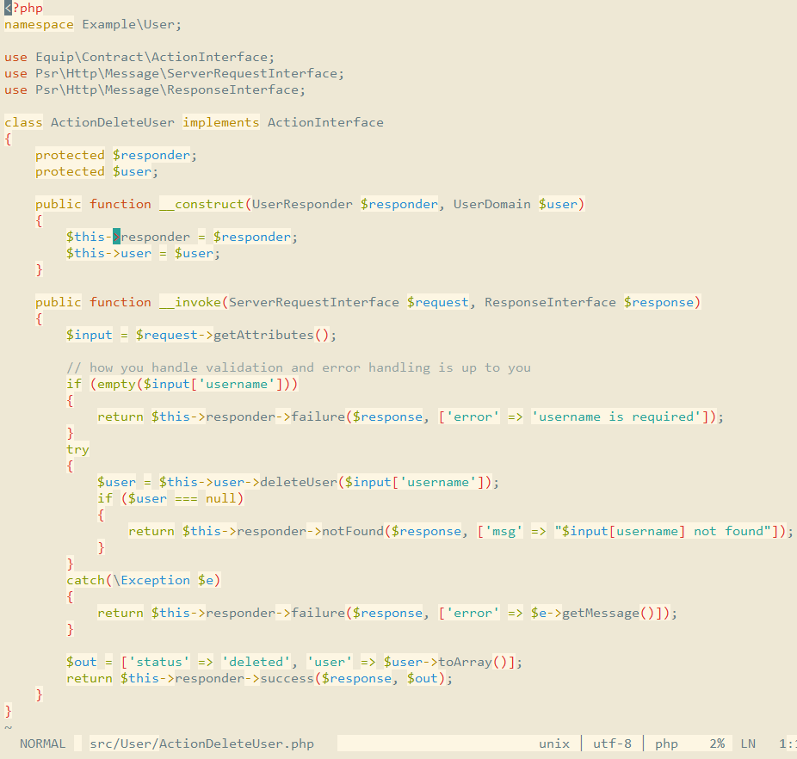
Example Action Deleting a user

Slide 22
Refactoring
You will likely end up with duplicated code at least for all the actions related to an entity
Short inheritance trees or traits could help a lot here

Slide 23
Responders
Easy Json with JsonFormatter
Easy to create your own
PlatesFormatter for using http://platesphp.com/
FormattedResponder for doing Accept content negotiation if you do json/html from the same endpoints (I never do)

Slide 24
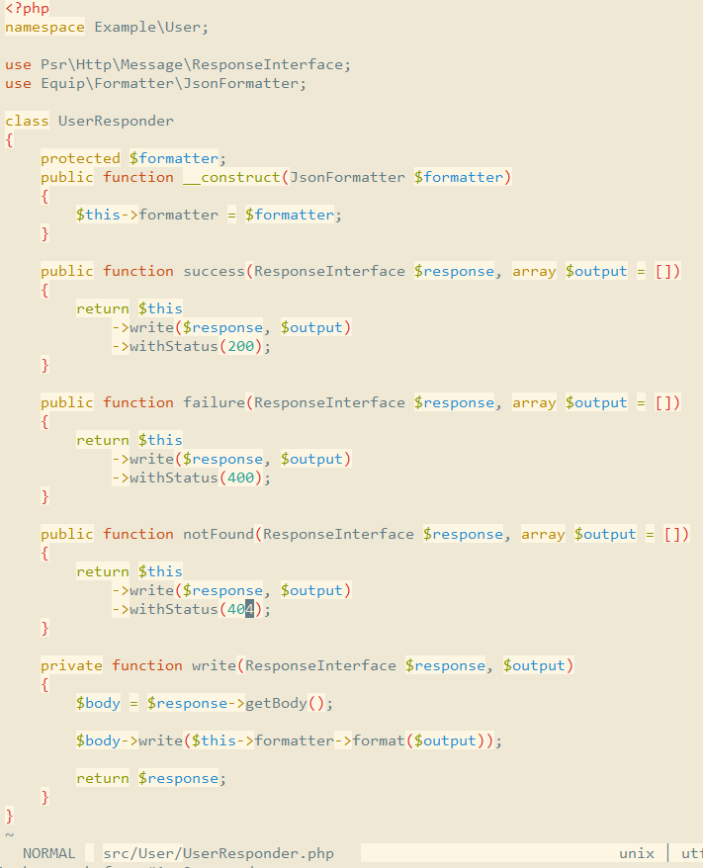

Slide 25
Wrap Up
Internal framework of http://wheniwork.com/, created as an open source product
All the basics are documented
It truly is a micro-framework so you will bring more to the table to complete your app
Some design choices are true trade-offs, (Action classes doing one thing, makes for easy refactoring, code sharing, but if you never refactor you will end up with copy paste)

Slide 26
Questions

