Slide 1

Prepared by group 31
Building Height Estimation From Satellite Images
Azaan Imran 26100281
Muhammad Ibrahim 26100151

Slide 2
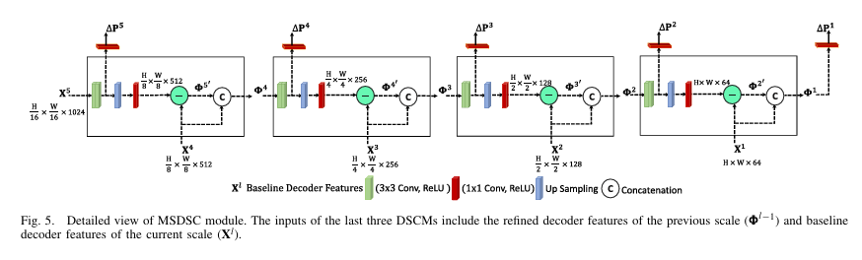
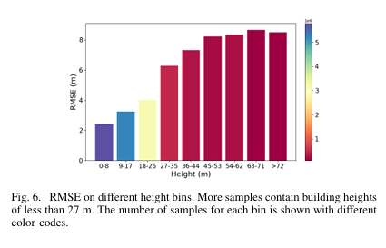
Paper 1: Stereollax Net: Stereo Parallax-Based Deep Learning for Building Height Estimation
Authors: Sana Jabbar and Murtaza Taj (Member, IEEE)
  Introduces Stereollax Net, a novel hybrid deep learning architecture that combines analytical stereo parallax formulation with end-to-end learning.
  Architecture:
    two encoders
    a decoder
    a Fully Connected Network
    a Multiscale Differential Shortcut Connection module
  Methodology: Computes a differential parallax image (1P) and uses it, along with the average photo-base (b) and satellite height (hs), in a closed-form equation to estimate building heights.
  Dataset Used: Evaluated on the 42-Cities and DFC2018 datasets, achieving state-of-the-art performance using only RGB imagery and fewer parameters compared to existing methods.
Relevance to Our Project:
  Provides a cutting-edge methodology for estimating building heights from satellite imagery.
  Demonstrates a successful integration of stereo vision concepts with deep learning, which can inspire improvements in our approach.
  Offers insights into multi-scale feature refinement and parameter regression that are applicable to our building height estimation project.
​

Slide 3
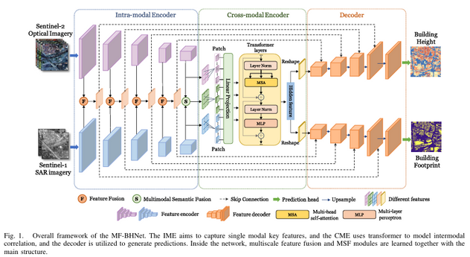
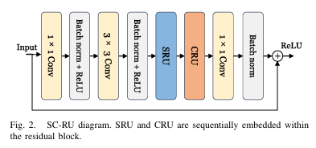
Paper 2: MF-BHNet: A Hybrid Multimodal Fusion Network for Building Height Estimation Using Sentinel-1 and Sentinel-2 Imagery
Authors: Siyuan Wang, Bowen Cai, Dongyang Hou, Qing Ding, Jiaming Wang, and Zhenfeng Shao (IEEE TGRS, 2024)
  Introduces MF-BHNet, a hybrid network that integrates Sentinel-1 (SAR) and Sentinel-2 (optical) data for accurate building height estimation.
  Architecture:
    Hybrid Multimodal Encoder (IME)
    Cross-Modal Encoder (CME)
    Multiscale Feature Fusion (MFF)
    Multimodal Semantic Fusion (MSF)
    Dual Decoders
  Methodology: Fuses complementary information from Sentinel-1 and Sentinel-2 imagery through a progressive coarse-to-fine multimodal fusion strategy, combining CNN-based feature extraction with transformer-based context modeling to accurately predict building height maps.
  Dataset Used: Evaluated on a dataset constructed from Sentinel-1/2 data covering 62 major Chinese cities, with ground truth building heights and footprints, demonstrating state-of-the-art performance (RMSE of 3.64 m) and high generalizability across 55 cities.
Relevance to Our Project:
  Presents an innovative fusion strategy for integrating heterogeneous data in building height estimation.
  Demonstrates advanced feature extraction by combining intramodal and cross-modal encoders with multiscale fusion, which can inspire enhancements in our model design.
  Presents a scalable, cost-effective solution using freely available Sentinel data, supporting our urban 3D mapping goal.

Slide 4
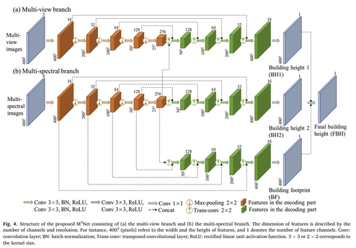
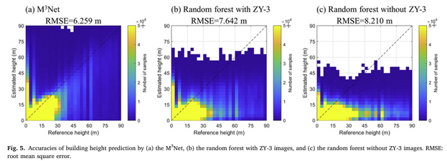
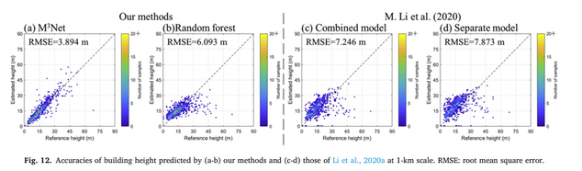
Paper 3: A Deep Learning Method for Building Height Estimation Using High-Resolution Multi-View Imagery Over Urban Areas: A Case Study of 42 Chinese Cities
Authors: Yinxia Cao and Xin Huang
  Introduces M3Net, a deep network that leverages high-resolution multi-view and multi-spectral imagery for accurate building height estimation over urban areas.
  Architecture:
    Dual-branch encoder–decoder structure
    Dual decoders
    U-Net based with skip connections
  Methodology: Fuses high-resolution ZY-3 multi-spectral and multi-view images within a multi-task learning framework using a weighted loss function based on task uncertainty, employing a "predict-then-aggregate" strategy to achieve fine-scale height estimates.
  Dataset Used: Evaluated on ZY-3 satellite images and corresponding ground truth building height data from 42 Chinese cities, covering diverse urban settings.
Relevance to Our Project:
  Provides a robust fusion strategy for integrating multi-view and multi-spectral data in building height estimation.
  Demonstrates advanced multi-task learning and fusion techniques that can inspire improvements in our model design.
  Offers a scalable, cost-effective solution using freely available satellite imagery, aligning with our urban 3D mapping goals.

Slide 5
Project Outline
  Scope
    Preprocess satellite data
    Train baseline and advanced multimodal fusion models (i.e. vision transformers)
    Incorporate hybrid approaches (transformers + CNN) to improve existing benchmarks
  Workflow
    Data Splitting: Train/validate/test sets
    Model Comparison: Evaluate using RMSE and other metrics
    Enhancements: Integrate building footprint tasks for multi-task learning

Slide 6


Datasets Available
42-Cities Dataset | High-resolution optical imagery (e.g., ZY-3) plus reference building heights across 42 major Chinese cities
DFC2018 Dataset | IEEE Data Fusion Contest dataset (2018) containing aerial or satellite imagery, building-height ground truth, and segmentation labels in certain urban regions
62-Cities Dataset | Multimodal Sentinel-1 (SAR) and Sentinel-2 (optical) data across 62 Chinese cities, combined with building footprints/height references
A-Map Building Data | Vector-based building footprints and floor counts (converted to height) from a Chinese map service provider (A-Map), focusing on major urban regions

Slide 7

Github Repos
  M3Net (Building Height Estimation)
    Link: https://github.com/lauraset/BuildingHeightModel
    Description: Official code from the “M3Net” paper, demonstrating a multi-task deep learning approach (building height + footprint) using ZY-3 or Sentinel data.
  monodepth2 (General Depth Estimation)
    Link: https://github.com/nianticlabs/monodepth2
    Description: Though not specific to buildings, it provides state-of-the-art monocular depth estimation code that can be adapted for urban 3D tasks.

