Slide 1
COVID-19 Patient Survival Prediction
Using Logistic Regression, Random Forest, SGD Classifier, and XGBoost
Azadeh Ansari
July 2, 2024

Slide 2
Introduction
Overview of the COVID-19 pandemic
Significant challenges to healthcare systems worldwide posed by COVID-19
Importance of predicting patient outcomes
Predicting patient outcomes based on their symptoms and medical history can be crucial

Slide 3
Data Description
Description of the dataset
COVID-19 patients' medical history
Patient symptoms.
This project is from Kaggle
Features: Age, Gender, Comorbidities, Symptoms, medical history (Diabetes, Athma …), etc.

Slide 4
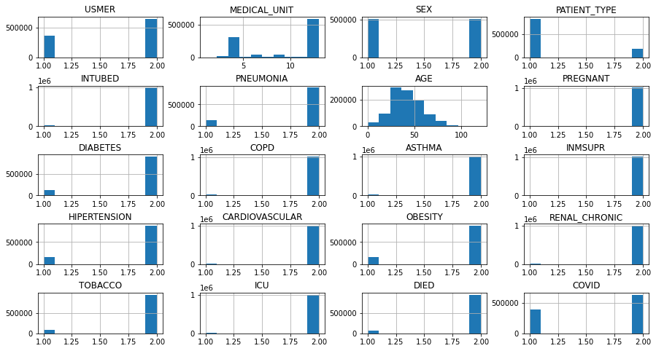
Data Description

Slide 5
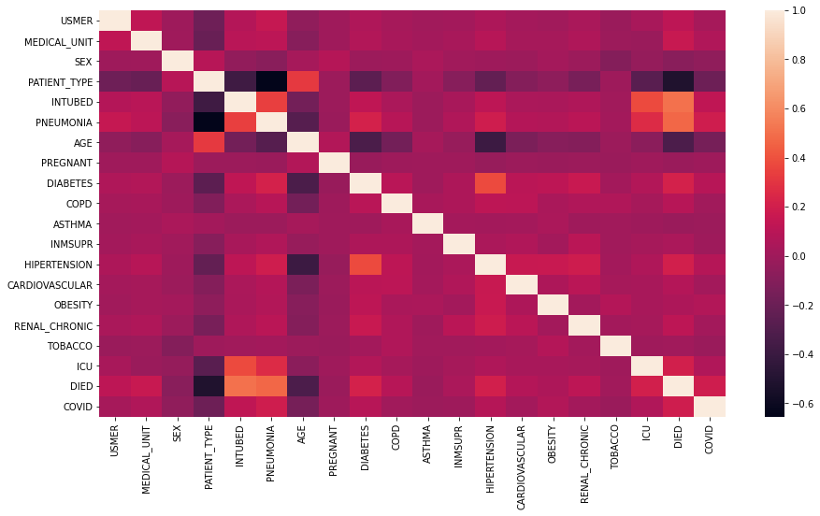
Data Description

Slide 6
Methodology
Data Preprocessing:
Cleaning,
Feature Engineering,
Normalization
Models Used:
Logistic Regression,
Random Forest,
SGD Classifier,
XGBoost

Slide 7
Evaluation Metrics
Accuracy
ROC Curve
Precision-Recall Curve

Slide 8
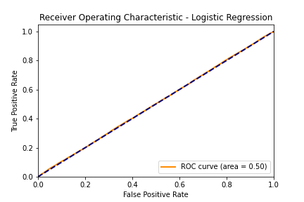
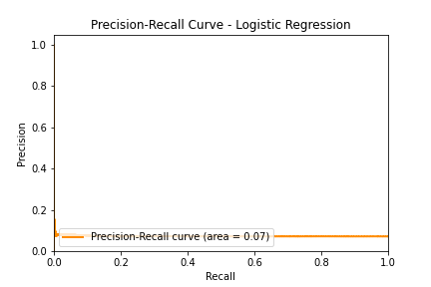
Logistic Regression Results
Accuracy: [0.95]
ROC Curve
Precision-Recall Curve

Slide 9
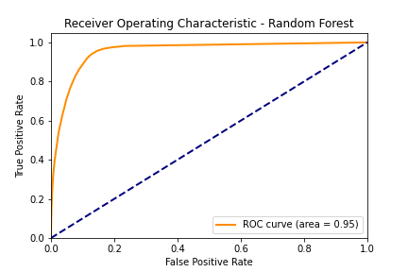
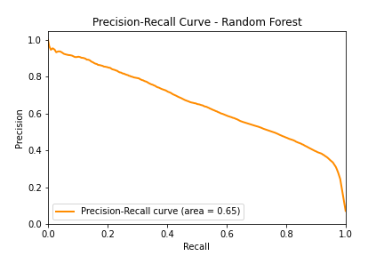
Random Forest Results
Accuracy: [0.95]
ROC Curve
Precision-Recall Curve

Slide 10
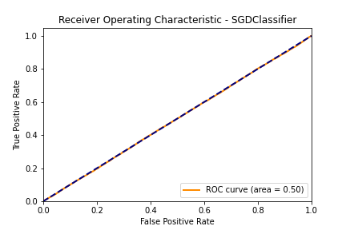
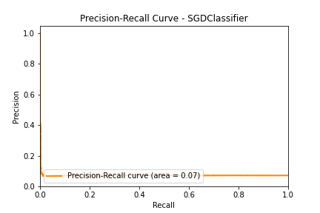
SGD Classifier Results
Accuracy: [0.073]
ROC Curve
Precision-Recall Curve

Slide 11
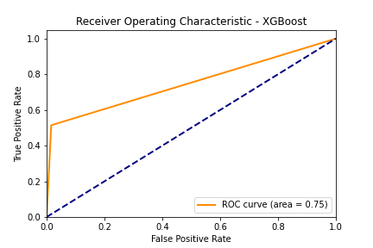
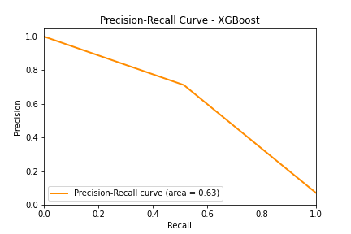
XGBoost Results
Accuracy: [0.95]
ROC Curve
Precision-Recall Curve

Slide 12
Comparison of Models
Accuracy Comparison
ROC Curve Comparison
Precision-Recall Curve Comparison

Slide 13
Conclusion
Summary of findings
SGD Classifier is as good as a random model. SVM could perform much better, but the run time is large due to the size of the data.
XG Boost performs well in terms of accuracy but not so well in terms of AUC and area under precision-recall curve.
Best performing model
Logistic Regression and Random Forest perform well in terms of the metrics we looked; however Logistic Regression performs slightly better.

Slide 14
Future Work
Potential improvements
Tuning hyper parameters and model optimization
Exploring additional models
Incorporating more data

