Slide 1
DRL Strategies
Deep Reinforcement Learning Trading Strategies

Slide 2
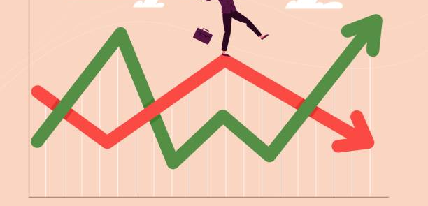
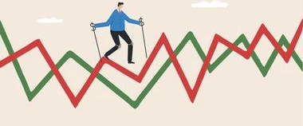
Stock Market Volatility
Notes:
Obviously The Stock Market is a very volatile place, hence even more reason to employ an artificial intellegince to make rational unemotional decisions

Slide 3
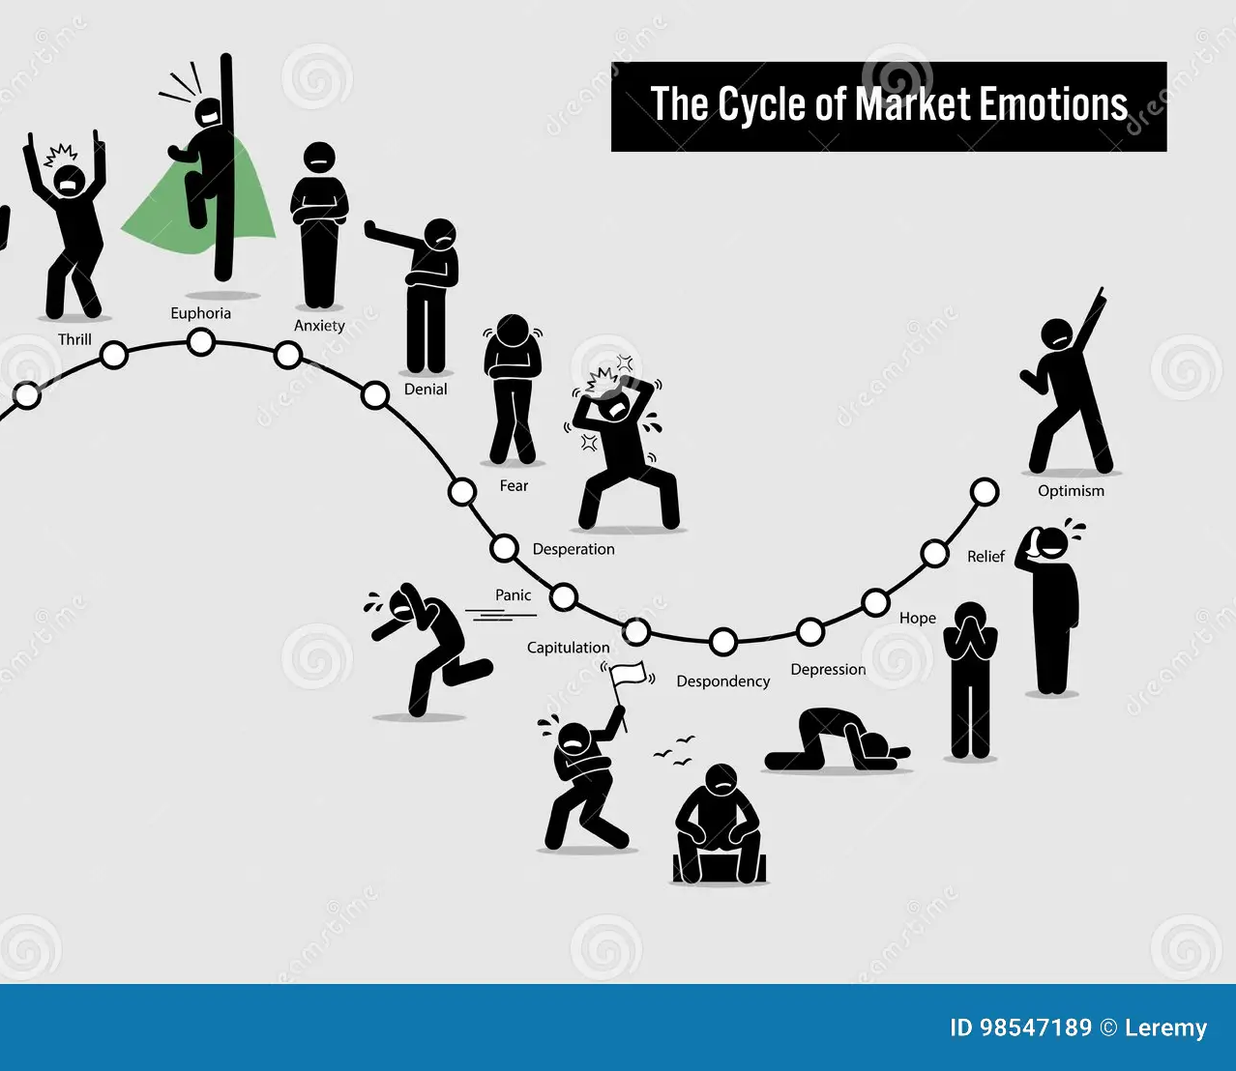
Market Emotions
Notes:
As you can see the market is driven by emotions and its very hard to keep your cool in different market conditions.

Slide 4
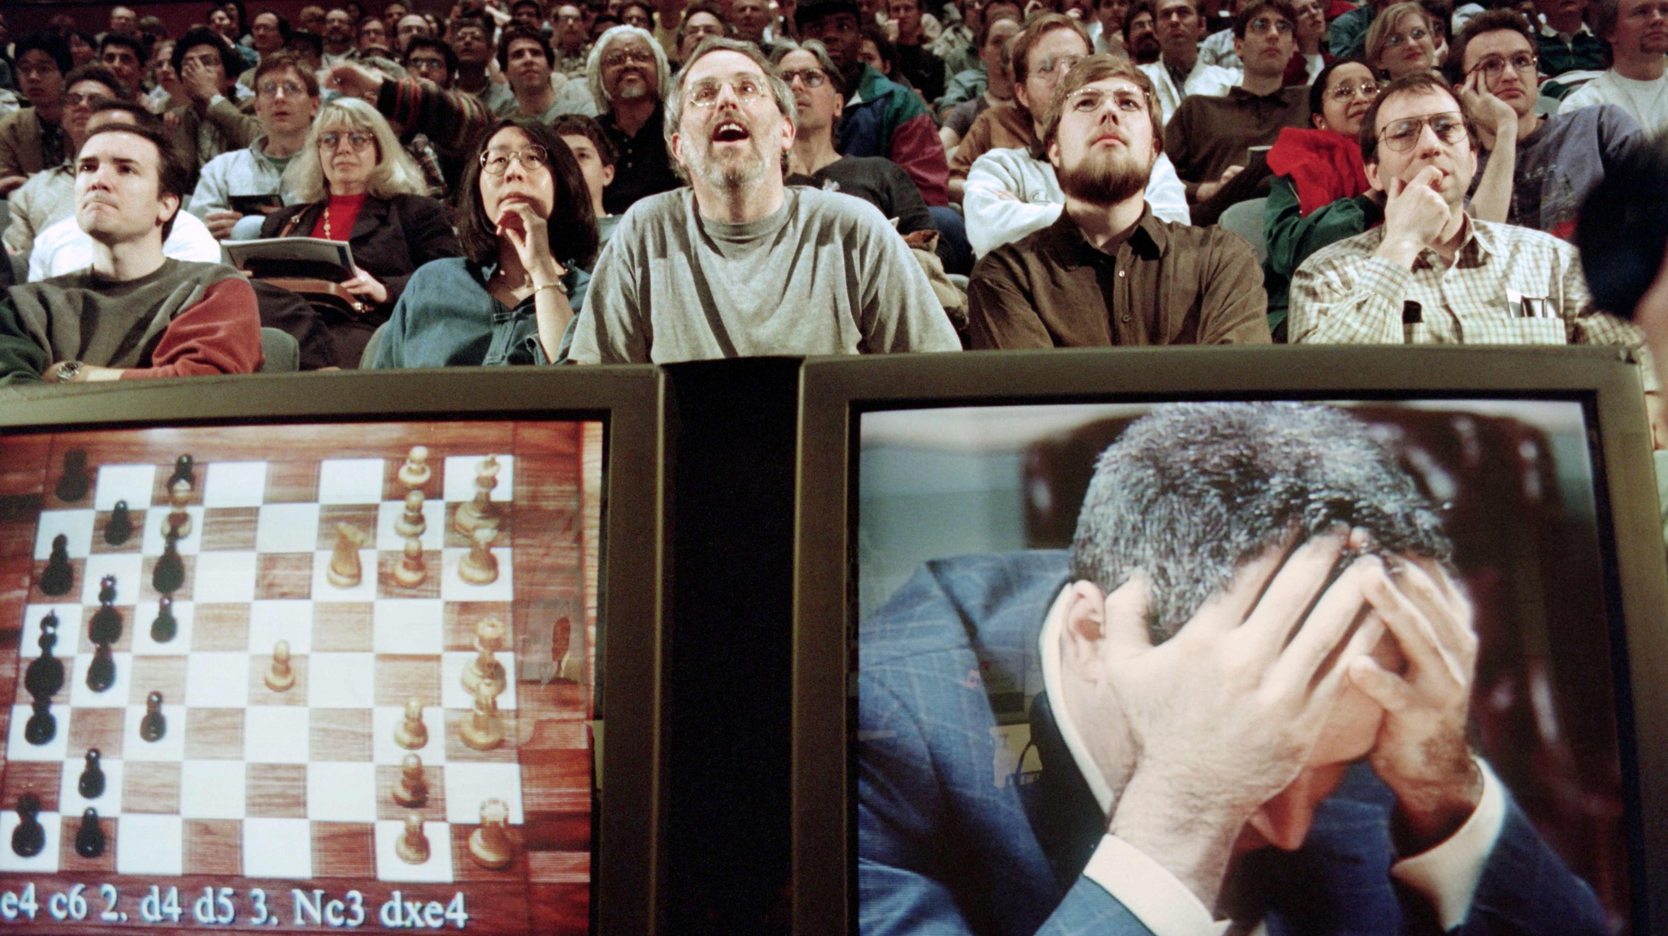
Why Algo trading
Notes:
1997 chess game where an AI won over a Chess Grandmaster and introduced AI supremacy to the Media

Slide 5



Every Investment Company or Hedge Fund has its own Strategies

Slide 6
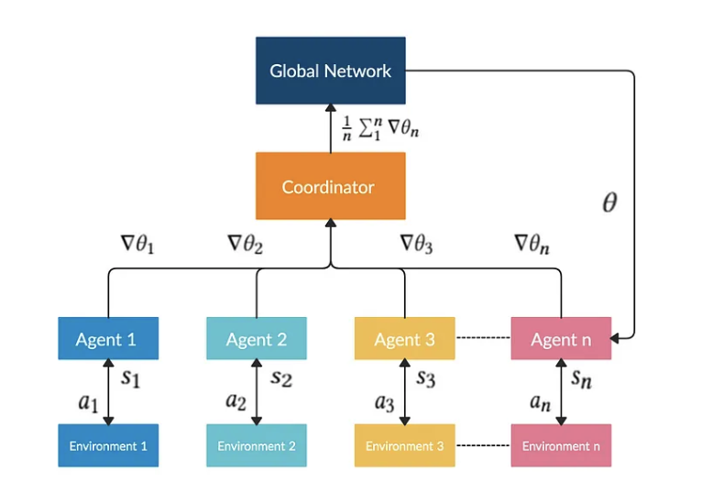
A2C
Notes:
A2C is a typical actor-critic algorithm which we use as a component in the ensemble method.
A2C is introduced to improve the policy gradient updates.
A2C utilizes an advantage function to reduce the variance of the policy gradient.
Instead of only estimates the value function, the critic network estimates the advantage function.
Thus, the evaluation of an action not only depends on how good the action is, but also considers how much better it can be.
So that it reduces the high variance of the policy networks and makes the model more robust.
A2C uses copies of the same agent working in parallel to update gradients with different data samples.
Each agent works independently to interact with the same environment.
After all of the parallel agents finish calculating their gradients, A2C uses a coordinator to pass the average gradients over all the agents to a global network.
So that the global network can update the actor and the critic network.
The presence of a global network increases the diversity of training data.
The synchronized gradient update is more cost-effective, faster and works better with large batch sizes.
A2C is a great model for stock trading because of its stability.

Slide 7
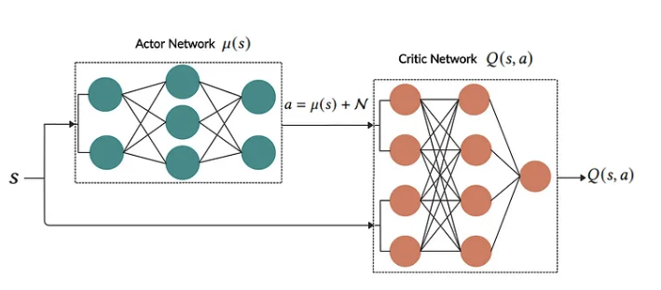
DDPG
Notes:
DDPG is an actor-critic based algorithm which we use as a component in the ensemble strategy to maximize the investment return.
DDPG combines the frameworks of both Q-learning and policy gradient, and uses neural networks as function approximators.
In contrast with DQN that learns indirectly through Q-values tables and suffers the curse of dimensionality problem, DDPG learns directly from the observations through policy gradient.
It is proposed to deterministically map states to actions to better fit the continuous action space environment.

Slide 8
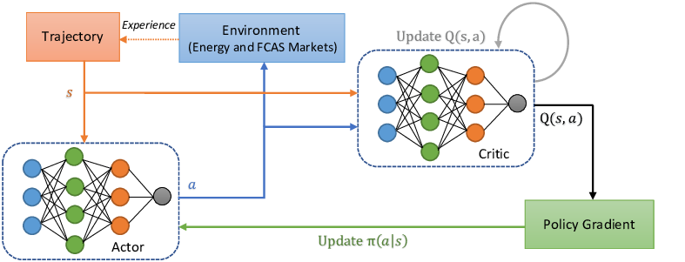
Proximal Policy Optimization
Notes:
PPO is introduced to control the policy gradient update and ensure that the new policy will not be too different from the older one.
PPO tries to simplify the objective of Trust Region Policy Optimization (TRPO) by introducing a clipping term to the objective function.
The objective function of PPO takes the minimum of the clipped and normal objective.
PPO discourages large policy change move outside of the clipped interval.
Therefore, PPO improves the stability of the policy networks training by restricting the policy update at each training step.
We select PPO for stock trading because it is stable, fast, and simpler to implement and tune.

Slide 9
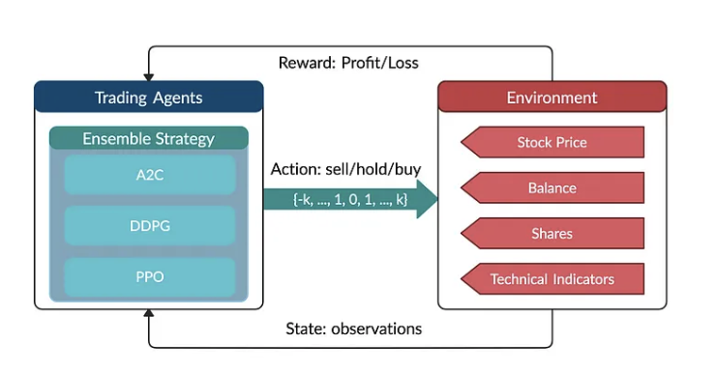
My Solution: Ensemble Deep Reinforcement Learning Trading
Notes:
This strategy includes all three actor-critic based algorithms: Proximal Policy Optimization (PPO), Advantage Actor-Critic (A2C), and Deep Deterministic Policy Gradient (DDPG).
It combines the best features of the three algorithms, thereby robustly adjusting to different market conditions.
The performance of the trading agent with different reinforcement learning algorithms is evaluated using the Sharpe ratio and compared with both the Dow Jones Industrial Average index and the traditional min-variance portfolio allocation strategy.

Slide 10
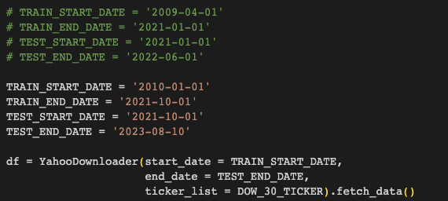
Data Gathering
Via YahooFinance Library

Slide 11
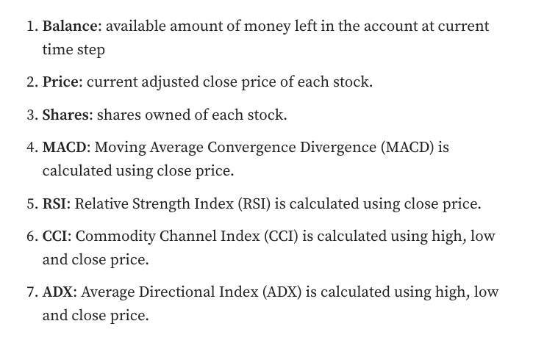
Information used

Slide 12
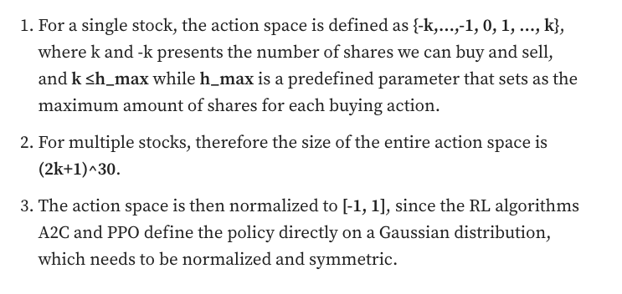
Action Space

Slide 13
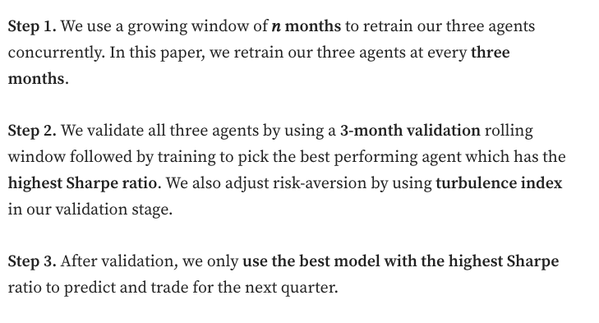
Ensemble Strategy

Slide 14
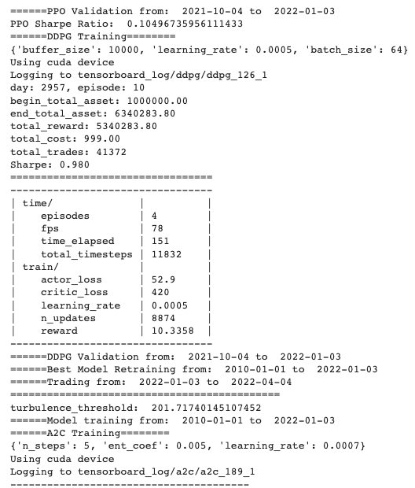
Example
Notes:
Here you can see that the model is using the ensemble method, to find the best sharpe ratio to then apply the correct method for the next quarter, and so on

Slide 15
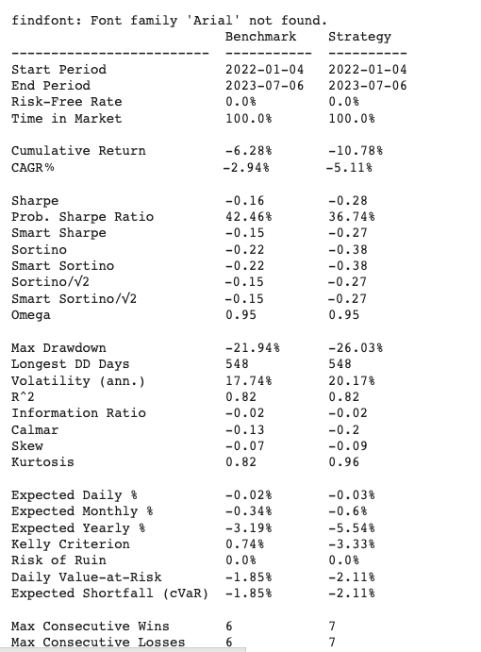
Findings
Notes:
Unfortunately my model with the selected hyperparameters does not perform well under the given market conditions, and needs to be retrained some more to reach the optimal market values, BUT it is not that far off!

Slide 16
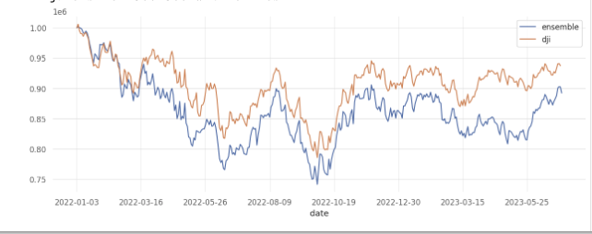
Findings
Notes:
Here you can see that model was underfitting a little bit, that can easily be fixed with due time and process, it is very on point nonetheless.

