Slide 1
Exploratory analysis of cryptocurrency
Traditional assets compared to cryptocurrency during times of crisis

Slide 2
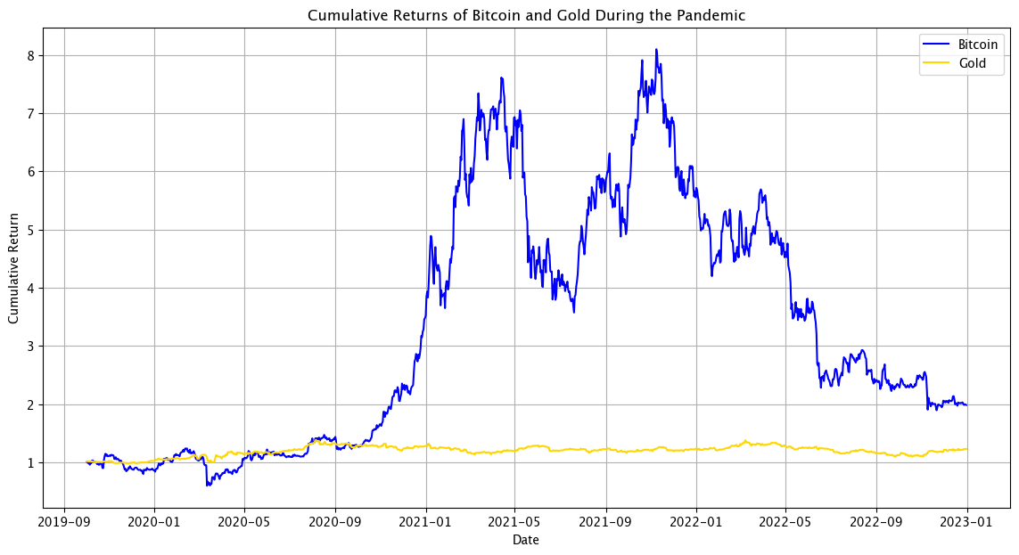
Cumulative returns of BTC – Gold during the pandemic

Slide 3
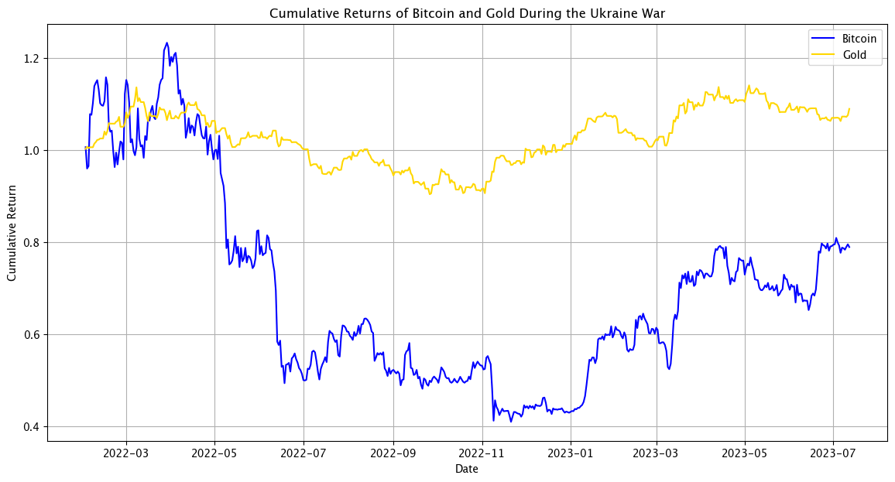
Cumulative returns of BTC – Gold during the Ukraine war

Slide 4
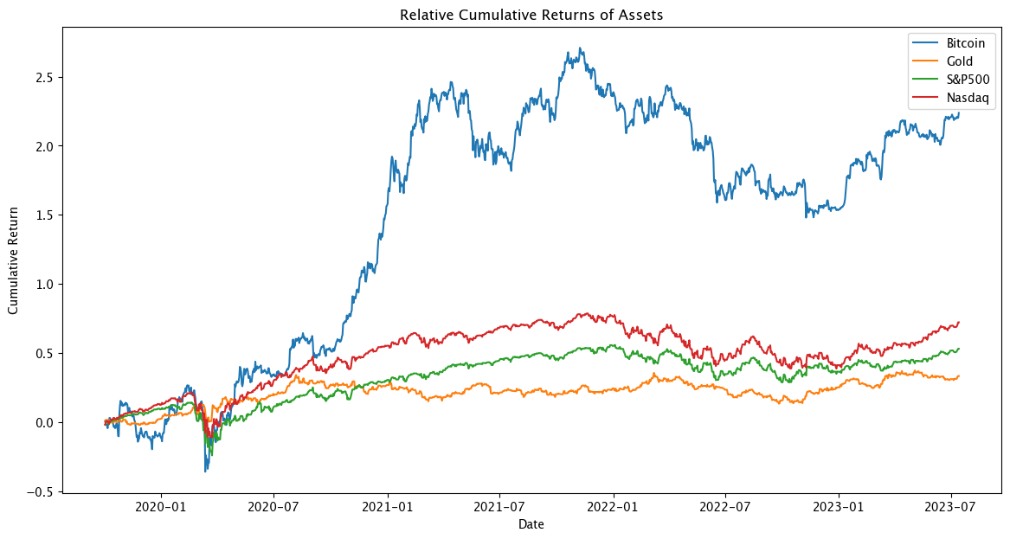
Return of all assets compared over the whole time frame

Slide 5
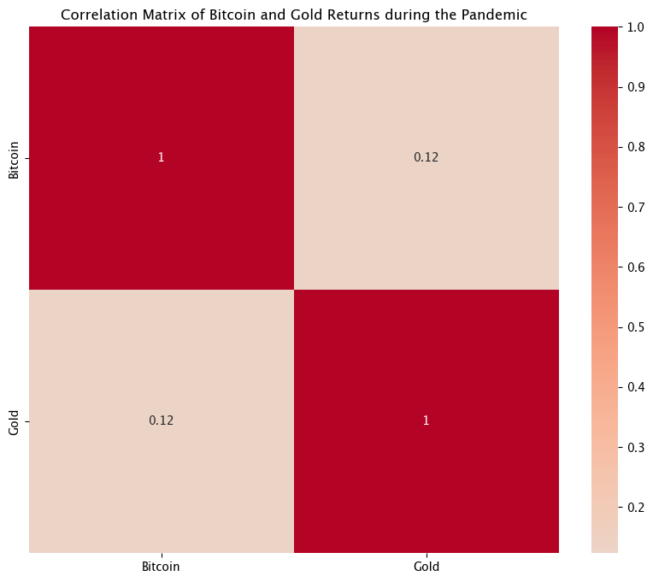

Correlation Matrix of BTC and Gold during the Pandemic and the Ukraine War
Similar correlation coefficients during two time periods
Notes:
The correlation matrices for the two periods show a positive but weak correlation between Bitcoin and Gold returns. The correlation coefficients were 0.12316 during the pandemic and 0.124663 during the Ukraine War. This suggests that Bitcoin and Gold prices tended to move in the same direction to some extent, but the relationship was weak. The similar correlation coefficients during the two periods suggests that while there may be some common factors influencing both Bitcoin and Gold prices, a large part of their price movements are likely driven by factors unique to each asset. Which makes them both very important assets to watch and take into portfolio during times of crisis and uncertainty.

Slide 6

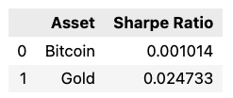
Risk-Adjusted Performance calculation - Sharpe Ratio
COVID-19 Pandemic
Ukraine War
After adjusting the Risk
BTC still had a higher
return and lower risk
After adjusting the risk rate
gold provided better returns than BTC
Take out the risk from the equasion
Then BTC did actually perform better
Than gold during that period, but with
Way higher volatility
Notes:
In conclusion, while Bitcoin provided a higher risk-adjusted return than Gold during the COVID-19 pandemic, Gold provided a higher risk-adjusted return during the Ukraine War.
As seen in the 4th slide – show it now –if you would take out the risk rate or volatility you’d find that Bitcoin actually provided quite good returns in that period. But with higher volatility.

Slide 7
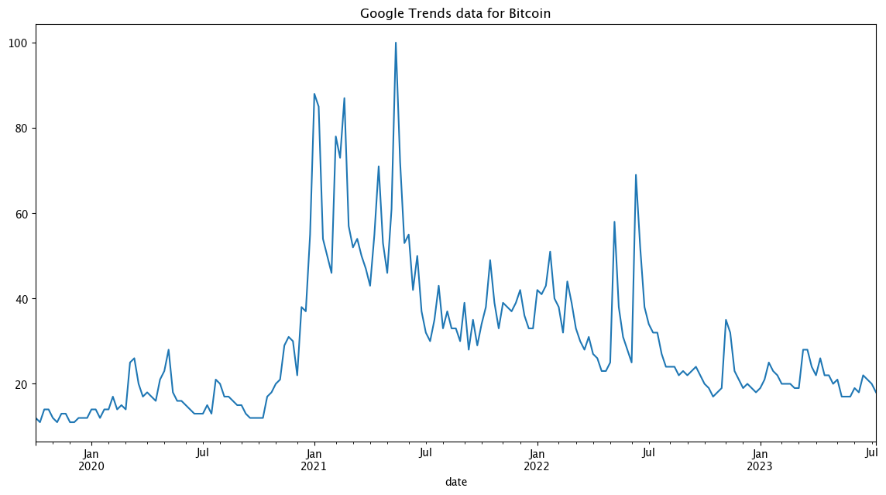
Google Trend Analysis
COVID-19 pandemic
Ukraine war
Notes:
Here we can see the trend pattern google analyzed during the time periods, we can clearly see two short term trend spikes which show the start of the COVID-19 pandemic and then the Ukraine war with a spike shortly after the war broke out and putin released a new law on the 14.04.20223 which made it able to take all men instantly into war.
People were running to get their hands on Bitcoin to get out of the country and change their money, because they couldn’t pay with their bank accounts or Rubel, BTC became a global currency safe haven for a large population.

Slide 8
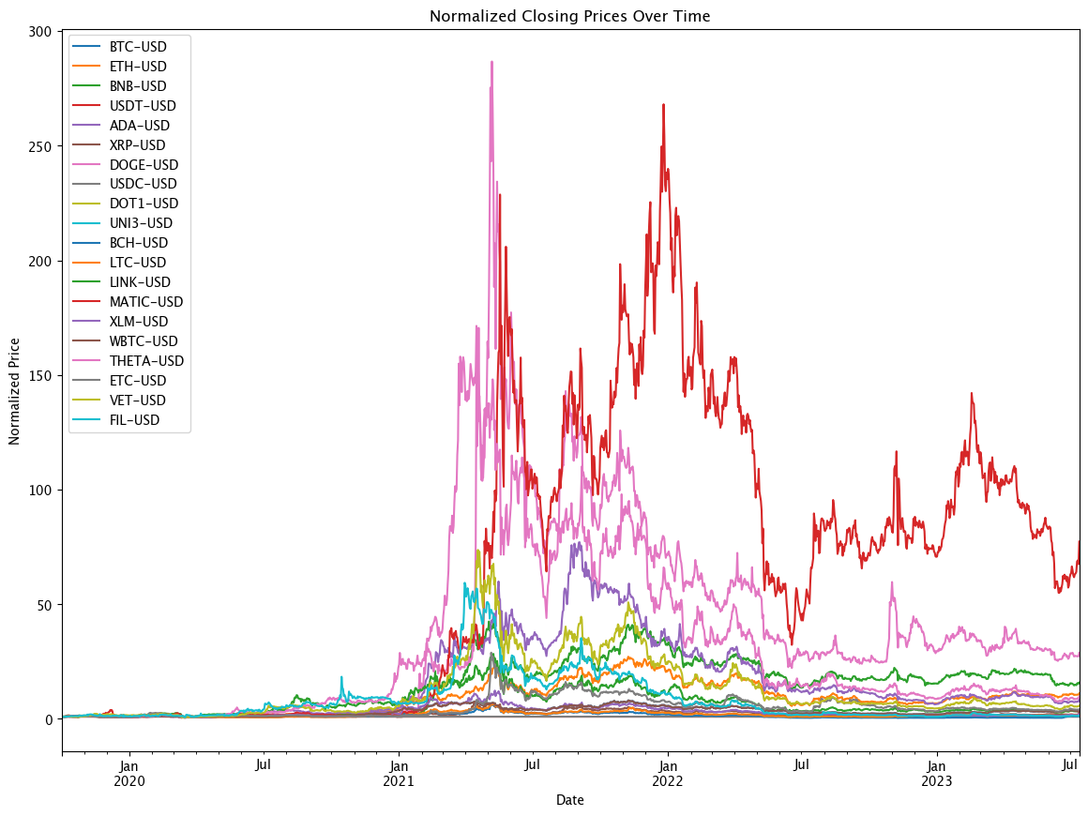
Top 20 Cryptocurrency prices

Slide 9
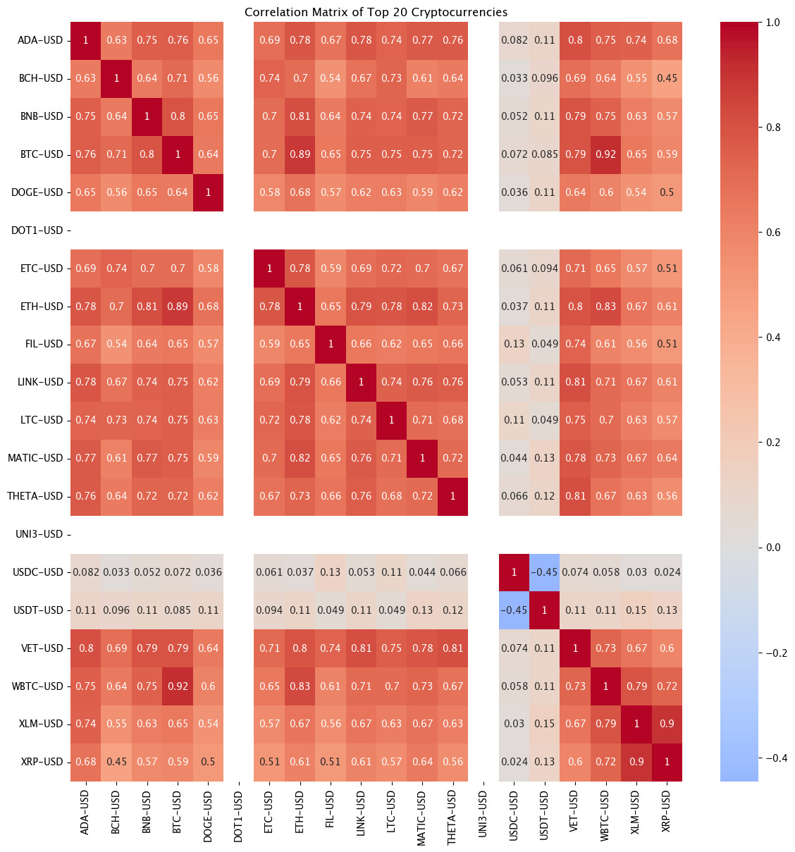
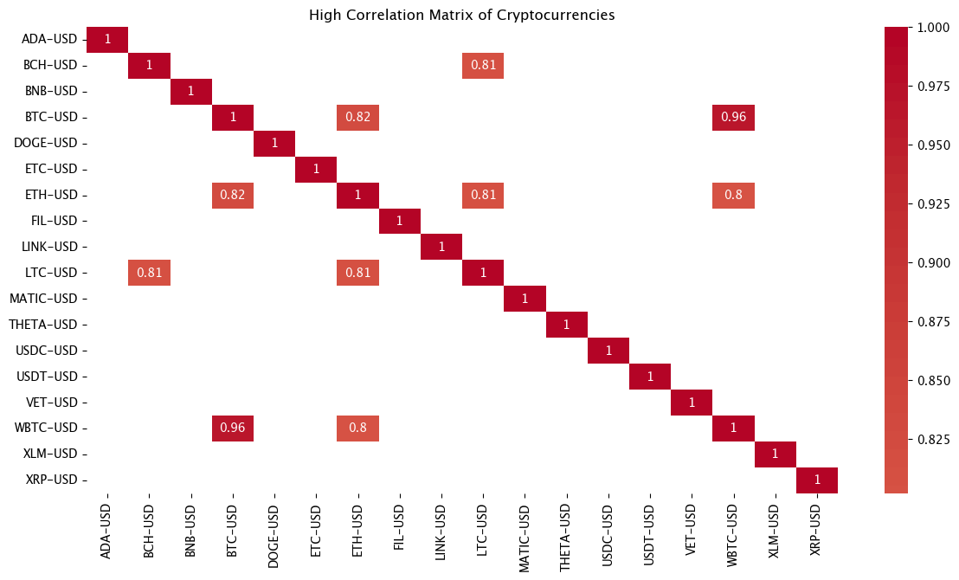
Correlation between the Top 20 Cryptos

Slide 10
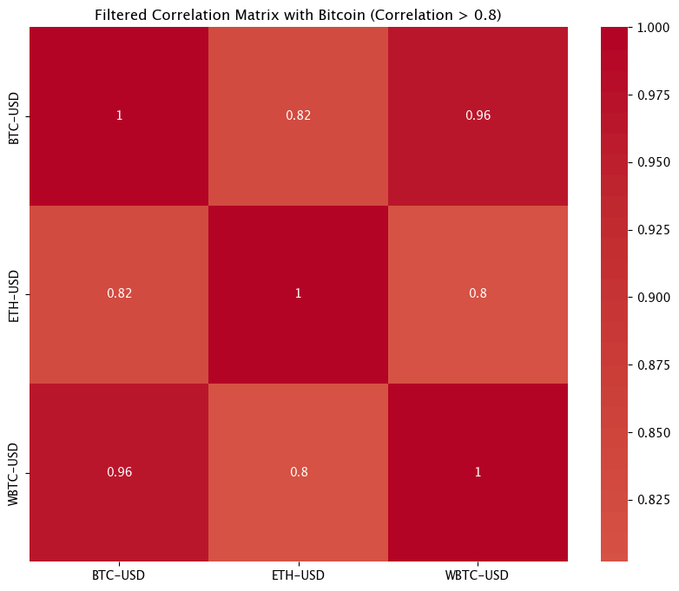
Correlation Matrix of every Currency that’s correlating with just BTC
- WBTC can be discarded as Value
Because it’s a copy of BTC
- Basically just ETH is correlating
with BTC

Slide 11
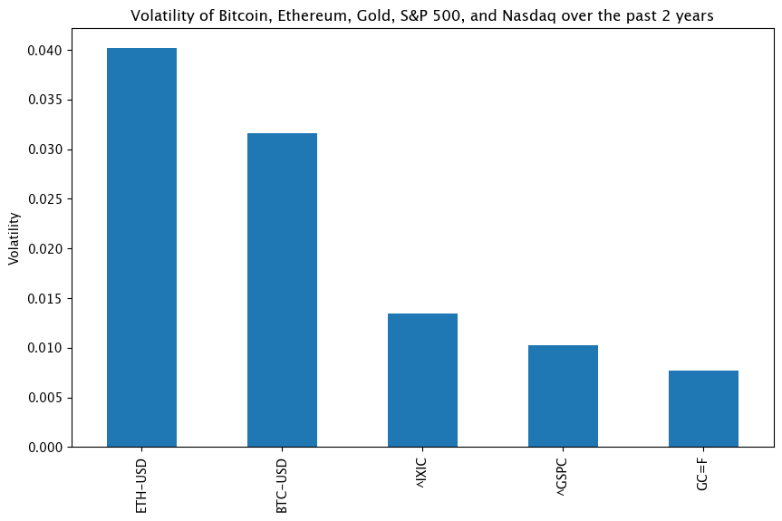
Volatility

Slide 12

Questions?

