Slide 1

Enterprise Architecture

Slide 2
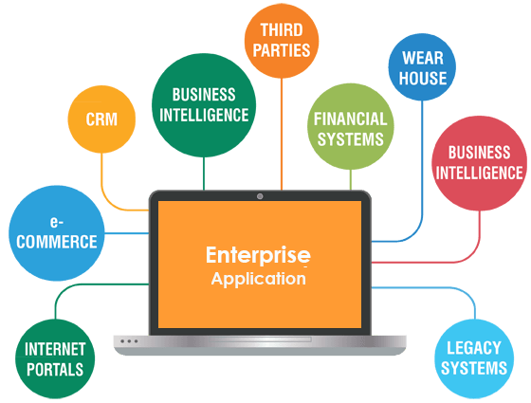
Notes:
-Complex & Durable & has many none functionality & has many user
-Maintainability, Extensibility Is Important
-redesigne after short time

Slide 3

What is Enterprise Software?
Enterprise applications are about the display, manipulation, and storage of large amounts of often complex data and the support or automation of business processes with that data
Notes:
https://dzone.com/articles/enterprise-application-0

Slide 4

What is Enterprise Software?
Enterprise applications are complex, scalable,
distributed, component-based.
In short, they are highly complex systems.
Notes:
2 step
https://dzone.com/articles/enterprise-application-0

Slide 5
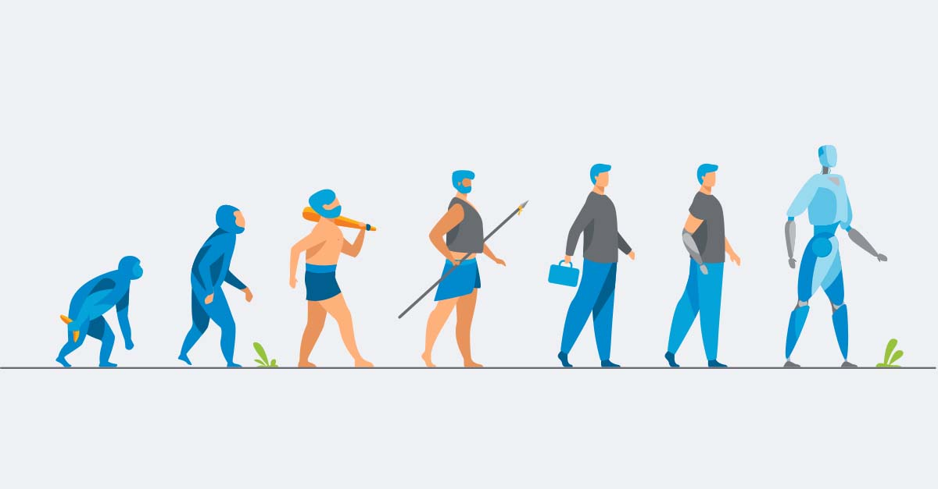
Lifespan?
Time To Adaptation

Slide 6
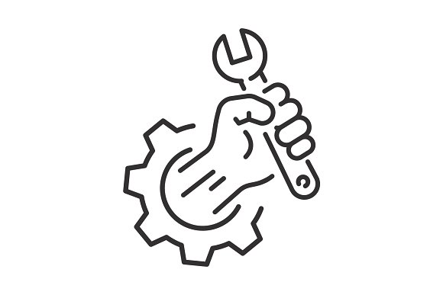

Maintainability, Extensibility Is Important

Slide 7

Software Design
Is the process of defining software solutions
to one or more sets of problems

Slide 8
Characteristics of a good design
High Cohesion . All responsibilites of a module should be related .
Low Coupling .How much a module depends upon others

Slide 9

Design Smells
Notes:
1- What is Entrprise Application?
has complex bussiness and , long life span (Maintainability , extendability)

Slide 10
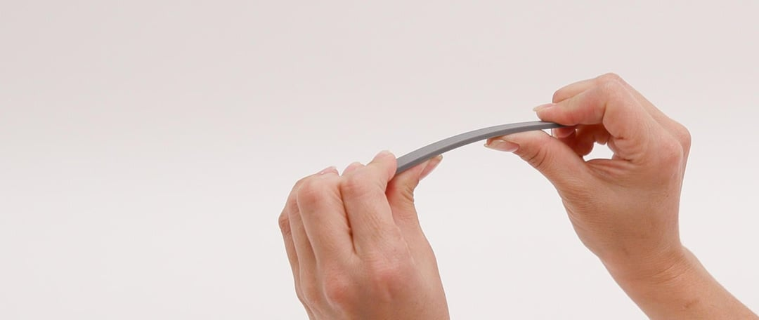
Rigidity
A design is rigid if a single change causes a cascade of subsequent changes in dependent modules.
The more modules that must be changed, the more rigid the design.

Slide 11
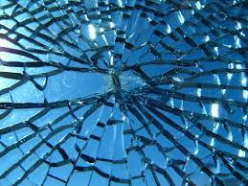
Fragility
Changes cause the system to break in place that have no conceptual relationship to the part that was changed

Slide 12
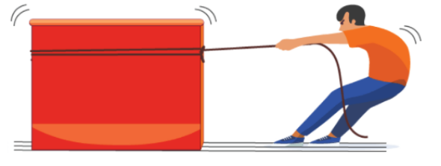
Immobility
A design is immobile when it contains parts that could be useful in other systems, but the effort and risk involved with separating those parts from the original system are too great.
This is an unfortunate but very common occurrence.

Slide 13
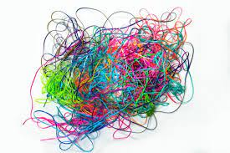
Needless Complexity
A design smells of needless complexity when it contains elements that aren't currently useful.
YAGNI - YOU AREN'T GONA NEED IT
Notes:
YAGNI - XP pinciple

Slide 14
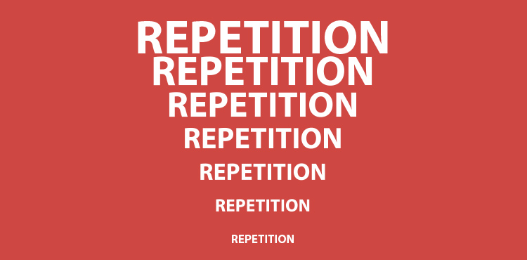
Needless Repetition
The design contains repeating structures that could be unified under a single abstraction
Duplication is Evil!
DRY - DON'T REPEAT YOURSELF
Notes:
The design contains repeating structures

Slide 15
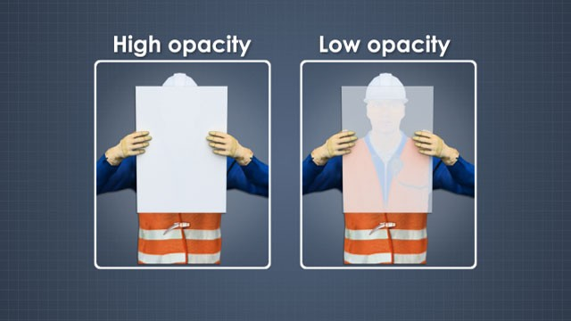
Opacity
It's hard to read and undrestand.it does not express it's intent well

Slide 16
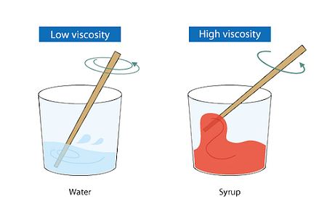
Viscosity
Doing thing right is harder than doing thing wrong
Viscosity of Software Some of the ways preserve the design; others do not (i.e., they are hacks). hen the design-preserving methods are more difficult to use than the hacks, the viscosity of the design is high.
Viscosity of environment comes about when the development environment is slow and inefficient. For example, if compile times are very long, developers will be tempted to make changes that don't force large recompiles, even though those changes don't preserve the design
Notes:
Software : When the design-preserving methods are
environment : compile times are very long,
more difficult to use than the hacks

Slide 17
SOLID Principles

Slide 18
Single Responsibility Principle (SRP)

Slide 19
The Single-Responsibility Principle
A class should have only one reason to change.
If a class has more than one responsibility, the responsibilities become coupled. Changes to one responsibility may impair or inhibit the class's ability to meet the others.
The SRP is one of the simplest principles but one of the most difficult to get right.

Slide 20
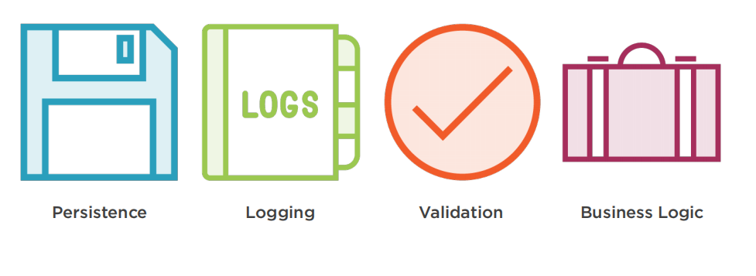
What Is a Responsibility?

Slide 21
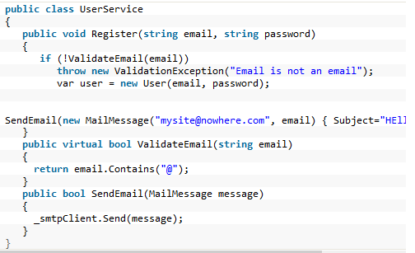
Violation of SRP example

Slide 22
Violation of SRP Result
Tight Coupling : Binds two (or more) details together in a way that’s difficult to change.
Separation of Concerns : Programs should be separated into distinct sections, each addressing a separate concern

Slide 23
Open/Closed Principle (OCP)

Slide 24
The Open/Closed Principle
Software entities (classes, modules, functions, etc.) should be open for extension but closed for modification
Open for extension . As the requirements of the application change, we can extend the module with new behaviors that satisfy those changes.
Closed for modification. Extending the behavior of a module does not result in changes to the source code of the module.
Notes:
https://lostechies.com/joeocampo/2008/03/21/ptom-the-open-closed-principle/

Slide 25
We should be able to introduce a change by adding new code, not by changing the existing.
When customers ask for a new feature they think that features will be added, they don’t think that developers will modify anything.
We must modify the existing code if it contains a bug.

Slide 26
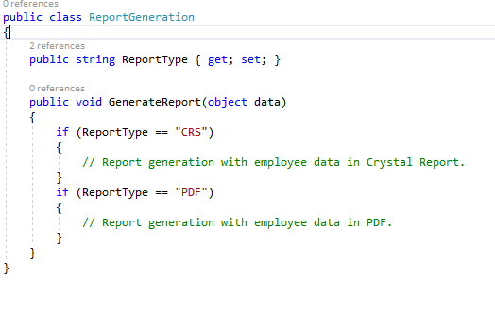
Violation of OCP example

Slide 27
How modify a module without changing its source code?
The answer is Abstraction.

Slide 28
Liskov Substitution Principle (LSP)
Notes:
Barbara Liskov and Jeannette Wing described the principle in a 1994
https://en.wikipedia.org/wiki/Liskov_substitution_principle

Slide 29
The Liskov Substitution Principle
Subtypes must be substitutable for their base types
LSP makes it clear that in OOD, the IS-A relationship pertains to behavior
A violation of LSP causing a violation of OCP
Notes:
PreConditions ,PostConditions https://docs.microsoft.com/en-us/dotnet/framework/debug-trace-profile/code-contracts
Dsign By Contract (software design approach)
Preconditions cannot be strengthened in a subtype.
Postconditions cannot be weakened in a subtype.
Invariants of the supertype must be preserved in a subtype.

Slide 30
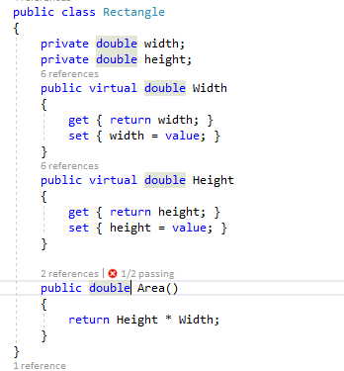
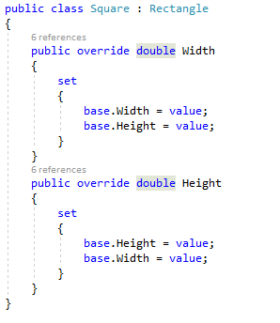
Violation of LSP example

Slide 31
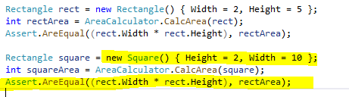

Slide 32
ICollection<T> : IEnumerable<T>
Defines:
Add
Clear
Contains
CopyTo
Remove
ReadOnlyCollection<T> : ICollection<T>
Add

Slide 33
Common Smells
Method throws NotSupportedException Or Empty implementations
Switch-case statements with checks of the actual type of an argument(Downcasts).

Slide 34
Interface Segregation Principle (ISP)

Slide 35
The Interface Segregation Principle
Basically ISP tells us that clients shouldn’t be forced to implement interfaces they don’t use. In other words, if you have an abstract class or an interface, then the implementers should not be forced to implement parts that they don’t care about

Slide 36
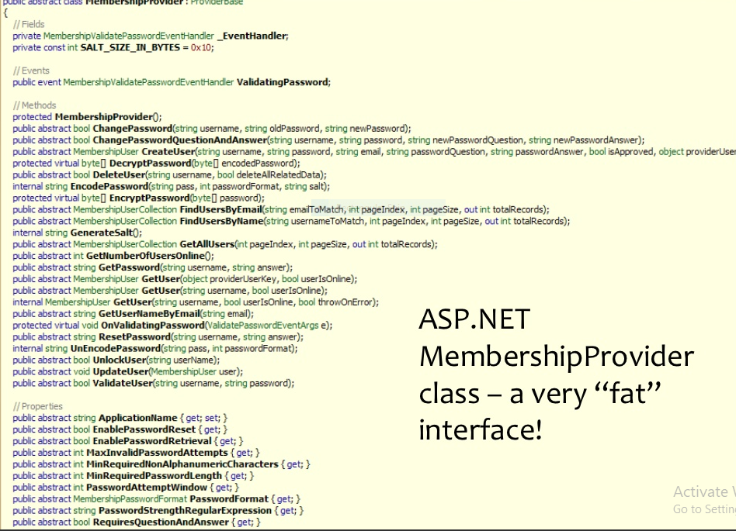
Violation of ISP example
Notes:
- Violate srp
- High Coupling

Slide 37
ISP Violation Problems
Violate LSP
Violate SRP , More coupling
Hard to test
Notes:
Use Adapter design pattern to fix ISP in lagacy code

Slide 38
Dependency Inversion Principle (DIP)

Slide 39
The Dependency-Inversion Principle
High-level modules should not depend on low-level modules. Both should depend on abstractions.
Abstractions should not depend upon details. Details should depend upon abstractions.

Slide 40
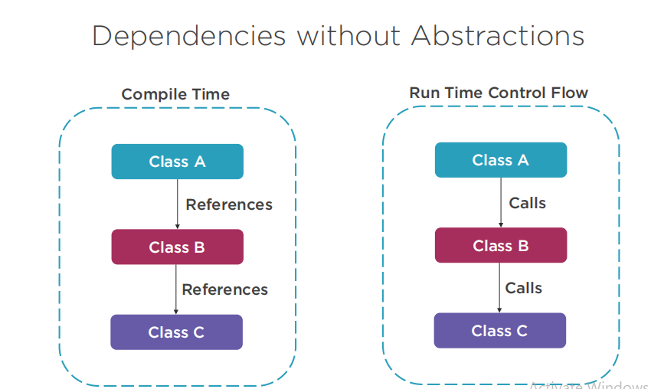

Slide 41
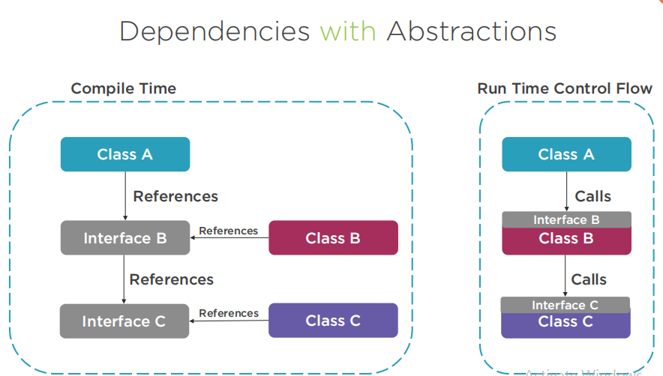

Slide 42
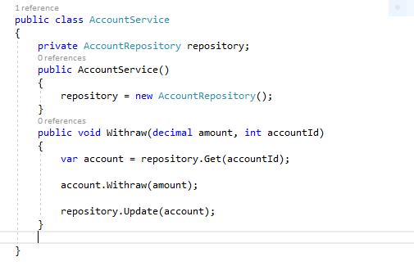
Violation of DIP example

Slide 43
DIP Violation Problems
Coupling
Cohission
Testability

Slide 44
Dependency Injection
Dependency Injection is a technique that is used to allow calling code to inject the dependencies a class needs when it is instantiated .

Slide 45
Dependency Injection Forms
Constructor Injection
Property Injection
Method Injection

Slide 46
Test Driven Development (TDD)

Slide 47
What Is Test Driven Development
Test Driven Development is a software development methodology whereby you write and run a set of tests before you write code.
The idea is that those tests will fail at first and then you start to write enough code to try to get all the tests to pass. Having all the tests pass could be a measure of the done criteria (dev-done) and also increases confidence in the quality of the code.

Slide 48
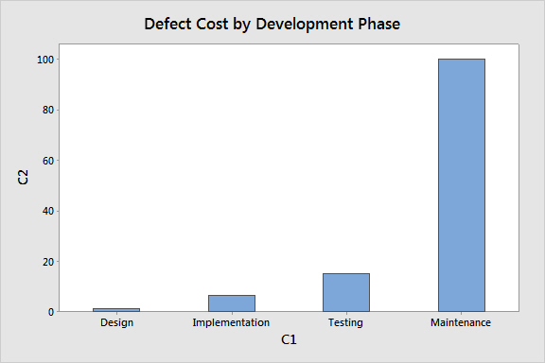
Why test is important?

Slide 49
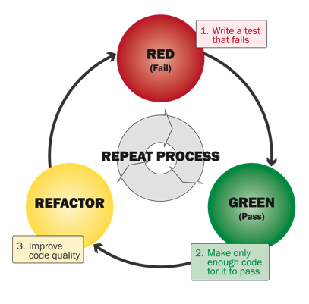
TDD Steps

Slide 50
Advantages
TDD helps you learn, understand the key principles of good modular design.
Reduces bugs in production code.
Documents your code better than documentation (it doesn’t go out of date since you’re running it all the time)
Makes code easier to maintain and refactor.

Slide 51
Different Types of Software Testing
Unit Testing
Integration Testing
Acceptance Testing
Load Testing
Stress Testing
Security Testing
….

Slide 52
Tools
.net (Nunit , Xunit)
Java (Junit)
Python (PyTest )
PHP (PHPUnit)
Nodejs (Jasmine)

