Slide 1
Architecture

Slide 2
Architecture of DDD applications
DDD is that it doesn’t require the use of any specific architecture.
The goal is to use just the right choices and combinations of architecture and architectural patterns.

Slide 3
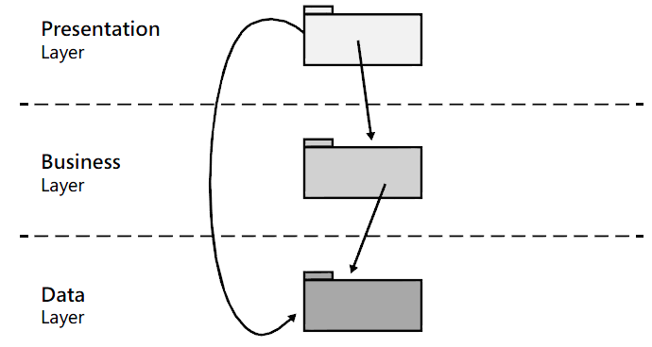
Layered Architecture
Classic Layered Architecture :

Slide 4
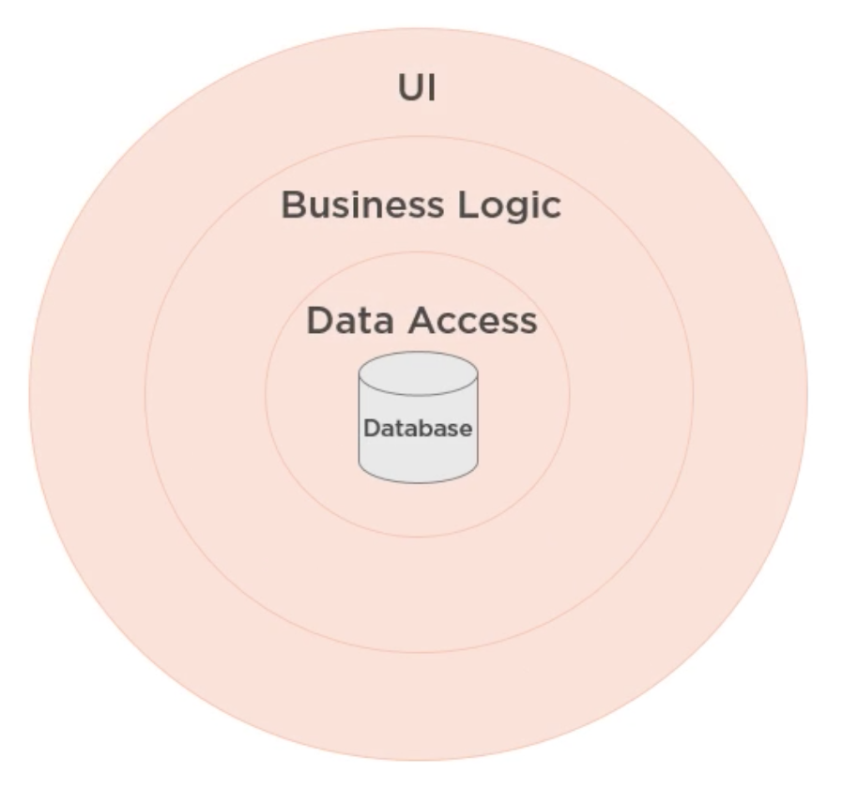
Data-Driven Design
Notes:
Based on RDBMS , all business in SP ( Technology)
Generate Code from Database Table
Modeling in Relational world is hard
Single Table => Single model => share between Sub Systems

Slide 5
Architecture in DDD
Isolate the expression of the domain model and the business logic, and eliminate any dependency on infrastructure, user interface, or even application logic that is not business logic. Partition a complex program into layers.

Slide 6
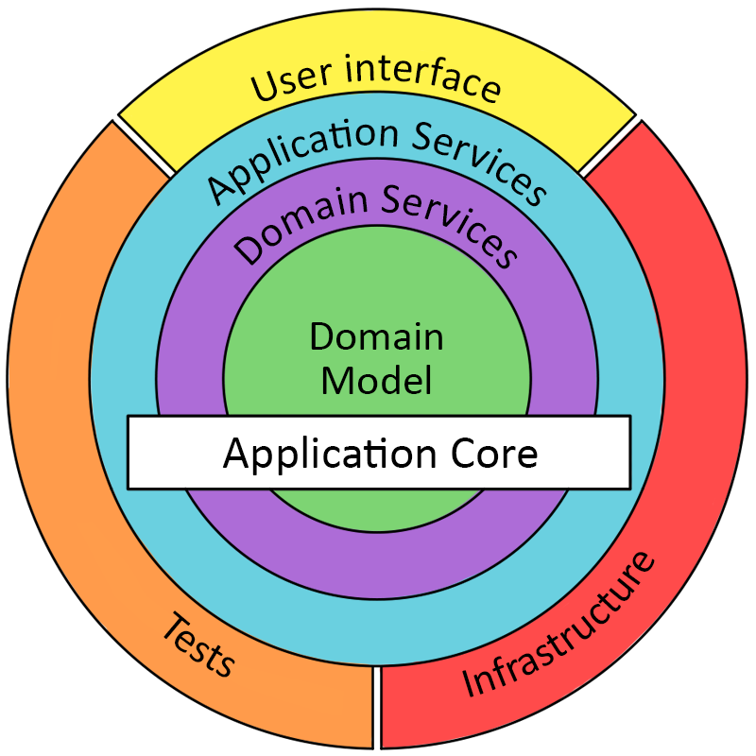
Onion Architecture

Slide 7
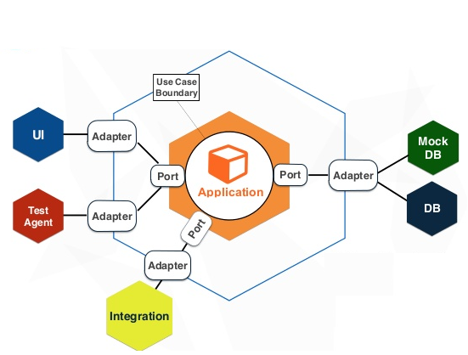
Ports and Adapters ( Hexagonal ) Architecture
Notes:
-We have 2 types port. Inbound ( entry ) or outbound ( exiting)
-An inbound port defines the exposure of the core’s functionality
-An outbound port define the core’s view of the outside world
-The primary or Driving Adapters represents the UI. These adapters can use the inbound ports (interfaces) provided by the core application.
-The secondary or Driven Adapters represent the connection to your back-end databases, external libraries, mail API’s, etc. The secondary adapters are implementations of the outbound port

Slide 8
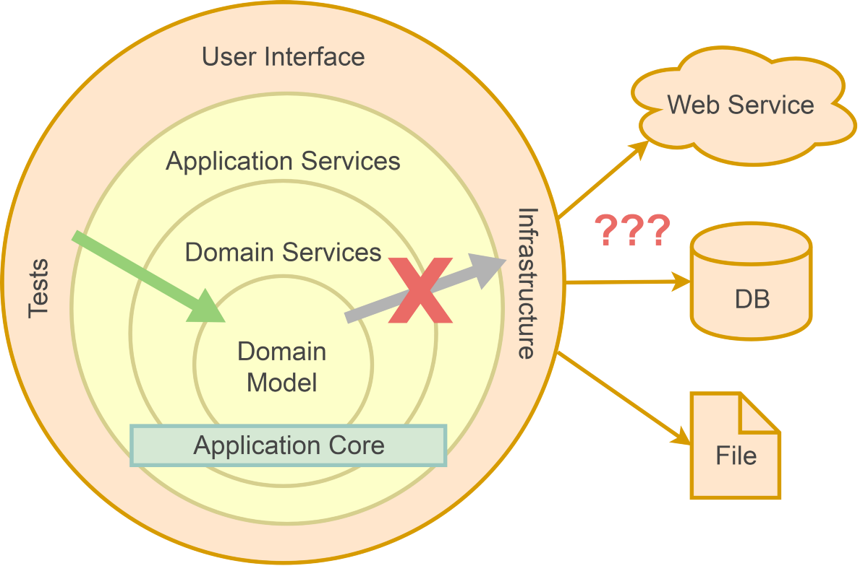
Dipendency Rule

Slide 9
The Domain Layer
The domain layer is where the Domain Model lives.
The domain layer doesn’t depend on any other layer.
The domain layer is agnostic to the technicalities of the clients it serves and data stores that persist the domain objects.

Slide 10
The Application Layer
Application services layer represent the use cases and behavior of the application. They contain application logic that coordinates the fulfillment of a use case by delegating to the domain layer and infrastructural layers.
Notes:
Bussiness Workflow

Slide 11
The Application Layer
Common responsibilities of application layer
Client of the domain layer
Coordinating the retrieving of domain objects from a data store (like repositories).
Control persistence transactions
Control Security

Slide 12
Application Logic vs Business Logic
Application logic contains the workflow steps require to fulfill a business use case. It’s all about coordination and orchestration through delegation to domain and infrastructural services.
Domain logic on the other hand is focused only with domain rules, concepts, information and work flows.

Slide 13
Rule of application service design
Application Services remain very lightweight, coordinating operations performed against domain objects.
If our Application Services become much complex, it is probably an indication that domain logic is leaking into the Application Services.

Slide 14
The Infrastructural Layers
The infrastructural layers of an application are the technical details that enable it to function :
Implementation of storing information.
Calling web service or provide message endpoints.
provide capabilities for logging, security, notification and…

Slide 15
Dependency Inversion Principle
Using DIP enables both the Domain and Infrastructure to depend on abstractions defined by the domain model.

