Slide 1

Team –1 JavaBots
NORMALIZATION

Slide 2

What is Normalization?
Normalization is the process of organizing the data in the database.
Normalization divides the larger table into smaller and links them using relationships.
The normal form is used to reduce redundancy (having several copies of the same data)
from the database table.

Slide 3
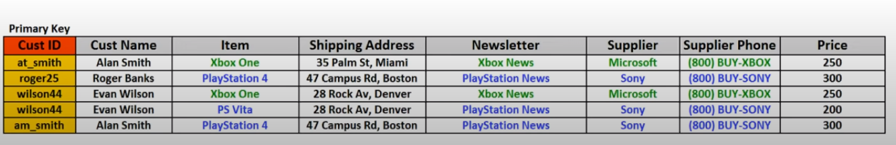
1st Normal Form(1NF)
Each cell to be single valued.
Entries in a column should be of same type.
Rows should be uniquely identified.

Slide 4
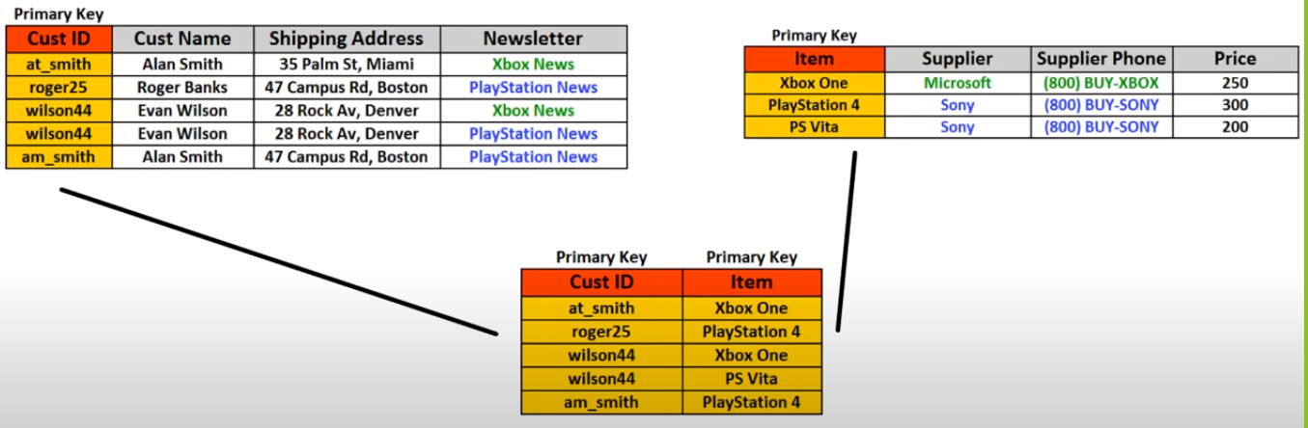
2-NF
It should be in 1NF.
It should not hold partially Dependency.

Slide 5
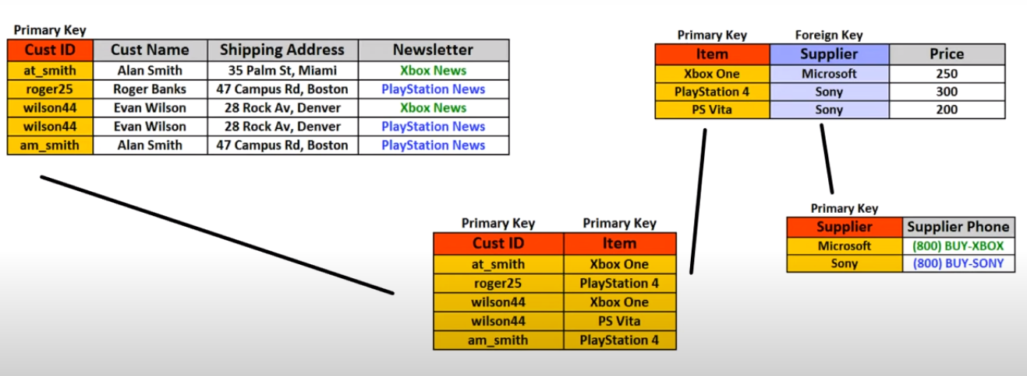
3-NF
It should be in 2NF​
There should not be transitive functional dependency.
If A->B then A should be super key or B is prime Attribute.

Slide 6
BCNF
BCNF is a special case of 3NF, where we have multiple overlapping candidate keys.
Popularity | Item | Date of Release | Year of Release
2 | Xbox One | 15 June 2012 | 2012
1 | PlayStation 4 | 9 July 2013 | 2013
3 | PS Vita | 20 July 2013 | 2013
1 | PlayStation 5 | 10 May 2014 | 2014
Candidate key:
{Item}.
{Popularity, Release Year}.
{DOR, Popularity}
Here we can see that Year Of release is dependent upon Date of Release. This may give rise to inconsistent data.
For example we can see that year of release and date of release contradict themselves.TO avoid such cases BCNF is used.
2 | PS Vita 2.0 | 30 May 2014 | 2016
Popularity | Item | DOR | YOR
at_smith | Xbox One | 15 June | 2012
wilson44 | Playstation 4 | 9 July | 2014
Here we can see that now Date Of Purchase is not dependent on year of purchase.

Slide 7
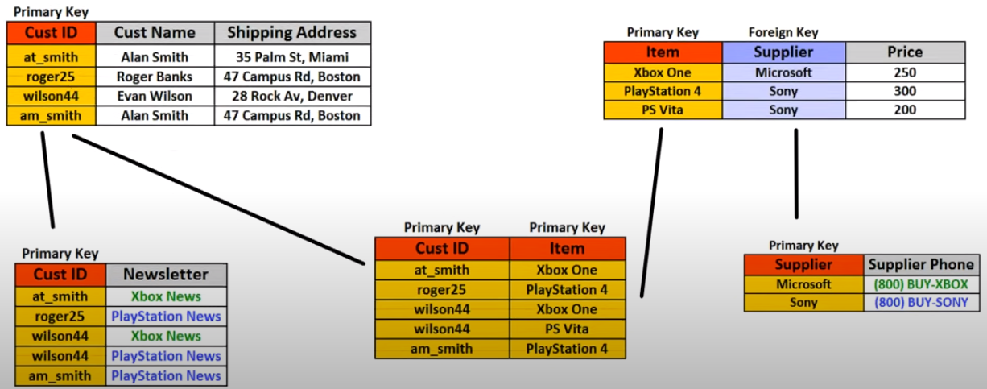
4-NF
It should be in BCNF.
It should not have multivalued dependency.
For a dependency A->B, if for a single value of A there exists multiple values in B then this relation is called multivalued dependency.

Slide 8
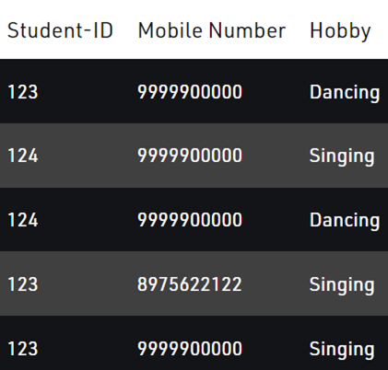
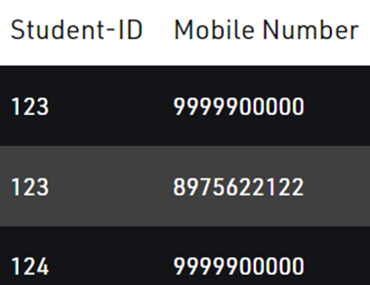
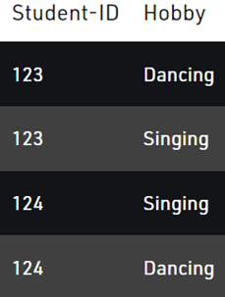
5-NF
It should be in 4NF.
Does not have join dependency and joining should be lossless.
5NF is satisfied when all the tables are broken into as many tables as possible in order to avoid redundancy.
5NF is also known as Project-join normal form.
Table P1
Table P2

Slide 9
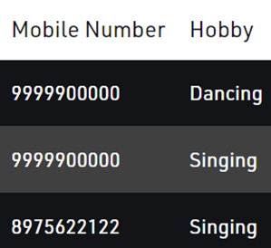
5-NF
Table P3
If natural join is performed on all the three relations then there will be no extra tuples.
So now we can say that P1, P2 and P3 are in fifth normal form.

