Slide 1
Clustering of non-numerical data
Presented by
Rekha Raja
Roll No: Y9205062

Slide 2
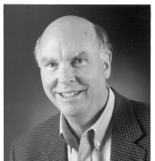
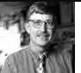

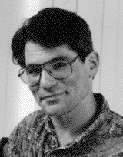
What is Clustering?
Clustering involves the task of dividing data points into homogeneous classes or clusters.
So that items in the same class are as similar as possible and
Items in different classes are as dissimilar as possible.
Given a collection of objects, put objects into groups based on similarity.
Do we put Collins with Venter because they’re both biologists, or do we put Collins with Lander because they both work for the HGP?
Biologist
Collins
Venter
Mathemat-ician
Lander
peter
HGP
Celera

Slide 3
Data Representations for Clustering
Input data to algorithm is usually a vector (also called a “tuple” or “record”)
Types of data
  Numerical
  Boolean
  Non-numerical: Non numerical data is any form of data that is measured in word, (non-numbers) form.
Example:
  Age, Weight, Cost (numerical)
  Diseased? (Boolean)
  Gender, Name, Address (Non-numerical)

Slide 4
Difficulties in non-numeric data clustering
Distance is the most natural method for numerical data
Distance metrics
  Euclidean distance
Similarity Calculation
Does not generalize well to non-numerical data
  What is the distance between “male” and “female”?

Slide 5


(a) Jacard’s coefficient calculation
Jaccard's coefficient A statistic used for comparing the similarity and diversity of sample sets.
  Jaccard similarity = sim(t_{i} , t_{j} ) = (number of attributes in common) / (total number of attributes in both) = (intersection of t_{i} and t_{j} ) / (union of t_{i} and t_{j} )
Where,
p = no. of variables that positive for both objects
q = no. of variables that positive for ith objects and negative for jth object
r = no. of variables that negative for ith objects and positive for jth object
s = no. of variables that negative for both objects
t = p+q+r+s = total number of variables
Jaccard's distance can be obtained from

Slide 6
Example
Feature of Fruit | Sphere shape | Sweet | Sour | Crunchy
Object A=Apple | Yes(1) | Yes(1) | Yes(1) | Yes(1)
Object B=Banana | No(0) | Yes(1) | No(0) | No(0)
The coordinate of Apple is = (1,1,1,1) and
The coordinate of Banana is = (0,1,0,0).
Because each object is represented by 4 variables, we say that these objects has 4 dimensions.
Here, p=1, q=3, r=0 and s=0.
Jaccard's coefficient between Apple and Banana is =1/(1+3+0)= 1/4 .
Jaccard's distance between Apple and Banana is =1-(1/4) = 3/4.
Lower values indicate more similarity.

Slide 7
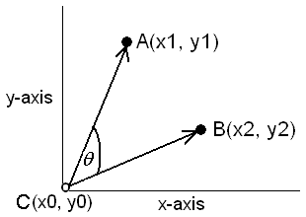
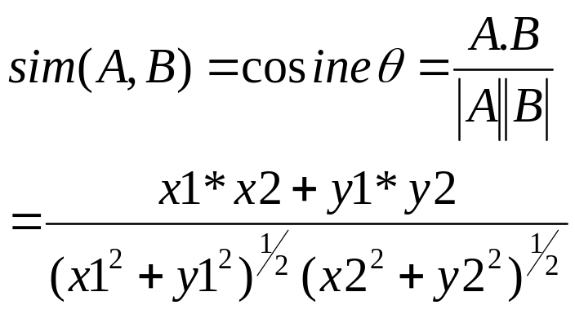
(b) Cosine similarity measurement
Assign Boolean values to a vector describing the attributes of a database element, then measure vector similarities with the Cosine Similarity Metric.
Cosine similarity is a measure of similarity between two vectors by measuring the cosine of the angle between them.
The result of the Cosine function is equal to 1 when the angle is 0, and it is less than 1 when the angle is of any other value.
As the angle between the vectors shortens, the cosine angle approaches 1, meaning that the two vectors are getting closer, meaning that the similarity of whatever is represented by the vectors increases.

Slide 8
example
Feature of Fruit | Sphere shape | Sweet | Sour | Crunchy
Object A=Apple | Yes (1) | Yes (1) | Yes (1) | Yes (1)
Object B=Orange | Yes (1) | Yes (1) | Yes(1) | No (0)
A = {1, 1, 1,1}
B = {1, 1, 1,0}
Dot Product:
A*B = w1*w2+x1*x2 + y1*y2 + z1*z2 = 1*1+1*1+1*1+1*0 = 3
the norm of each vector (their length in this case) is
|A|= (w1*w1+x1*x1 + y1*y1+z1*z1)^1/2 = (1+1+1+1)^1/2 = 2
|B| = (w2*w2+x2*x2 + y2*y2+z2*z2)^1/2 = (1+1+1+0)^1/2 = 1.732050888
|A|*|B| = 3.464101615
sim = cosine(theta) = A*B / (|A|*|B|) = 3/3.464101615 which is 0.866!!!
If we use previous example then we get
sim = cosine(theta) = A*B/(|A|*|B|) = 1/2 which is 0.5!!!

Slide 9
(c) Assign Numeric values
Assign Numeric values to non-numerical items, and then use one of the standard clustering algorithms.
Then use one of the standard clustering algorithms like,
  hierarchical clustering
    agglomerative ("bottom-up") or
    divisive ("top-down")
  Partitional clustering
  Exclusive Clustering
  Overlapping Clustering
  Probabilistic Clustering

Slide 10
Application
Text Clustering
Text clustering is one of the fundamental functions in text mining.
  Text clustering is to divide a collection of text documents into different category groups so that documents in the same category group describe the same topic, such as classic music or history or romantic story.
  Efficiently and automatically grouping documents with similar content into the same cluster.
Challenges:
Unlike clustering structured data, clustering text data faces a number of new challenges.
  Volume,
  Dimensionality, and
  Complex semantics.
These characteristics require clustering techniques to be scalable to large and high dimensional data, and able to handle semantics.

Slide 11
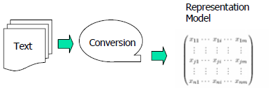
Representation Model
In information retrieval and text mining, text data of different formats is represented in a common representation model, e.g., Vector Space Model
Text data is converted to the model representation

Slide 12
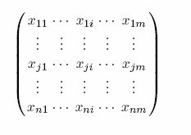
Vector Space Model (VSM)
Vector space model is an algebraic model for representing text documents (and any objects, in general) as vectors of identifiers.
A text document is represented as a vector of terms <t1, t2, …, ti, …, tm>.
Each term ti represents a word.
A set of documents are represented as a set of vectors, that can be written as a matrix.
Where each row represents a document, each column indicates a term, and each element xji represents the frequency of the ith term in the jth document.

Slide 13
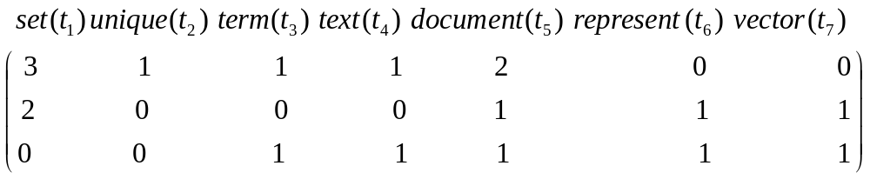
Vector Space Model (VSM)
SL. No. | Document Text
1 | The set of all n unique terms in a set of text documents forms the vocabulary for the set of documents.
2 | A set of documents are represented as a set of vectors, that can be written as a matrix.
3 | A text document is represented as a vector of terms
Representation model

Slide 14
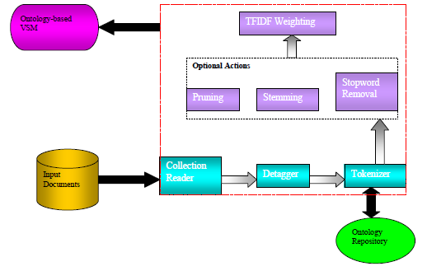
Text Preprocessing Techniques
Objective
Transform unstructured or semi-structured data or text data into structured data model i.e VSM.
Techniques:
Collection reader
Detagger
Tokenizer
Stopword removal
Stemming
Prunning
Term weighting

Slide 15
Collection Reader
Transform raw document collection into a common format, e.g., XML
Use tags to mark off sections of each document, such as,
<TOPIC>, <TITLE>, <ABSTRACT>,<BODY>
Extract useful sections easily
Example:
“Instead of direct prediction of a continuous output variable, the method discretizes the variable by kMeans clustering and solves the resultant classification problem.”
Detagger
Find the special tags in document
“,”, ”.”
Filter away tags
“Instead of direct prediction of a continuous output variable the method discretizes the variable by kMeans clustering and solves the resultant classification problem ”

Slide 16
Removing Stopwords
Stopwords
  Function words and connectives
  Appear in a large number of documents and have little use in
  describing the characteristics of documents.
Example
Removing Stopwords
  Stopwords:
  “of”, “a”, “by”, “and” , “the”, “instead”
  Example
    “direct prediction continuous output variable method discretizes variable kMeans clustering solves resultant classification problem”

Slide 17
Stemming
  Remove inflections that convey parts of speech, tense.
Techniques
  Morphological analysis (e.g., Porter’s algorithm)
  Dictionary lookup (e.g., WordNet)
Stems:
  “prediction --->predict”
  “discretizes --->discretize”
  “kMeans ---> kMean”
  “clustering --> cluster”
  “solves ---> solve”
  “classification ---> classify”
Example sentence
  “direct predict continuous output variable method discretize
  variable kMean cluster solve resultant classify problem”

Slide 18

Weighting Terms
  Weight the frequency of a term in a document
  Technique:
    -Where tf(dj,ti) is the frequency of term ti in document d_{i}, |D| is the
    total number of documents, and df(ti) is the number of documents in
    which ti occurs.
  Not all terms are equally useful
  Terms that appear too rarely or too frequently are ranked lower than terms that balance between the two extremes
  Higher weight means that the term is better to contribute to clustering results

Slide 19
Ontology and Semantic Enhancement of Presentation Models
Represent unstructured data (text documents) according to
ontology repository
  Each term in a vector is a concept rather than only a word or phrase
  Determine the similarity of documents
Methods to Represent Ontology
  Terminological ontology
  Synonyms: several words for the same concept
    employee (HR)=staff (Administration)=researcher (R&D)
    car=automobile
  Homonyms: one word with several meanings
    bank: river bank vs. financial bank
    fan: cooling system vs. sports fan

Slide 20


Ontology-based VSM
Each element of a document vector considering ontology is represented by:
Where X_{ji1} is the original frequency of t_{i1} term in the jth document,
is the semantic similarity between t_{i1} term and t_{i2} term .

Slide 21


Example
According to WordNet, terms ‘ball’, ‘football’, and ‘basketball’ are
semantically related to each other. Updating document vectors in
Table 1 by the formula, new ontology-based vectors are obtained.

Slide 22
Applications
Marketing: finding groups of customers with similar behavior given a large database of customer data containing their properties and past buying records;
Biology: classification of plants and animals given their features;
Insurance: identifying groups of motor insurance policy holders with a high average claim cost; identifying frauds;
City-planning: identifying groups of houses according to their house type, value and geographical location;
Earthquake studies: clustering observed earthquake epicenters to identify dangerous zones;

Slide 23
Conclusion
Good results are often dependent on choosing the right data representation and similarity metric
  Data: categorical, numerical, boolean
  Similarity: distance, correlation, etc.
Many different choices of algorithms, each with different strengths and weaknesses
  k-means, hierarchical, graph partitioning, etc.
Clustering is a useful way of exploring data, but is still very ad hoc

Slide 24
Reference
Hewijin Christine Jiau & Yi-Jen Su & Yeou-Min Lin & Shang-Rong Tsai, “MPM: a hierarchical clustering algorithm using matrix partitioning method for non-numeric data”, J Intell Inf Syst (2006) 26: 185–207, DOI 10.1007/s10844-006-0250-2.
Joshua Zhexue Huang1 & Michael Ng.2 & Liping Jing1,”Text Clustering: Algorithms, Semantics and Systems”,1 The University of Hong Kong, 2 Hong Kong Baptist University, PAKDD06 Tutorial, April 9, 2006, Singapore.
“Neuro fuzzy and soft computing “ ,computational approach to learning and machine intelligence, J.-S.R Jang,C.-T, Sun & E. MIZUTANI.
http://people.revoledu.com/kardi/tutorial/Similarity/Jaccard.html
http://en.wikipedia.org/wiki/Cluster_analysis
http://en.wikipedia.org/wiki/Cosine_similarity

Slide 25
Questions?
Which non-numerical clustering method, is most suitable for real time implementation?
Is there any other way by which you can cluster?
What method we have to use for mixed type of data?
What are the other application of clustering?

Slide 26
Thank You

