Slide 1
PYTHON GUI PROJECT
Student Expense
Tracker
Expense Tracker
Lunch
₹80
Travel
₹30
A beginner-friendly desktop app built with Python + Tkinter
Snacks
₹45
Presented by: Swayam Chougule-125A1022
Azain Bandarkar-125A1022
Abdul Hamid -125A1003
TOTAL ₹155
SIES Graduate School of Technology | Computer Engineering

Slide 2
1. Project Overview & Objectives
A practical mini-project aligned with the Python syllabus.
• Problem: students often lose track of small daily expenses.
• Solution: a simple GUI to enter expenses and see the total spent.
• Main features: add an expense, display saved records and calculate total.
• Syllabus concepts: Python basics, functions, lists, file handling and exception handling.
Expense Tracker
Lunch
₹80
Travel
₹30
Snacks
₹45
TOTAL ₹155
Goal
Keep everyday spending simple and visible.
2

Slide 3
2. GUI Design & Working
User enters details → app validates → saves → updates total.
Student Expense Tracker
• Tkinter creates labels, entry boxes and buttons.
• A list stores expense records while the app runs.
• A text file keeps records after closing the app.
• try/except handles invalid amount input.
Expense name
Amount (₹)
Lunch
80
Add
Saved expenses
Lunch — ₹80 Travel — ₹30 Snacks — ₹45
Total spent: ₹155
3

Slide 4
3. Python Code — Core Logic
The full code is split into small functions for easy explanation.
import tkinter as tk
from tkinter import messagebox
FILE = "expenses.txt"
expenses = []
def add_expense():
name = name_entry.get().strip()
try:
amount = float(amount_entry.get())
if not name or amount <= 0:
raise ValueError
except ValueError:
messagebox.showerror("Error", "Enter a name and amount > 0")
return
expenses.append((name, amount))
with open(FILE, "a") as f:
f.write(f"{name}|{amount}\\n")
name_entry.delete(0, tk.END)
amount_entry.delete(0, tk.END)
refresh_list()
def refresh_list():
expense_list.delete(0, tk.END)
total = 0
for name, amount in expenses:
expense_list.insert(tk.END, f"{name} - Rs.{amount:.2f}")
total += amount
total_label.config(text=f"Total: Rs.{total:.2f}")
add_expense()
Checks input, stores a record and refreshes the screen.
refresh_list()
Shows each expense and adds up the total.
try / except
Stops invalid input from crashing the program.
4

Slide 5
4. Finish the Code & Run the App
Add this final section below the core logic.
• Save as expense_tracker.py
• Run: python expense_tracker.py
• Add Lunch = 80 and Travel = 30.
• Expected total: Rs.110.00
• Note: to show old records after restart, add a small load-from-file function (or demo saving during one session).
root = tk.Tk()
root.title("Student Expense Tracker")
root.geometry("520x420")
tk.Label(root, text="Expense name").pack()
name_entry = tk.Entry(root, width=30)
name_entry.pack()
tk.Label(root, text="Amount (Rs.)").pack()
amount_entry = tk.Entry(root, width=20)
amount_entry.pack()
tk.Button(root, text="Add Expense",
command=add_expense).pack(pady=8)
expense_list = tk.Listbox(root, width=55)
expense_list.pack()
total_label = tk.Label(root, text="Total: Rs.0.00")
total_label.pack(pady=8)
root.mainloop()
5

Slide 6
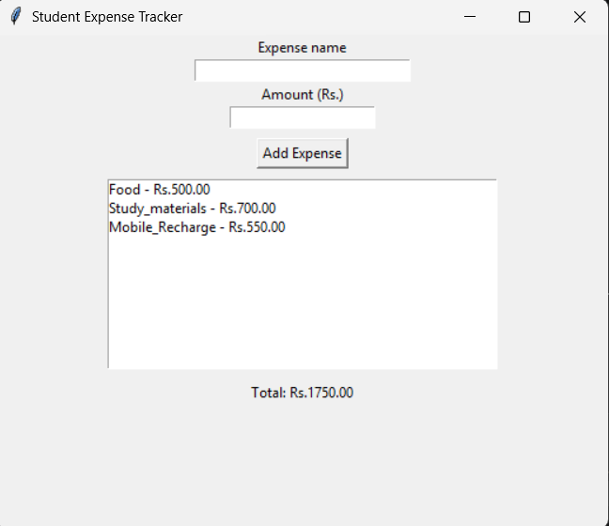

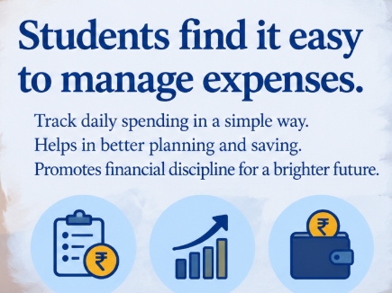
5.Result
6

Slide 7
THANK YOU!
Student Expense Tracker
Python • Tkinter • Lists • File Handling • Exception Handling
Expense Tracker
Lunch
₹80
Travel
₹30
Snacks
₹45
TOTAL ₹155
Azain | Hamid | Swayam

