Slide 1
GROUP MEETING · JURA DATASET · MULTI-OUTPUT GAUSSIAN PROCESSES
Multi-Output Gaussian Processes for Soil Cadmium Prediction
Trying to use Ni / Zn to help predict Cd - comparing an independent GP, ICM, and LMC (Q=2)
Presented by: Cai haozhang 8.28 2026
Jura MOGP · Group Meeting
1 / 17
Notes:
Good morning. Thank you for the time today.
My topic is: can we use cheap data to help predict expensive data? I use a soil dataset from Switzerland. I compare three models: a simple model, and two models that use more information.
Three numbers to remember: 359 sample points. 10 out of 10 — my result wins in every test. And Q = 2 — the best model uses two scales, not one.
Let's go through the story.

Slide 2
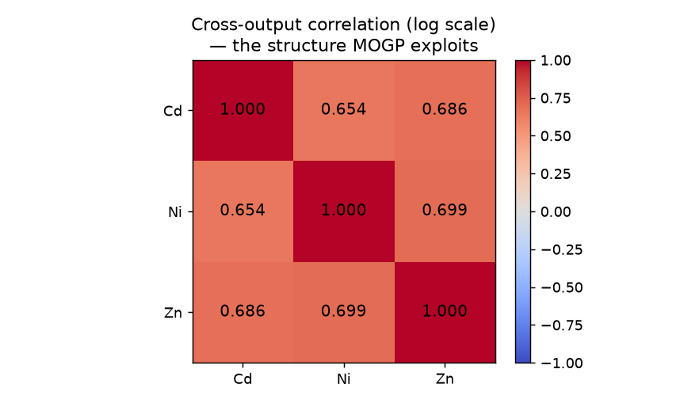
02
Why I thought Ni / Zn might help predict Cd
Cadmium (Cd) is an important indicator of soil heavy-metal contamination, but measuring it costs more than nickel (Ni) or zinc (Zn).
These three metals often come from the same source - pollution, or the local geology - so I expected them to appear together spatially.
So the question I started from: can the cheaper Ni / Zn measurements help predict the more expensive Cd?
Why I checked this first
On the log scale the three pairwise correlations are 0.65 / 0.69 / 0.70, which is fairly strong.
If these had been close to 0, there would have been no point doing any of the multi-output modelling.
Jura MOGP · Group Meeting
2 / 17
Notes:
First, why did I start this project?
Cadmium, or Cd, is a metal in soil. It is bad for health. But testing for Cd is expensive.
Nickel and zinc — Ni and Zn — are cheaper to test. And often, these three metals come from the same place. Same pollution, or same rock in the ground. So they tend to appear together.
My question was simple: can I use the cheap Ni and Zn data to help predict the expensive Cd data?
Before I built any model, I checked one thing first: are these three metals really related? I found the correlation is 0.65, 0.69, and 0.70. These numbers are not small. So yes, they are related. This is the reason the rest of my project makes sense.

Slide 3
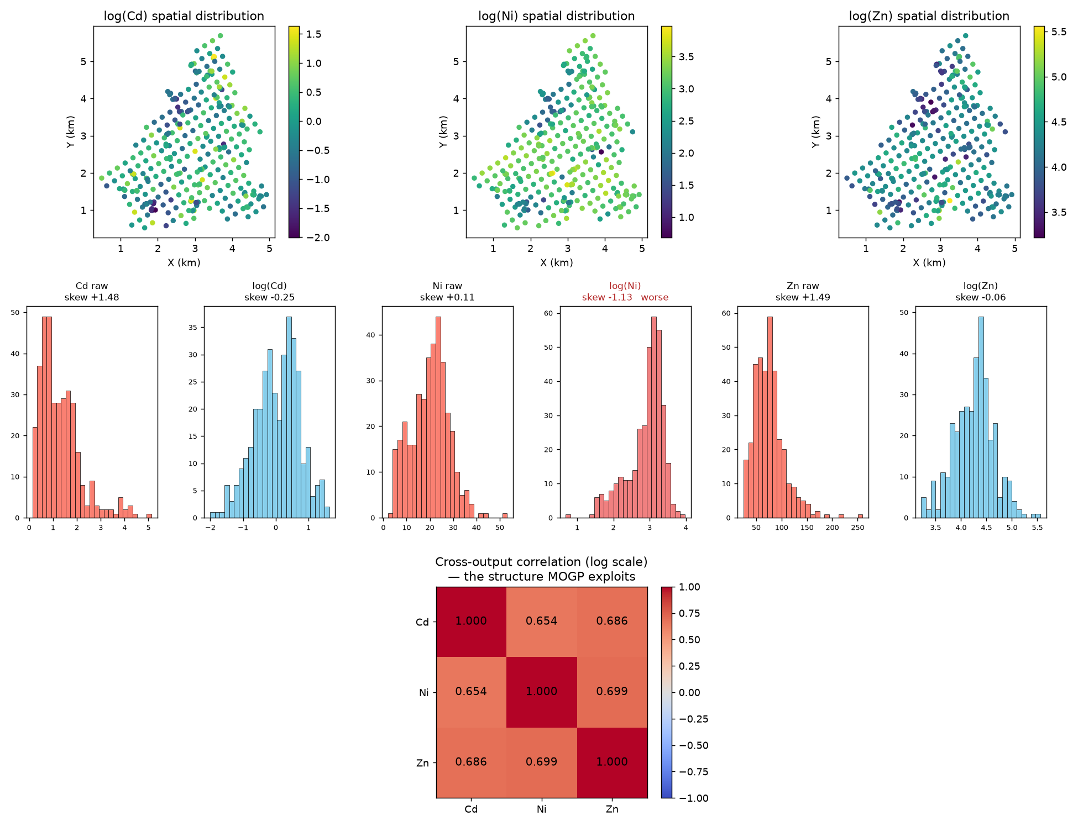
03
First, I looked at the raw data
What I saw
Cd and Zn were right-skewed, so I log-transformed them, which made them roughly symmetric. Ni was already close to symmetric, and the transform made it slightly worse (skew -1.13 vs +0.11) - I kept it anyway so all three metals share one scale.
Jura MOGP · Group Meeting
3 / 17
Notes:
Before modelling, I looked at the raw numbers.
Cd and Zn had a "right-skewed" shape. This means most values are small, but a few values are very large. So I used a log transform. After that, the shape became more symmetric, more like a normal bell curve.
But Ni was different. Ni was already close to symmetric before the transform. After I applied log to Ni, it actually became a little worse.
I want to be honest about this. I still used log for all three metals, because I need them on the same scale. But for Ni, this was not a perfect choice. It was a trade-off.

Slide 4
04
The dataset and how I split it
Jura dataset - 359 sampling sites in the Swiss Jura region, from Goovaerts (1997). I obtained it through OpenML (data_id=41554).
Output | Observations | Role
Cd (cadmium) | 259 | Target variable -- 100 further sites held out for testing
Ni (nickel) | 359 | Auxiliary variable -- observed everywhere
Zn (zinc) | 359 | Auxiliary variable -- observed everywhere
Heterotopic Design, Schematically
Cd training (259)
Cd test (100, hidden)
Task
Predict Cd at the 100 sites where I hid it. This setup imitates the real situation, where Cd assays cost more than Ni / Zn.
Ni / Zn (all 359 visible)
Avoiding test-set leakage
I computed the standardisation mean / variance from training data only - 259 Cd points, not 359.
At every site where Cd is hidden, Ni and Zn are still measured. This is the part that makes multi-output modelling possible here.
Jura MOGP · Group Meeting
4 / 17
Notes:
Now, the dataset. It is called the Jura dataset. It has 359 sample sites in the Jura mountains in Switzerland. It comes from a classic book by Goovaerts, published in 1997.
Look at this table. Cd has 259 points. I hide 100 more Cd points, to use later as a test. Ni and Zn are different — they are measured at all 359 points, with nothing hidden.
The task is: predict Cd at the 100 hidden points. This copies a real situation, where testing Cd costs more than testing Ni or Zn.
One important detail: when I compute the mean and the variance for standardization, I only use the 259 training points for Cd. Not all 359. If I used all 359, some test information would leak into training. I wanted to avoid that.
Look at the picture. At every site where Cd is missing, we still have Ni and Zn. This is the key idea. This is why a multi-output model can work here.

Slide 5
05
The three models I compared
Independent GP
ICM
LMC
baseline
MOGP · Q = 1
MOGP · Q = 2
Uses only the 259 Cd observations. It cannot see Ni / Zn.
K = k(x,x')*B[i,j]
One spatial scale, shared by all three outputs
K = sum_q k_q(x,x')*B_q[i,j]
Each latent function gets its own spatial scale
How they relate
ICM is just LMC with Q = 1. B comes from GPyTorch's IndexKernel, written as B = W*W^T + diag(kappa).
About the implementation
I used the Hadamard long-table form for all three models (each row = coordinates + task index + observation). A wide table cannot hold the missing Cd values, but a long table can. The trade-off is that it gives up the Kronecker speedup. Training runs on 977 rows.
Jura MOGP · Group Meeting
5 / 17
Notes:
Now let me explain the three models.
The first model is an independent GP. GP means Gaussian Process. This is the baseline. It only uses the 259 Cd points. It cannot see Ni or Zn at all.
The second model is called ICM. It is a multi-output model. It uses one spatial scale. This scale is shared by all three outputs.
The third model is called LMC. It is also multi-output. But it can use more than one scale. Each part of the model — we call it a "latent function" — gets its own scale. In my case, I use two scales, so Q equals 2.
Here is an important relationship: ICM is just a special case of LMC, when Q equals 1.
One note about how I built this. I used a format called "long-table form." Each row has a location, a task number, and one measured value. A normal table cannot hold missing values well. But this long-table form can. The cost is: I lose a speed trick called the Kronecker speedup. Training uses 977 rows in total.

Slide 6
06
How I checked the result was not just luck
10 random splits
Each split re-draws the 259 / 100 partition with a different random seed, and re-standardises from scratch
1
Paired comparison
All three models run on the same split, then compared with a paired t-test and a Wilcoxon test
2
Metrics
Test RMSE / MAE / NLL on the 100 held-out Cd sites
3
One setting I had to change
GPyTorch only uses exact Cholesky below 800 training points, and I have 977, so I raised that limit manually
4
Jura MOGP · Group Meeting
6 / 17
Notes:
Before I trust any result, I need to check: is it real, or just luck?
I did four things.
First, I ran 10 random splits. Each time, I chose the 100 hidden Cd points again, with a new random seed. And I standardized the data again, each time, from scratch.
Second, paired comparison. All three models run on the same split. Then I compare them using two statistical tests: a paired t-test, and a Wilcoxon test.
Third, my metrics. I use RMSE, MAE, and NLL. RMSE means: how big is the average prediction error. Lower is better.
Fourth, one technical setting I had to fix. The software, called GPyTorch, only uses an exact math method when the data has less than 800 points. I have 977 points. So I had to raise this limit by hand. Without this fix, the numbers become noisy and unreliable.

Slide 7
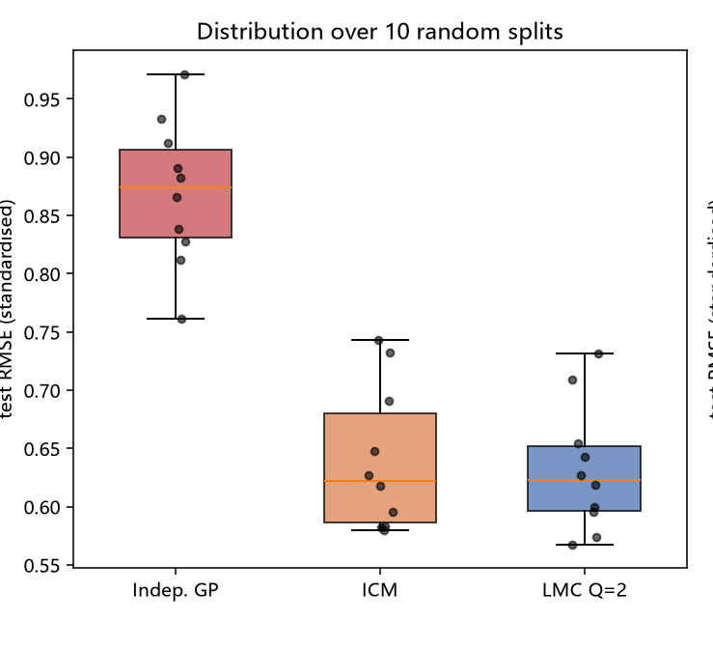
07
Main result: both multi-output models beat the baseline
+26.3%
+27.3%
p < 0.001
ICM, RMSE reduction vs. independent GP
(+/- 5.4%, over 10 splits)
LMC (Q=2), RMSE reduction vs. independent GP
(+/- 4.5%, over 10 splits)
Paired t-test, independent GP vs. LMC
Better on all 10 splits
Model | Test RMSE (standardized) | vs. independent GP
Independent GP (baseline) | 0.8694 ± 0.0620 | —
ICM | 0.6399 ± 0.0619 | +26.3% ± 5.4%
LMC (Q = 2) | 0.6320 ± 0.0544 | +27.3% ± 4.5%
One question I expected: why not just use linear regression?
I tried it. A plain regression Cd ~ Ni + Zn at the same location gives RMSE 0.76, and LMC gives 0.73. So most of the improvement really does come from simply having Ni / Zn at the same site, and the GP only adds about 4% more. I still think the GP is worth using, for two reasons: linear regression gives no uncertainty estimate, and it cannot predict at all where Ni / Zn are missing, whereas the GP falls back to spatial interpolation.
Jura MOGP · Group Meeting
7 / 17
Notes:
Now, the main result.
ICM reduces the error by 26.3 percent, compared to the baseline. LMC reduces it by 27.3 percent. Both numbers come from an average over 10 splits.
The p-value is less than 0.001. A p-value tells us: how likely is this result, if there is really no true difference? A small p-value means: this result is probably real, not luck. And LMC wins on all 10 out of 10 splits.
Look at this table. Independent GP has an error of 0.87. ICM brings it down to 0.64. LMC brings it down to 0.63.
Now, one question I expected. Why not just use simple linear regression?
I tried it. A plain regression, using Cd, Ni, and Zn at the same location, gives an error of 0.76. LMC gives 0.73. So most of the improvement really comes from just having Ni and Zn at the same place. The GP model only adds about 4 percent more.
But I still think the GP is worth using. Two reasons. First, linear regression cannot tell us how confident it is. The GP can. Second, linear regression completely fails where Ni and Zn are missing. But the GP can still make a reasonable guess there, using nearby points.

Slide 8
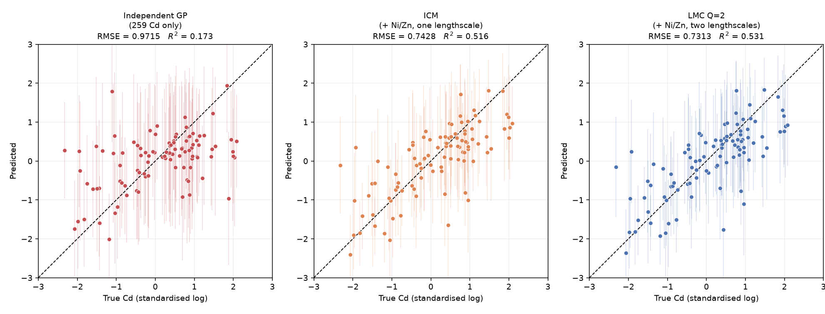
08
What the predictions actually look like
How to read this
Each dot is a test site: x-axis is the true Cd value, y-axis is the prediction. A dot on the dashed diagonal is a perfect prediction. From independent GP to ICM to LMC the dots pull in toward the diagonal - the same improvement the RMSE numbers describe.
Jura MOGP · Group Meeting
8 / 17
Notes:
This picture shows the predictions directly.
Each dot is one test site. The x-axis is the true Cd value. The y-axis is the predicted value. A dot on the dashed line means a perfect prediction.
Look at the three plots, left to right: independent GP, then ICM, then LMC. You can see the dots move closer to the line. This is the same improvement we just saw in the RMSE numbers, but now you can see it directly.

Slide 9
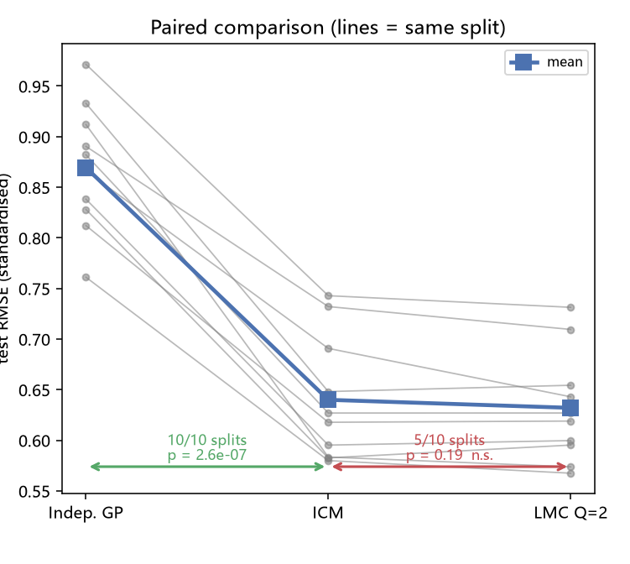
09
The same result on all 10 splits
p < 0.001
Independent GP -> ICM
Better on 10 / 10 splits
p < 0.001
Independent GP -> LMC
Better on 10 / 10 splits
How to read this
Each grey line is one random split. The green arrow (GP vs ICM) wins 10/10. The red arrow (ICM vs LMC) is only 5/10, not significant - I come back to that on slide 14.
Jura MOGP · Group Meeting
9 / 17
Notes:
I want to confirm: is this improvement stable? Or did I just get lucky one time?
Here, each grey line is one random split. From independent GP to ICM, and from independent GP to LMC, both p-values are less than 0.001. And the win rate is 10 out of 10, both times.
Look at the lines. They go down from left to right. They almost never cross each other. This tells me the improvement is stable. It does not depend on one lucky split.

Slide 10
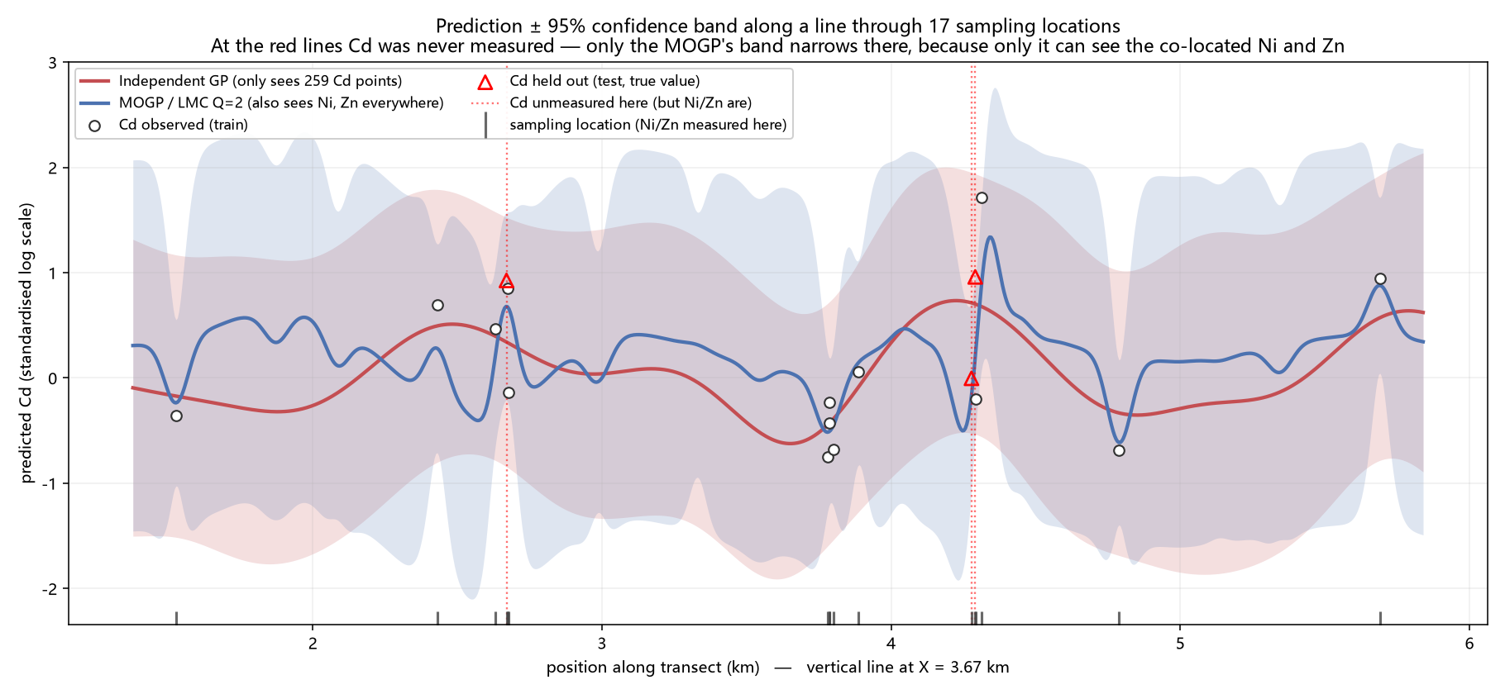
10
Where does the improvement come from?
The numbers
Across the 100 test sites the uncertainty becomes about 23% narrower (GP 0.75 -> LMC 0.58), but only within about 0.05 km of a sampling site. That is very close to the short-range lengthscale LMC learned (0.052 km), so I think the gain comes from borrowing at the same location.
Jura MOGP · Group Meeting
10 / 17
Notes:
Now a deeper question: where, exactly, does this improvement come from?
Across the 100 test points, the uncertainty becomes about 23 percent smaller, on average. But — and this is important — this only happens within about 0.05 kilometers of a real sample point.
This number, 0.05 kilometers, is very close to a number the model learned by itself: 0.052 kilometers. This is called a "lengthscale." It tells the model how far away two points can still affect each other.
So my idea is: the improvement comes from borrowing information at the same location. It is not simple smoothing over a large area.

Slide 11
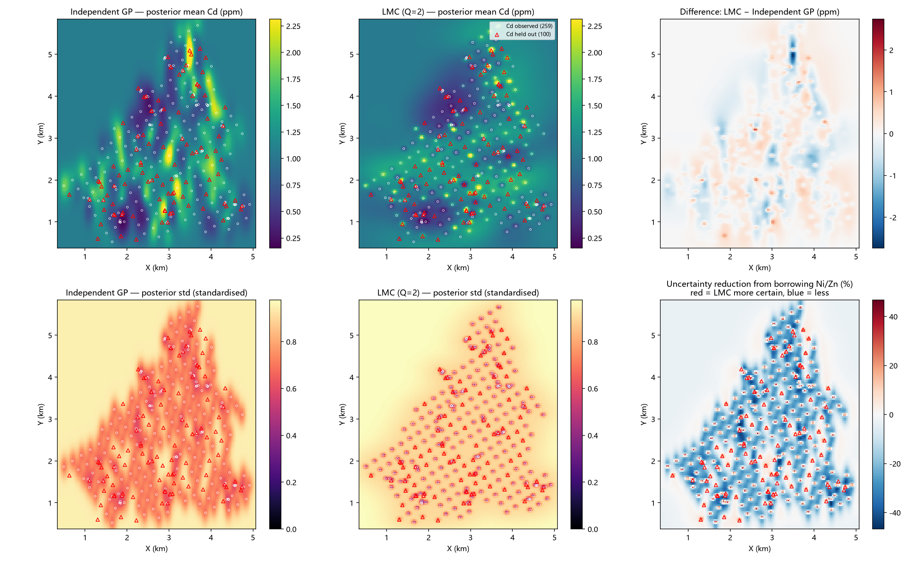
11
Where on the map does the model become more confident?
How to read this
Top row: predicted Cd for the independent GP and for LMC, and the difference between them. Bottom row: the uncertainty of each model, and on the right the percentage reduction. The red areas - where LMC is more confident - sit almost entirely on the sampling sites. In the gaps between sites there is almost no gain.
Jura MOGP · Group Meeting
11 / 17
Notes:
Let's look at this on a map.
Top row: predicted Cd values, for independent GP and for LMC, and the difference between them. LMC follows the local details more closely.
Bottom row: how uncertain each model is. On the right, the percentage change. Red areas mean LMC is more confident than independent GP. Notice — red areas sit almost exactly on the sample points. In the empty areas between points, there is very little gain.

Slide 12
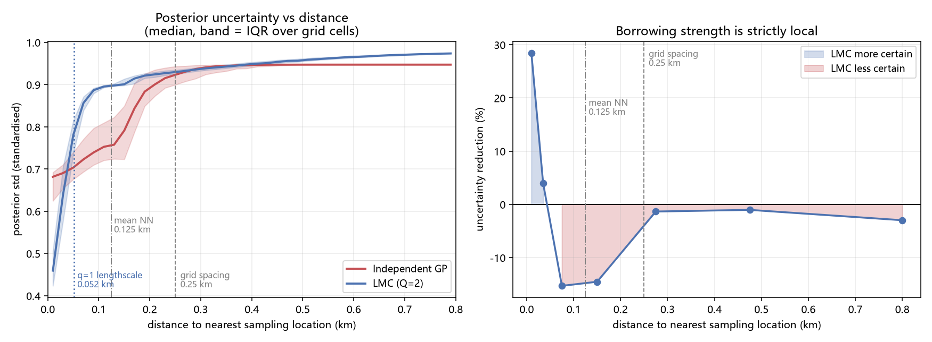
12
How far does the borrowing reach?
~0.05 km
0.052 km
0.125 / 0.25 km
Where the two curves cross
The short-range lengthscale LMC learned
Mean nearest-neighbour distance / grid spacing, for reference
These two numbers came out almost the same, which is why I think the borrowing only works within about one short-range lengthscale.
Jura MOGP · Group Meeting
12 / 17
Notes:
This slide checks the same idea, using numbers.
The two curves — GP and LMC — cross at about 0.05 kilometers. The lengthscale the model learned is 0.052 kilometers. These two numbers are almost the same.
For reference, the average distance between neighboring points is 0.125 kilometers. The regular grid spacing is 0.25 kilometers.
Since the crossing point matches the learned lengthscale so closely, I believe the borrowing effect really is limited to about one lengthscale. It does not reach much further than that.

Slide 13
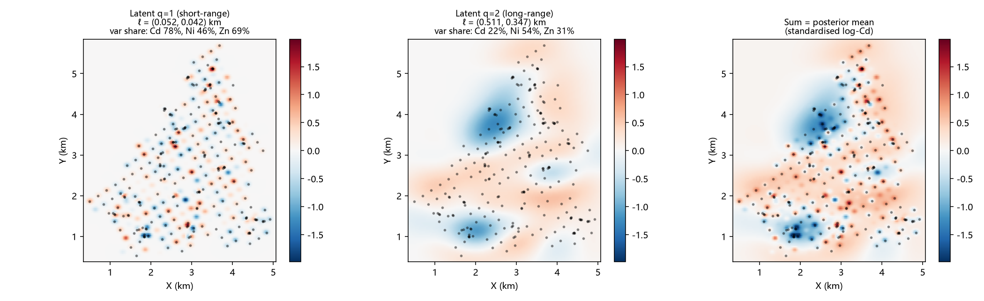
13
The two scales, and what I think they mean
Latent function | Scale ℓ (km) | Share of Cd var. | Cd-Ni corr. | Interpretation
q=1 short-range | 0.052 × 0.042 | 77.7% | 0.673 | Local anthropogenic input (pollution)
q=2 long-range | 0.511 × 0.347 | 22.3% | 0.941 | Regional geological background
Something I found surprising
The long-range component accounts for only 22% of Cd's prior variance, but it contributes about 63% of the variation in the actual prediction surface. So variance share and actual influence are not the same thing.
The long-range component's cross-output correlation is close to 1. My interpretation is that at that scale the three metals behave almost like scaled copies of the same underlying field.
Jura MOGP · Group Meeting
13 / 17
Notes:
Now, something I find interesting.
Look at this table. The LMC model, with Q equals 2, learned two separate scales.
The first one is short-range. Its scale is about 50 meters. It explains 77.7 percent of the variation in Cd. Its correlation with Ni is 0.673. My guess is: this represents local pollution. Something added by human activity, close to the surface.
The second one is long-range. Its scale is about 500 meters. It explains only 22.3 percent of the variation in Cd. But its correlation with Ni is 0.941 — very close to 1. My guess is: this represents the regional geology. The natural rock and soil under a wide area.
Here is something surprising. Even though the long-range part explains only 22 percent of the variance, it actually contributes 63 percent of the shape we see in the final prediction map. So explaining variance, and having real influence on the result, are not the same thing.

Slide 14
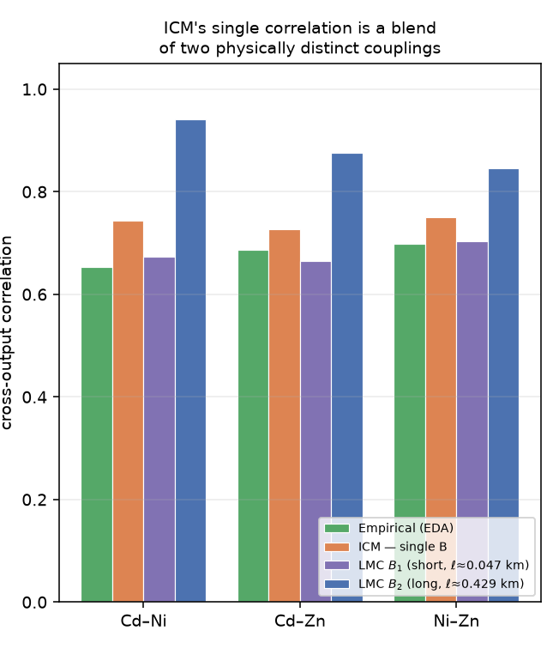
14
A result I want to mention up front
5 / 10
LMC vs. ICM, splits won
p = 0.19 - not significant
Model | lengthscale (km) | Cd-Ni corr.
ICM (its only one) | (0.079, 0.058) | 0.743
LMC q=1 (short-range) | (0.052, 0.042) | 0.673
LMC q=2 (long-range) | (0.511, 0.347) | 0.941
Something I should mention
I expected LMC to predict better than ICM, but the test says it does not - it only won 5 of 10 splits, so I cannot claim LMC is more accurate. What I did notice is that ICM has only one correlation value (about 0.74), while LMC splits it into 0.67 and 0.94, and ICM's number sits right between them. My understanding is that the two scales are being averaged together, and ICM's structure has no way to separate them. That average is also what made me think Cd's spatial correlation was weak at first.
Jura MOGP · Group Meeting
14 / 17
Notes:
Now, I want to share something honestly, before anyone asks.
I expected LMC to predict better than ICM. But the test says: no, not significantly. LMC only won 5 out of 10 splits. The p-value is 0.19. This is not significant. So I cannot say LMC predicts more accurately.
But I noticed something else. Look at the table. ICM has only one correlation number: about 0.74. LMC splits this into two numbers: 0.67 and 0.94. And ICM's single number sits almost exactly between them.
My understanding is: ICM is mixing two different things into one average number. Its structure cannot separate them. This mixed number also caused an earlier mistake of mine — at first, I thought Cd's spatial correlation was weak. But that was wrong. It was just this averaging effect hiding the real structure.

Slide 15
15
Summary
What improved
What I found interesting
Both multi-output models beat the single-output baseline on all 10 splits. The improvement seems to come mostly from having Ni / Zn measured at the same locations. Compared with a plain regression on those same co-located values, the GP still adds something - an uncertainty estimate, and the ability to keep predicting where Ni / Zn are missing.
With Q=2, LMC separated a short-range and a long-range component. I think these correspond to local contamination and regional geology, though I would want more evidence before saying that firmly.
How the slides fit together
The correlation exists (p.2) -> borrowing information reduces uncertainty (p.6-10) -> allowing two scales separates them (p.11) -> but this does not improve prediction accuracy, which I tested and am reporting (p.12).
Jura MOGP · Group Meeting
15 / 17
Notes:
Let me summarize.
What improved: both multi-output models beat the baseline, on all 10 splits. The improvement mostly comes from having Ni and Zn measured at the same location. Compared to simple linear regression, the GP still adds value — a real uncertainty estimate, and the ability to keep predicting where data is missing.
What I found interesting: with Q equals 2, LMC separates a short-range part and a long-range part. I believe these connect to local pollution and regional geology. But I want more evidence before I say this firmly.
How the slides connect: the correlation exists — that is slide 2. Borrowing information reduces uncertainty — slides 6 to 10. Allowing two scales reveals the real structure — slide 11. But this structure does not improve prediction accuracy — I tested this honestly, and reported it, on slide 12.

Slide 16
16
What I have so far, and what I do not
The whole pipeline runs end to end and I can reproduce every number in these slides. The improvement over the baseline holds across 10 splits.
What I still need to work out
How to choose Q properly. I compared Q=1 and Q=2 because that is the smallest test of whether more than one scale exists, but deciding how many scales to keep needs model-selection criteria such as BIC or AIC, and I am still learning that part.
The model uses one shared noise term for all three metals rather than a separate one per metal. I would like to check whether that matters.
I have only tested this on one dataset, and the whole gain depends on Ni / Zn being measured at the same sites - I do not know yet how it behaves when they are not.
Jura MOGP · Group Meeting
16 / 17
Notes:
Finally, I want to be clear about what I still need to learn.
First, how to properly choose Q. I only compared Q equals 1 and Q equals 2. This is the smallest possible test, to check if more than one scale exists. But choosing the right number of scales needs model-selection tools, like BIC or AIC. I am still learning this part.
Second, my model uses one shared noise value for all three metals. I have not checked if giving each metal its own noise value would matter.
Third, I have only tested this on one dataset. And the whole improvement depends on Ni and Zn being measured at the same location as Cd. I do not yet know what happens when they are not.

Slide 17
Thank You
Questions and comments welcome
All numbers come from results/*.csv and *.json; the pipeline scripts are in src/
Jura MOGP · Group Meeting
17 / 17
Notes:
Thank you very much for listening.
All the numbers in these slides can be reproduced from my result files. All my code is organized and available.
I am happy to take any questions now.

