Slide 1
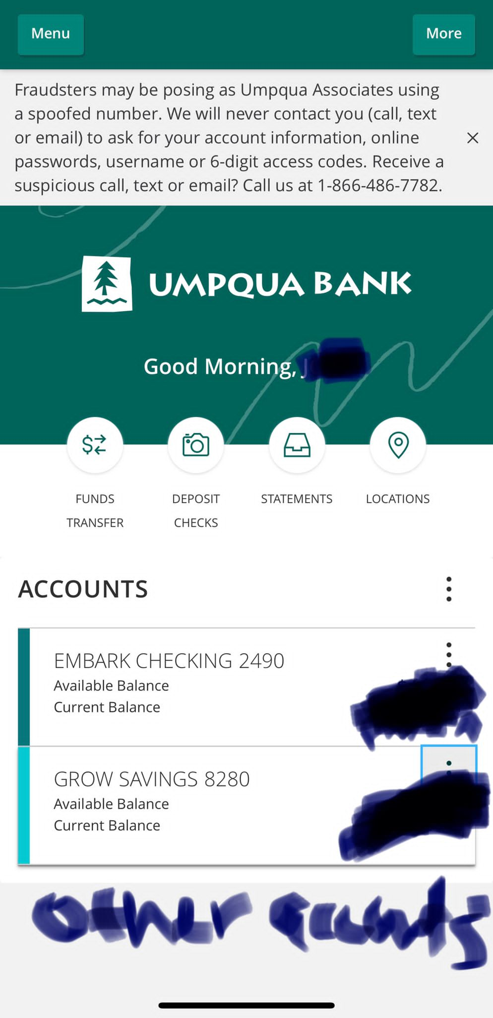
As a user when I click on deposit money. I waantg to see options for.
LINK YOUR ACCOUNT
DEPOSIT CHECK
CASH DESPOST
REDEEM GIFT CARX
Plaid.com for linking of an exiting account
Deposit check this will give the users

Slide 2
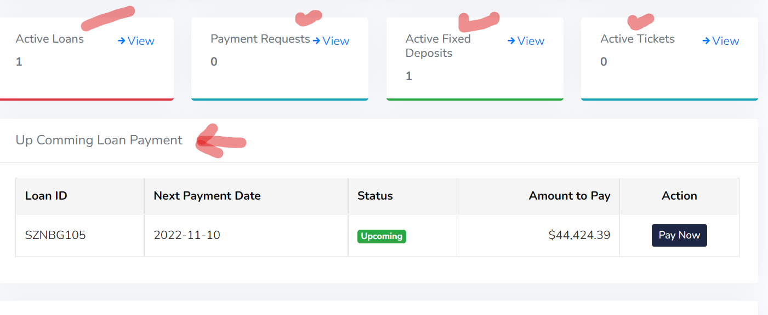
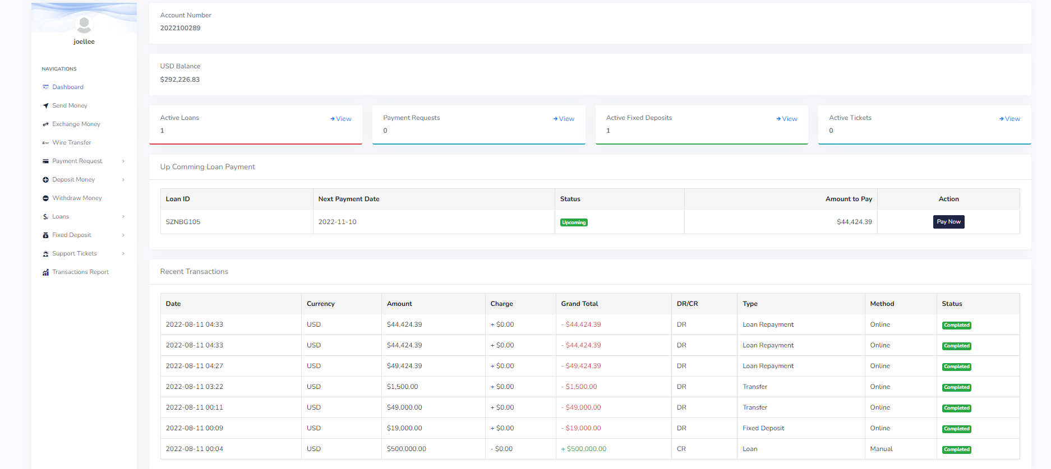
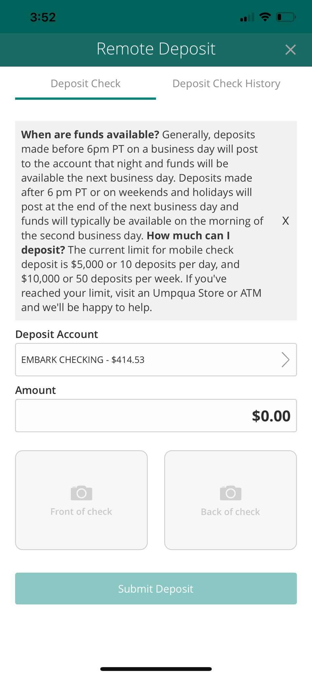
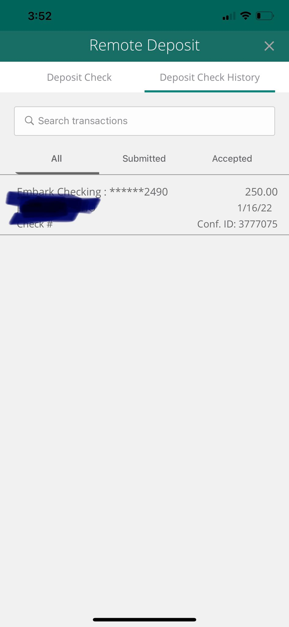
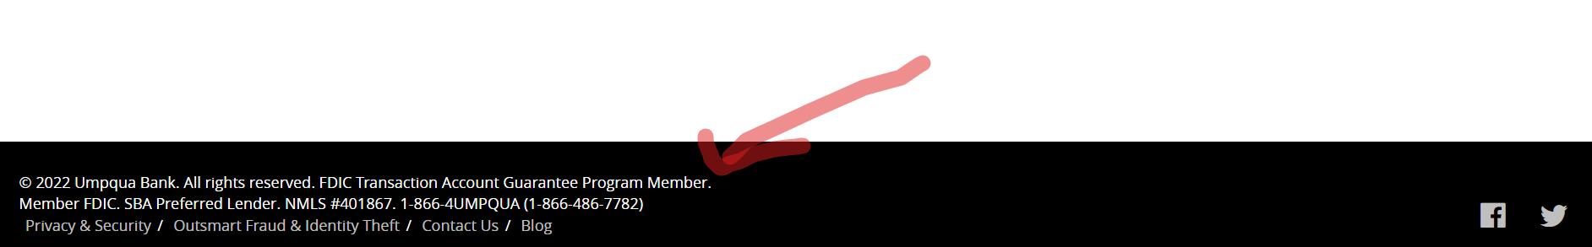
OLD USERS DASHBOARD
The current old dashboard content. Active loans should go under the loan features.
Payment Request should go under Payment request Features.
Active fixed deposit should go under active fixed deposit.
Active Tickets should go under tickets a notification of how many numbers tickets.
Up coming Loan payment should go under the Loans Features
For the sub-accounts: users can create up to 3 accounts>users can name the account, and reason and can transfer from their main.
Admin: can view activities on this from each user.
This is the image of the old user’s dashboard. things we want to move on the top with icons are Deposit, Send
Wire Transfer.
EPIC - DEPOSIT MONEY, WIRE TRANSFER, STATEMENTS, EXCHANGE.
This is a news section. Admin will input manually from the backend and it will show on the user’s dashboard
As a user when sign into my dashboard.
I want to see the deposit money. So that I can easily pick my choice available
NEW USERS DASHBOARD
Deposit check Sample
History for users, check deposit
Our bank name with logo.
And a time zone to the user name
Deposit via
Linking your account
Deposit Via Check.
Deposit via ATM
Options to create a Sub Account. And options to collapsed all account
Linking your card, we will provide API from plaid.com this will help users link any of their existing accounts into our script.
Deposit via check. Just like the image. It will show content, which can be static and users can take the front and back of checks for their deposit.
NOTE: While its pending on the user’s dashboard. Admin must be able to see the deposit front and back for verification.
Admin will be able to approve delete or deny it. By approving it. It will be automatically deposited in the user’s account balance. And by denial it. Users will be able to see their check history, denial, etc.
Deposit via ATM: admin will manually input the ATM address that users can deposit: when users click on deposit via ATM they will see the list according to their locations.
Also, each and every activity will come with notification options for users to get in their email.
As a user, I want to see on the bottom of my dashboard. Institutional name and some other information.
So that I can easily read or navigate to their social page.

