Slide 1
A Spectral Approach to Protein Structure
Aaron Zampaglione
2011 Fall

Slide 2
EIGAs Objective
Structurally compare protein folds.
Fast.
Notes:
The whole objective of EIGAs is to find a way to compare protein folds structurally (spectral). A proteins structure is a major contributing factor to a proteins function. Finding common folds would be of great use for comparing common protein functionality.

Slide 3
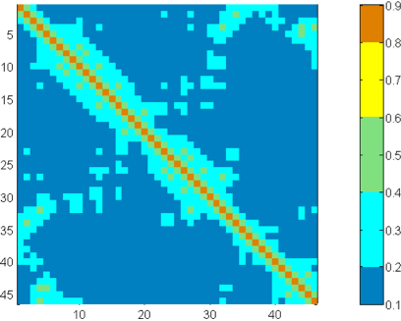
Contact Matrix
Notes:
To compare the 3D coordinates of the residues within a protein, the algorithm constructed a contact matrix. Instead of a binary cutoff matrix (is or is not in contact), the smooth contact matrix assigns a weighted value based on how close two residues are (up to a certain cutoff).

Slide 4
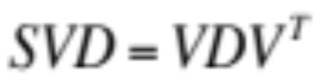
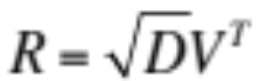
Intrinsic Contact Coordinates
R0 | R1 | R2 | R3 | R4
cos(θ0,0) | … | …
… | cos(θ1,1)
… |  | cos(θ2,2)
 |  |  | cos(θ3,3)
 |  |  |  | cos(θ4,4)
Notes:
Protein sequences through a fold vary from protein to protein. In order to compare two proteins, a coordinate system that is “intrinsic” to the folds is necessary. Using Rayleigh’s Principle, a coordinate system can be defined based on the eigenvectors of the contact coordinate matrix.
Using Support Vector Decomposition, we can obtain the contact matrices’ eigenvectors and eigenvalues. The diagonal eigenvalue matrix and the transpose of the eigenvectors can be multiplied to obtain the intrinsic coordinate matrix (R). Each column in the matrix represents a residue’s intrinsic coordinates. Each entry in a column represents the cosine of the angle between residue j and eigenspace i (the proof is provided in the paper). Finally, we look for the row containing the greatest cosine value in that column, which represents the best-matching eigenvalue for that residue.

Slide 5
Protein Fingerprint
[λ0, λ1, λ2, λ3, …, λn]
Notes:
At this point, every residue of the protein is assigned the “best” eigenvalue, leaving us with a spectral fingerprint for the protein. Once a proteins fingerprint is obtained, it no longer needs to be calculated! All the previous steps were a “preprocessing” phase.

Slide 6
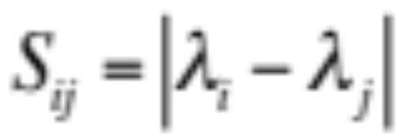
DP
Notes:
Once the fingerprints of proteins were obtained, they could be aligned using standard DP (minimizing based on the absolute difference in protein fingerprint differences). However, we didn’t find the DP to be so trivial, mostly due to their initialization factor. We are still not positive on their exact implementation, so the best we could do was compare results.
Take the Mij equation with a fine grain of salt. It is not the exact “process” used for the results section, but helps understand how the difference in fingerprint values contribute to the DP selection.

Slide 7
Hard Alignment Results
Protein 1 | Protein 2 | Our Score | Report’s Score
﻿1FXIa (96) | 1UBQ (76) | 74 | 74
1TEN (89) | 3HHRb (195) | 89 | 88
3HLAb (99) | 2RHE (114) | 95 | 95
2AZAa (129) | 1PAZ (120) | 107 | 109
1CEWi (108) | 1MOLa (94) | 90 | 88
1CID (177) | 2RHE (114) | 112 | 133
1CRL (534) | 1EDE (310) | 307 | 304
2SIM (381) | 1NSBa (392) | 348 | 339
1BGEb (159) | 2GMFa (121) | 119 | 121
1TIE (166) | 4FGF (124) | 121 | 120
Notes:
The report only provided quantifiable results on what they considered to be “hard alignments”. Notice that there is a slight variation on the score’s we obtained and the scores provided in the report. We have contacted the original authors of the paper and are awaiting a reply.

Slide 8
Skolnick Results
Fold 1 | Fold 2 | % Aligned avg. | % Aligned stdv.
TIM B/A Barrel | TIM B/A Barrel | 83.23 | 5.70
TIM B/A Barrel | Ferritin | 65.83 | 4.64
TIM B/A Barrel | Flavodxin | 48.40 | 2.24
TIM B/A Barrel | Cupredoxin | 39.60 | 1.84
TIM B/A Barrel | Mic. Ribo. | 40.96 | 1.67
Ferritin | Ferritin | 83.91 | 7.47
Ferritin | Flavodxin | 68.62 | 3.95
Ferritin | Cupredoxin | 57.13 | 3.45
… | … | … | …
Notes:
In this result set, we compared all the proteins in the Skolnick data set. We compared proteins from one fold category to another and observed the alignment percentage (number of fingerprints aligned over the total alignment length).
Some notes:
When a fold is compared to itself (all proteins in that fold are compared to one another), we notice a high percentage of aligned sections. This is to be expected, as proteins in the same fold category should have a lot of folds in common (high alignment percentage).
Some protein folds relate closely to other protein folds (TIM B/A Barrel vs. Ferritin).

Slide 9
Future
Implement EIGA.
Find structural motifs using local (spectral) alignment.
Compare the motifs using global (spectral) alignment.
Notes:
The next step would be to implement EIGA. EIGA is an improvement on top of EIGAs. The algorithm iteratively looks for the best alignment based on the standard coordinates and the eigenspaces of the protein folds. Unfortunately, the first step of EIGA requires EIGAs and this project cannot advance until our results align with theirs.
In the long run, one possible task would be to implement a local alignment version of their original global spectral alignment approach. Local alignment would enable the identification of structural motifs between a pair of proteins. The motifs between pairs could then be compared to the motifs of other proteins to find common motifs in a family (or even common functionality of motifs based on the proteins they are apart of).

Slide 10
References
Shibberu Y., Holder A. A Spectral Approach to Protein Structure Alignment. Mathematics Department Rose-Hulman Institute of Technology. Terre Haute, IN 47803. 2011. DOI= http://ieeexplore.ieee.org/xpl/freeabs_all.jsp?arnumber=5710873.

