Slide 1
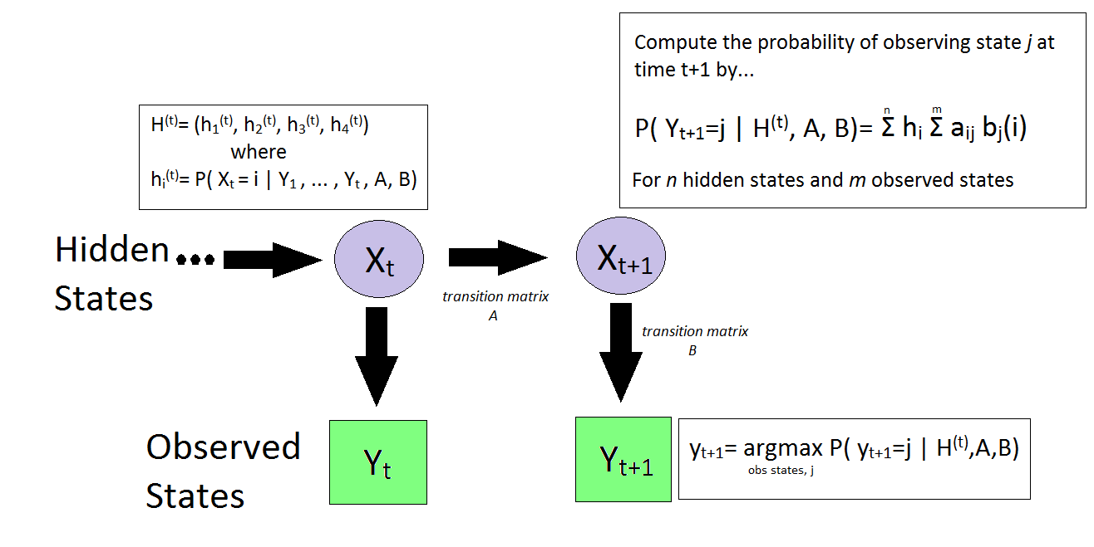



AM207 : Modeling MBTA Ridership
Using Stochastic Methods
Lyla Fadden
Filip Piasevoli
Aaron Zampaglione
Simon Malian
Bayesian Linear Regression
Training Hidden Markov Models
We saw in lecture that Hidden Markov Models can be used to model time series with n hidden states and m observed states. Building off research we did to predict daily ridership, we set out to build a model to predict ridership in real-time by training an HMM using the Baum-Welch algorithm. Our final Hidden Markov Model consisted of 4 hidden states and 3 observed states. The observed states can be interpreted as ‘lower than expected’, ‘as expected’, and ‘higher than expected’ ridership for time t.
Predicting Ridership
School of Engineering and Applied Sciences • Institute for Applied Computational Science

Slide 2
The title of my fabulous project
Introduction
I am an abstract. I am succinct and carefully written.
blah blah blah
blah blah blah
Describe the data, experiments etc
Conclusions
blah blah blah
Approach
blah blah blah
blah blah blah
here is some of my code.
School of Engineering and Applied Sciences • Institute for Applied Computational Science

