Slide 1
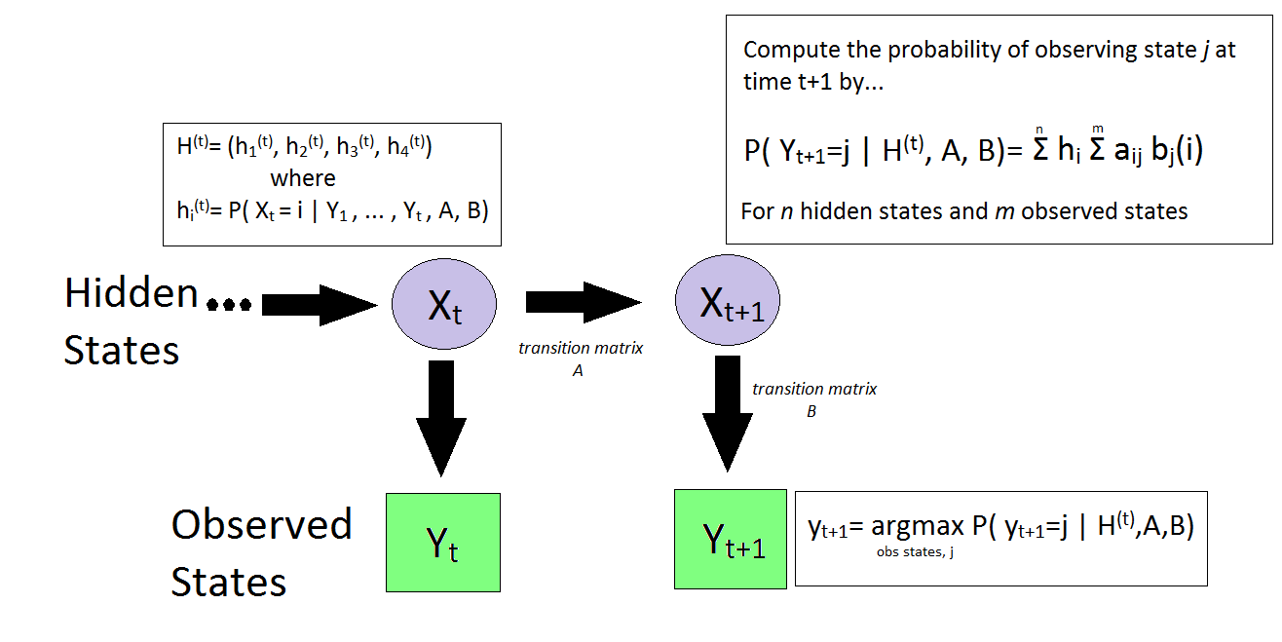
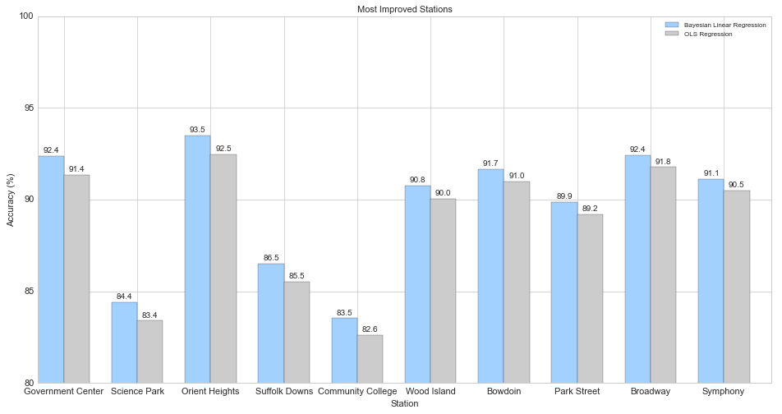
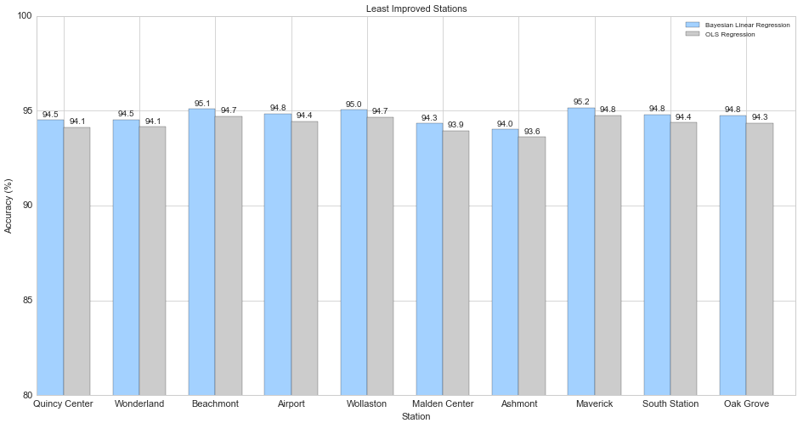
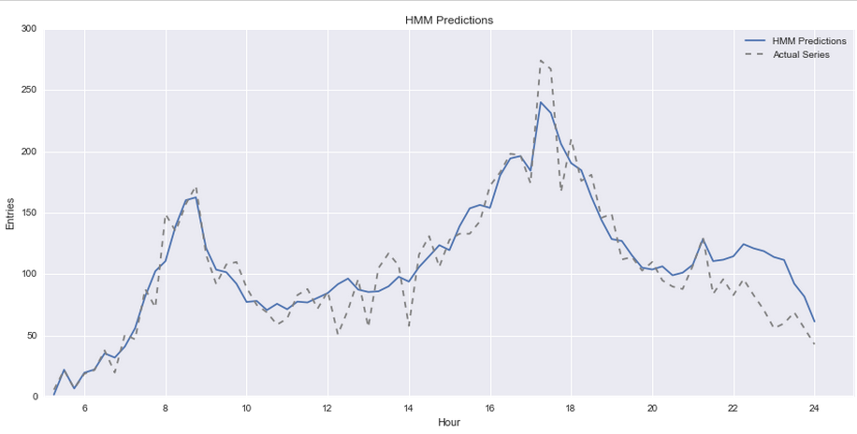
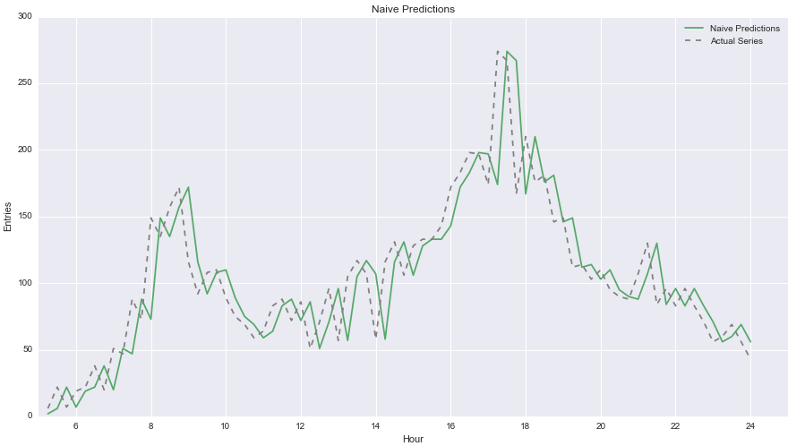



AM 207 – Modeling MBTA Ridership
Using Stochastic Methods
We are members of a four-person team of Harvard students working alongside MBTA staff to analyze and better predict demand for public transportation. The primary goal of that project is a machine learning model to predict subway demand, accounting for recent past ridership, seasonal/cyclical effects, and sporadic events like severe weather and major events.
Bayesian Linear Regression
Training Hidden Markov Models (HMMs)
We will use a Bayesian Linear Regression framework, in order to estimate the parameters of the linear models to predict ridership.
The optimal features used for prediction were determined from a previous experiment. Some of the features include:
The number of entries for this station on the same day one week ago.
The amount of snow the fell for that day, in inches.
The amount of snow accumulated up to the current day.
A binary column representing if a Bruins game occurred on this day.
A binary column representing if a Celtics game occurred on this day.
A binary column representing if a Red Sox game occurred on this day.
In order to sample from a Bayesian posterior, we generated informative priors for each of our parameters (features) using linear regression on the whole dataset. We sampled from our posterior distribution of betas for a final set of coefficients.
We set out to build a model to predict ridership in real-time by training an HMM using the Baum-Welch algorithm. Our final Hidden Markov Model consisted of 4 hidden states and 3 observed states. The observed states can be interpreted as ‘lower than expected’, ‘as expected’, and ‘higher than expected’ ridership for time t.
Predicting Ridership using the Hidden Markov Model
➔
The HMM predictions were more accurate than the naive predictions in 74% of days in our test set, using SSR as the accuracy metric. Below you can see plots of the HMM-predicted entries and the naïve-predicted entries. Note the smoothness of the HMM predictions and the way that it's able to accurately predict most of the peaks in the dataset.
Lyla Fadden, Aaron Zampaglione, Filip Piasevoli, Simon Malian
Harvard University School of Engineering and Applied Sciences • Institute for Applied Computational Science

