Slide 1
MBTA Capstone
Harvard - Spring 2015
Lyla Fadden <lylafadden@g.harvard.edu>
Micah Lanier <micahlanier@g.harvard.edu>
Filip Piasevoli <fpiasevoli@g.harvard.edu>
Aaron Zampaglione <azampaglione@g.harvard.edu>

Slide 2
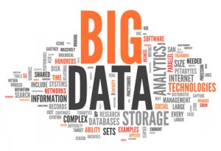
Overview
Public Transit Agencies
Transportation Data
Notes:
Over the past several years, public transit agencies have been collecting enormous amounts of data about their riders. Like many other industries affected by the Data Wave, transforming this data into useful information can be burdensome.
Our goal is to develop analytics for decision-makers that will ultimately be used to improve public transportation services.

Slide 3

Harvard and the MBTA
Capstone Project
MBTA’s Fare Collection System
Internal and External Patterns
Notes:
Using data from the MBTA’s fare collection system, we plan to develop predictive models of ridership patterns based on past travel.
This includes both internal patterns (i.e. given the number of people boarding buses, what can we expect for nearby subway ridership?) and the influence of external events (i.e. public events, good vs. bad weather, etc.).

Slide 4




Motivation
“How does weather affect MBTA ridership?”
“Can we identify similar stations?”
“How do public events affect ridership?”
“Can we predict ridership for a given day?”

Slide 5
Transportation Data
January, 2014 – February, 2015
7.83 million records
286 million rides (~1.3 million per weekday)
Aggregation:
Bus route/direction and T location
15-minute increments

Slide 6

Transportation Data

Slide 7
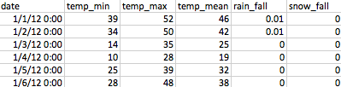
Weather Data

Slide 8
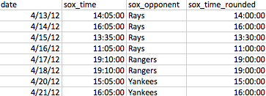
Event Data

Slide 9
Prediction Features
linear model, historical benchmark(86%) which predictors we decided on, which stations improved the most, final accuracy

Slide 10
Prediction Accuracy
Overall 94% Accuracy
30 stations > 95%
4 stations bloe < 90% (Science Park, Community College, Riverside, Suffolk Downs)

Slide 11
Snow Trend

Slide 12
Weather Visualization
http://goo.gl/9F9kky
(http://azampagl.github.io/mbta-weather)

Slide 13
Event Visualization
http://goo.gl/2RRjCC
(http://micahlanier.github.io/cs171-gameday)

Slide 14
Future Work
Bus Data
Public Events
Sentiment Analysis
MBTA Alerts
Understanding Outliers
Integrate Exit Data
Real-time Systems
We’re still discovering…

Slide 15
Questions
?
?
?
?
?
?
?

