Slide 1
MBTA Captstone
Harvard - Spring 2015
Lyla Fadden <lylafadden@g.harvard.edu>
Micah Lanier <micahlanier@g.harvard.edu>
Filip Piasevoli <fpiasevoli@g.harvard.edu>
Aaron Zampaglione <azampaglione@g.harvard.edu>

Slide 2

Overview
Public Transit Agencies
Transportation Data
Notes:
Over the past several years, public transit agencies have been collecting enormous amounts of data about their riders. Like many other industries affected by the Data Wave, transforming this data into useful information can be burdensome.
Our goal is to develop analytics for decision-makers that will ultimately be used to improve public transportation services.

Slide 3

MBTA
MBTA’s Fare Collection System
Internal and External Patterns
Notes:
Using data from the MBTA’s fare collection system, we plan to develop predictive models of ridership patterns based on past travel.
This includes both internal patterns (i.e. given the number of people boarding buses, what can we expect for nearby subway ridership?) and the influence of external events (i.e. public events, good vs. bad weather, etc.).

Slide 4
Problems
“How does weather affect MBTA ridership?”
“How does snow affect ridership on the MBTA?”
“How did the ridership during the 2015 Boston Blizzards differ from normal ridership, and ridership during other snow storms?”
Notes:
“When there is an accumulation of <X> inches of snow, the MBTA can expect a <Y>% change in ridership at station <Z>.”
“When there is a blizzard, the MBTA will need a <X>% increase in shuttles in district <Y>.”
“When a blizzard occurs, the MBTA will need to add <X> trains on the <Z> subway line.”

Slide 5
Previous Work
Making Data Matter… - Tribone
Focused on Performance Metrics
Estimating Crowds from Fare-Collection Data
Room for Improvement
Notes:
Focus on performance metrics
Headway: time between vehicles
Big Gaps: headways above threshold
Reliability Buffer Time: extra time passengers must budget above typical journey time to arrive on-time with specified level of confidence
Measure severity of delays
Areas ripe for improvement
High-volume and branched structure of Red Line lead to inconsistencies in off-peak hours
Estimating Crowds from Fare-Collection Data
How to identify crowding of vehicles through the use of entrance data, train capacity, and headways. If we receive service data, we could build models to estimate the change in crowding during events like inclement weather

Slide 6
Previous Work
Automatic Data… Passenger Demand... - Frumin
Analysis of Passenger Demand
Passenger Patterns
Notes:
Automatic Data… Passenger Demand...- Frumin
Analysis of passenger demand cross-referenced with tables of scheduled departure
Found passengers adjust their arrival behavior with knowledge of performance both in real-time and ahead of time
Can we detect changes due to MBTA alerts, weather forecasts, etc?
Are changes more easily detected on buses since they run according to a posted schedule?

Slide 7
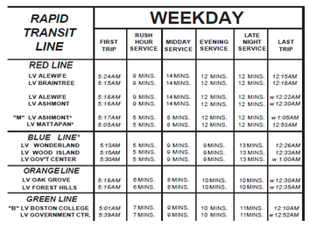
Previous Work
MBTA Blue Book, 2014

Slide 8
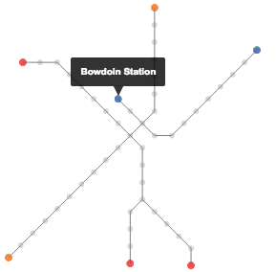
Previous Work
MBTAViz
http://mbtaviz.github.io

Slide 9
Transportation Data
January, 2014 – February, 2015
7.83 million records
286 million rides (~1.3 million per weekday)
Aggregation:
Bus route/direction and T location
15-minute increments

Slide 10

Transportation Data

Slide 11
Weather Data
Obvious question: how does weather affect demand?
Daily weather history
Typical daily weather for comparison
Sources:
NOAA and affiliates (NWS, NCDC)
Weather Underground

Slide 12
Weather Data
Temperatures (low / high / average)
Snowfall and precipitation
Typical snow depth
Other weather events: hail, fog
Miscellanea: wind speed, visibility

Slide 13
Exploration
Ipython notebook 1…

Slide 14
Exploration
Ipython notebook 2…

Slide 15
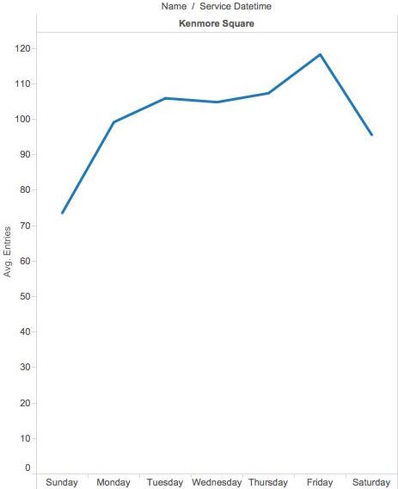
Exploration
Explore with Tableau…

Slide 16
Future Work
Weather, Weather, Weather…
Public Events
Sentiment Analysis
MBTA Alerts
We’re still discovering…

Slide 17
Questions
?
?
?
?
?
?
?

