Slide 1
MBTA Capstone
Harvard - Spring 2015
Lyla Fadden <lylafadden@g.harvard.edu>
Micah Lanier <micahlanier@g.harvard.edu>
Filip Piasevoli <fpiasevoli@g.harvard.edu>
Aaron Zampaglione <azampaglione@g.harvard.edu>

Slide 2

Overview
Public Transit Agencies
Transportation Data
Notes:
Over the past several years, public transit agencies have been collecting enormous amounts of data about their riders. Like many other industries affected by the Data Wave, transforming this data into useful information can be burdensome.
Our goal is to develop analytics for decision-makers that will ultimately be used to improve public transportation services.

Slide 3

Harvard and the MBTA
Capstone Project
MBTA’s Fare Collection System
Internal and External Patterns
Notes:
Using data from the MBTA’s fare collection system, we plan to develop predictive models of ridership patterns based on past travel.
This includes both internal patterns (i.e. given the number of people boarding buses, what can we expect for nearby subway ridership?) and the influence of external events (i.e. public events, good vs. bad weather, etc.).

Slide 4




Motivation
“How does weather affect MBTA ridership?”
“Can we identify similar stations?”
“How do public events affect ridership?”
“Can we predict ridership for a given day?”

Slide 5
Transportation Data
January, 2014 – February, 2015
7.83 million records
286 million rides (~1.3 million per weekday)
Aggregation:
Bus route/direction and T location
15-minute increments

Slide 6

Transportation Data

Slide 7
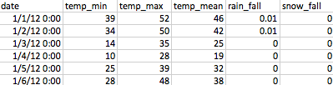
Weather Data

Slide 8
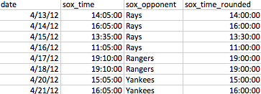
Event Data

Slide 9
Similar Stations
Finds similar station based on ridership
Improve survey process

Slide 10
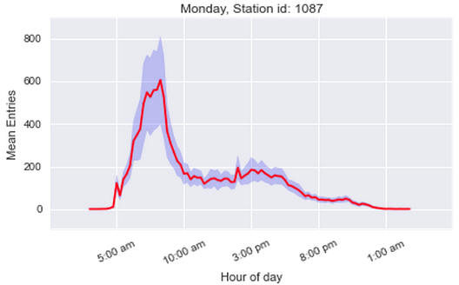
Oak Grove Ridership

Slide 11
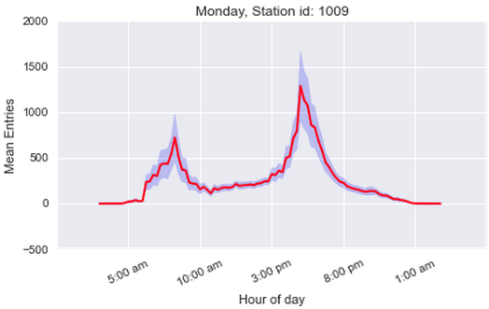
South Station Ridership

Slide 12
Similar Stations

Slide 13
Dissimilar Stations

Slide 14
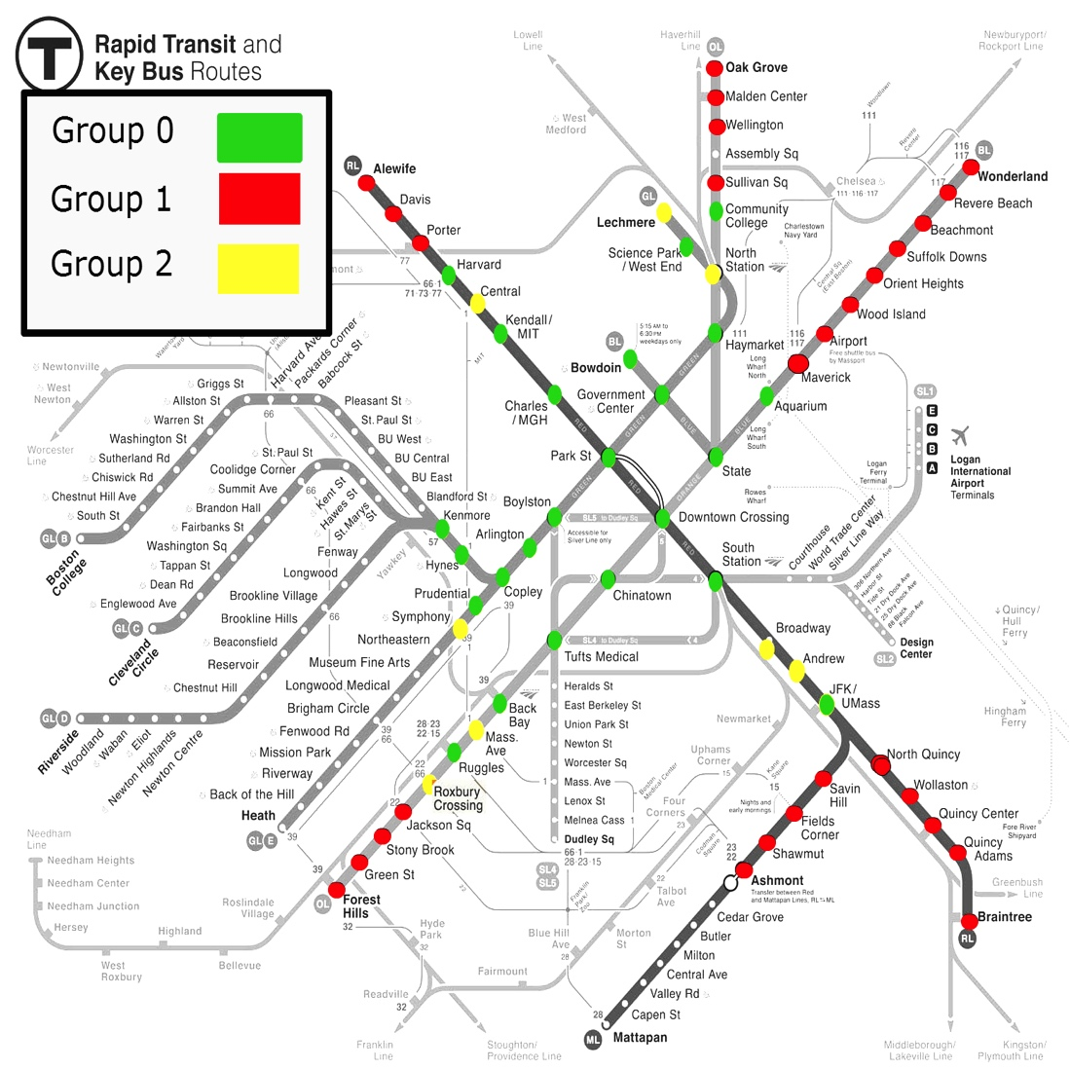
Station Groupings

Slide 15
Prediction
Predict daily entries for each station
Improve personnel allocation

Slide 16
Prediction Features
Historical Entries
Day/Month
Snowfall and Snow Accumulation
Sporting Events (Bruins/Celtics/RedSox)

Slide 17
Prediction Accuracy
94% Accuracy
(Average across all stations)
Outliers: Science Park, Community College, Riverside, and Suffolk Downs

Slide 18

Weather and MBTA
Analyze snow and rain trends
Understand change in demand

Slide 19
Snow Trend

Slide 20
Weather Visualization
http://goo.gl/9F9kky
(http://azampagl.github.io/mbta-weather)

Slide 21

Sports and the MBTA
Focus on Red Sox, Bruins, Celtics
Spikes in demand before and after events
Entry Lift: increase in entries versus game-less days and times
Pre-game lift across the system
Post-game lift at nearby stations

Slide 22
Pre-game Entry Over Time

Slide 23
Pre-game Entry Per Game

Slide 24
Pre-game Lift per Team
Bruins: largely core stations, northern Orange Line (Oak Grove, Wellington), ends of Red Line (Alewife, Braintree).
Celtics: primarily core stations, more southern Orange Line (Ruggles, Back Bay).
Red Sox: heavy outer station traffic at Riverside, Alewife, Braintree, Wonderland, etc

Slide 25
Post-game Station Trends

Slide 26
Event Visualization
http://goo.gl/2RRjCC
(http://micahlanier.github.io/cs171-gameday)

Slide 27
Future Work
Bus Data
Public Events
Sentiment Analysis
MBTA Alerts
Understanding Outliers
Integrate Exit Data
Real-time Systems
We’re still discovering…

Slide 28
Questions
?
?
?
?
?
?
?

