Slide 1
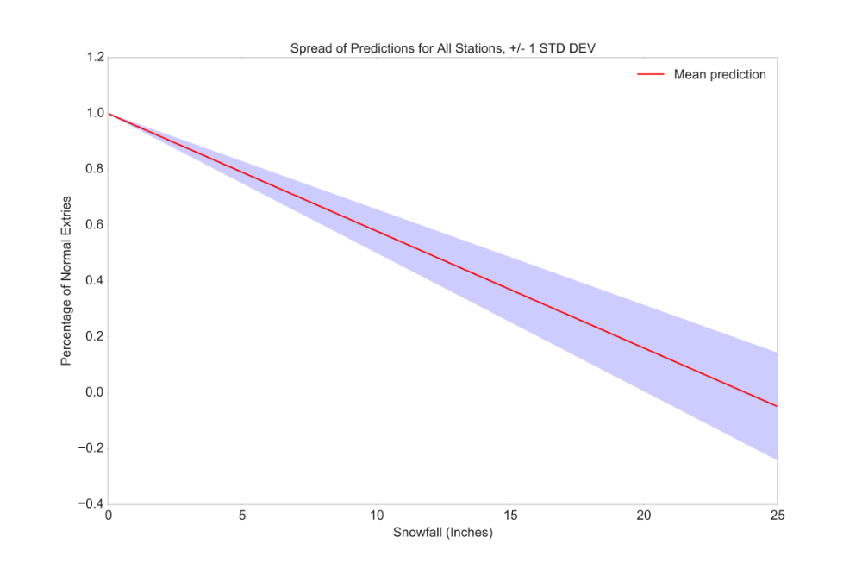
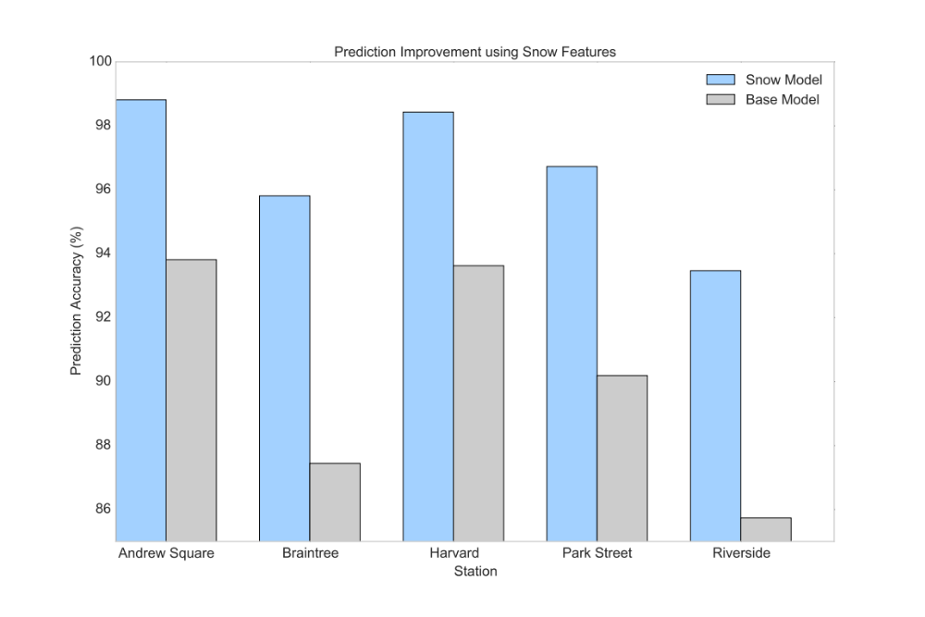
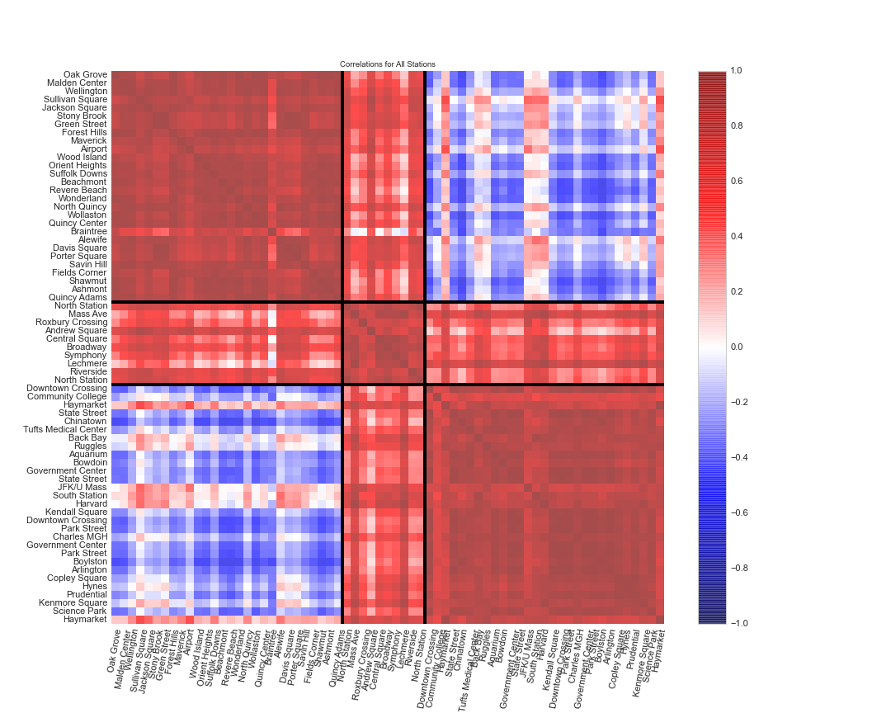
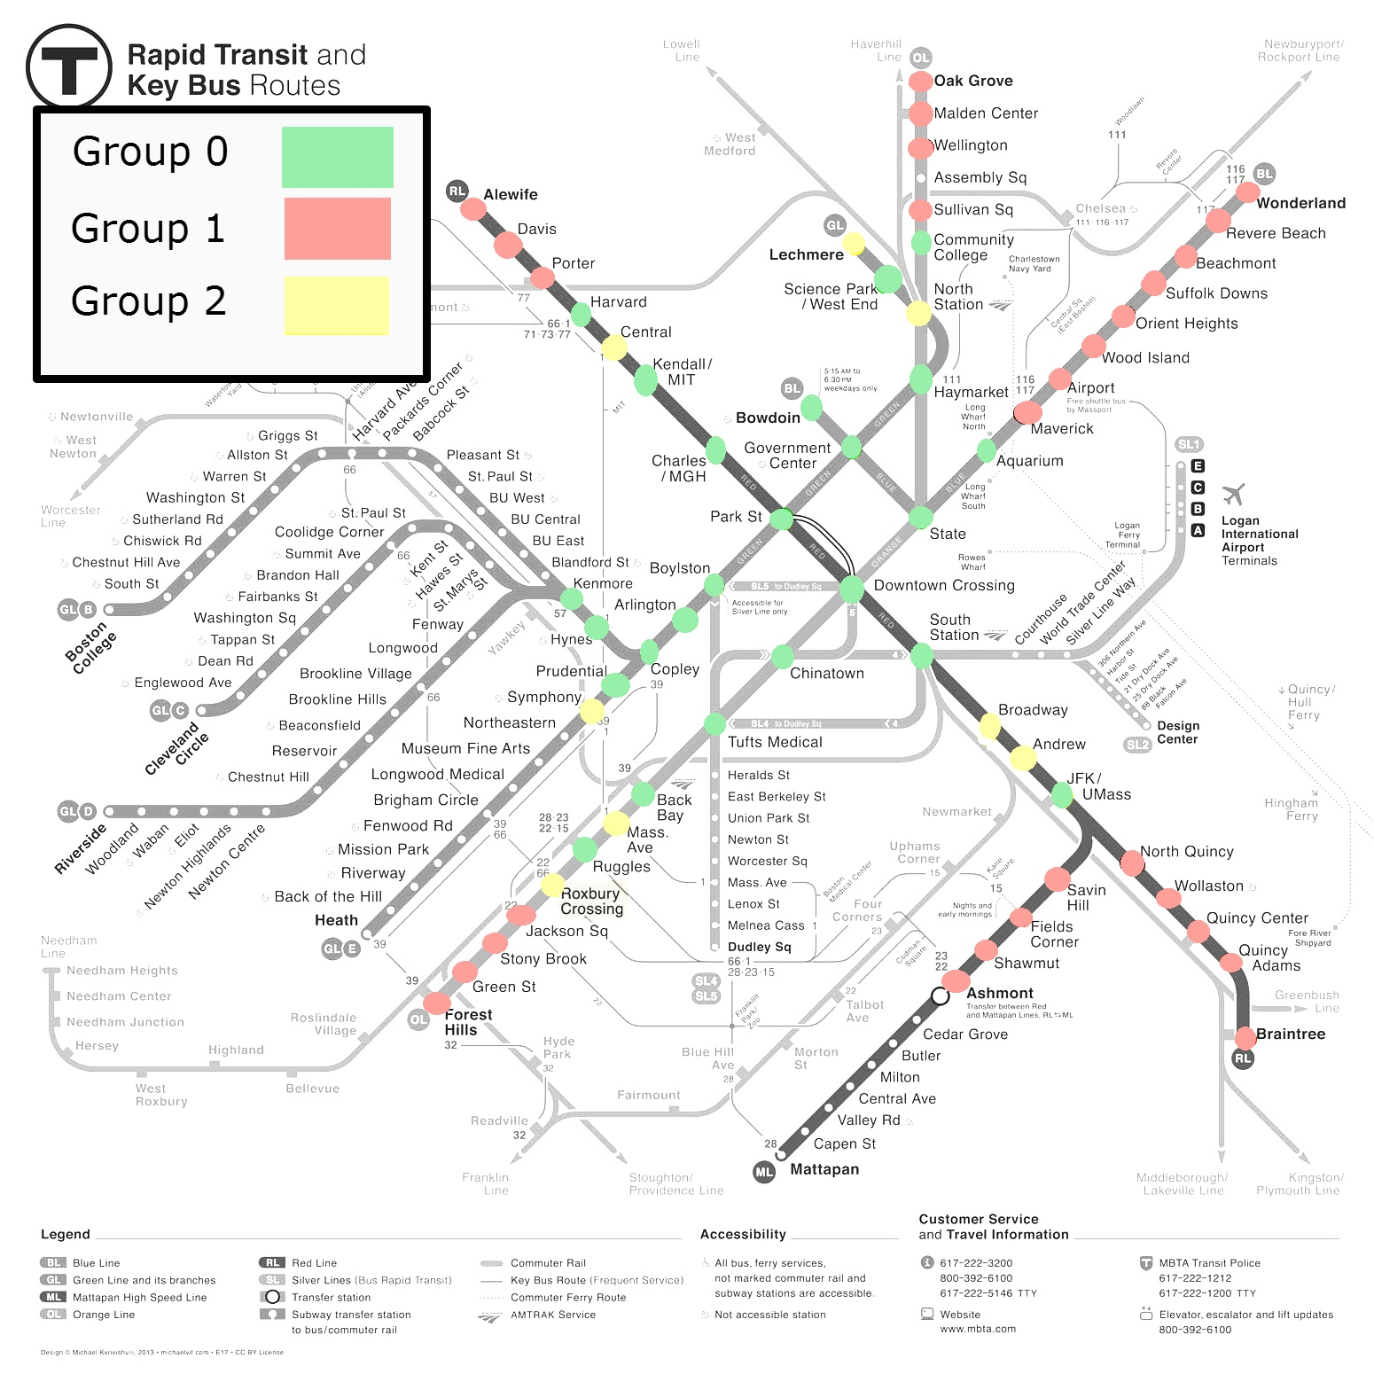

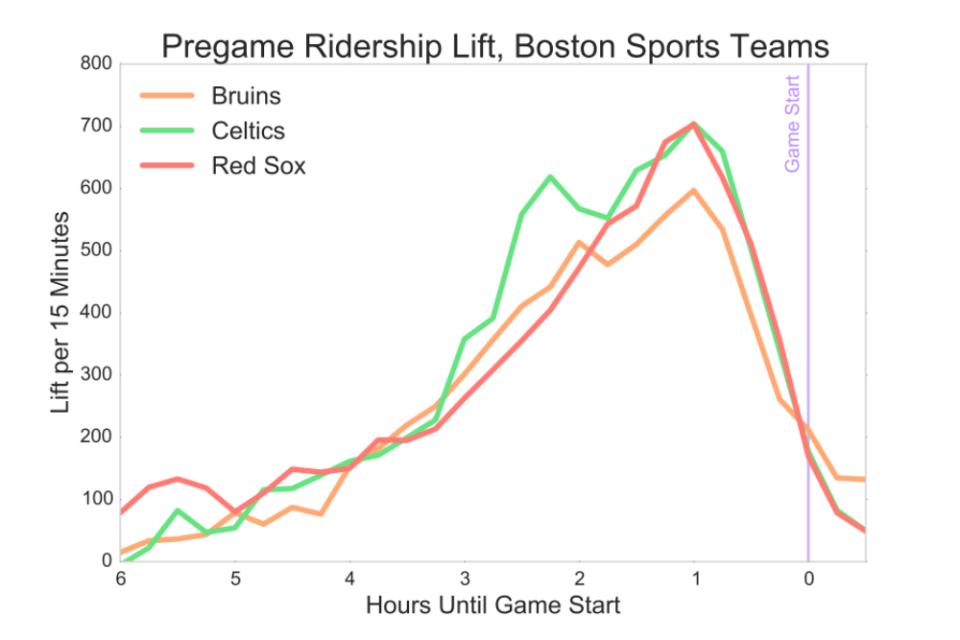
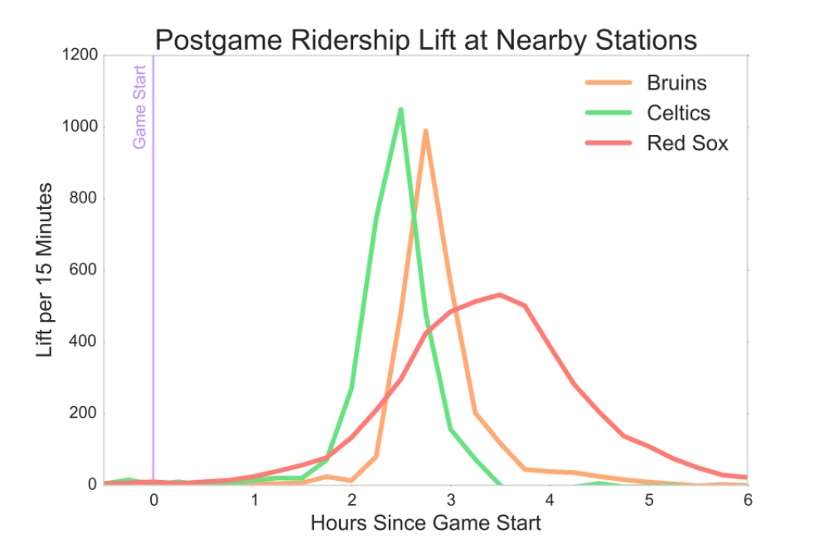
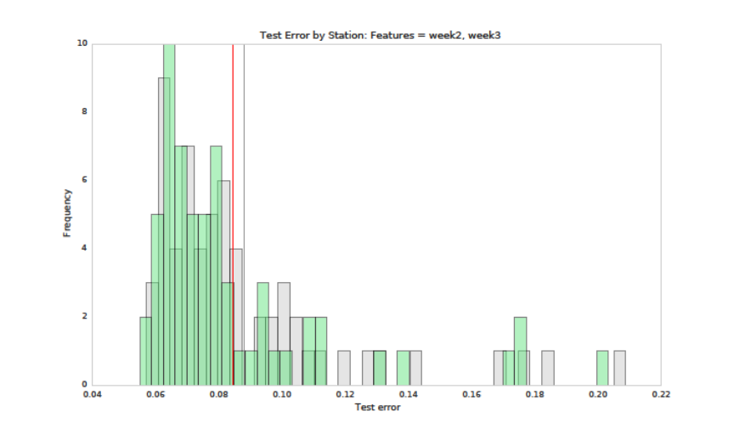
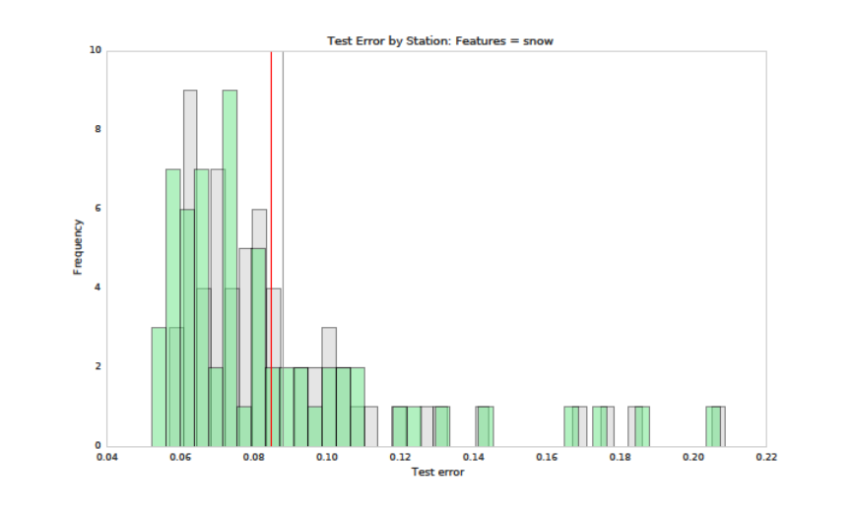
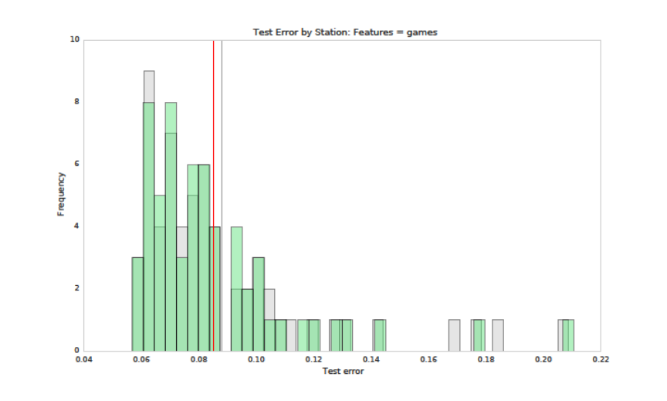
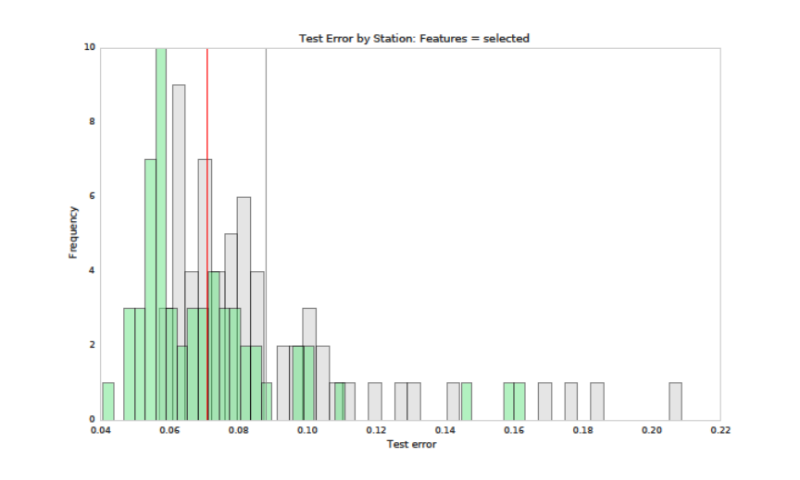
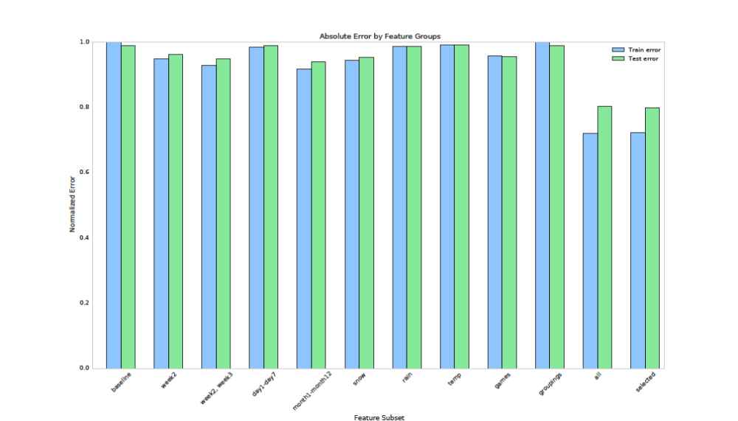


Harvard IACS Capstone
Micah Lanier
Fil Piasevoli
Aaron Zampaglione
Lyla Fadden
How does snow affect ridership?
Can we determine similar stations?
Changes in normal ridership is important to understand from an MBTA perspective. Deviances from normal patterns can affect scheduling, quality of service, and personnel allocation. After some exploratory analysis, it was clear that snowfall had an adverse linear effect on ridership.
Changes in the accuracy of ridership predictions are one way of determining the importance of snow to the MBTA. Using Linear Regression, we compared a baseline model to a model that included snow “features”. Across all stations, we were
able to improve prediction accuracy by
2.3% with the inclusion of snow
fall and snow accumulation.
In our exploration of the MBTA data, we set out to a way to identify similar stations based on their ridership patterns. Considering the trends of ridership rather than the volume of ridership, we computed pair-wise correlation coefficients for each station in the MBTA system. Using Principal Component Analysis and k-means clustering, we identified the three groupings above based solely on the patterns of ridership. We found that ridership patterns reflect the geographic location of each
station. Group 1 consists of stations further away from the city which have the majority
of their entries during the morning rush hour. Group 0 stations are closer to the city center
with heightened evening rush hour entries.
How do events affect ridership?
Can we predict ridership?
Feature Extraction for Prediction
When selecting a subset of relevant features for the construction of the prediction model, we incorporated the central insights from the exploration, weather, and events analysis of the project:
⦁ The nature of the station ridership data is highly periodical, therefore we include average entries from the previous 1,2,3 weeks to have periodicity built into model
⦁ Entries for a specific day of the week and month of the year display their own patterns so day and month were added as one-hot encoded features
⦁ The presence of snow and the amount of snow accumulation has an effect on ridership
⦁ Sports game traffic contribute a significant lift in ridership particularly at stations near the event
⦁ The generated station groupings based on similar AM/PM ridership patterns are also considered
Before games, fans of each Boston sports team show similar demand patterns, with ridership peaking an hour before game start. Though not shown here, Red Sox fans have a clear preference for the Green Line, while other fans are evenly split among the Green, Orange, and Red Lines. The Blue Line draws few fans of any team.
After games, entries at nearby T stations (North, Kenmore Square, and Hynes) show predictable trends. Basketball and hockey games have predictable lengths; fans swarm North Station after they finish. Baseball games—longer and less predictable—show a wide range of entries around the end of each game.
The distribution of the predictive error by station shows the added benefit of each feature subset compared to the baseline. Historical entries, snow data and game data have a significant impact on prediction.
Predictive accuracy (train) = 94%
Predictive accuracy (test) = 93%
School of Engineering and Applied Sciences • Institute for Applied Computational Science

