Slide 1
WORKING KAT
Presenters:
Avery Zamzow
Grant Buley Nazym Bexeitova
Anuradha Edirisuriya

Slide 2
OVERVIEW
The project ‘Working Kat’ is developed in JAVA language with eclipse. Which mainly focuses on basic operation of students and manager system.
The project aims to build a web application to get working opportunity through University. In this project, we are providing effective tools to apply for the jobs
Also, this is a effective tool to manage student employees and time card.

Slide 3
TASK INVOLVEMENT Students task….
Search managers
Search for the department to find out the managers contact information
Sign up, login, update, and delete profile
If student is employee, search for the managers to contact them
Time clock in and out

Slide 4
MANAGER’S TASK
Search students working in their department to see their time card
Add and delete profile
Update their information of their profile

Slide 5
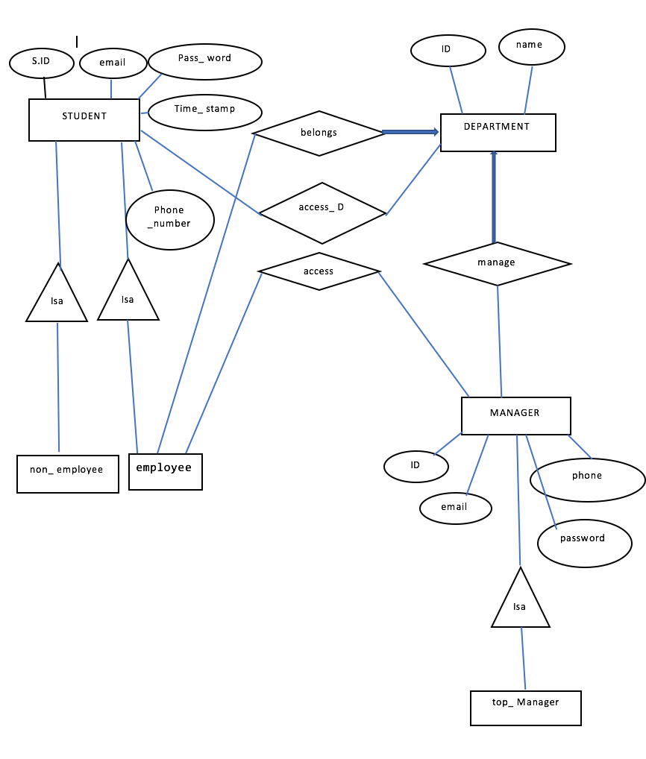
Database ER Diagram

Slide 6
Technology Used
Application used:
Eclipse
Design Tool:
Window builder (drag and drop)
Code standard:
Java
Database:
DB Browser for SQLite

Slide 7
DEMO

Slide 8
DISTRIBUTION OF Work
Analysis – Discussion - All
Database Design- Avery and Grant
Java Program- Avery and Naz
Application Design- Naz and Anuradha
Power point- Anuradha
Application Idea- Naz

Slide 9
Future Work
We can further implement some features like,
Upload Resume
Have Status shown on students profiles
Allow Managers to give rewards
Allow Students to Request for days off on the profile
Member varification by email
Announcments/News

Slide 10
Conclusion
We provide simple design that student can access easily.
The project ‘Working Kat’ provides
search function , update function
login function, delete function
Signup function….... for managers and students.
This project is the tool to manage student employees and time card.

Slide 11
END
THANK YOU !!!!!

