Slide 1
DBKL PROFESSIONAL COURSE
Lift & Escalator Training
Simulator Suite
Twelve interactive simulators for the design, operation, maintenance and energy management of lifts and escalators
Kursus Rekabentuk Serta Penyelenggaraan Sistem Lif dan Eskalator — Penjimatan Tenaga
Engineering-accurate · Bilingual EN / BM · Every formula cited · Runs offline

Slide 2
How to use the suite
One consistent shell — twelve dial-turning simulators
1
Bilingual
2
Show formula
3
Trainer notes
Switch EN / BM at any time — every label, insight and content string is bilingual.
Reveal the cited mathematics behind every result on screen.
Built-in objective, classroom flow and discussion prompts per simulator.
4
Set the tariff
5
Three-pane layout
6
Runs offline
Edit the header to your building’s real TNB rate so RM figures are relevant.
Controls · Visualisation · Results & insights — the same shell across all twelve.
Static build opens from file:// — no server, ideal for classroom laptops.
DBKL · Lift & Escalator Training Simulator Suite
2

Slide 3
Course map — twelve simulators
Each simulator maps to a course module, a standard and an acceptance result
# | Simulator | Module | Standard | Key result
1 | Traffic Flow Simulator | 2 | CIBSE Guide D / Barney | INT 28.7 s · HC 13.5%
2 | Group Control Comparison | 2 | Monte-Carlo (CIBSE) | −24% AWT · −65% stops
3 | Lift Sizing Wizard | 2 | CIBSE Guide D §4 | 4 × 1600 kg × 2.5 m/s
4 | Energy Pie Calculator | 4 | ISO 25745-2 | ≈ 6,150 kWh / year
5 | Sleep-Mode / Standby Payback | 4 | ISO 25745-2 | ≈ RM 830/yr · immediate
6 | VVVF vs Old-Drive | 4 / 6 | CIBSE Table 6.3 | ≈ 50% traction saving
7 | Regenerative Drive | 6 | Energy balance | ≈ 27% net reduction
8 | LED Retrofit Calculator | 4 | MyHIJAU CO₂ | payback < 1–2 yr
9 | Escalator Operating Modes | 4 / 9 | EN 115-1 / ISO 25745-3 | −36% slow · −60% stop
10 | Fault Diagnosis Trainer | 3 | MS EN 81-20/50 | 10 trees · ≤ 6 questions
11 | Maintenance Schedule Planner | 5 | MS 2473 / DOSH PMA | schedule + iCal + gap
12 | Hazard Hunt | 7 | OSHA 1994 | 5×5 risk · scored scenes
DBKL · Lift & Escalator Training Simulator Suite
3

Slide 4
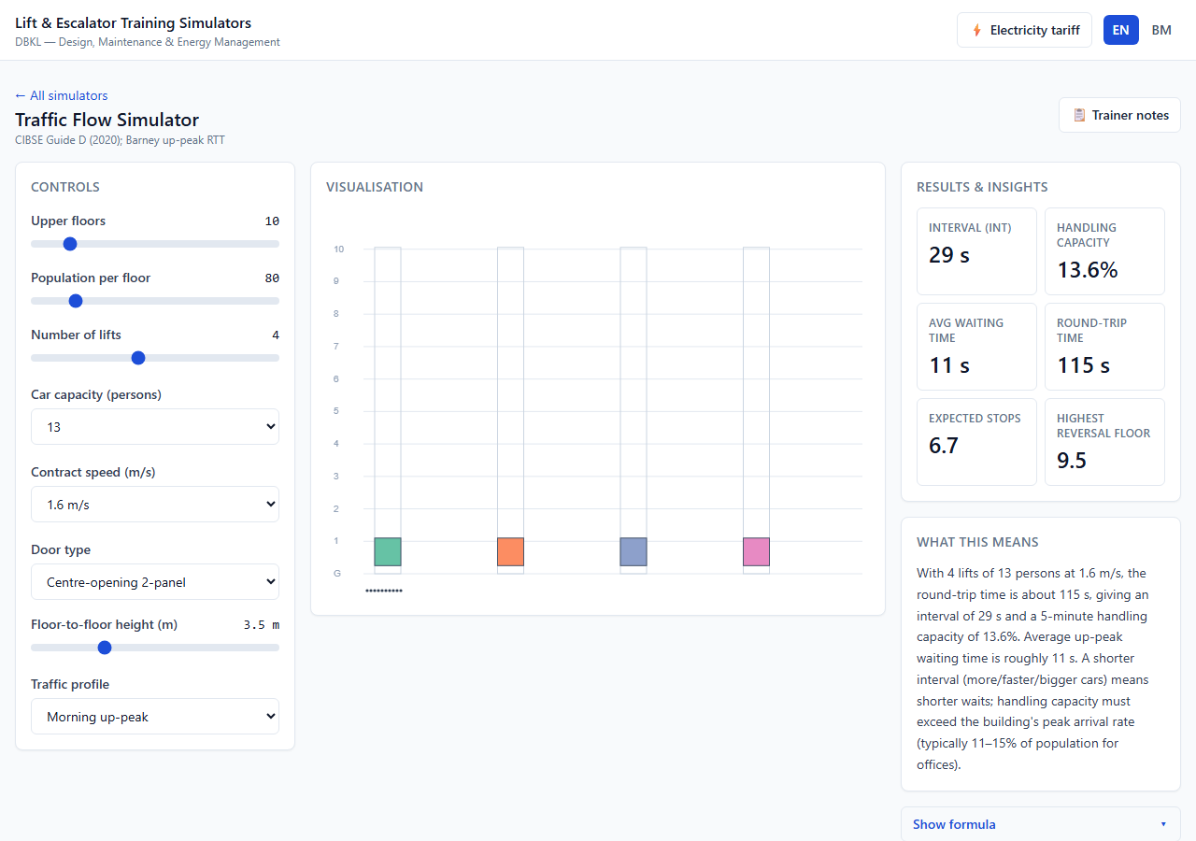
1
Simulator 1 — Traffic Flow Simulator
Module 2
CIBSE Guide D (2020) · Barney up-peak round-trip time
WHAT IT TEACHES
Compute and interpret the two headline lift-traffic metrics — interval (INT) and 5-minute handling capacity (HC%) — and relate them to round-trip time (RTT).
KEY RESULT
INT 28.7 s · HC 13.5%
WHAT YOU SEE
Animated cars cycle lobby→upper floors; INT, HC%, RTT and AWT update live.
Default 10 floors · 80/floor · 4×13p × 1.6 m/s
DBKL · Lift & Escalator Training Simulator Suite
4

Slide 5
1
Simulator 1 — Traffic Flow Simulator
Module 2
Engineering & classroom guide
ENGINEERING & FORMULAS
RTT = 2·H·t_v + (S+1)·t_s + 2·P·t_p
INT = RTT / N
HC% = (300·P·N) / (RTT·U) × 100
H reversal floor · S stops · P pax/trip · U served pop · N cars
Served population U = pop/floor × upper floors (DECISIONS T1).
DRIVE IT IN CLASS
KEY INSIGHT & MISCONCEPTION
Read the defaults: INT ≈ 29 s, HC ≈ 13.5%. Office target: HC 11–15%, INT ≤ 30 s.
Add a 5th car — watch INT fall and HC rise.
Raise speed to 2.5 m/s, then car capacity to 16 — compare each effect on RTT.
Switch the traffic profile (up / two-way / down) and note the waiting-time factor.
Faster lifts mainly help tall buildings. For low rises, door + transfer time and the number of stops dominate RTT — adding a car often beats adding speed. HC% is the share of population moved per 5 min, not how many fit in a car.
DISCUSS A building fails its up-peak target. Which lever — more, bigger, or faster cars — and why?
DBKL · Lift & Escalator Training Simulator Suite
5

Slide 6
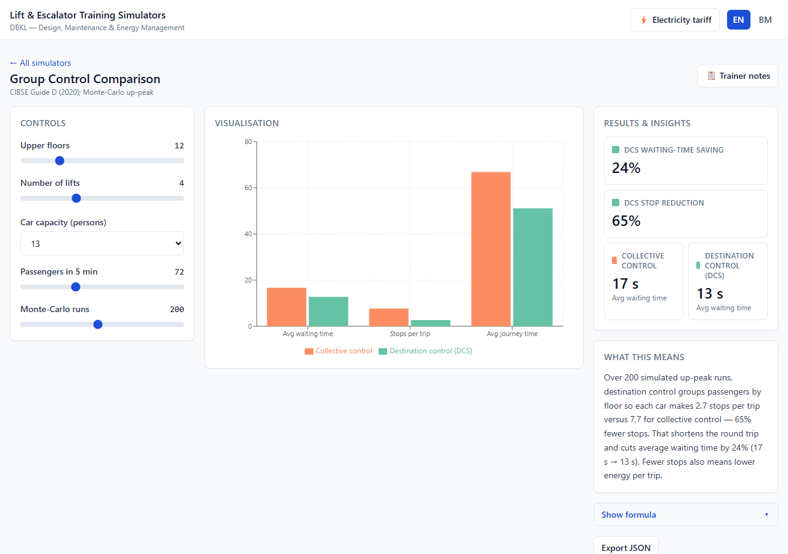
2
Simulator 2 — Group Control Comparison
Module 2
Monte-Carlo up-peak simulation · CIBSE Guide D (2020)
WHAT IT TEACHES
Explain why Destination Control (DCS) cuts stops and waiting time versus conventional collective control.
KEY RESULT
−24% AWT · −65% stops
WHAT YOU SEE
Split bar chart: collective vs DCS waiting time, stops/trip and journey time.
200-run Monte-Carlo · 12 floors · 4 cars
DBKL · Lift & Escalator Training Simulator Suite
6

Slide 7
2
Simulator 2 — Group Control Comparison
Module 2
Engineering & classroom guide
ENGINEERING & FORMULAS
Same random passenger stream → two algorithms
Collective: nearest car, stops at every hall call
DCS: group by destination → far fewer stops/trip
200 Monte-Carlo runs → mean AWT, stops/trip, journey
Fewer accel/decel cycles also cut energy per trip.
DRIVE IT IN CLASS
KEY INSIGHT & MISCONCEPTION
Run the 200-run Monte-Carlo on the defaults; read the headline reductions.
Read the bar chart: AWT, stops/trip and journey time for both algorithms.
Increase demand and floors — DCS’s advantage usually grows as there are more passengers to group.
DCS is not “just a fancier button”: it changes car assignment so passengers sharing a destination ride together, so each car stops far fewer times. Fewer stops save both time and energy.
DISCUSS What is the behavioural cost of DCS (entering your floor at the lobby), and when might it confuse users?
DBKL · Lift & Escalator Training Simulator Suite
7

Slide 8
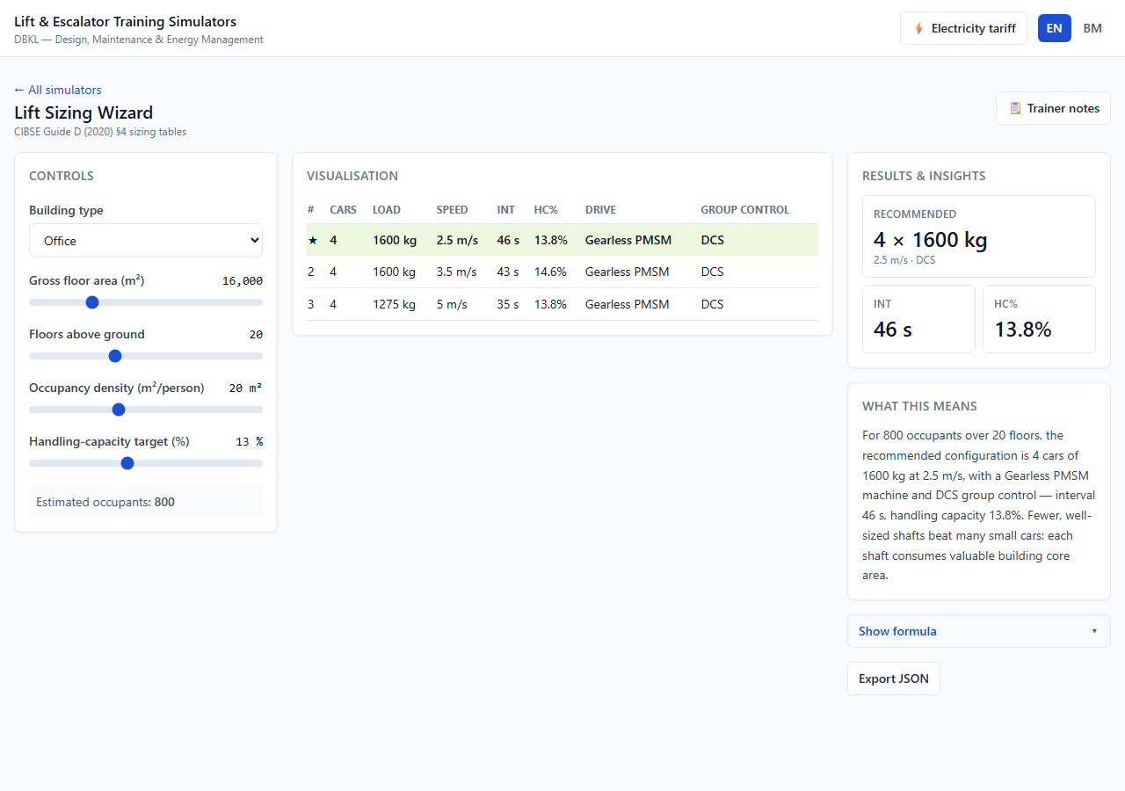
3
Simulator 3 — Lift Sizing Wizard
Module 2
CIBSE Guide D (2020) §4 — sizing tables
WHAT IT TEACHES
Translate a building brief (area, floors, occupancy) into a ranked shortlist of viable lift configurations, and justify the recommendation.
KEY RESULT
4 × 1600 kg × 2.5 m/s
WHAT YOU SEE
Ranked shortlist table; the ★ row is the recommended configuration.
Gearless PMSM + DCS · 16,000 m² · 20 floors
DBKL · Lift & Escalator Training Simulator Suite
8

Slide 9
3
Simulator 3 — Lift Sizing Wizard
Module 2
Engineering & classroom guide
ENGINEERING & FORMULAS
Occupants U = GFA / density (16,000 / 20 = 800)
For each N cars × Q car size × v speed:
compute RTT → INT = RTT/N, HC%
Keep configs with HC ≥ target AND INT ≤ ceiling
Rank by fewest shafts first
Tall single-zone case uses INT ceiling 48 s, HC target 13% (DECISIONS T2).
DRIVE IT IN CLASS
KEY INSIGHT & MISCONCEPTION
Read the recommended ★ option on the defaults.
Raise the HC target — watch weaker options drop out.
Change building type and density — occupant count and shortlist update.
More small lifts are not cheaper: each shaft consumes costly building-core area, so fewer right-sized shafts usually win. Sizing balances handling capacity, interval, capex and energy — never one number.
DISCUSS Why does a 20-floor single-zone building end up with a longer interval, and what design move (zoning, sky-lobby) shortens it?
DBKL · Lift & Escalator Training Simulator Suite
9

Slide 10
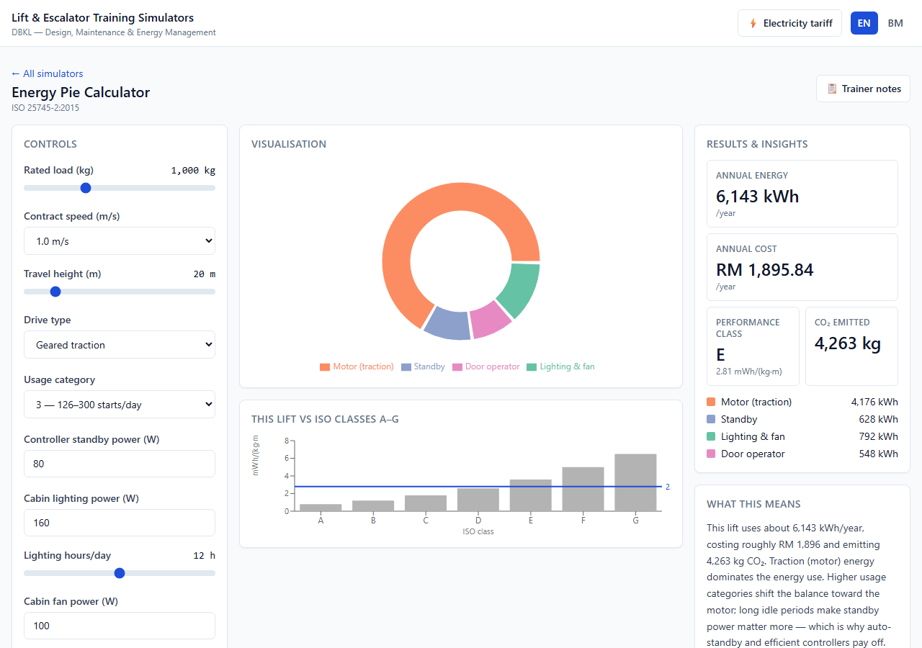
4
Simulator 4 — Energy Pie Calculator
Module 4
ISO 25745-2:2015 — energy calculation & classification
WHAT IT TEACHES
Decompose a lift’s annual energy into traction (motor), standby, door-operator and auxiliary (lighting + fan) — and show how usage intensity shifts the balance between them.
KEY RESULT
≈ 6,150 kWh / year
WHAT YOU SEE
Donut of motor / standby / door / auxiliary with the A–G class ladder.
ISO Annex E worked example (6,000–9,000 band)
DBKL · Lift & Escalator Training Simulator Suite
10

Slide 11
4
Simulator 4 — Energy Pie Calculator
Module 4
Engineering & classroom guide
ENGINEERING & FORMULAS
W = k_load · m_rated · g · h (out-of-balance work)
E_rc = W / η_drive η: geared .50 · PMSM .70 · hyd .35
Daily = E_rc·n_starts + standby + door + auxiliary
Annual = Daily × 365
Specific = Annual / (load·travel) → class A–G
k_load = 0.35 office load factor (ISO Annex E); E_rc estimated, not measured (DECISIONS E1).
DRIVE IT IN CLASS
KEY INSIGHT & MISCONCEPTION
Read the donut on the default lift (1000 kg, geared, category 3).
Drop usage to category 1 — standby + lighting overtake the motor.
Push to category 6 — the motor dominates. Discuss why.
Switch geared → gearless PMSM; the motor slice shrinks (higher efficiency).
The motor is NOT always the biggest consumer. Over a year, standby + lighting can exceed traction on a low-traffic lift (500 W left on 20 h/day ≈ 3,650 kWh/yr). That is the case for auto-standby and LED retrofits.
DISCUSS Which single change would most reduce THIS lift’s annual energy? (It depends on the dominant slice.)
DBKL · Lift & Escalator Training Simulator Suite
11

Slide 12
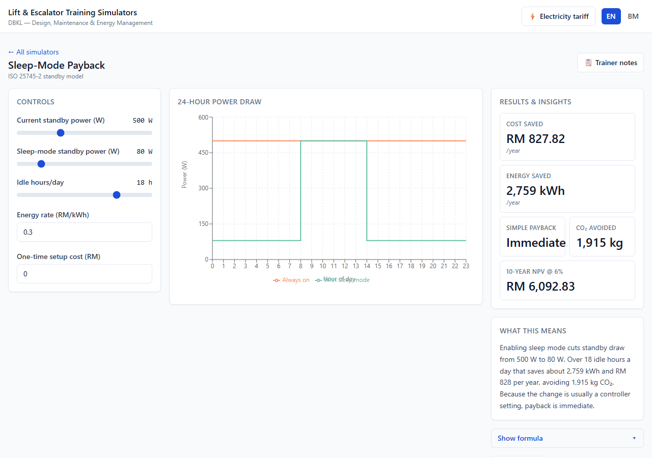
5
Simulator 5 — Sleep-Mode / Standby Payback
Module 4
ISO 25745-2:2015 — standby energy model
WHAT IT TEACHES
Quantify the savings from enabling lift auto-standby (sleep mode), and explain why the payback is usually immediate.
KEY RESULT
≈ RM 830/yr · immediate
WHAT YOU SEE
24-hour power chart; the gap between always-on and sleep is the saving.
500 → 80 W idle · 18 h/day
DBKL · Lift & Escalator Training Simulator Suite
12

Slide 13
5
Simulator 5 — Sleep-Mode / Standby Payback
Module 4
Engineering & classroom guide
ENGINEERING & FORMULAS
ΔE = (P_before − P_after)/1000 · h_idle · 365 [kWh/yr]
Saving_RM = ΔE × tariff
Payback = capex / Saving_RM
CO₂ = ΔE × 0.694 kg/kWh
500→80 W over 18 h/day ≈ 2,760 kWh/yr. Usually a controller setting → payback ≈ immediate.
DRIVE IT IN CLASS
KEY INSIGHT & MISCONCEPTION
Read the RM/year saving on the defaults (no capex).
Point at the 24-h chart: the gap between always-on and sleep is the saving.
Set a non-zero capex (controller upgrade) — payback appears.
Raise idle hours to 22 — savings grow on a near-idle lift.
Standby is not negligible: it runs 24/7, so even small wattage accumulates. The saving is almost always a controller setting, not new hardware — so payback is effectively immediate.
DISCUSS What lift behaviours reset the idle timer, and how might frequent false triggers erode the savings?
DBKL · Lift & Escalator Training Simulator Suite
13

Slide 14
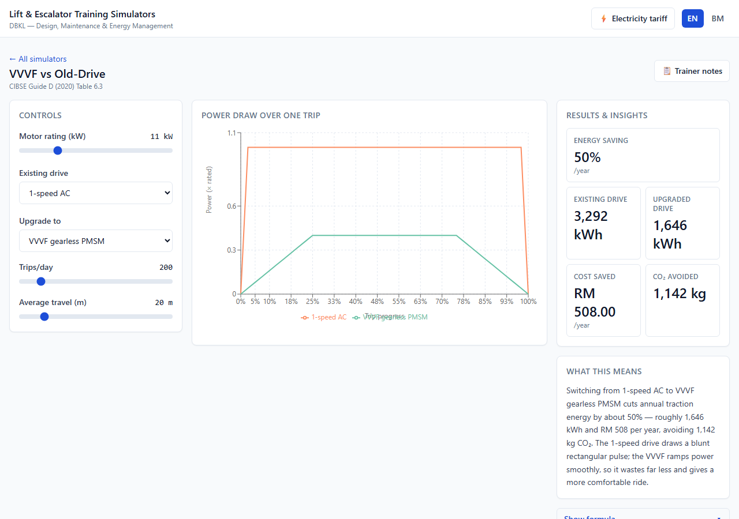
6
Simulator 6 — VVVF vs Old-Drive
Module 4 / 6
CIBSE Guide D (2020) Table 6.3 — drive relative energy
WHAT IT TEACHES
Explain why VVVF drives — especially gearless PMSM — use far less energy than older 1-/2-speed AC or ACVV drives.
KEY RESULT
≈ 50% traction saving
WHAT YOU SEE
Power-over-trip curves: blunt 1-speed pulse vs smooth VVVF ramp.
1-speed AC → gearless PMSM
DBKL · Lift & Escalator Training Simulator Suite
14

Slide 15
6
Simulator 6 — VVVF vs Old-Drive
Module 4 / 6
Engineering & classroom guide
ENGINEERING & FORMULAS
Relative index: 1-speed 1.00 · 2-speed .95 · ACVV .70
VVVF geared .55 · gearless .40
Saving = (idx_old − idx_new) / (idx_old + f_fixed)
= (1.00 − 0.40) / (1.00 + 0.20) = 50%
f_fixed = 0.20 (controls/auxiliaries the drive can’t reduce) reconciles the 60% index with the 45–55% target (DECISIONS M1).
DRIVE IT IN CLASS
KEY INSIGHT & MISCONCEPTION
Read the % saving on the default 1-speed → gearless PMSM swap.
Study the power-over-trip chart: blunt rectangular pulse vs smooth ramp.
Step through the drive ladder (2-speed → ACVV → VVVF geared → gearless).
Energy is not proportional to motor nameplate — the mechanical work per trip is set by the lift, not the motor. VVVF lets a right-sized motor do the same work with far less waste; the smooth ramp also cuts peak demand, heat and gear wear.
DISCUSS Besides energy, what does the smooth VVVF ramp improve? (Ride comfort, peak demand, motor heat, gear wear.)
DBKL · Lift & Escalator Training Simulator Suite
15

Slide 16
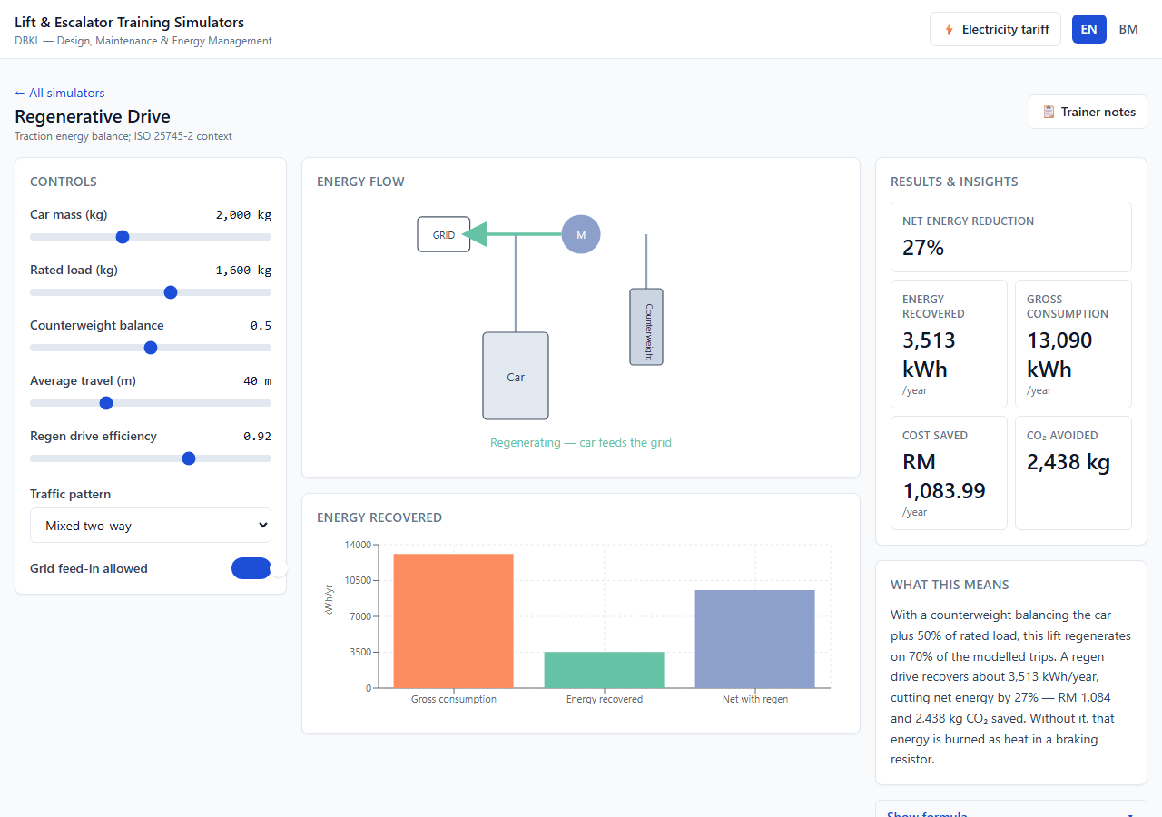
7
Simulator 7 — Regenerative Drive
Module 6
Traction energy balance · ISO 25745-2 context
WHAT IT TEACHES
Explain when a lift motor generates rather than consumes, and quantify the annual energy a regen drive recovers instead of wasting as heat.
KEY RESULT
≈ 27% net reduction
WHAT YOU SEE
Energy-flow schematic + bars for gross, recovered and net energy.
1600 kg · mixed traffic · feed-in on (band 20–35%)
DBKL · Lift & Escalator Training Simulator Suite
16

Slide 17
7
Simulator 7 — Regenerative Drive
Module 6
Engineering & classroom guide
ENGINEERING & FORMULAS
Δm = (m_car + k·m_load) − m_cwt
ΔPE = Δm·g·h ΔPE>0 motoring · ΔPE<0 regenerating
Recovered = η_regen · Σ|ΔPE_regen| − friction
friction = 0.06 · gross weight (never recoverable)
Correct physics: heavier side descending → regenerating (DECISIONS R1). Grid feed-in OFF → recovery = 0.
DRIVE IT IN CLASS
KEY INSIGHT & MISCONCEPTION
Read the ~25–30% net reduction on the defaults.
Trace the energy arrow: into the car (motoring) vs back to grid (regenerating).
Toggle grid feed-in OFF — the saving collapses to zero.
Compare up-peak vs down-peak — which regenerates more?
Regen is not “free energy” — it only recovers part of what gravity returns on descents; friction and inertia losses are never recoverable, which is why the reduction is 20–35%, not ~60%. High-rise, high-traffic lifts with heavy descents benefit most.
DISCUSS Why does a perfectly balanced trip (Δm ≈ 0) neither consume nor regenerate much traction energy?
DBKL · Lift & Escalator Training Simulator Suite
17

Slide 18
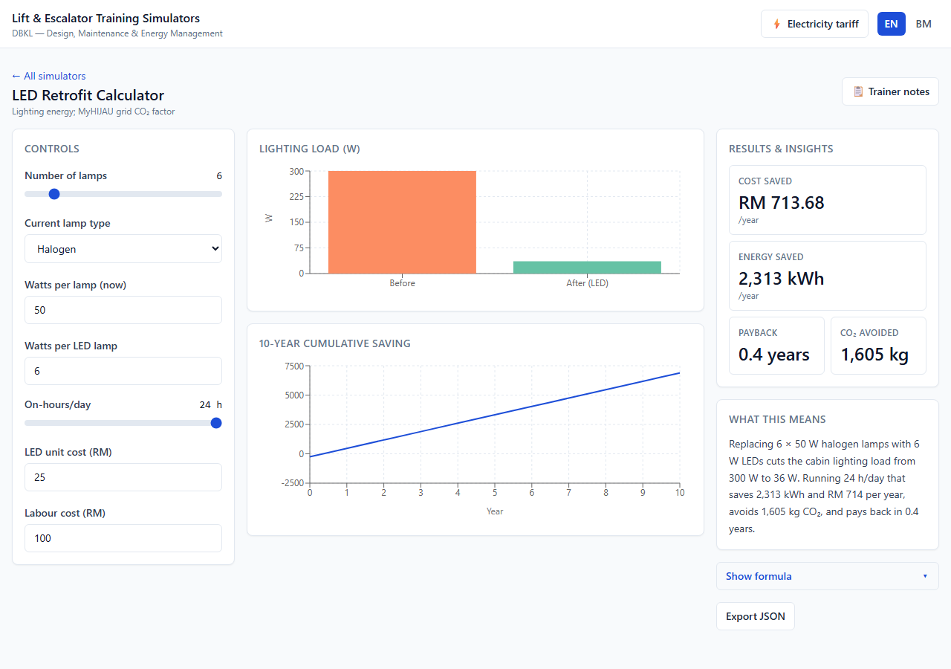
8
Simulator 8 — LED Retrofit Calculator
Module 4
Lighting energy · MyHIJAU grid CO₂ factor (0.694)
WHAT IT TEACHES
Quantify cabin/shaft lighting savings, payback and CO₂ avoided from swapping incandescent / halogen / CFL lamps to LED.
KEY RESULT
payback < 1–2 yr
WHAT YOU SEE
Before/after load bars and a cumulative-savings line crossing zero.
6 × 50 W halogen → 6 W LED · 24 h/day
DBKL · Lift & Escalator Training Simulator Suite
18

Slide 19
8
Simulator 8 — LED Retrofit Calculator
Module 4
Engineering & classroom guide
ENGINEERING & FORMULAS
Load = n · W ; ΔP = n·(W_old − W_LED)
ΔE = ΔP/1000 · hours · 365 [kWh/yr]
Payback = (n·unit + labour) / (ΔE × tariff)
CO₂ avoided = ΔE × 0.694 kg/kWh
Cabin lamps often run 24/7 — the cumulative-savings line crosses zero in ~1–2 years.
DRIVE IT IN CLASS
KEY INSIGHT & MISCONCEPTION
Read RM/year saved and payback on the 6-halogen default.
Pick a lamp type — typical wattage + LED-equivalent auto-seed.
Watch the cumulative line cross zero at the payback year.
Drop on-hours 24 → 12; discuss how payback lengthens.
LEDs are not “too expensive to bother” — the crossover is typically under 1–2 years. Beyond kWh, they cut heat load (less air-con) and maintenance (far longer lamp life).
DISCUSS Beyond energy, what operational benefits justify an LED retrofit in a lift cabin?
DBKL · Lift & Escalator Training Simulator Suite
19

Slide 20
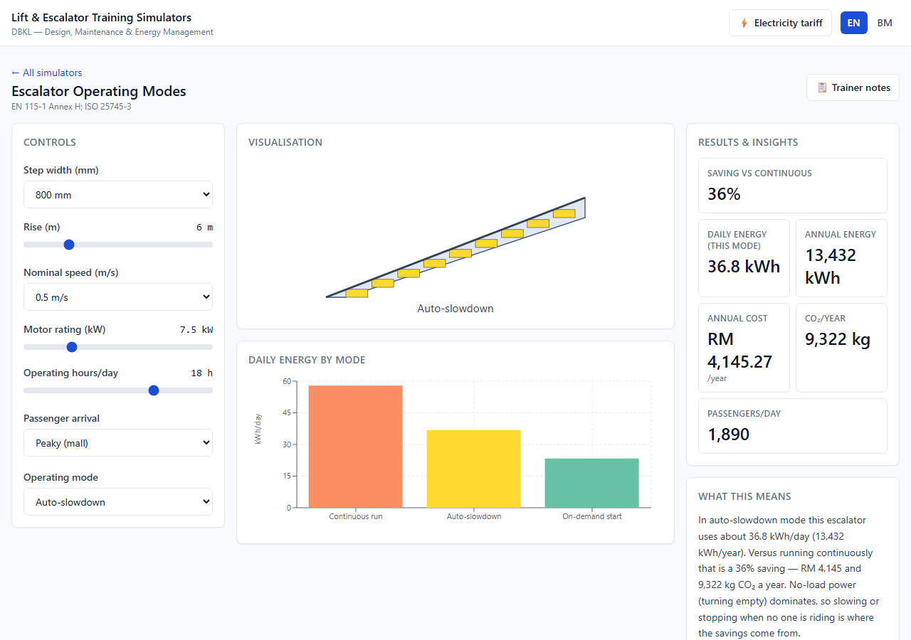
9
Simulator 9 — Escalator Operating Modes
Module 4 / 9
EN 115-1 Annex H · ISO 25745-3:2015
WHAT IT TEACHES
Compare continuous, auto-slowdown and on-demand escalator operation and quantify each saving — recognising that no-load (empty) running dominates consumption.
KEY RESULT
−36% slow · −60% stop
WHAT YOU SEE
Side-by-side daily energy for continuous, slowdown and on-demand modes.
800 mm · 6 m rise · peaky-mall traffic
DBKL · Lift & Escalator Training Simulator Suite
20

Slide 21
9
Simulator 9 — Escalator Operating Modes
Module 4 / 9
Engineering & classroom guide
ENGINEERING & FORMULAS
P_noload ≈ 0.30–0.55 · P_rated (dominant!)
Continuous: full power every operating hour
Auto-slowdown: crawl when idle → ~ −36%
On-demand: stop, restart on sensor → ~ −60%
Savings shrink under uniform (steady) flow — there is little idle time to harvest.
DRIVE IT IN CLASS
KEY INSIGHT & MISCONCEPTION
Read ~36% on the auto-slowdown default (peaky mall).
Switch to on-demand — saving jumps to ~60%.
Change profile to uniform — savings shrink.
Compare all three modes on the bar chart.
An empty escalator does NOT use almost nothing — it draws 30–55% of rated power just turning the steps. And on-demand isn’t always best: on busy continuous-flow units it barely stops, and frequent stop/start stresses components. Match the mode to the traffic.
DISCUSS For a transit-station escalator busy 18 h/day, which mode would you specify, and why?
DBKL · Lift & Escalator Training Simulator Suite
21

Slide 22
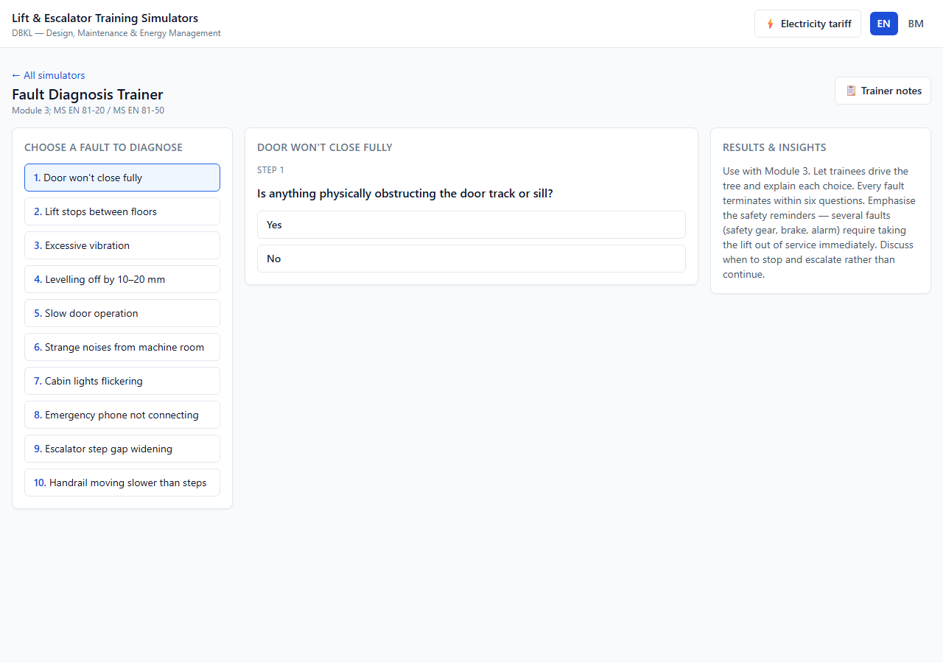
10
Simulator 10 — Fault Diagnosis Trainer
Module 3
MS EN 81-20:2017 / MS EN 81-50:2017
WHAT IT TEACHES
Systematically diagnose the top-ten common lift/escalator faults — knowing the likely cause, first action, escalation point, relevant clause and safety reminder.
KEY RESULT
10 trees · ≤ 6 questions
WHAT YOU SEE
Branching question flow ending in a cause + safety diagnosis card.
Each path reachable & bounded (test-enforced)
DBKL · Lift & Escalator Training Simulator Suite
22

Slide 23
10
Simulator 10 — Fault Diagnosis Trainer
Module 3
Engineering & classroom guide
ENGINEERING & FORMULAS
Decision tree of yes/no questions (≤ 6 deep)
Each path → terminal node:
{ cause · first action · escalate · clause · safety }
10 trees; every node reachable from the root
Snapshot tests enforce reachability, no cycles, and the ≤6-question limit (MAINTENANCE.md).
DRIVE IT IN CLASS
KEY INSIGHT & MISCONCEPTION
Pick a fault; a trainee drives the questions aloud, justifying each answer.
At the diagnosis, read the SAFETY reminder first.
Backtrack and explore an alternative branch — see the diagnosis change.
“Reset and run” is dangerous: some trips (safety gear, overspeed governor) must never be reset before inspection. Knowing WHEN to escalate is part of competent maintenance — several faults require taking the lift out of service immediately.
DISCUSS Name a fault that must never be reset on site. Who has authority to return the lift to service, and on what evidence?
DBKL · Lift & Escalator Training Simulator Suite
23

Slide 24
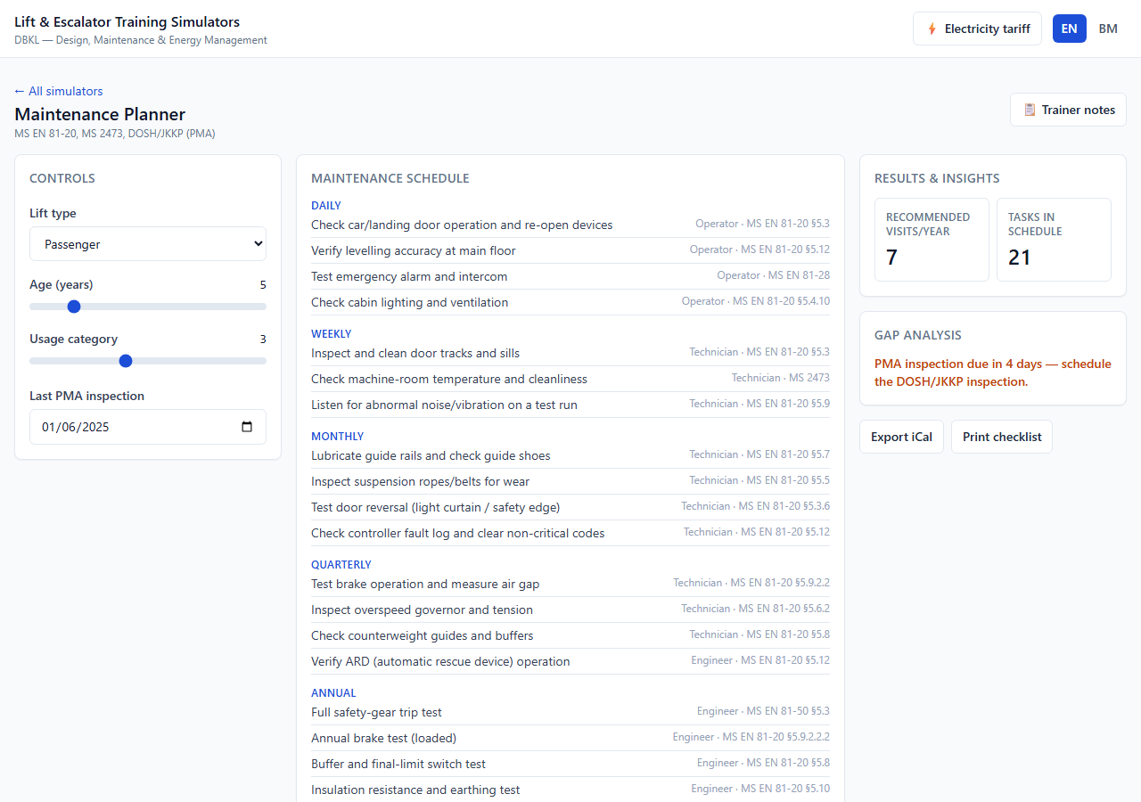
11
Simulator 11 — Maintenance Schedule Planner
Module 5
MS 2473 · MS EN 81-20 · DOSH/JKKP (PMA)
WHAT IT TEACHES
Build a frequency-based maintenance plan for a given lift, identify the statutory DOSH/JKKP (PMA) obligation, and spot scheduling gaps.
KEY RESULT
schedule + iCal + gap
WHAT YOU SEE
Schedule grouped by frequency with a colour-coded PMA gap banner.
Daily → statutory; overdue banner turns red
DBKL · Lift & Escalator Training Simulator Suite
24

Slide 25
11
Simulator 11 — Maintenance Schedule Planner
Module 5
Engineering & classroom guide
ENGINEERING & FORMULAS
Tasks tagged { frequency · skill · appliesTo · standard }
Schedule = filter(by lift type), group daily→statutory
PMA gap = today − last_PMA vs 365 days
→ overdue · due-soon · ok
Export RFC 5545 iCal into a facilities calendar. PMA (DOSH/JKKP) is annual and statutory.
DRIVE IT IN CLASS
KEY INSIGHT & MISCONCEPTION
Read the schedule grouped by frequency, plus the gap-analysis banner.
Set last PMA over a year ago — the banner turns red (overdue).
Switch lift type to goods/hospital — type-specific tasks appear.
Export the iCal file into a facilities calendar.
Maintenance is not “one monthly visit” — tasks span daily checks to annual statutory tests. The PMA inspection is a legal requirement, not optional; lapsing it can force the lift out of service.
DISCUSS Your PMA lapsed last month. Walk through the immediate steps — service status, DOSH/JKKP booking, records and liability.
DBKL · Lift & Escalator Training Simulator Suite
25

Slide 26
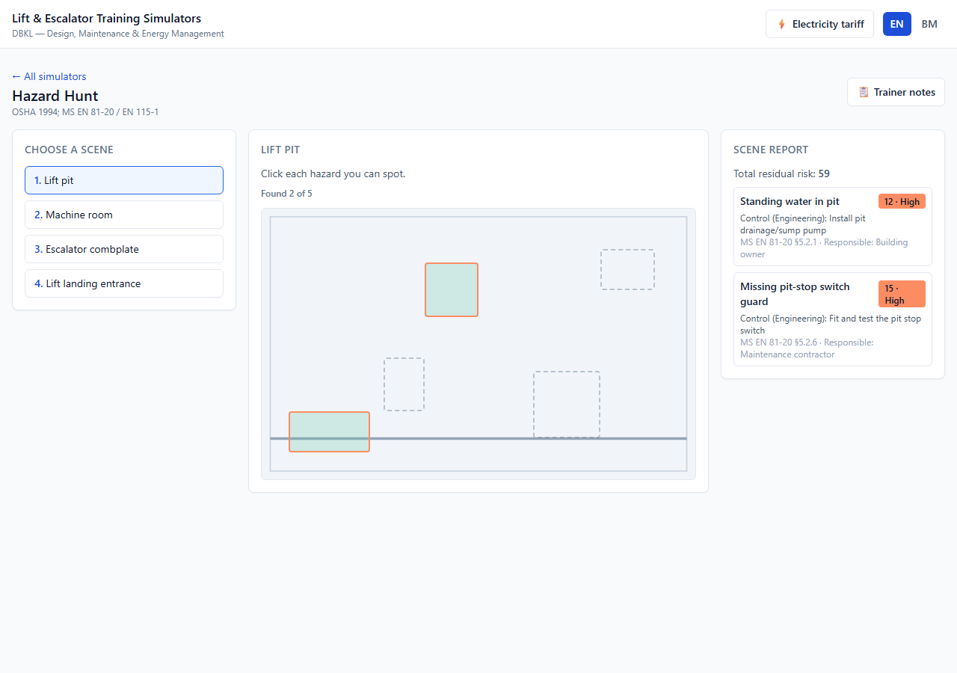
12
Simulator 12 — Hazard Hunt
Module 7
OSHA 1994 (Act 514) · MS EN 81-20 / EN 115-1
WHAT IT TEACHES
Spot common lift/escalator hazards, score risk (likelihood × severity), choose a control from the hierarchy, and assign responsibility.
KEY RESULT
5×5 risk · scored scenes
WHAT YOU SEE
Clickable scene with risk-banded hotspots and a residual-risk report.
Pit · machine room · combplate · landing
DBKL · Lift & Escalator Training Simulator Suite
26

Slide 27
12
Simulator 12 — Hazard Hunt
Module 7
Engineering & classroom guide
ENGINEERING & FORMULAS
Risk R = Likelihood × Severity (each 1–5)
5×5 matrix → band: low · medium · high · critical
Control hierarchy: Engineering > Administrative > PPE
Residual risk = Σ R after the chosen control
Each hazard cites its standard and a responsible party; the scene report totals residual risk.
DRIVE IT IN CLASS
KEY INSIGHT & MISCONCEPTION
Pick a scene (pit, machine room, combplate, landing).
Trainees click each hazard; found ones highlight by risk-band colour.
For each: discuss score, control tier, cited standard and owner.
Review the scene report and total residual risk.
PPE does NOT fix the hazard — it is the lowest control tier; eliminate or engineer the hazard out first. And hazards are not equal: the 5×5 matrix prioritises high-likelihood, high-severity items.
DISCUSS Take your highest-risk hazard. Propose an engineering control and re-score the residual risk — did the band drop?
DBKL · Lift & Escalator Training Simulator Suite
27

Slide 28
Standards & references
Every constant and formula in the suite is traceable to a standard or source
Safety & construction
Energy & classification
MS EN 81-20:2017 — passenger & goods lifts (75 kg/person, §5.4.2.1.1)
MS EN 81-50:2017 — examinations & tests for components
EN 115-1 — safety of escalators & moving walks (Annex H)
ISO 25745-2:2015 — energy calculation & classification, lifts
ISO 25745-3:2015 — escalators & moving walks
Traffic & design
Malaysian regulatory & data
CIBSE Guide D: Transportation Systems in Buildings (2020)
Barney & Al-Sharif — Elevator Traffic Handbook, 2nd ed.
Strakosch — The Vertical Transportation Handbook
OSHA 1994 (Act 514) · DOSH/JKKP statutory PMA inspection
MS 2473 — lift maintenance practice
TNB Tariff C1: peak RM 0.365 · off-peak RM 0.224 · max-demand RM 30.30/kW·mo
MyHIJAU 2023 grid factor: 0.694 kg CO₂/kWh
Physical constants
g = 9.80665 m/s² (BIPM SI Brochure, 2019)
Air density 1.225 kg/m³ at 15 °C (ISO 2533:1975)
DBKL · Lift & Escalator Training Simulator Suite
28

Slide 29
Engineering decisions & honest simplifications
Where the brief and a cited standard could conflict, the resolution is documented — not hidden
Energy model (E1)
VVVF saving (M1)
E_rc is estimated from out-of-balance work ÷ drivetrain efficiency, not a measured Annex B cycle; every downstream ISO 25745-2 step is standard.
A fixed control/auxiliary load (f = 0.20) reconciles the 60% relative index with the 45–55% acceptance band and published case studies.
Traffic HC (T1)
Regen physics (R1/R2)
Served population = pop/floor × upper floors; the standalone “population 500” in the brief is treated as a slip — it reproduces HC 13.5% and INT 28.7 s.
Corrected so the heavier side descending = regenerating; a 0.06 friction fraction calibrates net recovery into the manufacturers’ 20–35% band.
Offline-first (A1)
Cited & tested
A hash router + relative base lets the production build run from file:// on classroom laptops with no server.
The pure engineering layer is React-free, fully cited, and unit-tested to 100% line coverage against worked examples.
DBKL · Lift & Escalator Training Simulator Suite
29

Slide 30
Teach the trade-offs —
not just the numbers.
Open the suite, pick a card, and let trainees turn the dials.
12
7
100%
EN / BM
file://
simulators
course modules
cited engineering
bilingual
runs offline
Kursus Rekabentuk Serta Penyelenggaraan Sistem Lif dan Eskalator — Penjimatan Tenaga

